Slide 1
Team Project
Group 2 –
Hamza Bhatti (21223241)
Amrit Parajuli (21243872),
Tashan Nicholas-Cousins (21234209)
Joe Sykes (21223675)

Slide 2
Outcome
What we are developing
Our roles
Project plan
Current Progress
Demo
BitBucket Link: https://HamzaB93@bitbucket.org/HamzaB93/csci5_-team_project.gitq

Slide 3
What We Are Developing
A website for a supermarket called Vista
Why a website makes sense
What the finished product will contain
Trolley
Supply management: Hamza
Loyalty scheme: Joe
Advertising and marketing: Amrit
Payment system: Tashan

Slide 4
Our Roles
Project Manager: Hamza
Quality assurance: Tashan
Other roles:
Element integration: Hamza and Joe
User documentation/ manual: Amrit
Technical doc: Hamza and Amrit
Tester: Tashan

Slide 5
Project Plan – WBS Brainstorm
Project Management. | Supplies.
Analysis. | Advertising.
Design. | Loyalty.
Risk Assessment. | Payments.
Quality Assurance. | Project review.
Presentation, preparation. | Documentation.
Testing. | User guide.
Research information. | User manual.
Software development. | Gantt chart.
Functionality. | Testing website and database.
Core tasks. | Update website.
Website design. | Update database.
Database setup. | Trolley/ cart.
Database integration. | Deals system.
Testing database. | Story board.

Slide 6
Project Plan – WBS Top-Down
1.Project Management 1.1. Project Management tools 1.1.1. Gantt Chart 1.1.2. Project Review
2.Analysis 3.1.Research
3.Risk Assessment
4.Design 5.1.Website drawings 5.2.Website creation
5.Software Development 6.1.Website Functionality 6.2.Trolley/Cart 6.3.Database Setup 6.4.Database Integration 6.5.Payments 6.6.Loyalty 6.7.Supplies 6.8.Marketing 6.9.Update website if required 6.10.Update database if required 6.11.Deal System
6.Quality Assurance
7.Testing 7.1.Testing Database 7.2.Testing Website
8.Documentation 8.1.Technical Documentation 8.2.User Documentation 8.2.1.User Manual

Slide 7
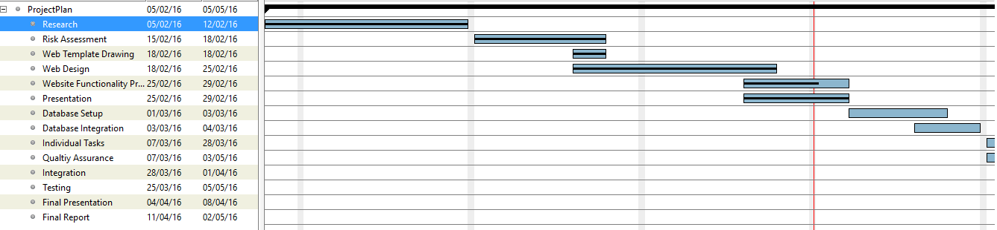
Project Plan - Gantt
Progress is marked by the black bar
Red line indicates “Today”. (Date taken: 28/02/2016)

Slide 8
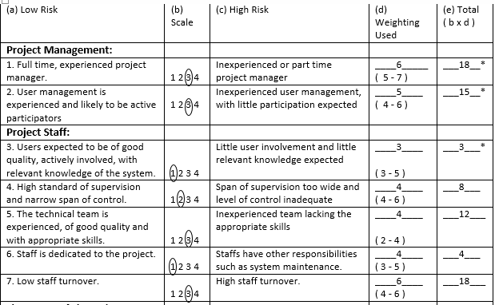
Risk Assessment

Slide 9
Current Progress On Development
The core
A simple database has been set up
A webpage has been created
Home page occupied using PHP
Started trolley implementation
Pseudo code for deals

Slide 10
Demo
We will now show you our progress so far

Slide 11
Individual Contribution To Core (i)
Group as whole
Helped design the website layout
Hamza
Set up product database
Populated area of website with database data
Started implementing a trolley
Joe
Developed website
Started implementing a trolley
Investigated how to implement deals for products

Slide 12
Individual Contribution To Core (ii)
Amrit
Helped implement CSS (In progress)
Wrote pseudo code on how to implement deals for products
Tashan
Helped implement CSS (in progress)
Research for implementing a trolley payment

Slide 13
QA
We will now try to answer your questions.

