Slide 1
Group 3
Abdullah Abadi, Jay'Quan Mason, Keysa Ibrahim, Hamza Baroud, Ryan Thompson, Sidi Cherif, And Misal Khondker
CIS 411-Database Systems

Slide 2

Topic:
National Basketball Association
(Basketball Database)
Our Database will...
Retrieve all primary keys such as Players, Teams, Coaches, Stats, and Leagues Data.
Distribute all attributes of a specific Player/Team.
Represent the connection of all queries by teams.
Show our one-to-many, many-to-none, many-to-many relationships.

Slide 3
Narrative Description
Our database is a application being created for the NBA or for couches to contract players based on their stats by giving a data set based on player statistics, and historical performance data to inform strategic decisions and optimize revenue streams. This data can also be used to create applications and websites that can be tailed for fantasy sport fans.

Slide 4
Relational Schema for Entities and Relationships.
Leagues | Conference-ID, Conference, (Eastern, Western)
Coaches | Coach Name ((First, Last), Teams-ID))
Teams | Team-ID, Teams, Ranking, (Conference-ID(Con-1, Con-2))
Players | Player-ID, (P-Name, Team-ID)
Stats | PlayerStats-ID, Games_Played, (FieldGoal-PG, ThreePoints-PG, Steals-PG, Blocks-PG, Points-PG, Player-ID)

Slide 5
League Table, Attributes with Keys
Conference-1 (EAST)
Conference-2 (WEST)
Teams-ID | Teams | Ranking
21 | BOS | 1
6 | NYK | 2
3 | MIL | 3
4 | CLE | 4
18 | ORL | 5
26 | IND | 6
1 | PHI | 7
25 | MIA | 8
19 | CHI | 9
9 | ATL | 10
28 | HOU | 11
30 | TOR | 12
16 | CHA | 13
22 | WAS | 14
20 | DET | 15
Teams-ID | Teams | Ranking
2 | OKC | 1
11 | DEN | 2
10 | MIN | 3
15 | LAC | 4
12 | DAL | 5
5 | PHO | 6
23 | NOP | 7
13 | LAL | 8
8 | SAC | 9
7 | GSW | 10
27 | BRK | 11
17 | UTA | 12
14 | MEM | 13
29 | SAS | 14
24 | POR | 15

Slide 6
Coaches Table, Attributes with Keys
Coach-Name | Teams-ID
Billy Donovan | 19
Brian Keefe | 22
Chauncey Billups | 24
Chris Finch | 10
Darko Rajaković | 30
Darvin Ham | 13
Doc Rivers | 3
Erik Spoelstra | 25
Frank Vogel | 5
Gregg Popovich | 29
Ime Udoka | 28
J. B. Bickerstaff | 4
Jamahl Mosley | 18
Jason Kidd | 12
Joe Mazzulla | 21
Jordi Fernández | 27
Mark Daigneault | 2
Michael Malone | 11
Mike Brown | 8
Monty Williams | 20
Nick Nurse | 1
Quin Snyder | 9
Rick Carlisle | 26
Steve Clifford | 16
Steve Kerr | 7

Slide 7
Team Table, Attributes with Keys
Teams-ID | Teams | Ranking | Conference-ID
1 | PHI | 7 | Conference-1
2 | OKC | 1 | Conference-2
3 | MIL | 3 | Conference-1
4 | CLE | 4 | Conference-1
5 | PHO | 6 | Conference-2
6 | NYK | 2 | Conference-1
7 | GSW | 10 | Conference-2
8 | SAC | 9 | Conference-2
9 | ATL | 10 | Conference-1
10 | MIN | 3 | Conference-2
11 | DEN | 2 | Conference-2
12 | DAL | 5 | Conference-2
13 | LAL | 8 | Conference-2
14 | MEM | 13 | Conference-2
15 | LAC | 4 | Conference-2
16 | CHA | 13 | Conference-1
17 | UTA | 12 | Conference-2
18 | ORL | 5 | Conference-1
19 | CHI | 9 | Conference-1
20 | DET | 15 | Conference-1
21 | BOS | 1 | Conference-1
22 | WAS | 14 | Conference-1
23 | NOP | 7 | Conference-2
24 | POR | 15 | Conference-2
25 | MIA | 8 | Conference-1
26 | IND | 6 | Conference-1
27 | BRK | 11 | Conference-2
28 | HOU | 11 | Conference-1
29 | SAS | 14 | Conference-2
30 | TOR | 12 | Conference-1

Slide 8
Players Table, Attributes with Keys
Player-ID | Player-Name | Team-ID
1 | Joel Embiid | PHI
2 | Luka Dončić | DAL
3 | Shai Gilgeous-Alexander | OKC
4 | Giannis Antetokounmpo | MIL
5 | Donovan Mitchell | CLE
6 | Kevin Durant | PHO
7 | Jalen Brunson | NYK
8 | Devin Booker | PHO
9 | Stephen Curry | GSW
10 | Jayson Tatum | BOS
11 | De'Aaron Fox | SAC
12 | Trae Young | ATL
13 | Anthony Edwards | MIN
14 | Tyrese Maxey | PHI
15 | Nikola Jokić | DEN
16 | Kyrie Irving | DAL
17 | LeBron James | LAL
18 | Anthony Davis | LAL
19 | Ja Morant | MEM
20 | Desmond Bane | MEM
21 | Damian Lillard | MIL
22 | Kawhi Leonard | LAC
23 | Julius Randle | NYK
24 | LaMelo Ball | CHO
25 | Lauri Markkanen | UTA
26 | Paolo Banchero | ORL
27 | DeMar DeRozan | CHI
28 | Jaren Jackson Jr. | MEM
29 | Cade Cunningham | DET
30 | Karl-Anthony Towns | MIN

Slide 9
Stats Table, Attributes with Keys
Player_Stats-ID | Games_Played | FieldGoalPerGame | ThreePointsPerGame | StealsPerGame | BlocksPerGame | PointsPerGame | Player-ID
Joel Embiid | 34 | 11.8 | 1.2 | 1.1 | 1.8 | 35 | 1
Luka Dončić | 52 | 11.7 | 3.9 | 1.5 | 0.6 | 34 | 2
Shai Gilgeous-Alexander | 58 | 11 | 1.3 | 2.1 | 0.9 | 31 | 3
Giannis Antetokounmpo | 59 | 11.5 | 0.5 | 1.3 | 1 | 31 | 4
Devin Booker | 49 | 9.7 | 2.2 | 0.9 | 0.4 | 28 | 5
Stephen Curry | 56 | 9 | 5 | 0.8 | 0.4 | 28 | 6
Jalen Brunson | 56 | 9.8 | 2.7 | 0.9 | 0.2 | 28 | 7
Kevin Durant | 52 | 10.1 | 2.2 | 0.9 | 1.3 | 28 | 8
Donovan Mitchell | 47 | 9.7 | 3.4 | 1.8 | 0.5 | 28 | 9
De'Aaron Fox | 51 | 9.8 | 2.8 | 1.9 | 0.4 | 27 | 10
Jayson Tatum | 56 | 9.2 | 3.1 | 1 | 0.6 | 27 | 11
Kyrie Irving | 38 | 9.8 | 2.9 | 1.2 | 0.5 | 26 | 12
Trae Young | 51 | 8.2 | 3.3 | 1.4 | 0.2 | 26 | 13
Anthony Edwards | 57 | 9.1 | 2.5 | 1.2 | 0.5 | 26 | 14
Tyrese Maxey | 54 | 9.1 | 3.1 | 1 | 0.5 | 26 | 15
Nikola Jokić | 58 | 10.1 | 1 | 1.2 | 0.9 | 26 | 16
Ja Morant | 9 | 8.9 | 1.6 | 0.8 | 0.6 | 25 | 17
LeBron James | 53 | 9.5 | 2.2 | 1.2 | 0.6 | 25 | 18
Anthony Davis | 57 | 9.6 | 0.3 | 1.1 | 2.4 | 25 | 19
Desmond Bane | 37 | 8.9 | 3.3 | 1 | 0.5 | 24 | 20
Damian Lillard | 56 | 7.3 | 2.9 | 1.1 | 0.2 | 24 | 21
Kawhi Leonard | 53 | 9 | 2.2 | 1.7 | 0.8 | 24 | 22
Julius Randle | 46 | 8.6 | 1.7 | 0.5 | 0.3 | 24 | 23
LaMelo Ball | 22 | 8.3 | 3.2 | 1.8 | 0.2 | 24 | 24
Lauri Markkanen | 50 | 7.8 | 3.2 | 0.8 | 0.5 | 23 | 25
Paolo Banchero | 58 | 8.1 | 1.5 | 1 | 0.5 | 23 | 26
DeMar DeRozan | 58 | 7.8 | 0.9 | 1.1 | 0.6 | 23 | 27
Anfernee Simons | 35 | 7.7 | 3.3 | 0.5 | 0.1 | 22 | 28
Kyle Kuzma | 58 | 8.7 | 2.3 | 0.5 | 0.7 | 22 | 29
Jimmy Butler | 40 | 6.7 | 1 | 1.4 | 0.4 | 22 | 30

Slide 10
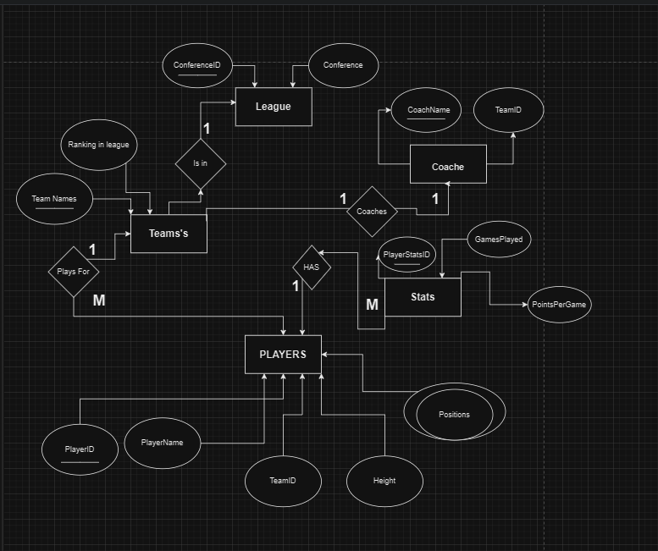
Logical and Physical Modeling

Slide 11

SQL Queries

Slide 12
All Queries Across Two Tables
First: Teams To Coaches: Retrieve the coach that a team is coached by
  SQL:
PARAMETERS [EnterTeam] Text ( 255 );
  SELECT coaches.CoachName
  FROM coaches INNER JOIN teams ON coaches.[TeamsID] = teams.[TeamsID]
  WHERE (((teams.Teams)=[EnterTeam]));
Second: Retrieve all the players that play for a specific team
SQL:
PARAMETERS [EnterTeam] Text ( 255 );
SELECT Players.PlayerName
FROM Players INNER JOIN teams ON Teams.[Teams] = Players.[TeamID]
WHERE Teams.Teams = [EnterTeam]
Third: Retrieve all teams for a certain league and their ranking in that league
SQL:
PARAMETERS [EnterConference] Text ( 255 );
SELECT Teams.Teams, Teams.Rank, League.Conference AS Conference
FROM League INNER JOIN Teams ON League.[ConferenceID] = Teams[ConfrenceID]
WHERE ((([League].[Conference])=[EnterConference]))
ORDER BY Teams.Rank;

Slide 13
All Queries Across Three Tables
First: Most PPG for a team:
SQL:
PARAMETERS [Enter Team] Text ( 255 );
SELECT Players.PlayerName, Teams.Teams, MAX(Stats.PointsPerGame) AS MAXPointsPerGame
FROM (Players INNER JOIN Teams ON Players.TeamID = Teams.Teams_ID) INNER JOIN Stats ON Players.PlayerID = Stats.PlayerID
WHERE Teams.Teams = [Enter Team]
GROUP BY Players.PlayerName, Teams.Teams
ORDER BY MAXPointsPerGame DESC;
Second: Most Games Played for a team:
SQL:
PARAMETERS [Enter Team] Text ( 255 );
SELECT Players.PlayerName, Teams.Teams, MAX(Stats.GamesPlayed) AS MostGamesPlayed
FROM (Players INNER JOIN Teams ON Players.TeamID = Teams.Teams_ID) INNER JOIN Stats ON Players.PlayerID = Stats.PlayerID
WHERE Teams.Teams = [Enter Team]
GROUP BY Players.PlayerName, Teams.Teams
ORDER BY MostGamesPlayed DESC;
Third: Most Threes For a team
  SQL:
PARAMETERS [Enter Team] Text ( 255 );
SELECT Players.PlayerName, Teams.Teams, MAX(Stats.ThreePointsPerGame) AS MostThreesMade
FROM (Players INNER JOIN Teams ON Players.TeamID = Teams.Teams_ID) INNER JOIN Stats ON Players.PlayerID = Stats.PlayerID
WHERE Teams.Teams = [Enter Team]
GROUP BY Players.PlayerName, Teams.Teams
ORDER BY MostThreesMade DESC;

Slide 14
Queries Across Four Tables​
Retrieves the highest points per game across the entire league:
SQL:
SELECT: Players.PlayerName, League.Conference, Teams.Teams, Stats.PointsPerGame
FROM: ((Players INNER JOIN Stats ON Players.PlayerID = Stats.PlayerID) INNER JOIN (League INNER JOIN Teams ON League.ConferenceID = Teams.ConfrenceID) ON Players.TeamsID = Teams.Teams) INNER JOIN Coaches ON Teams.TeamsID= Coaches.TeamsID;

Slide 15
Queries Across Five Tables
Retrieves all data for every player in the league:
SQL:
SELECT Players.PlayerName, Coaches.CoachName, Teams.Teams, League.Conference, Stats.FieldGoalPerGame
FROM ((Players INNER JOIN Stats ON Players.PlayerID = Stats.PlayerID) INNER JOIN (League INNER JOIN Teams ON League.ConferenceID = Teams.ConfrenceID) ON Players.TeamsID = Teams.Teams) INNER JOIN Coaches ON Teams.TeamsID = Coaches.TeamsID;

Slide 16
Summary
To conclude this project, our presentation has demonstrated our ability to retrieve all data within the NBA.

