Slide 1
SOCIAL CONVERSATION INTELLIGENCE
Social Ear
Understanding public feedback
with AI and source evidence
Project overview and platform walkthrough
20 October 2026
Notes:
Social Ear helps organizations explore social feedback, identify recurring issues and investigate the original conversations. This deck describes the implemented local application and separates working features from configuration requirements and future work. Screenshots show synthetic demo data, never private API keys.
Source: https://github.com/HamzaElhaddaji/social-ear

Slide 2
PROJECT IDEA
The problem Social Ear addresses
Public feedback is difficult
to review at scale
What are people discussing?
Identify recurring topics and product features.
How do they feel?
Comments arrive in different places,
repeat the same issues and mix
positive feedback with complaints.
Compare estimated sentiment and review uncertain cases.
What needs investigation?
Inspect original posts and assign follow-up work.
02
Notes:
Teams can receive feedback across several channels. Social Ear centralizes imported conversations so a user can inspect the underlying evidence rather than relying only on aggregate metrics. The platform does not claim complete coverage of social networks or automatically understand every conversation.
Project source: https://github.com/HamzaElhaddaji/social-ear
Presentation snapshot: 20 October 2026.

Slide 3
WHO IT SERVES
Users and a typical scenario
Marketing teams
Customer experience teams
Understand brand mentions and compare keyword-based conversation groups.
Find recurring support issues and track investigations.
Community managers
Researchers
Review conversations and acknowledge relevant alerts.
Explore a bounded dataset and export evidence for further analysis.
Example: a mobile-app launch generates complaints about login and notifications.
03
Notes:
The intended users include marketing teams, customer-experience teams, community managers and researchers. These are target audiences rather than documented customer deployments. Example: a mobile-app team imports launch feedback, discovers support complaints, checks original records and assigns a reviewer.
Project source: https://github.com/HamzaElhaddaji/social-ear
Presentation snapshot: 20 October 2026.

Slide 4
HOW IT WORKS
The conversation analysis workflow
01
Collect
Upload a CSV or run an enabled connector.
02
Prepare
Normalize dates, skip duplicates and save records.
03
Analyze
Estimate sentiment and discover topics locally.
04
Explore
Filter conversations and retrieve supporting evidence.
05
Act
Review labels, assign issues and save reports.
04
Notes:
CSV uploads and enabled social connectors produce durable background jobs. The worker normalizes dates, rejects oversized records and skips duplicates before committing a batch. Sentiment and language metadata travel with each record. The dashboard, research assistant and team workflow use tenant-scoped records.
Project source: https://github.com/HamzaElhaddaji/social-ear
Presentation snapshot: 20 October 2026.

Slide 5
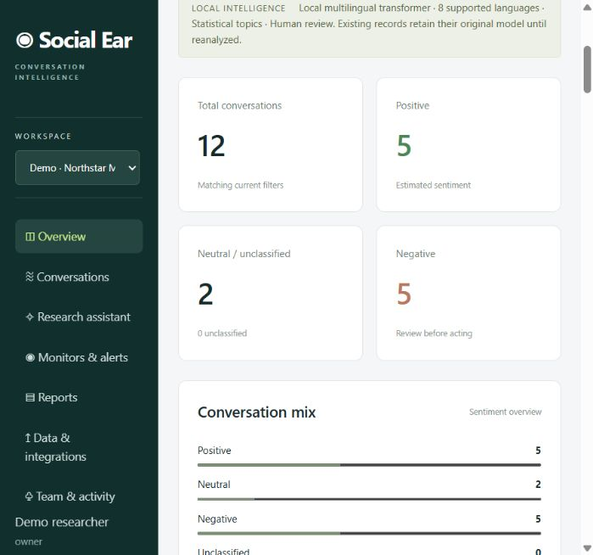
PLATFORM WALKTHROUGH
The platform dashboard
Conversation overview
View totals and the estimated sentiment mix for the current filters.
Topics and trends
Explore statistical topic clusters, dated volumes and source comparisons.
Demo snapshot
The sample workspace contains 12 synthetic conversations. These are not business results.
Actual platform screenshot. Synthetic demo data.
05
Notes:
The screenshot is an actual local platform capture. Demo data currently contains 12 posts, with five positive, five negative and two neutral records after local reanalysis. The dashboard updates when filters change. Topic clusters depend on the selected records.
Screenshot source: http://127.0.0.1:8001/ captured on 20 October 2026. Data belongs to the synthetic demo workspace.
Project source: https://github.com/HamzaElhaddaji/social-ear
Presentation snapshot: 20 October 2026.

Slide 6
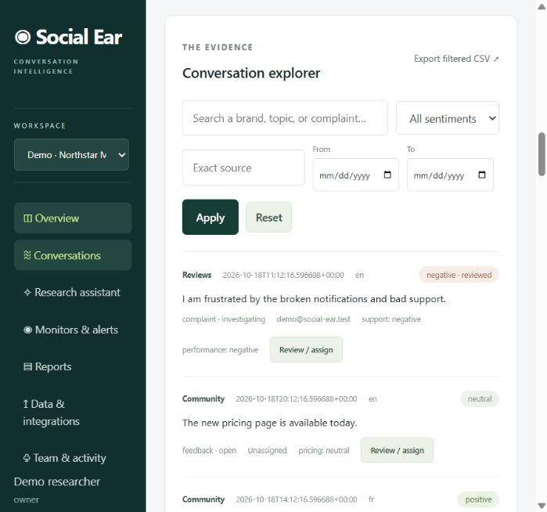
PLATFORM WALKTHROUGH
Conversation exploration
Search and filter
Filter by text, source, sentiment and date range.
Inspect the record
Read the post, language, sentiment and investigation status.
Export evidence
Download the filtered dataset as CSV for further review.
Actual platform screenshot. Synthetic demo data.
06
Notes:
The conversation explorer paginates results at 25 posts per page by default. Exports include filtered evidence. The backend protects exported cells from spreadsheet formula interpretation. Social-source records can retain original URLs and provider IDs.
Screenshot source: http://127.0.0.1:8001/ captured on 20 October 2026. Data belongs to the synthetic demo workspace.
Project source: https://github.com/HamzaElhaddaji/social-ear
Presentation snapshot: 20 October 2026.

Slide 7
ANALYSIS METHODS
Local AI analysis
8 supported languages
Arabic, English, French, German, Hindi,
Italian, Spanish and Portuguese
Sentiment
Topics and review
A local CPU transformer predicts positive, neutral or negative labels. Unsupported languages remain unclassified.
TF-IDF and K-means group related vocabulary. Human reviewers can correct sentiment labels.
Predictions are estimates. Short text, truncation and domain differences can affect results.
07
Notes:
The optional ONNX backend uses a pinned quantized export of Cardiff NLP twitter-XLM-roBERTa sentiment. Supported languages are Arabic, English, French, German, Hindi, Italian, Spanish and Portuguese. Model card: https://huggingface.co/cardiffnlp/twitter-xlm-roberta-base-sentiment . Implementation and setup: https://github.com/HamzaElhaddaji/social-ear/blob/main/docs/MULTILINGUAL.md . Topic discovery uses TF-IDF and K-means. Default fallback configuration is English VADER plus explicit product-support rules. The running demo uses ONNX.
Project source: https://github.com/HamzaElhaddaji/social-ear
Presentation snapshot: 20 October 2026.

Slide 8
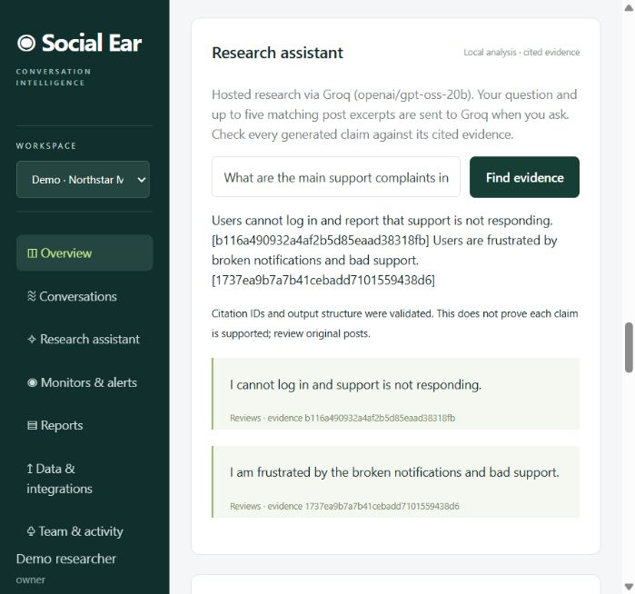
PLATFORM WALKTHROUGH
Research answers with source citations
Ask about an issue
The assistant retrieves up to five relevant workspace excerpts.
Hosted generation
Configured Groq generates structured claims from those excerpts.
Review the evidence
The server checks citation IDs. Users still need to verify the claims.
Actual platform screenshot. Synthetic demo data.
08
Notes:
The current running application uses Groq hosted research with model openai/gpt-oss-20b. The question and at most five excerpts, each capped at 2,000 characters, go to the provider when the user submits a question. Keys stay server-side. Existing citations only establish that referenced records exist, not that generated claims are true. Extractive mode and optional local Ollama mode also remain available. Source: https://github.com/HamzaElhaddaji/social-ear/blob/main/docs/GROQ.md
Screenshot source: http://127.0.0.1:8001/ captured on 20 October 2026. Data belongs to the synthetic demo workspace.
Project source: https://github.com/HamzaElhaddaji/social-ear
Presentation snapshot: 20 October 2026.

Slide 9
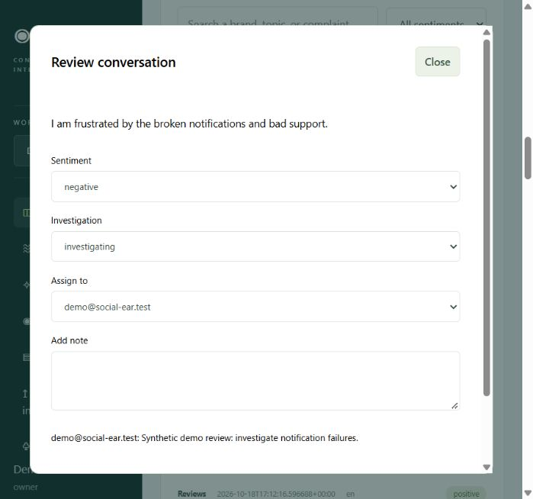
PLATFORM WALKTHROUGH
Human review and issue ownership
Correct a label
A reviewer can replace the estimated sentiment.
Assign responsibility
Select a workspace member and set the investigation status.
Keep the context
Add notes. Reanalysis preserves human-reviewed sentiment.
Actual platform screenshot. Synthetic demo data.
09
Notes:
The review dialog displays one synthetic conversation. Investigation states are open, investigating and resolved. Assignment requires an existing workspace member. Audit entries record review actions. Human-reviewed sentiment survives subsequent automated reanalysis.
Screenshot source: http://127.0.0.1:8001/ captured on 20 October 2026. Data belongs to the synthetic demo workspace.
Project source: https://github.com/HamzaElhaddaji/social-ear
Presentation snapshot: 20 October 2026.

Slide 10
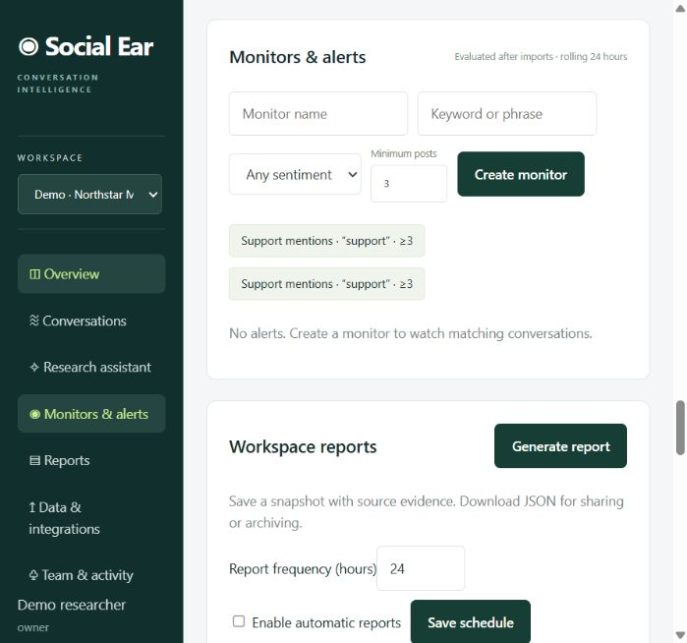
PLATFORM WALKTHROUGH
Keyword monitors and alerts
Define a signal
Choose a keyword, an optional sentiment and a minimum post count.
Rolling 24 hours
Imports trigger evaluation of recent matching conversations.
Acknowledge alerts
Identical evidence sets do not create duplicate alerts.
Actual platform screenshot. Synthetic demo data.
10
Notes:
These are explicit keyword/count thresholds. They are not predictive crisis models or statistically validated anomaly detection. Dates use UTC. The monitor uses published time, with ingestion time when no published date exists. The screenshot shows configured demo monitors and the current absence of matching alerts.
Screenshot source: http://127.0.0.1:8001/ captured on 20 October 2026. Data belongs to the synthetic demo workspace.
Project source: https://github.com/HamzaElhaddaji/social-ear
Presentation snapshot: 20 October 2026.

Slide 11
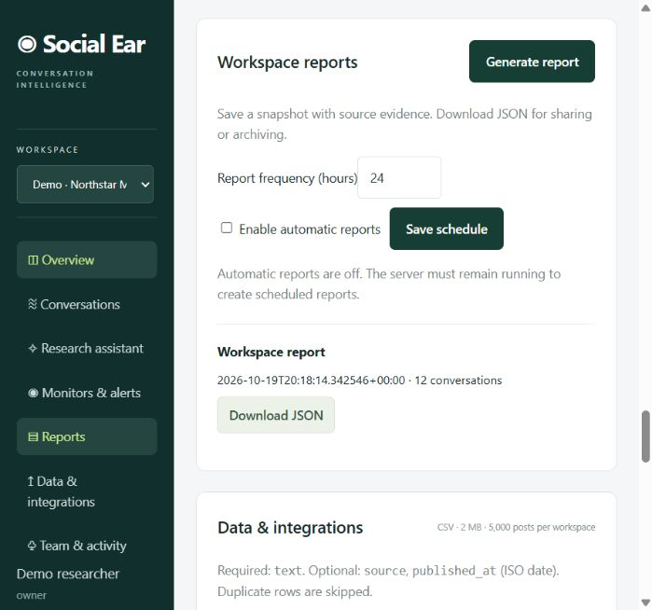
PLATFORM WALKTHROUGH
Saved reports and recurring schedules
Capture a snapshot
Generate a workspace report with summary statistics and evidence.
Schedule updates
Choose an interval from 1 to 168 hours.
Share a report
Download a saved JSON report. The server must remain running for schedules.
Actual platform screenshot. Synthetic demo data.
11
Notes:
Report jobs run in the database-backed worker. Saved reports contain a summary plus a bounded evidence sample. The current export format is JSON, not a styled PDF report. Schedules coalesce missed intervals into one report after restart. This release does not email reports.
Screenshot source: http://127.0.0.1:8001/ captured on 20 October 2026. Data belongs to the synthetic demo workspace.
Project source: https://github.com/HamzaElhaddaji/social-ear
Presentation snapshot: 20 October 2026.

Slide 12
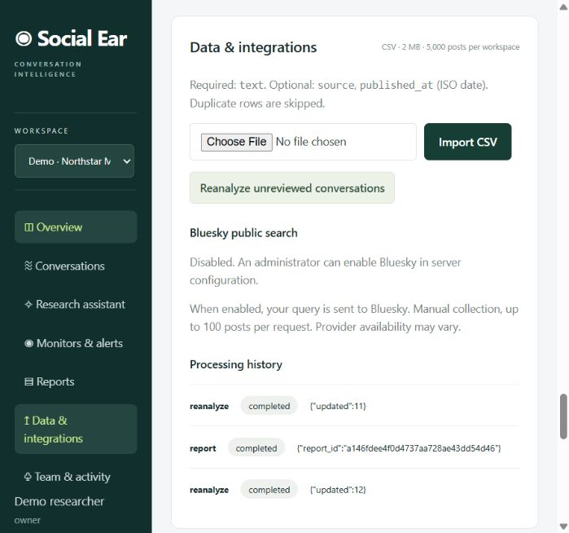
PLATFORM WALKTHROUGH
Data import and processing history
CSV ingestion
Required column: text. Optional source and published_at columns.
Reliable processing
Atomic batches, duplicate detection and persisted job status.
Local capacity
Uploads are limited to 2 MB and workspaces to 5,000 posts.
Actual platform screenshot. Synthetic demo data.
12
Notes:
The import interface queues a job and reports completion or a redacted failure. Users can retry failed jobs up to three attempts. The original CSV is not committed to Git. Storage is local SQLite by default or PostgreSQL through configuration.
Screenshot source: http://127.0.0.1:8001/ captured on 20 October 2026. Data belongs to the synthetic demo workspace.
Project source: https://github.com/HamzaElhaddaji/social-ear
Presentation snapshot: 20 October 2026.

Slide 13
INTEGRATIONS
Available data sources
Source | Collection scope | Access requirement
CSV | Uploaded conversation records | No external credentials
Bluesky | Up to 100 search results | Enable public API collection
Mastodon | Up to 40 public hashtag posts | Enable collection, token if required
YouTube | Up to 100 top-level video comments | Enable collection and configure an API key
Connectors run manually and depend on provider permissions, quota and availability.
13
Notes:
Provider access and permissions determine live availability. CSV import works without external service credentials. Mastodon public access returned 40 posts in a live read-only check during development. YouTube has mocked integration coverage and needs an API key. Social connectors remain disabled in the current demo configuration. Sources: https://github.com/HamzaElhaddaji/social-ear/blob/main/docs/SOCIAL_CONNECTORS.md
Project source: https://github.com/HamzaElhaddaji/social-ear
Presentation snapshot: 20 October 2026.

Slide 14
TECHNICAL DESIGN
Application architecture
Layer | Technology | Responsibility
Browser interface | HTML, CSS, JavaScript | Dashboard, evidence search and team workflows
Application API | Python / FastAPI | Authentication, roles and validated endpoints
Service worker | Database-backed jobs | Imports, analysis, monitors and scheduled reports
Data storage | SQLAlchemy | SQLite locally or PostgreSQL in Docker
Analysis / generation | ONNX, scikit-learn, Groq | Local sentiment and topics, optional hosted research
The current worker, scheduler and rate limiter assume one application process.
14
Notes:
The application is implemented in Python and browser JavaScript. FastAPI exposes authenticated endpoints, SQLAlchemy handles relational storage and a single worker thread processes durable job records. SQLite and PostgreSQL use the same service code. Topic analysis and sentiment run locally. Groq is an optional external boundary for research generation. This is a single-process deployment rather than a distributed production architecture.
Project source: https://github.com/HamzaElhaddaji/social-ear
Presentation snapshot: 20 October 2026.

Slide 15
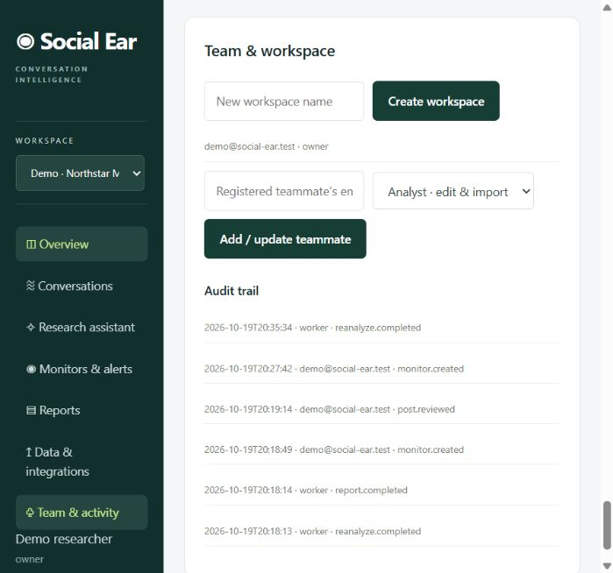
SECURITY AND COLLABORATION
Workspace access and privacy
Role-based access
Owners manage members. Analysts edit. Viewers read.
Workspace boundaries
Authorization scopes records, jobs and reports to workspace membership.
Secrets and hosted AI
Keys stay in ignored local configuration. Groq receives only selected research excerpts.
Actual platform screenshot. Synthetic demo data.
15
Notes:
Security controls include scrypt password hashing, expiring server-side sessions, HTTP-only cookies, CSRF checks, host/origin validation and tenant-scoped lookups. Tests exercise isolation and role enforcement. Local .env stores plaintext credentials and requires ordinary filesystem protection. This deck intentionally excludes keys, passwords and provider key-management screens. The screenshot contains a synthetic demo email address.
Screenshot source: http://127.0.0.1:8001/ captured on 20 October 2026. Data belongs to the synthetic demo workspace.
Project source: https://github.com/HamzaElhaddaji/social-ear
Presentation snapshot: 20 October 2026.

Slide 16
DELIVERY
Deployment and verification
Local execution
Docker package
Python 3.12, a virtual environment and the repository dependencies. Launch with python -m app.
A non-root application image and PostgreSQL Compose configuration support a local deployment.
40 passed
3 CI jobs passed
Latest local regression run, with one optional model test skipped
SQLite, PostgreSQL and container image build
Live Groq generation and multilingual inference also passed separate smoke checks.
16
Notes:
The latest application commit in this presentation is 72d8725. Local regression execution ran 41 tests: 40 passed, and one optional live multilingual-model test was skipped in that run. The live model test passed separately earlier. GitHub CI for the commit passed SQLite, PostgreSQL and Docker build jobs. This does not establish production load capacity or perfect AI accuracy. Local Docker engine execution was unavailable during development. CI source: https://github.com/HamzaElhaddaji/social-ear/actions/runs/39438928786
Project source: https://github.com/HamzaElhaddaji/social-ear
Presentation snapshot: 20 October 2026.

Slide 17
PROJECT STATUS
Current limits and next priorities
Analysis quality
Broader listening
Build representative evaluation datasets and measure performance by language and domain.
Add approved provider integrations, incremental sync and deletion propagation.
Production operations
Account administration
Introduce distributed workers, shared rate limiting, migrations and larger dataset support.
Add password recovery, SSO, retention controls and optional email notifications.
The current release targets local use and requires human review of AI estimates.
17
Notes:
The implemented local platform is useful for bounded feedback datasets. The complete advanced vision still requires representative model evaluation, stronger production operations and account administration. Existing alerts use thresholds. Current connectors do not provide comprehensive social-network coverage, incremental synchronization or deletion propagation. Public hosting is outside the selected local/Docker delivery target. Source: https://github.com/HamzaElhaddaji/social-ear/blob/main/docs/ROADMAP.md
Project source: https://github.com/HamzaElhaddaji/social-ear
Presentation snapshot: 20 October 2026.

Slide 18
SOURCE CODE AND DOCUMENTATION
Project repository
Social Ear
Application code, setup instructions
and implementation documentation
github.com/HamzaElhaddaji/social-ear
Private repository. Access requires permission from the owner.
18
Notes:
The repository is private. Viewers need access from the repository owner. The repository README includes setup, architecture, scope and links to detailed configuration documentation.
Repository: https://github.com/HamzaElhaddaji/social-ear
Project source: https://github.com/HamzaElhaddaji/social-ear
Presentation snapshot: 20 October 2026.

