Slide 1

Department of Information Technology University of Gujrat
“Event Scheduling System”
Supervised by:
Miss Sabiqa Ashraf.
Presented by:
Muhammad Talha Tarar 16491556-013
Muhammad Hamza Javed 16491556-023
Ahmed Jamal 16491556-040

Slide 2
Introduction
Android application.
Manual Event organizing is a time consuming task.
Facilitate event organizer and client in their interaction.
Event organizer can provide its services to promote its business.
Client can get these services and hire event organizer for their events.
Rating based availability of event organizers and services.

Slide 3
Existing System
System | Limitation
Evento.com.pk | Specific organization. No android application. Complex Interface. Provide limited services related to event.
ShadiBox.com | Unable to directly interact with event organizer. No android application. No payment method.
Eventoxs.com | Specific organization. Limited services. No android application. No online payment method.

Slide 4
Problem Statement
There is currently no android application available for easy access.
Hectic process for event organizer and client to communicate.
Tiresome process of payment method.
Complex system interface for user interaction.
No recommendation for users.

Slide 5

Proposed System
Single Platform will be provided for customer and event organizer to directly interact with each other.
Help user to find the best place` for their event.
Help user to find services related to their event.
Help event organizer in their business decision.
Help event organizer to advertise their business.
Both event organizer and customer can use android application to perform their tasks.

Slide 6
Modules
Client
Sign In /Up for an account. View update about specific event. Organize any event Communicate with event organizers. Can search venues. Create customized packages of their own choice. Can get services related to event. Order for any event. Get suggestions based on rating. Give feedback.

Slide 7
Modules
Event Organizer
Manage its account. View, accept or delete orders. Can analyze its order history. Update its portfolio to attract customers. Can communicate with clients or others event organizers. Calendar to manage orders. Analyze its performance according to client’s rating.
Admin
Block/unblock user. Block /unblock event organizer. View clients and organizers profile. Can analyze service provider based upon ratings. Communicate with clients and service providers.

Slide 8
Non Functional Requirements :-
User-Friendly interface
Responsive
Secure
Performance oriented
More accurate

Slide 9
Tools & Technology
Android Studio IDE(Platform)
Java (Language for android application development)
XML(For application layout)
Firebase(User Authentication, Firestore , Cloud Function)
HTML, CSS, Bootstrap(Construction and designing admin panel)
JavaScript, Node.js(Backhand functionality)

Slide 10
Conclusion
Advantages:
To overcome the problems in existing system.
Time Saving.
Easy to use.
User friendly Interface.
Disadvantages:
Must have android phone.
Need internet connection.

Slide 11
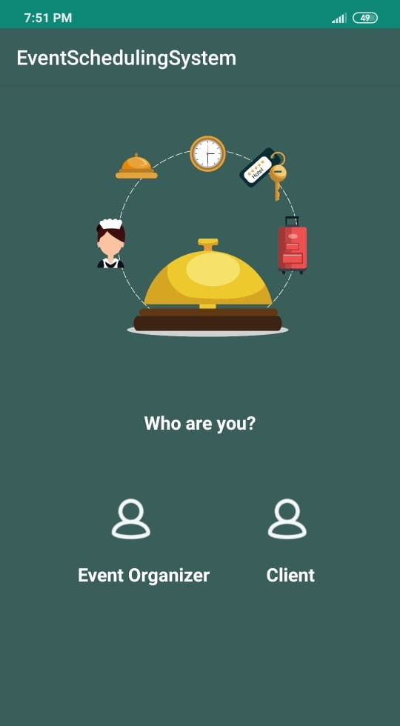
Prototype:
Home Screen Figure (1)

Slide 12
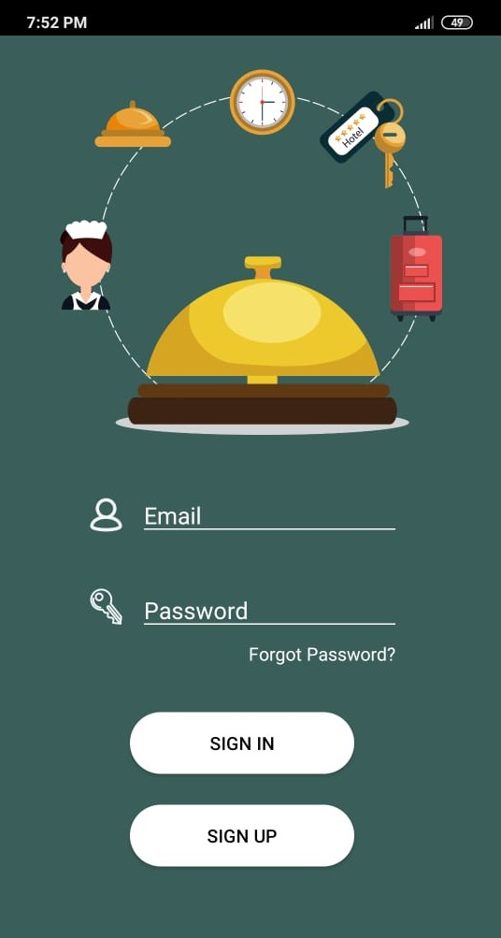
Continue…
Event Organizer Sign In/ Up Figure (2)

Slide 13
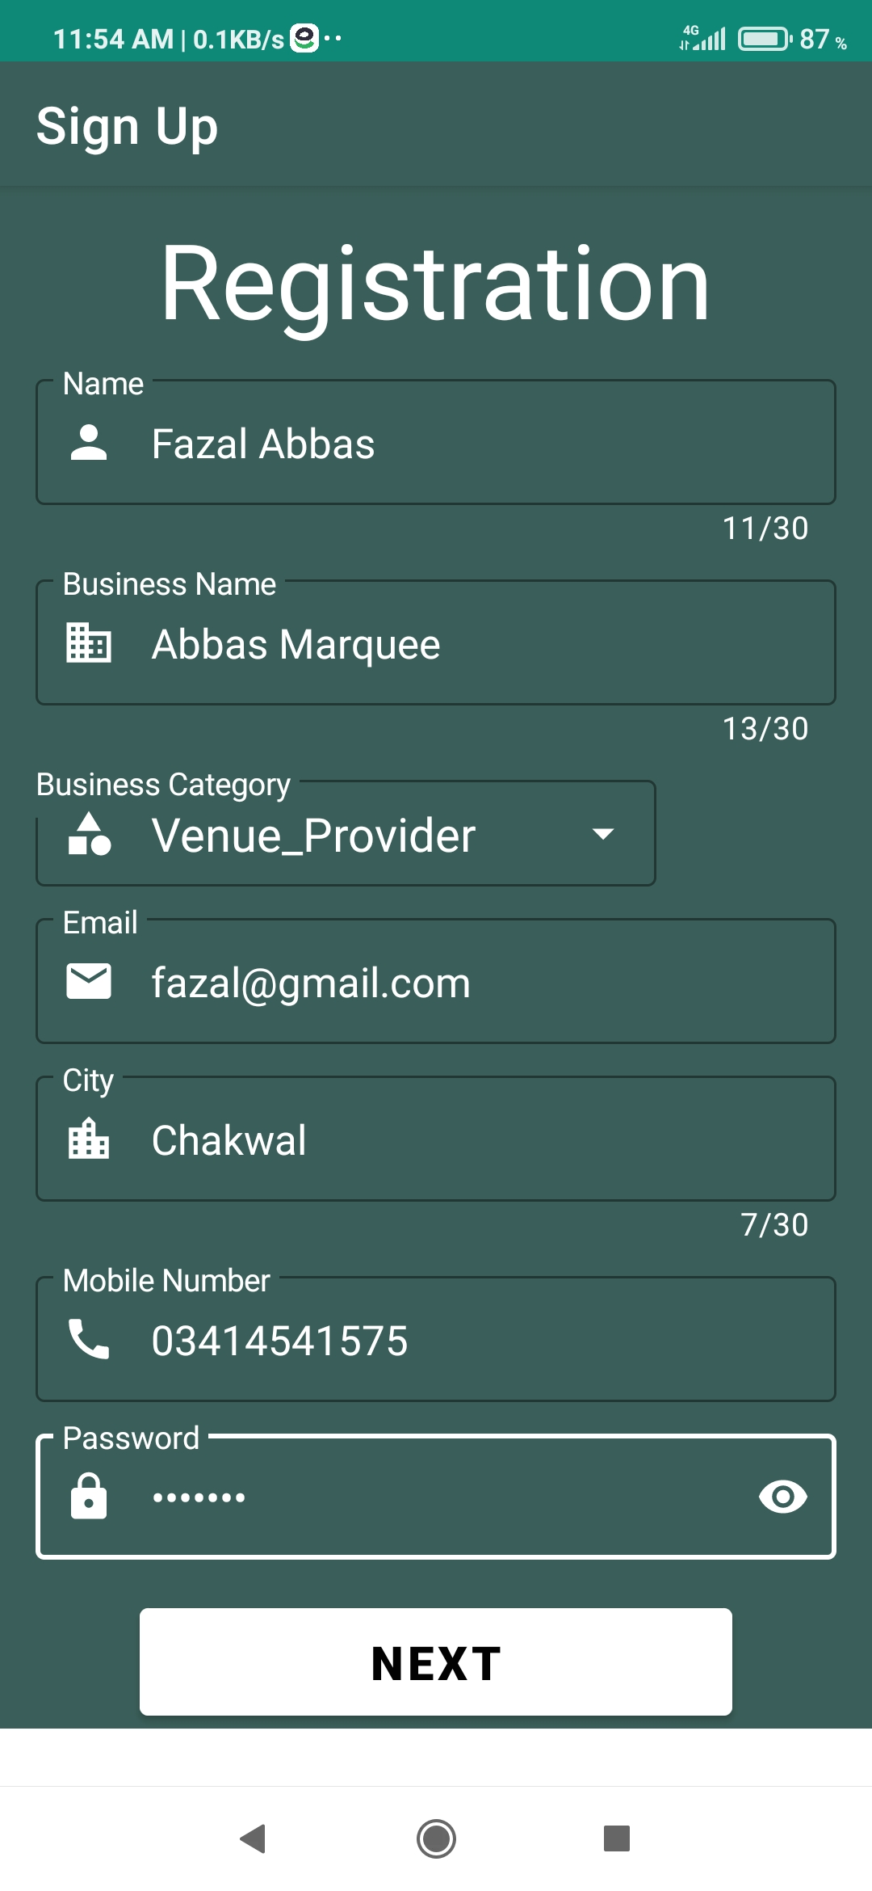
Continue…
Event Organizer Registration Figure (3)

Slide 14
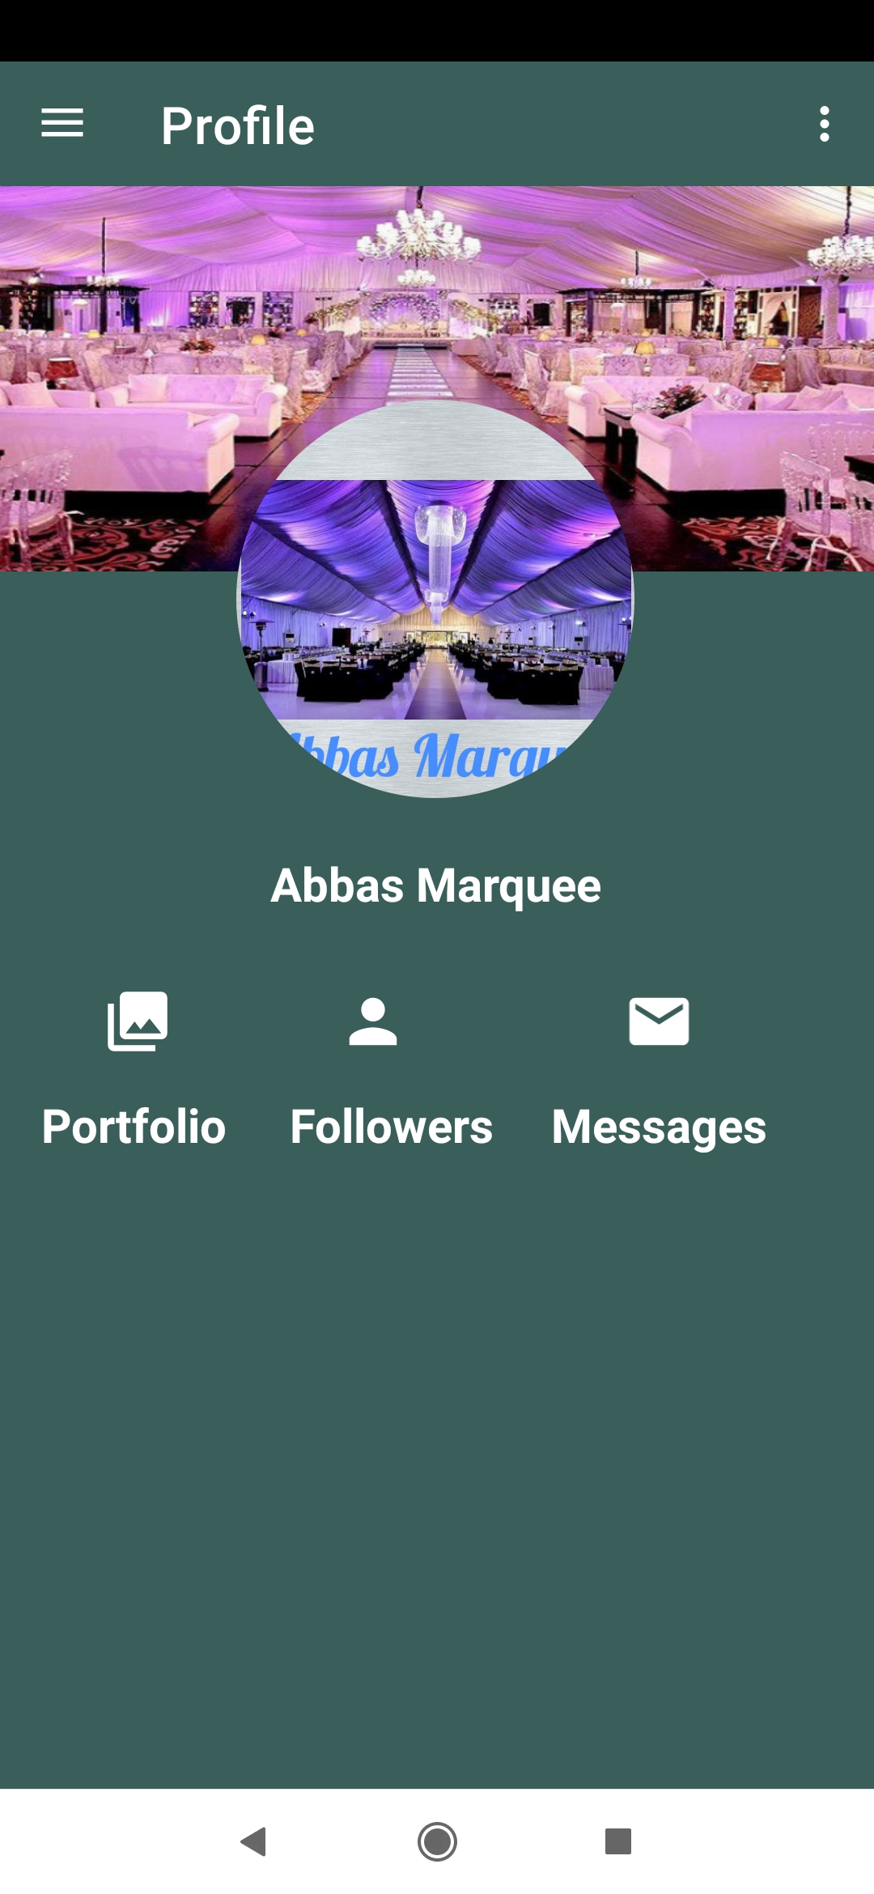
Continue…
Event Organizer Profile Figure (4)

Slide 15
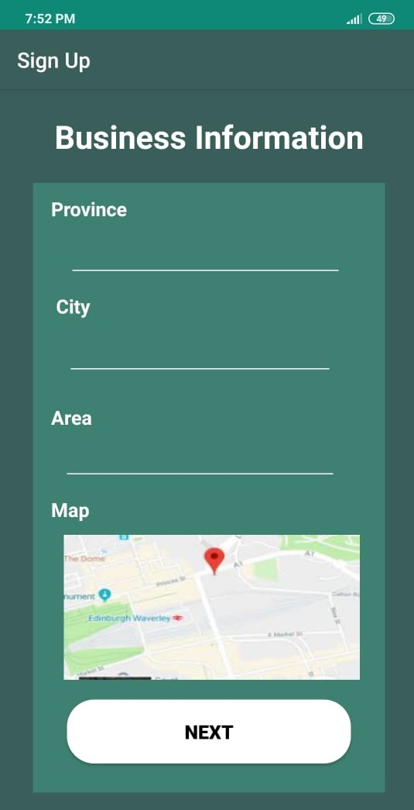
Continue…
Event Organizer Registration 3 Figure (5)

Slide 16
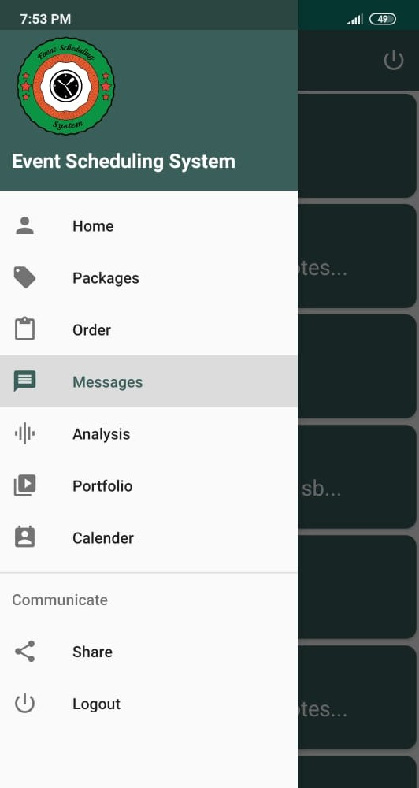
Continue…
Event Organizer Navigation Figure (6)

Slide 17
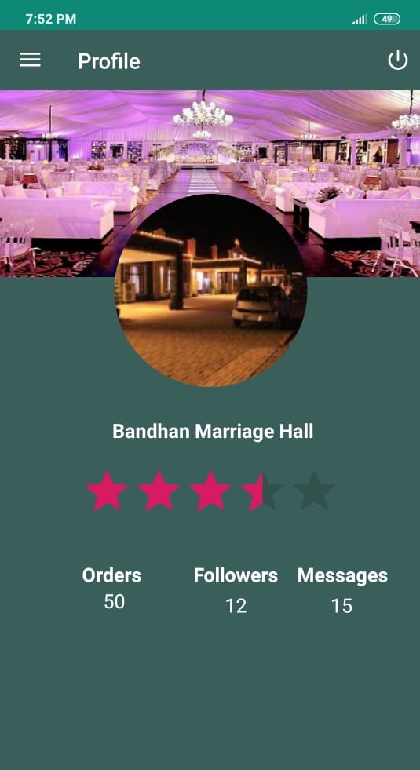
Continue…
Event Organizer Home Figure (7)

Slide 18
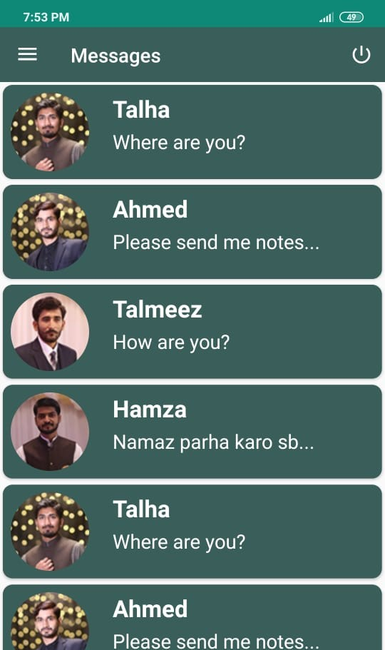
Continue…
Event Organizer Chat Figure (8)

Slide 19
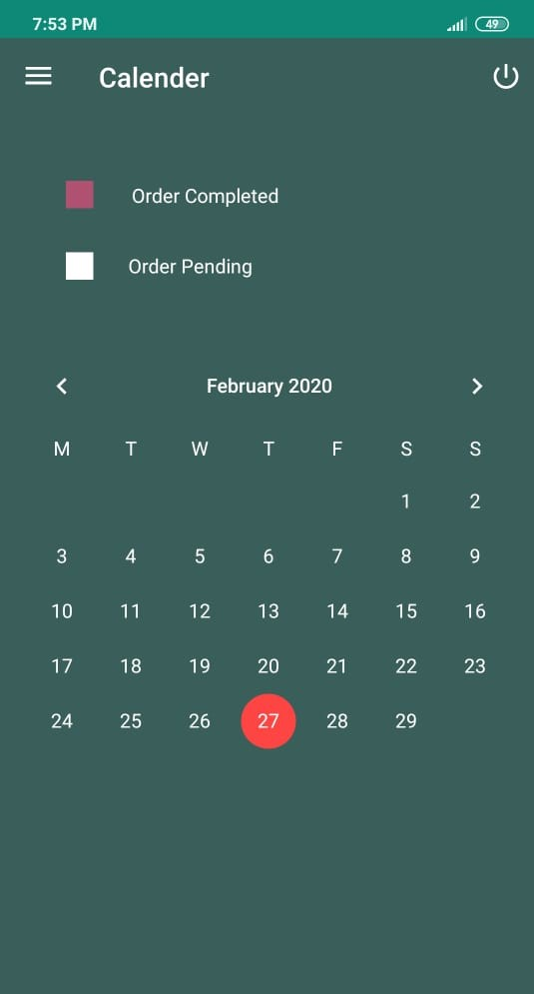
Continue…
Event Organizer Calendar Figure (9)

Slide 20
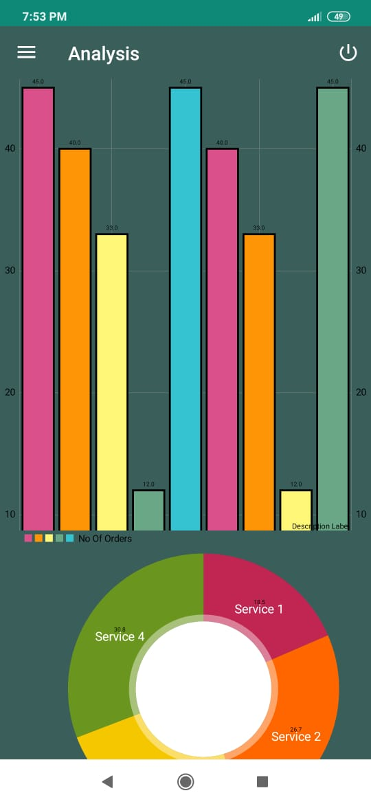
Continue…
Event Organizer Analysis Figure (10)

Slide 21
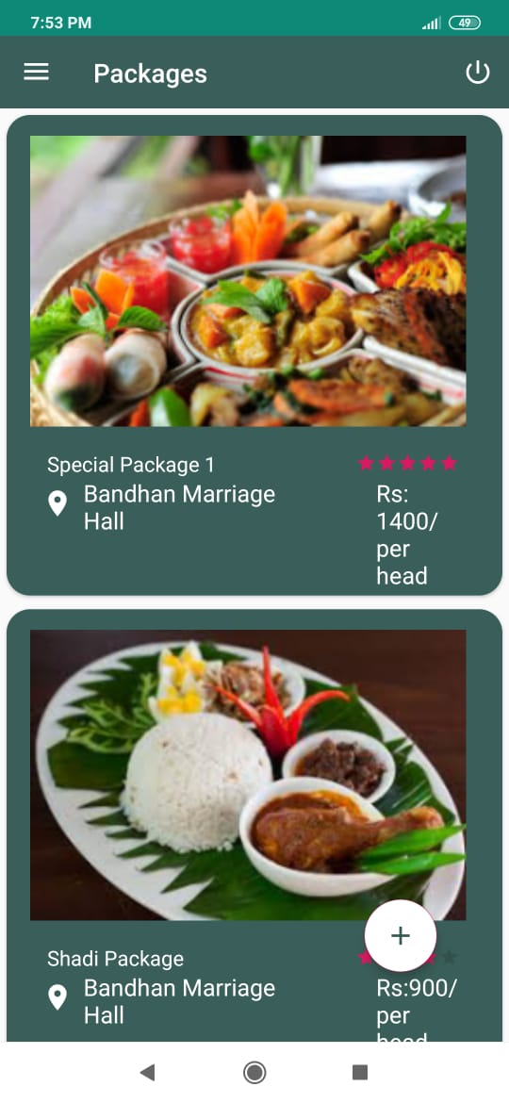
Continue…
Event Organizer Orders Figure (11)

Slide 22
Continue…
Event Organizer Packages Figure (12)

Slide 23
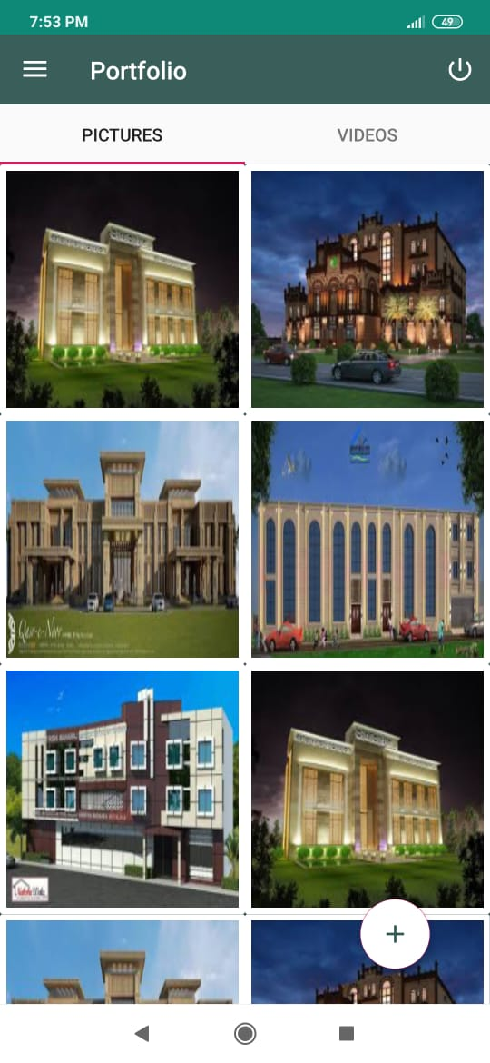
Continue…
Event Organizer Portfolio Figure (13)

Slide 24
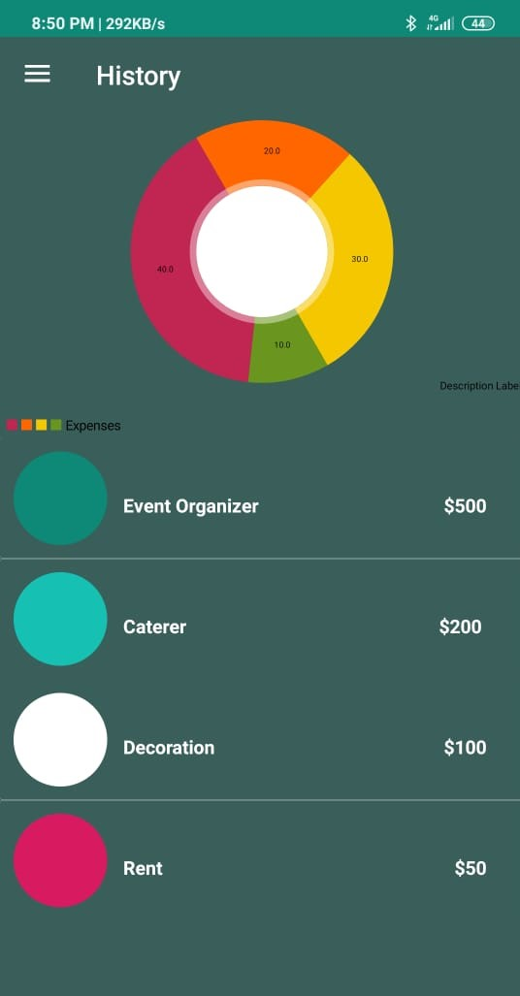
Continue…
Client History
Figure (17)

Slide 25
Continue…
Client Messages
Figure (18)

Slide 26
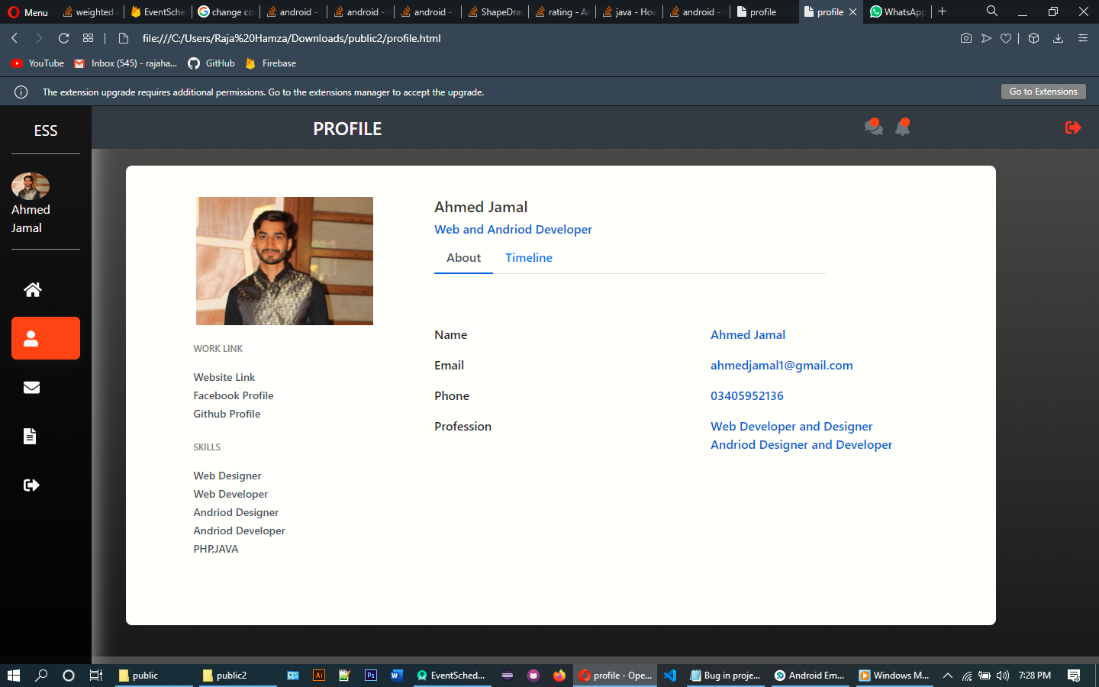

Slide 27
