Slide 1
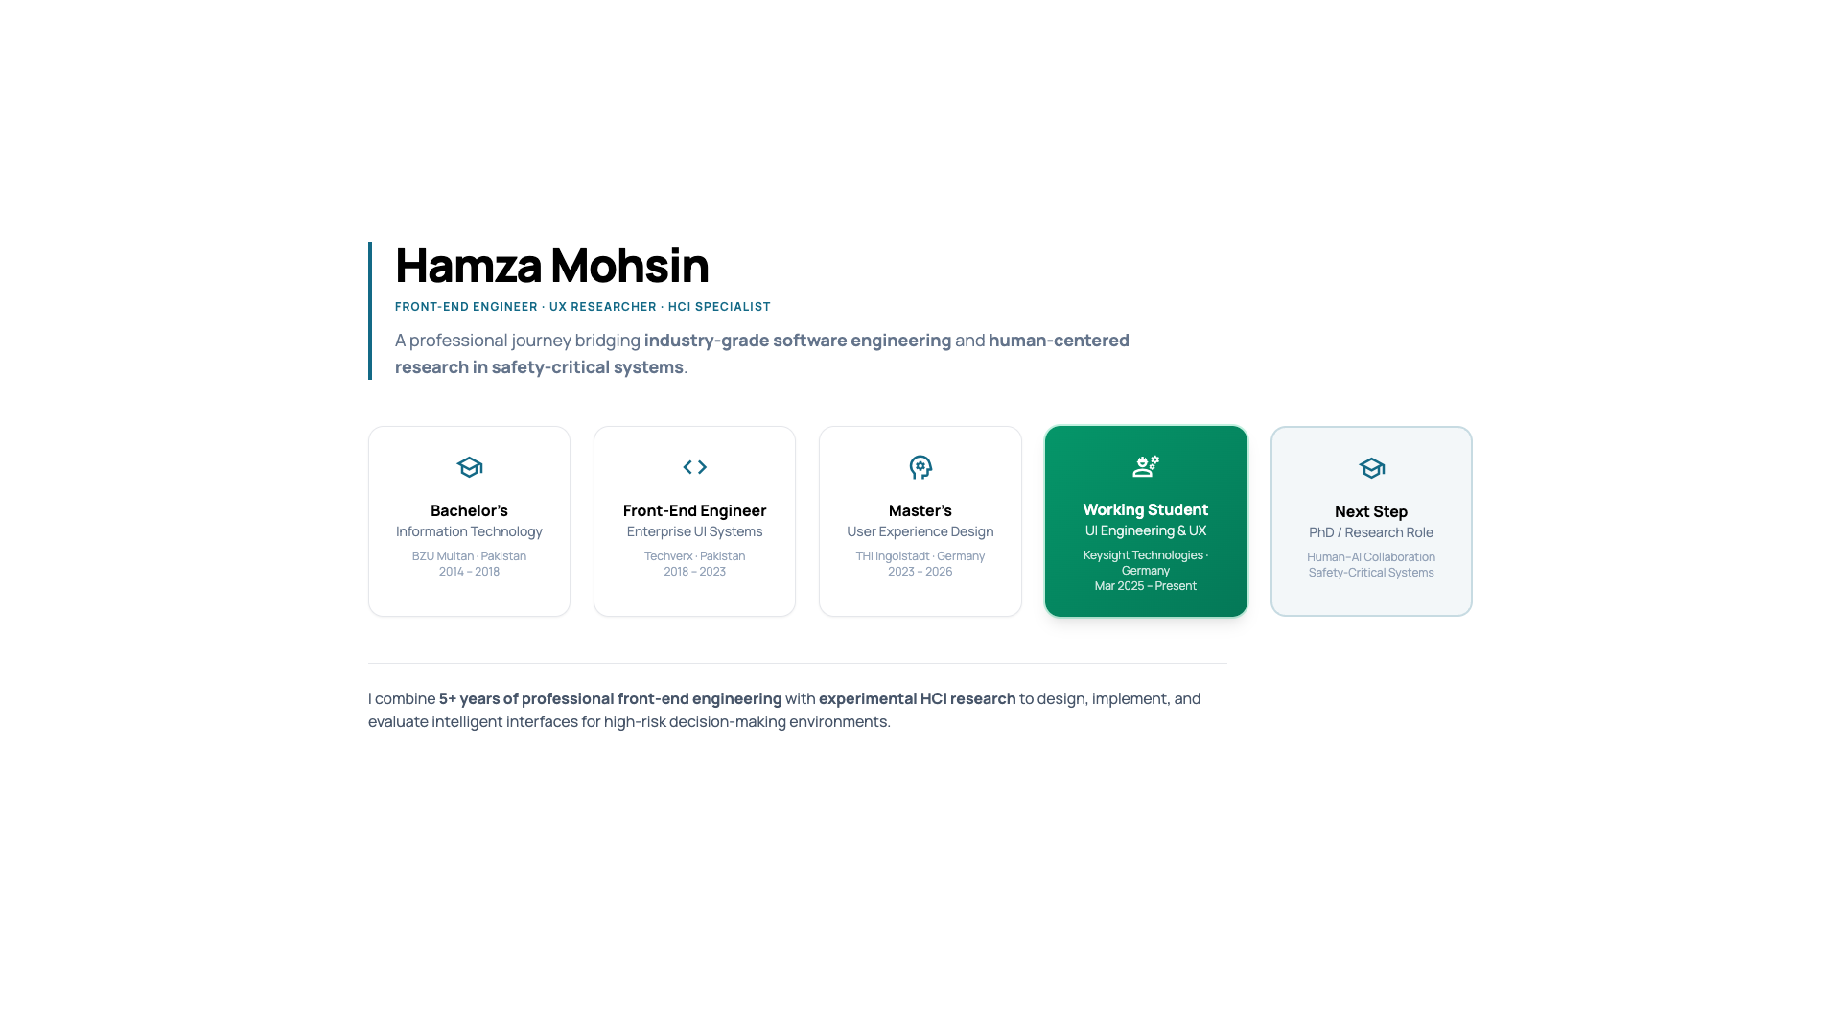
Notes:
Introduce yourself, background, and structure of the presentation.

Slide 2
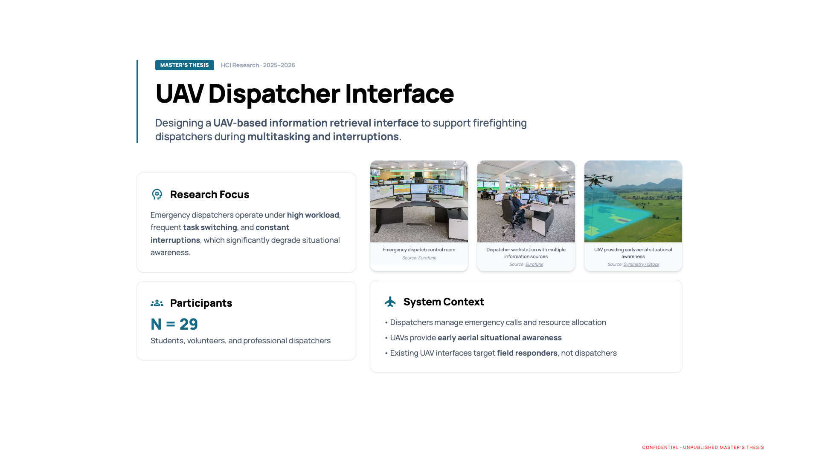
CONFIDENTIAL · UNPUBLISHED MASTER’S THESIS
Notes:
UAV dispatcher interface overview. Emphasize multitasking, interruptions, and research motivation. Confidential unpublished work.

Slide 3
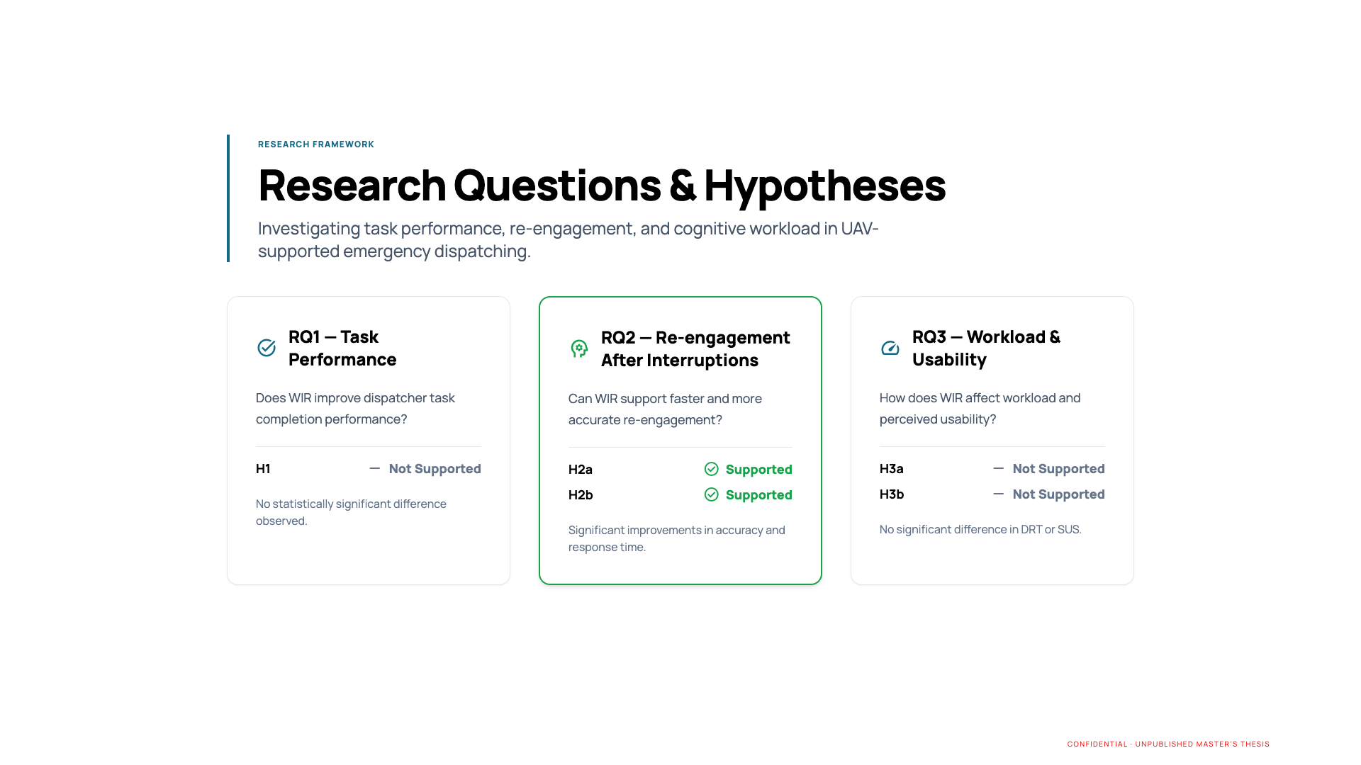
CONFIDENTIAL · UNPUBLISHED MASTER’S THESIS
Notes:
Explain research questions and hypotheses related to situational awareness and re-engagement. Confidential unpublished work.

Slide 4
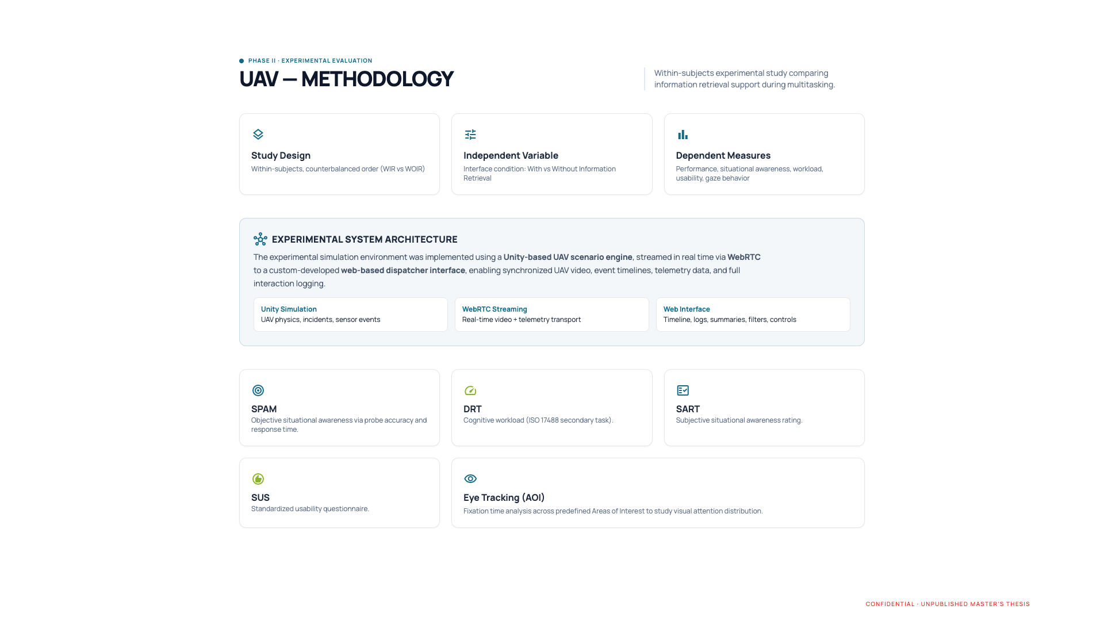
CONFIDENTIAL · UNPUBLISHED MASTER’S THESIS
Notes:
Describe experimental design, participants, measures, and within-subjects setup. Confidential unpublished work.

Slide 5
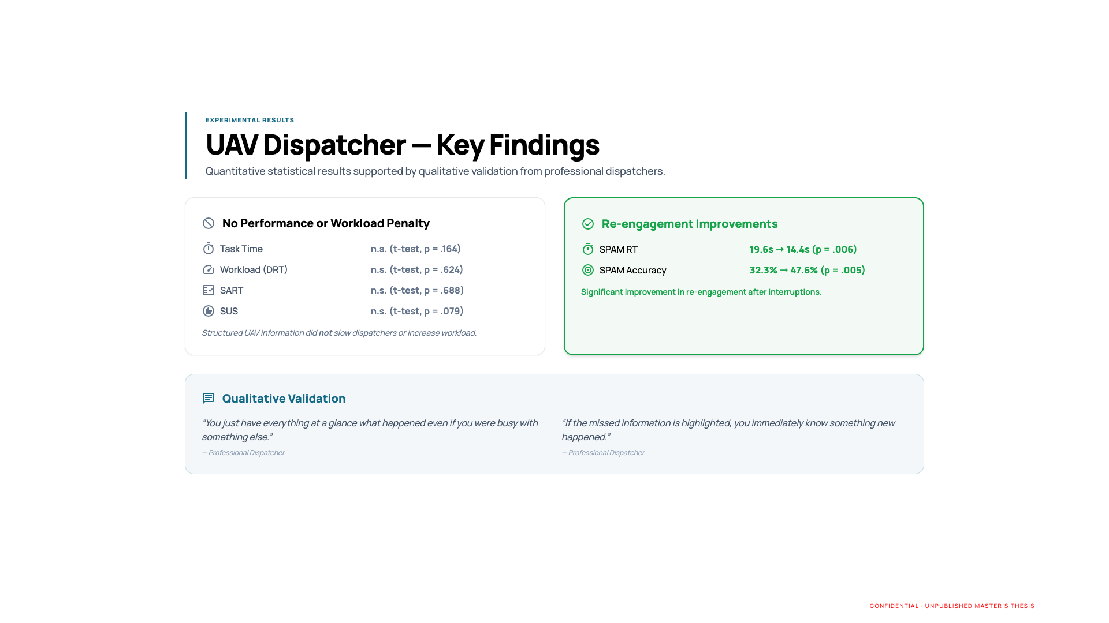
CONFIDENTIAL · UNPUBLISHED MASTER’S THESIS
Notes:
Walk through quantitative results and which hypotheses were supported. Confidential unpublished work.

Slide 6
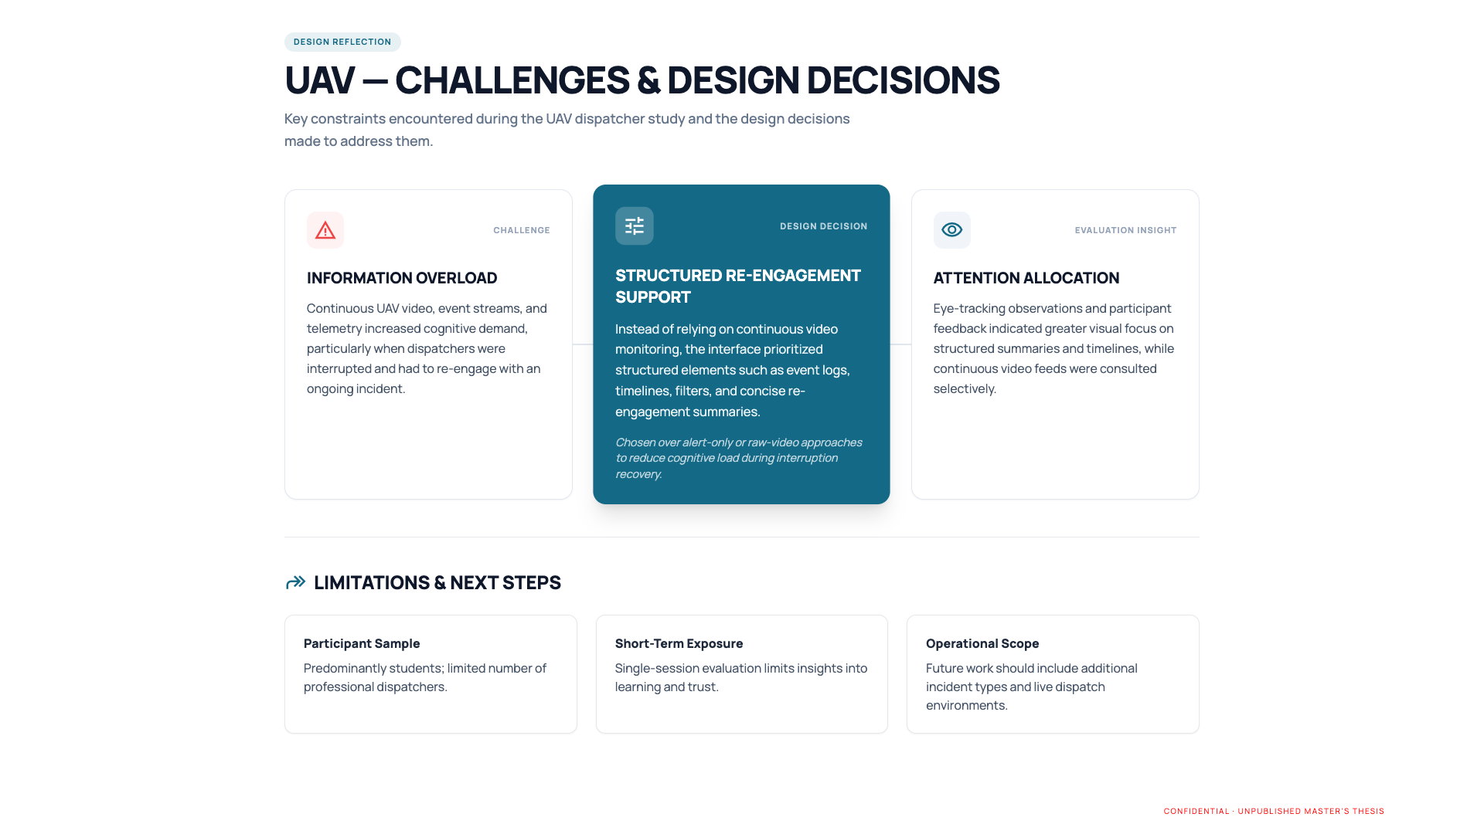
CONFIDENTIAL · UNPUBLISHED MASTER’S THESIS
Notes:
Discuss design challenges, trade-offs, and system limitations. Confidential unpublished work.

Slide 7
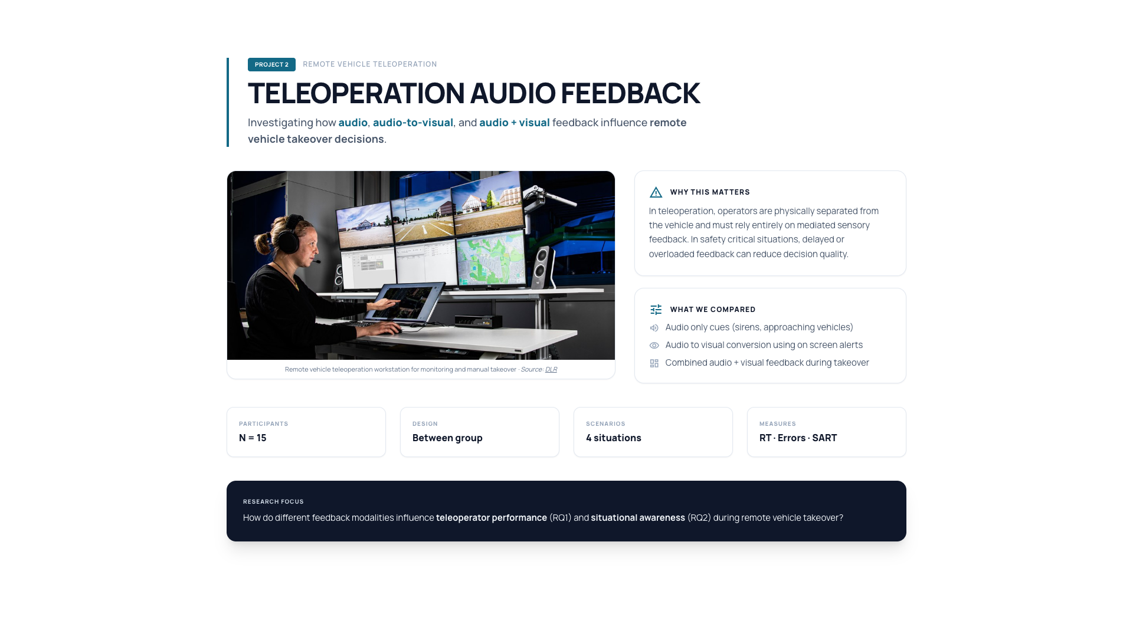
Notes:
Introduce teleoperation study and emergency takeover context.

Slide 8
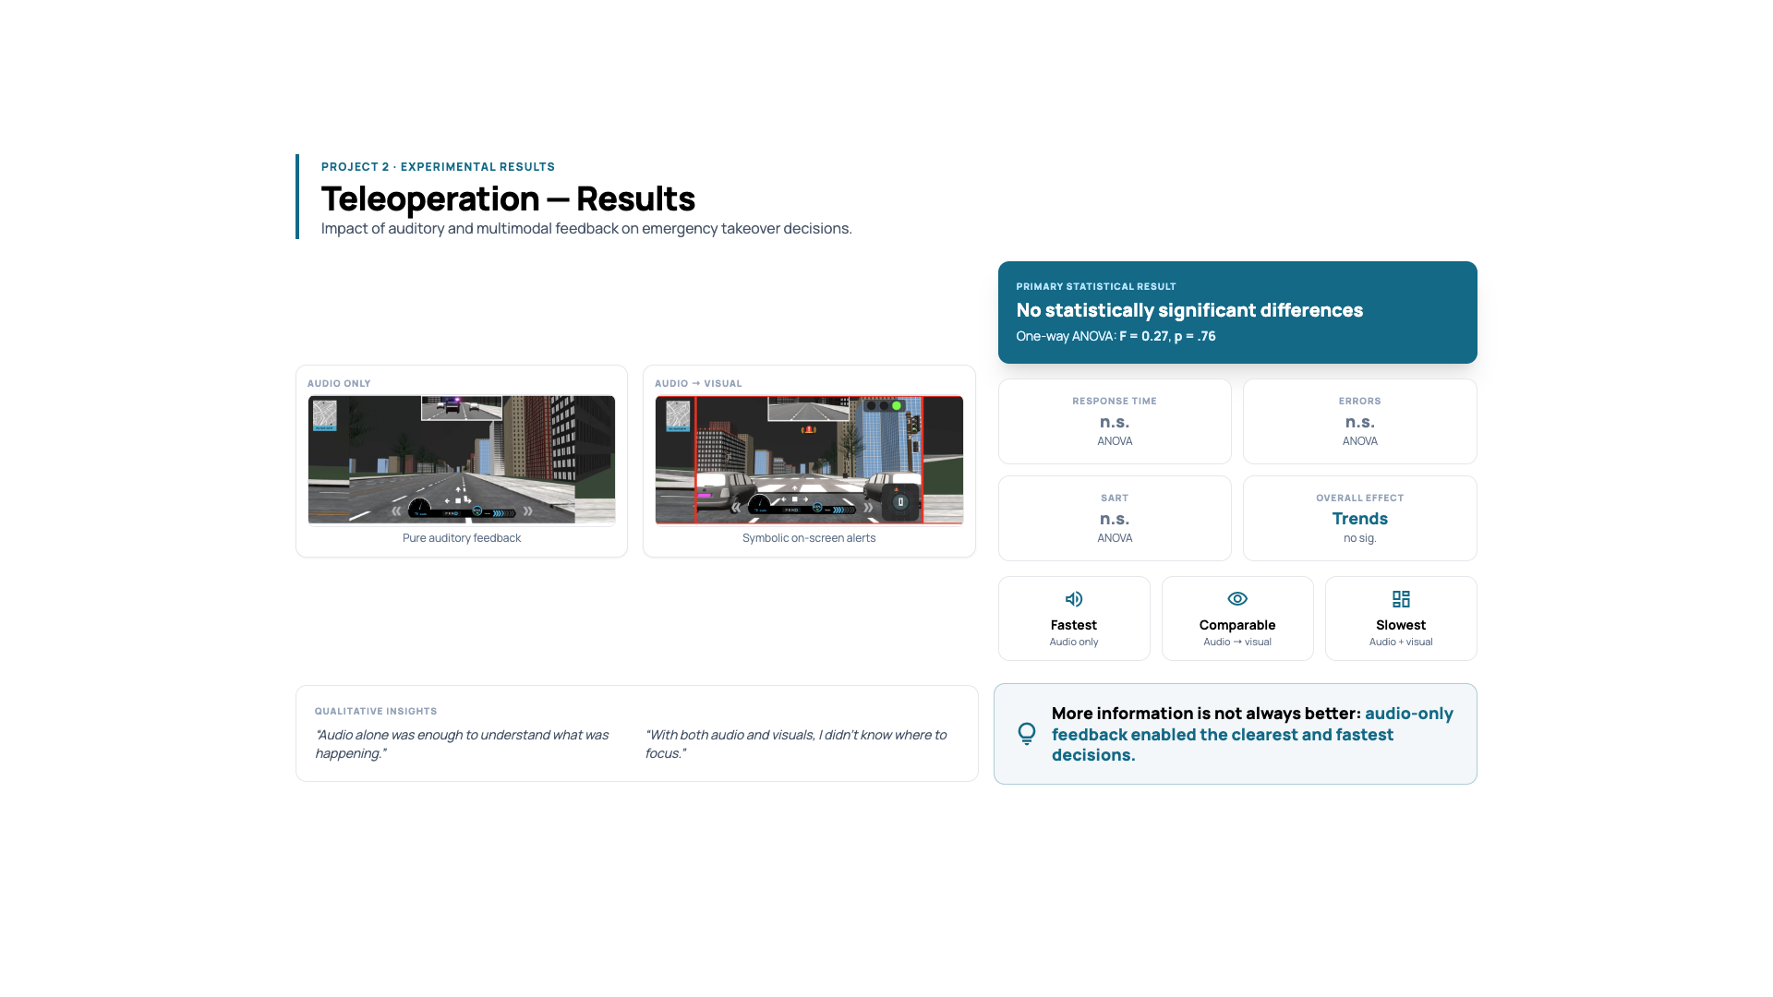
Notes:
Explain response time trends, ANOVA results, and qualitative feedback.

Slide 9
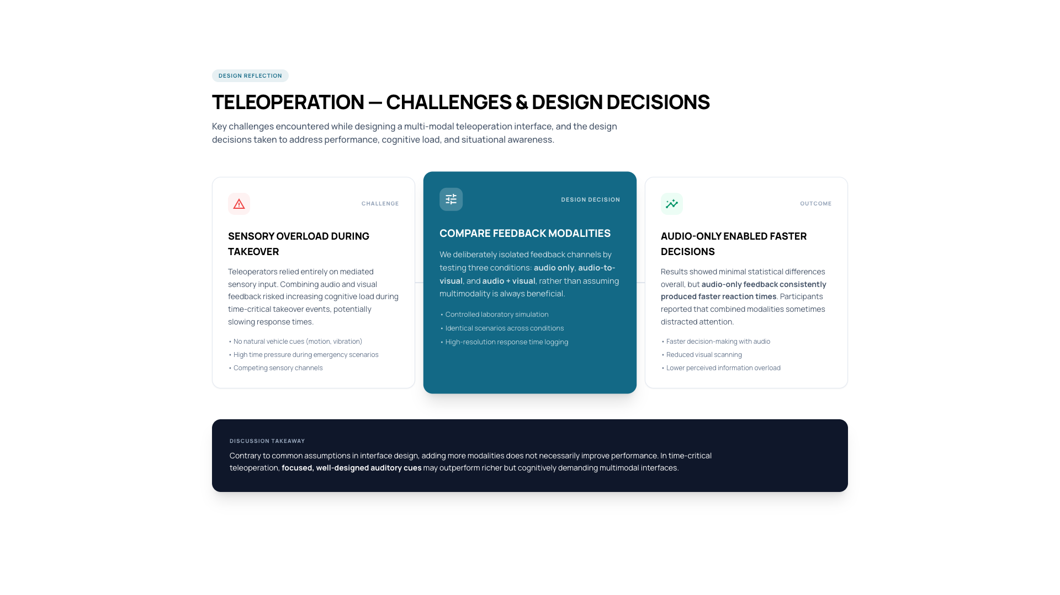
Notes:
Reflect on multimodal overload and design decisions.

Slide 10
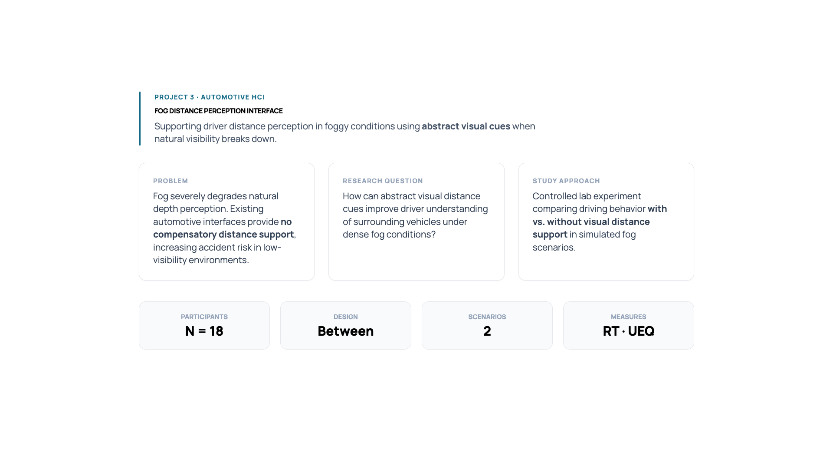
Notes:
Present fog interface motivation and distance perception problem.

Slide 11
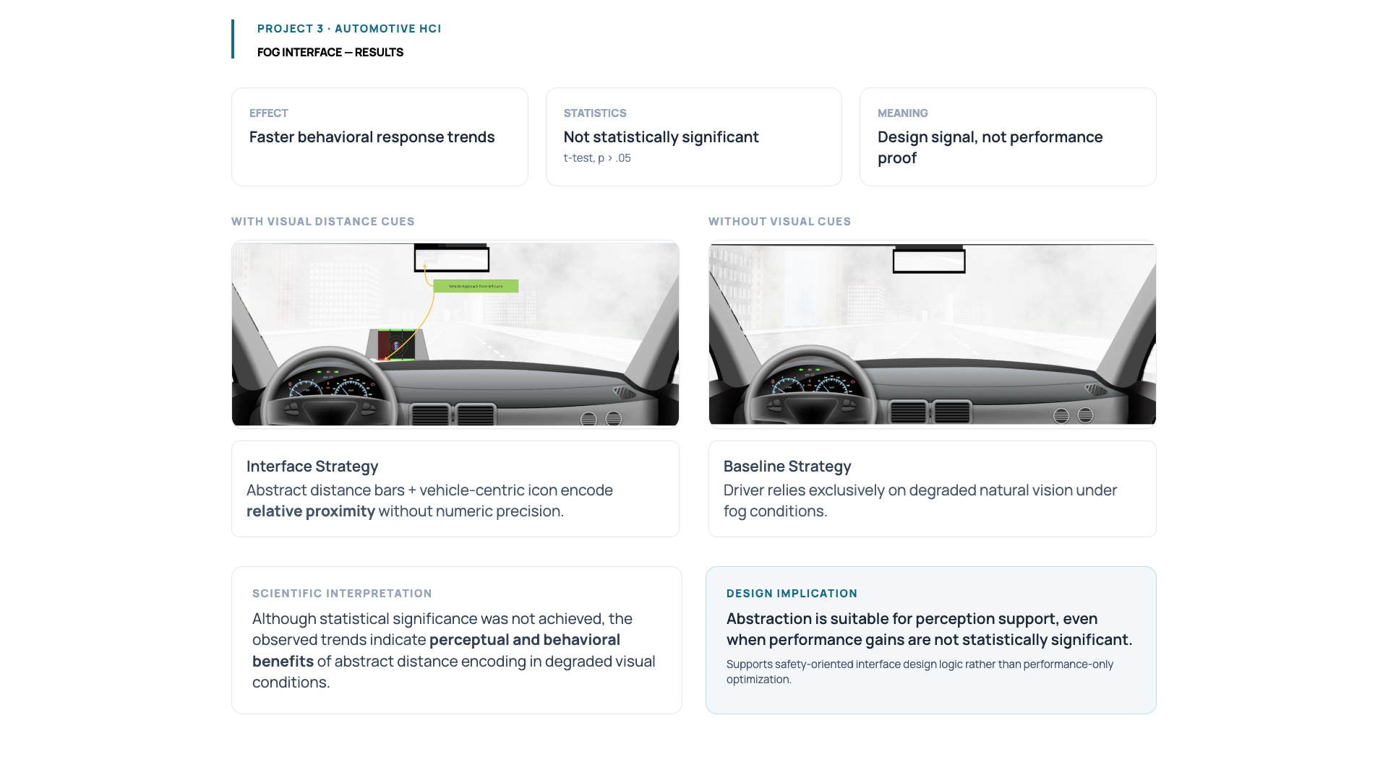
Notes:
Explain t-test results, trends, and why non-significance still matters.

Slide 12
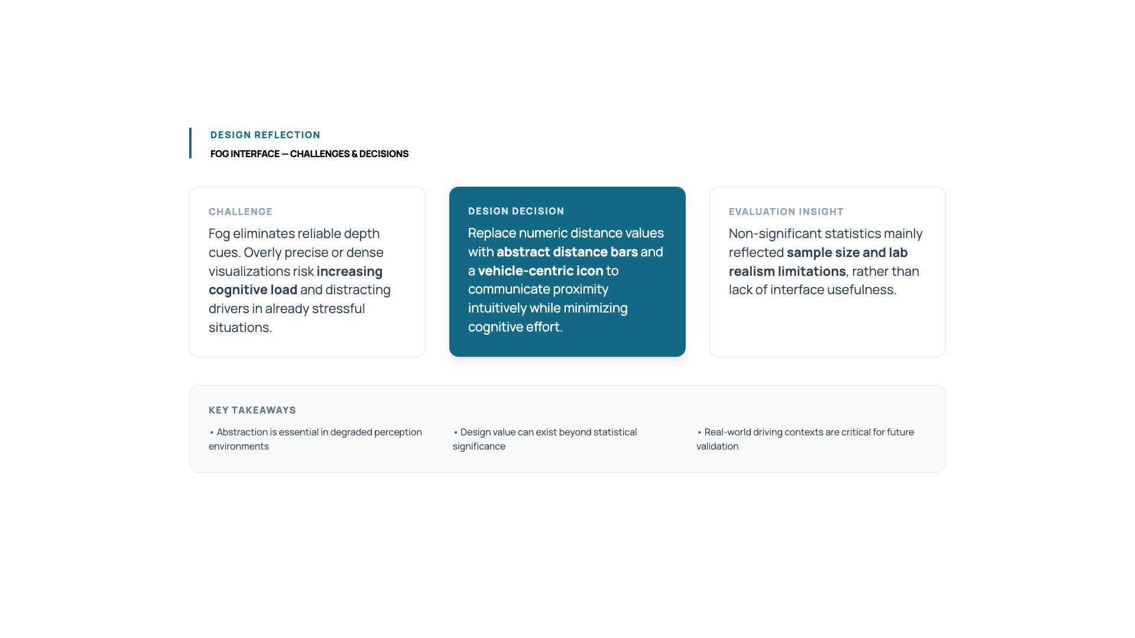
Notes:
Discuss abstraction vs precision and future improvements.

Slide 13
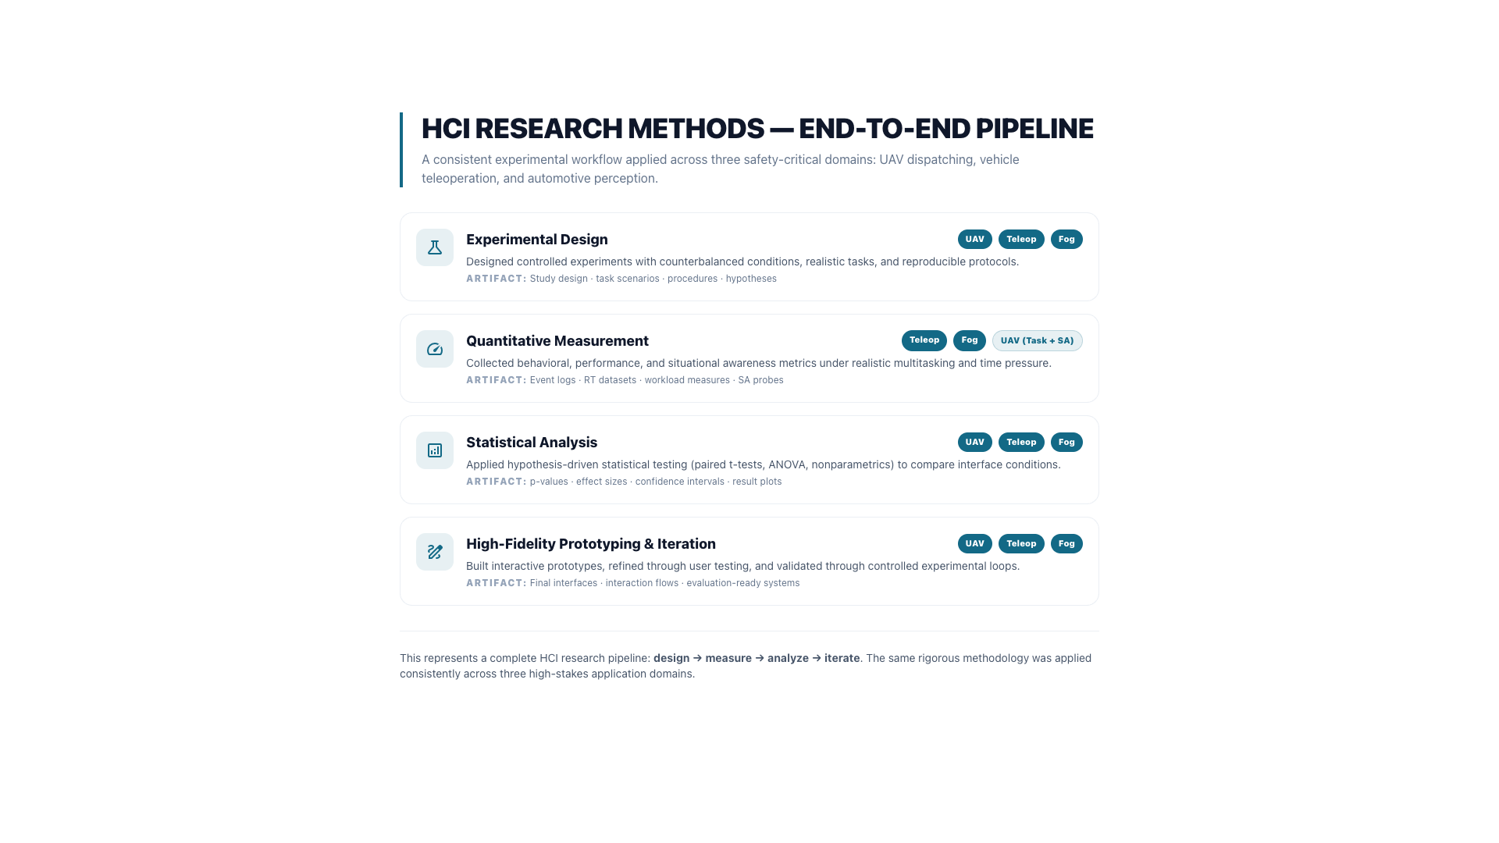
Notes:
Summarize methods across projects and position your research profile.

Slide 14
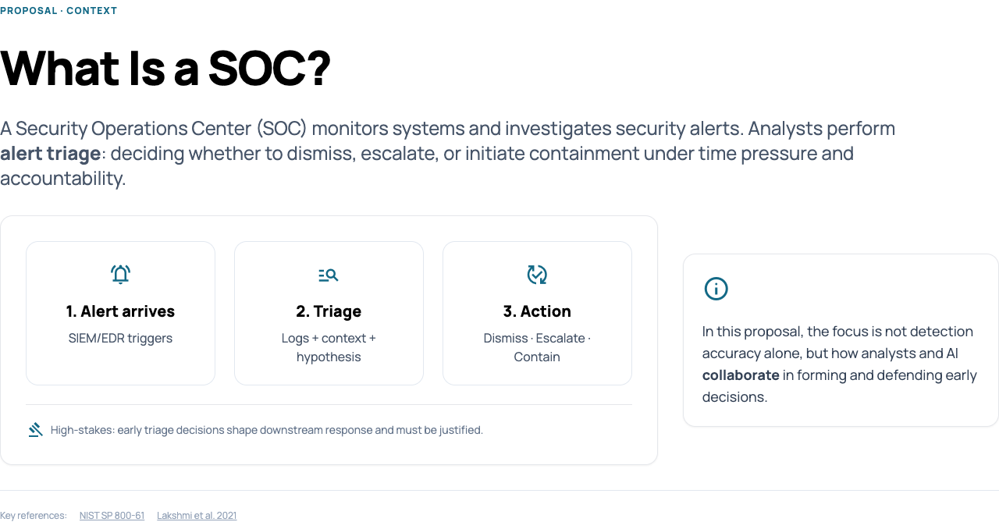
Notes:
Problem context: SOC alert triage as a sensemaking task.

Slide 15
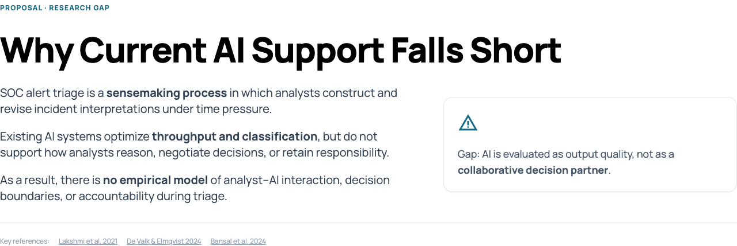
Notes:
Why triage is difficult: fragmented information and changing information needs.

Slide 16
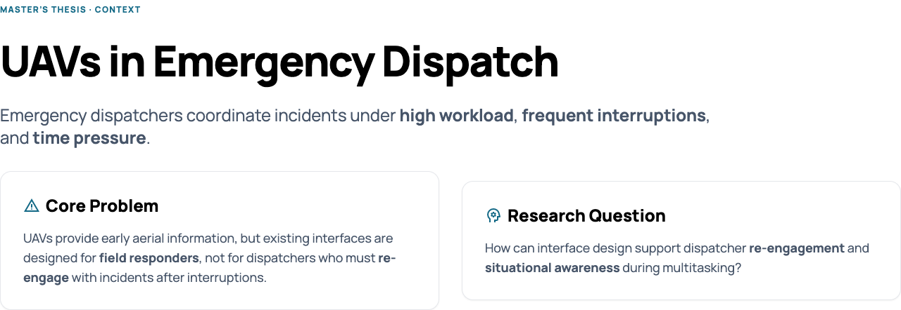
Notes:
Current role of AI in SOCs.

Slide 17
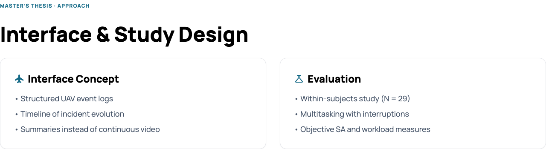
Notes:
Research gap.

Slide 18
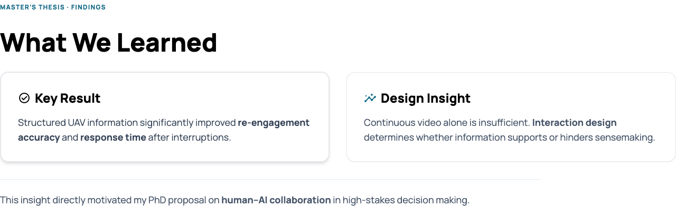
Notes:
Research questions.

Slide 19
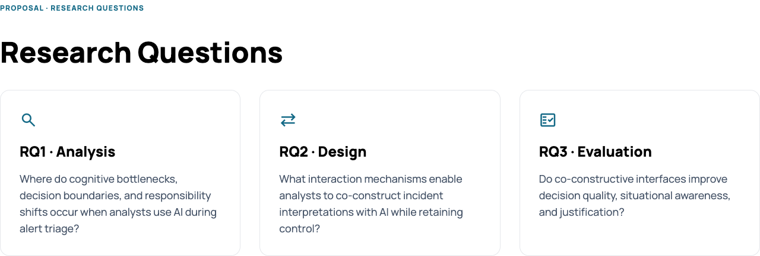
Notes:
Methodology.

Slide 20
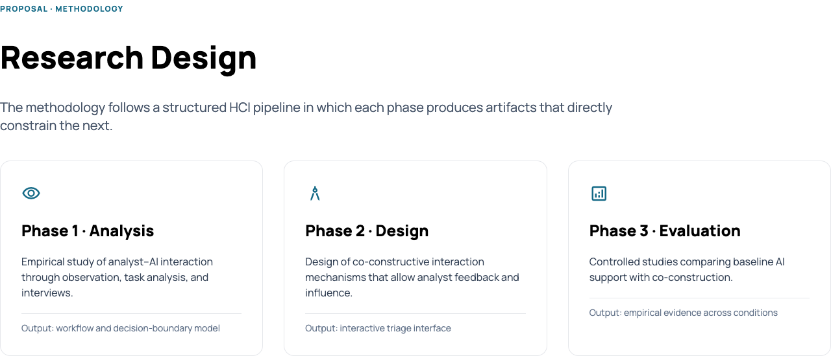
Notes:
Full proposal and Overleaf link.

Slide 21
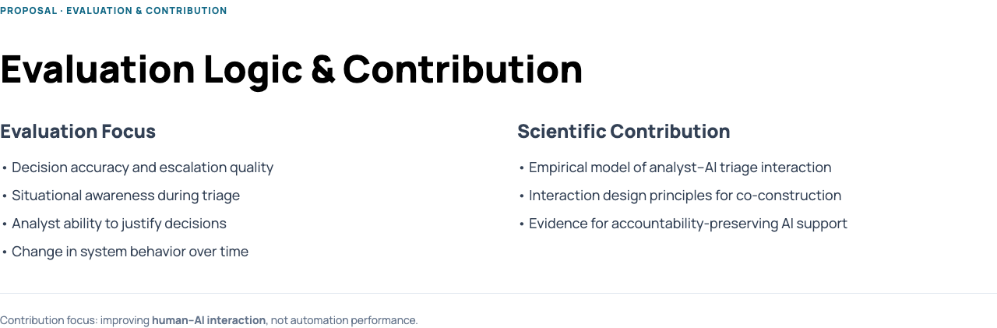
Notes:
SOC proposal section 8

