Slide 1
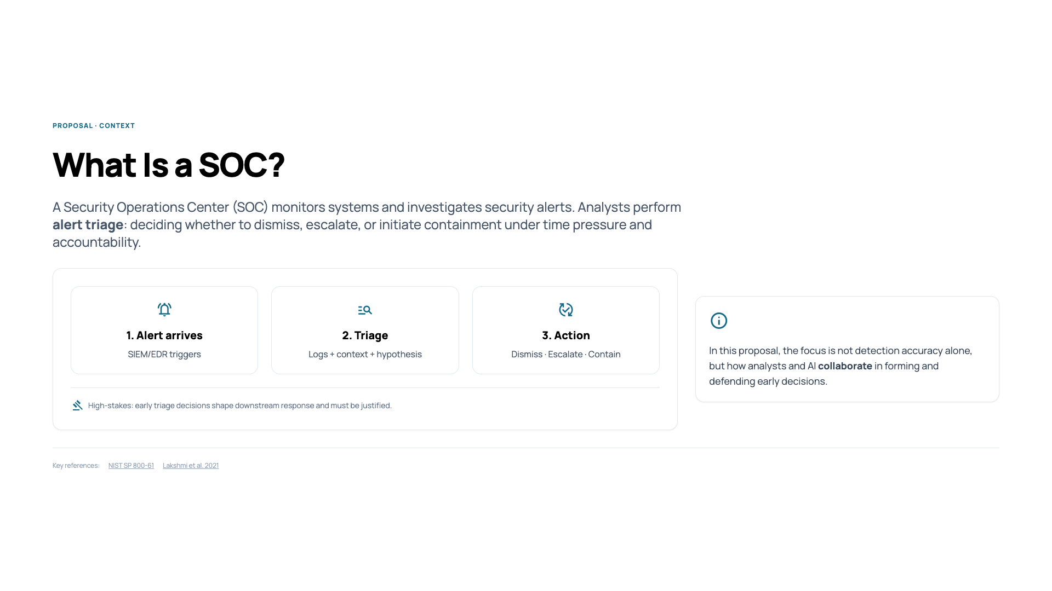
Notes:
“A Security Operations Center, or SOC, is responsible for monitoring systems and responding to security alerts. Analysts perform alert triage: deciding whether an alert should be dismissed, escalated, or trigger containment.”
“This happens under time pressure, with incomplete information, and analysts remain accountable for early decisions.”
“In this proposal, I focus specifically on this early triage phase, where interpretation and responsibility are critical.”

Slide 2
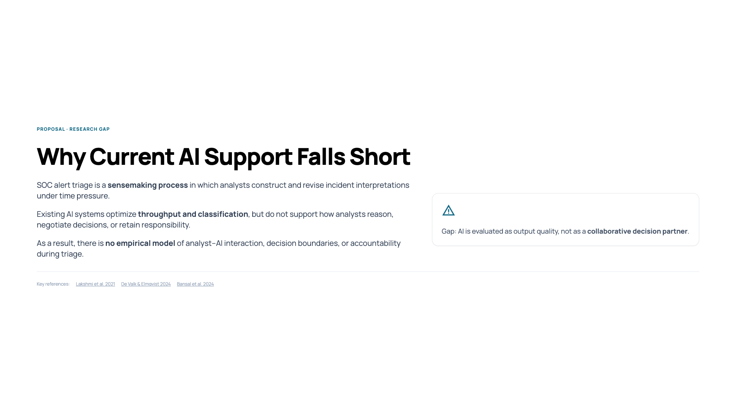
Notes:
“Prior work shows that alert triage is fundamentally a sensemaking process. Analysts construct and revise hypotheses using alerts, logs, and context.”
“However, current AI systems in SOCs mainly optimize throughput — prioritization, correlation, summaries.”
“What’s missing is support for how analysts reason, negotiate decisions, and retain responsibility when AI is involved.”
“As a result, we lack empirical models of analyst–AI interaction, decision boundaries, and accountability during triage.”
“AI is evaluated as output quality, not as a collaborative decision partner.”

Slide 3
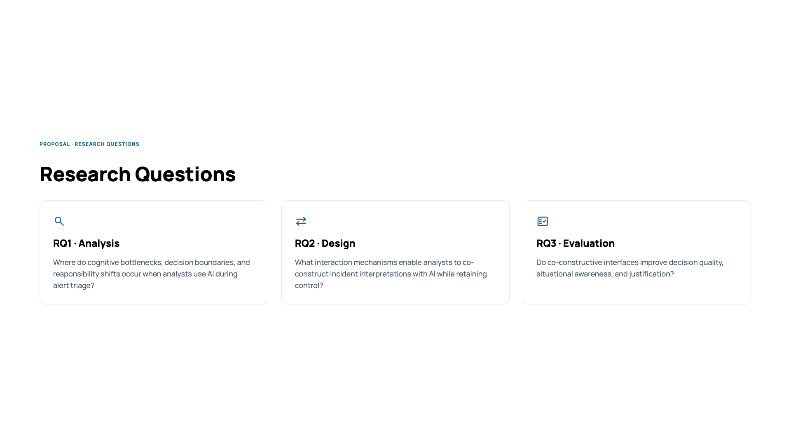
Notes:
“The research questions follow directly from this gap.”
RQ1
“First, I ask where cognitive bottlenecks, decision boundaries, and responsibility shifts occur when analysts use AI during triage.”
RQ2
“Second, I investigate what interaction mechanisms allow analysts to co-construct incident interpretations with AI while retaining control.”
RQ3
“Third, I evaluate whether such co-constructive interfaces actually change decision quality, situational awareness, and justification.”
Meta framing (important):
“RQ1 is descriptive, RQ2 is constructive, and RQ3 is evaluative.”

Slide 4
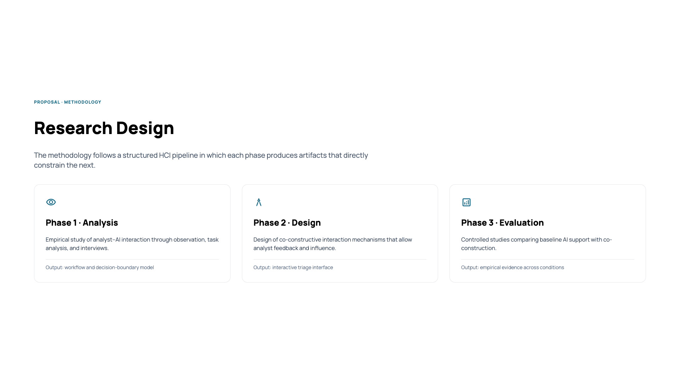
Notes:
“The methodology follows a structured HCI pipeline with three phases.”
Phase 1 — Analysis
“I empirically study how analysts interact with AI-supported triage tools using observation, task analysis, and interviews.”
“The output is a workflow and decision-boundary model that captures breakdowns and responsibility shifts.”
Phase 2 — Design
“These findings directly inform the design of co-constructive interaction mechanisms.”
“The result is an interactive triage interface that allows analyst feedback and influence.”
Phase 3 — Evaluation
“Finally, I evaluate this interface in controlled studies against baseline AI support.”
Key sentence (very important):
“Each phase produces artifacts that directly constrain the next phase.”

Slide 5
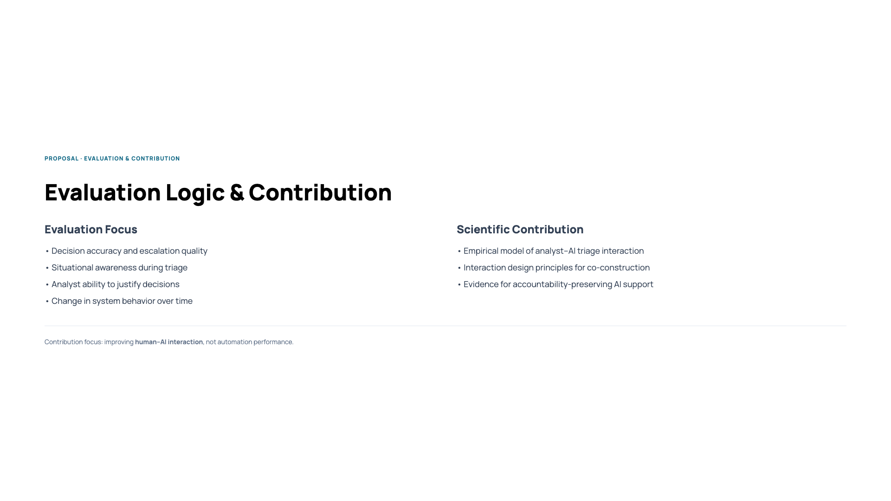
Notes:
“Evaluation focuses on both task outcomes and human factors.”
“I examine decision accuracy, situational awareness during triage, the ability to justify decisions, and changes in system behavior over time.”
“The scientific contributions are threefold.”
“First, an empirical model of analyst–AI interaction during SOC triage.”
“Second, interaction design principles for co-construction in high-stakes cybersecurity contexts.”
“Third, empirical evidence for AI support that preserves accountability rather than obscuring it.”
“The contribution is not a better model, but a better interaction between humans and AI in high-stakes decisions.”

