Slide 1
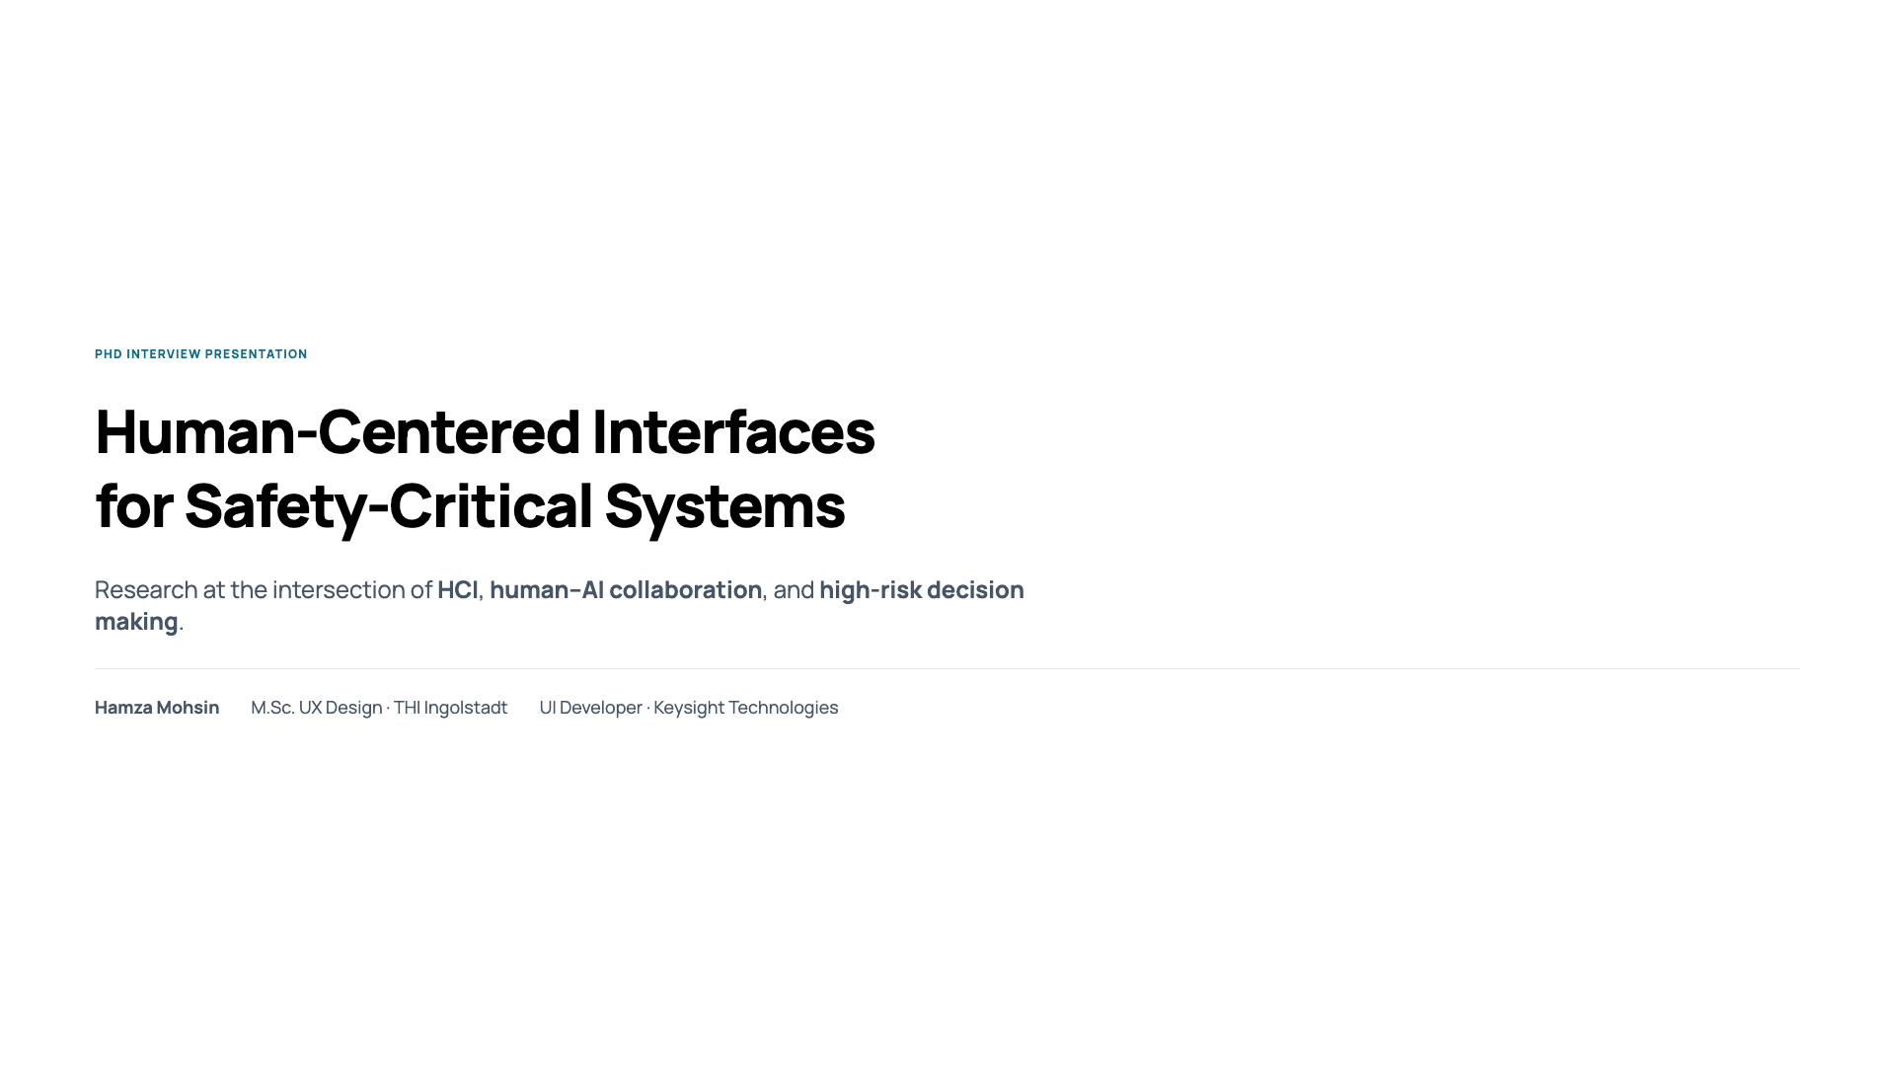
Notes:
“My work focuses on human-centered interface design for safety-critical systems, particularly where humans interact with intelligent systems under time pressure.”
“I’m interested in how interaction design shapes human decision making when errors have serious consequences.”

Slide 2
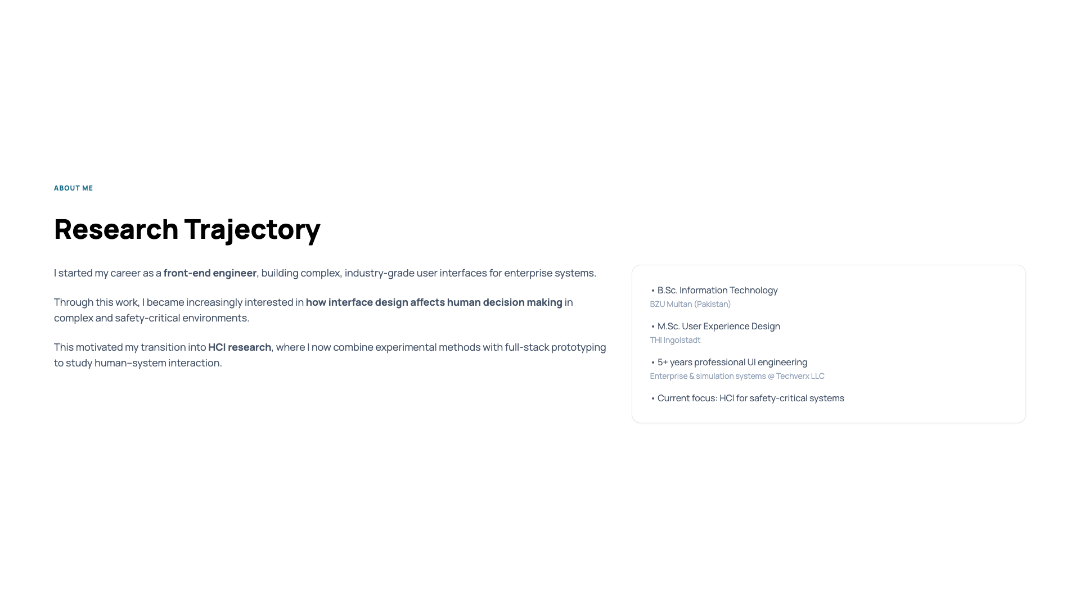
Notes:
“I started my career as a front-end engineer, building complex enterprise user interfaces.”
“Through this work, I became increasingly interested in how interface design affects human decision making in complex systems, not just usability.”
“This motivated my transition into HCI research, where I now combine experimental methods with full-stack prototyping.”
“My Master’s thesis was my first step into systematic, experimental HCI research.”

Slide 3
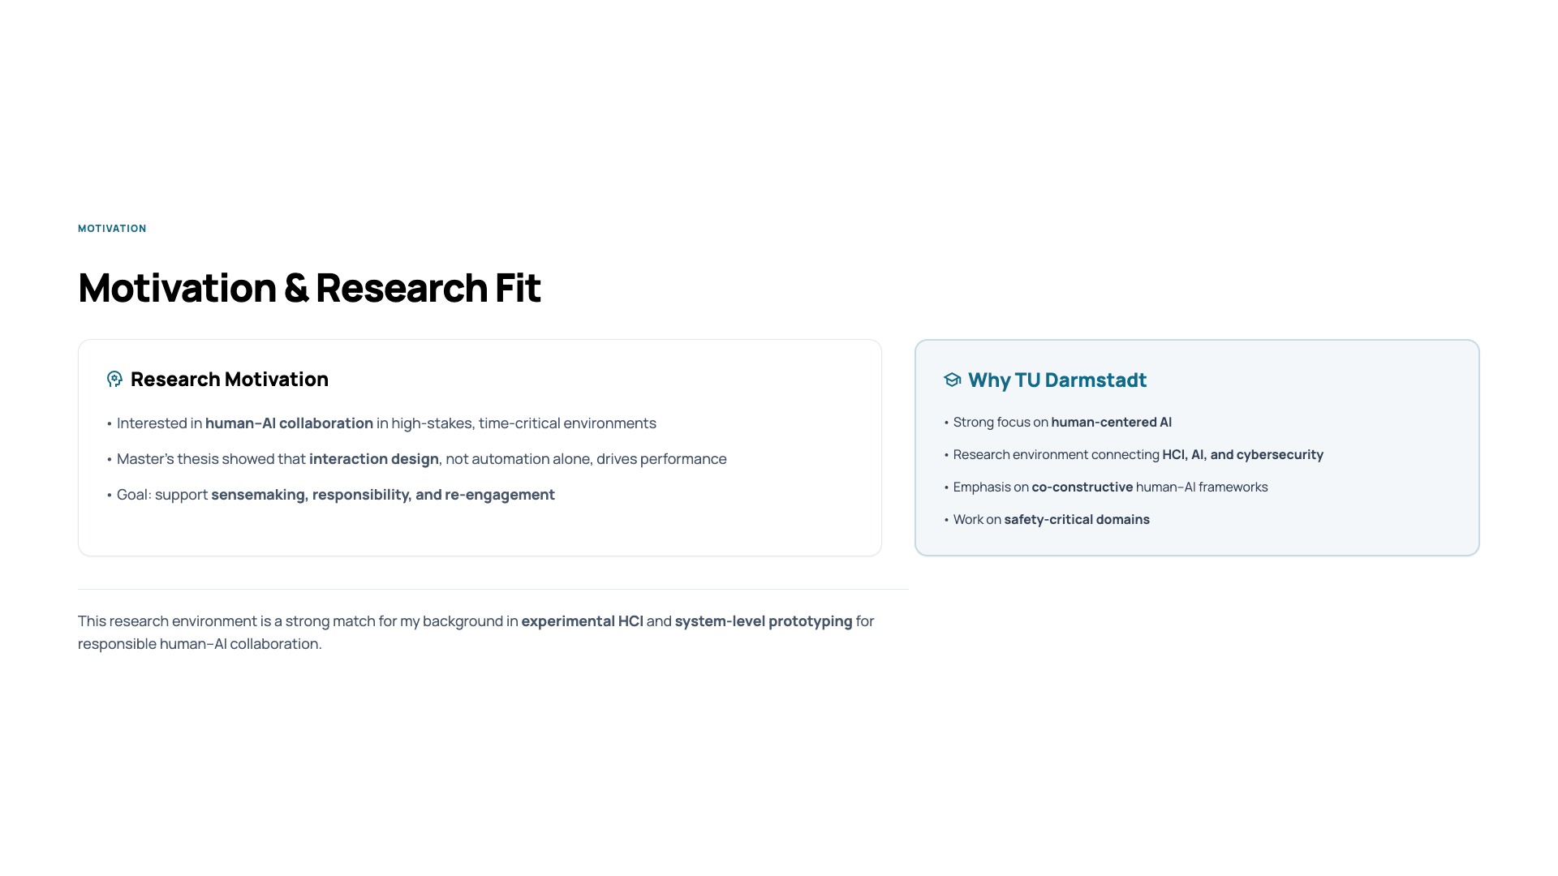
Notes:
“My motivation comes from studying how humans and AI collaborate in high-stakes, time-critical environments.”
“My Master’s work showed that performance improvements come less from automation and more from interaction design that supports sensemaking and responsibility.”
“This research environment is a strong fit because it explicitly studies human-AI collaboration in safety-critical domains.”

Slide 4
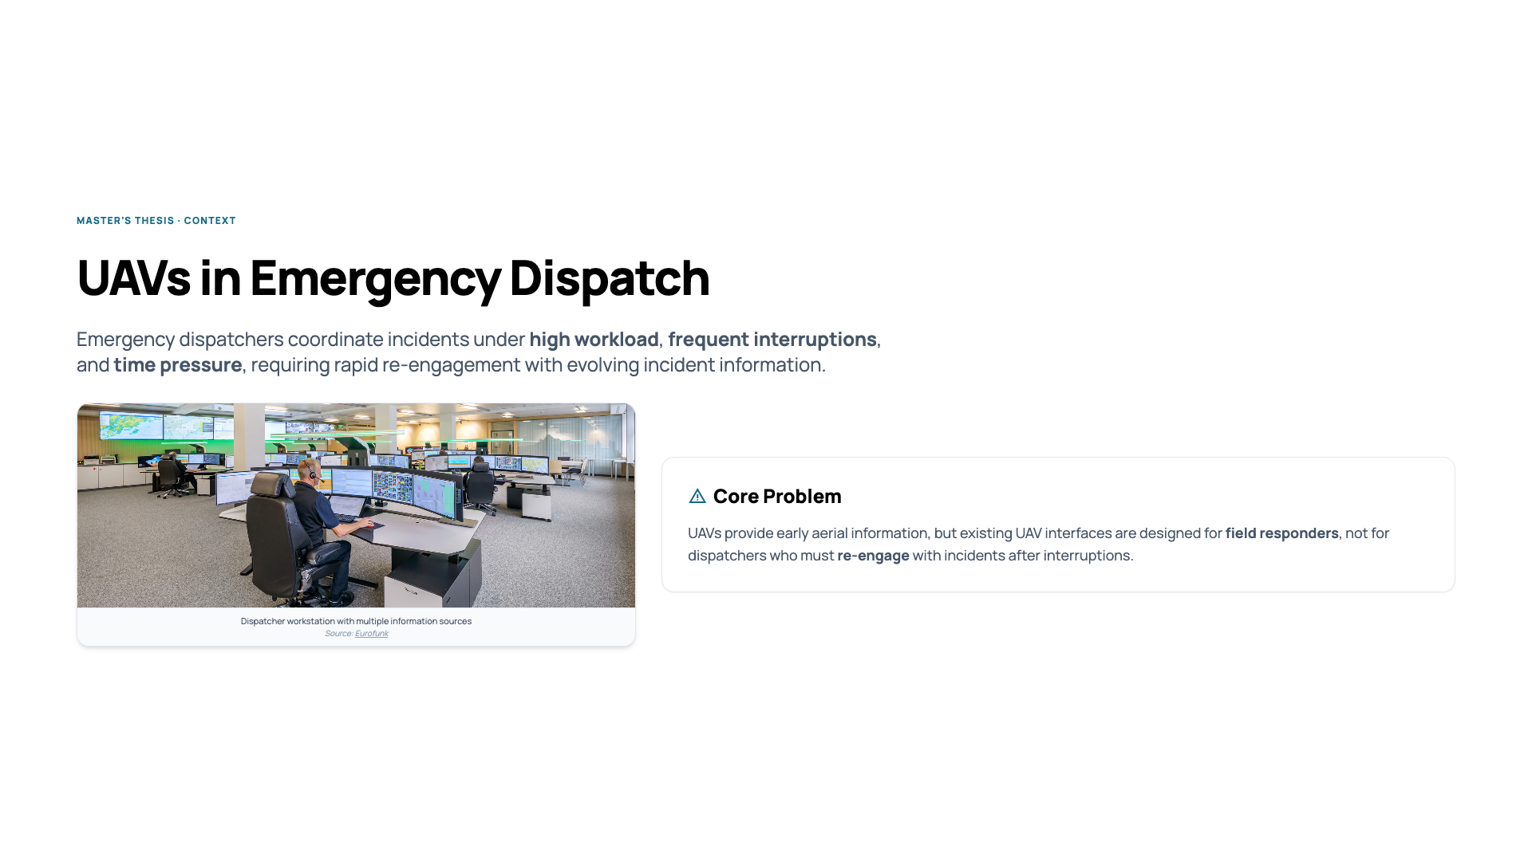
Notes:
“Emergency dispatchers coordinate incidents under high workload, frequent interruptions, and time pressure.”
“UAVs can provide early aerial information, but most existing UAV interfaces are designed for field responders.”
“Dispatchers, however, must frequently re-engage with incidents after interruptions, which existing interfaces do not support well.”
“This gap motivated my research question.”

Slide 5
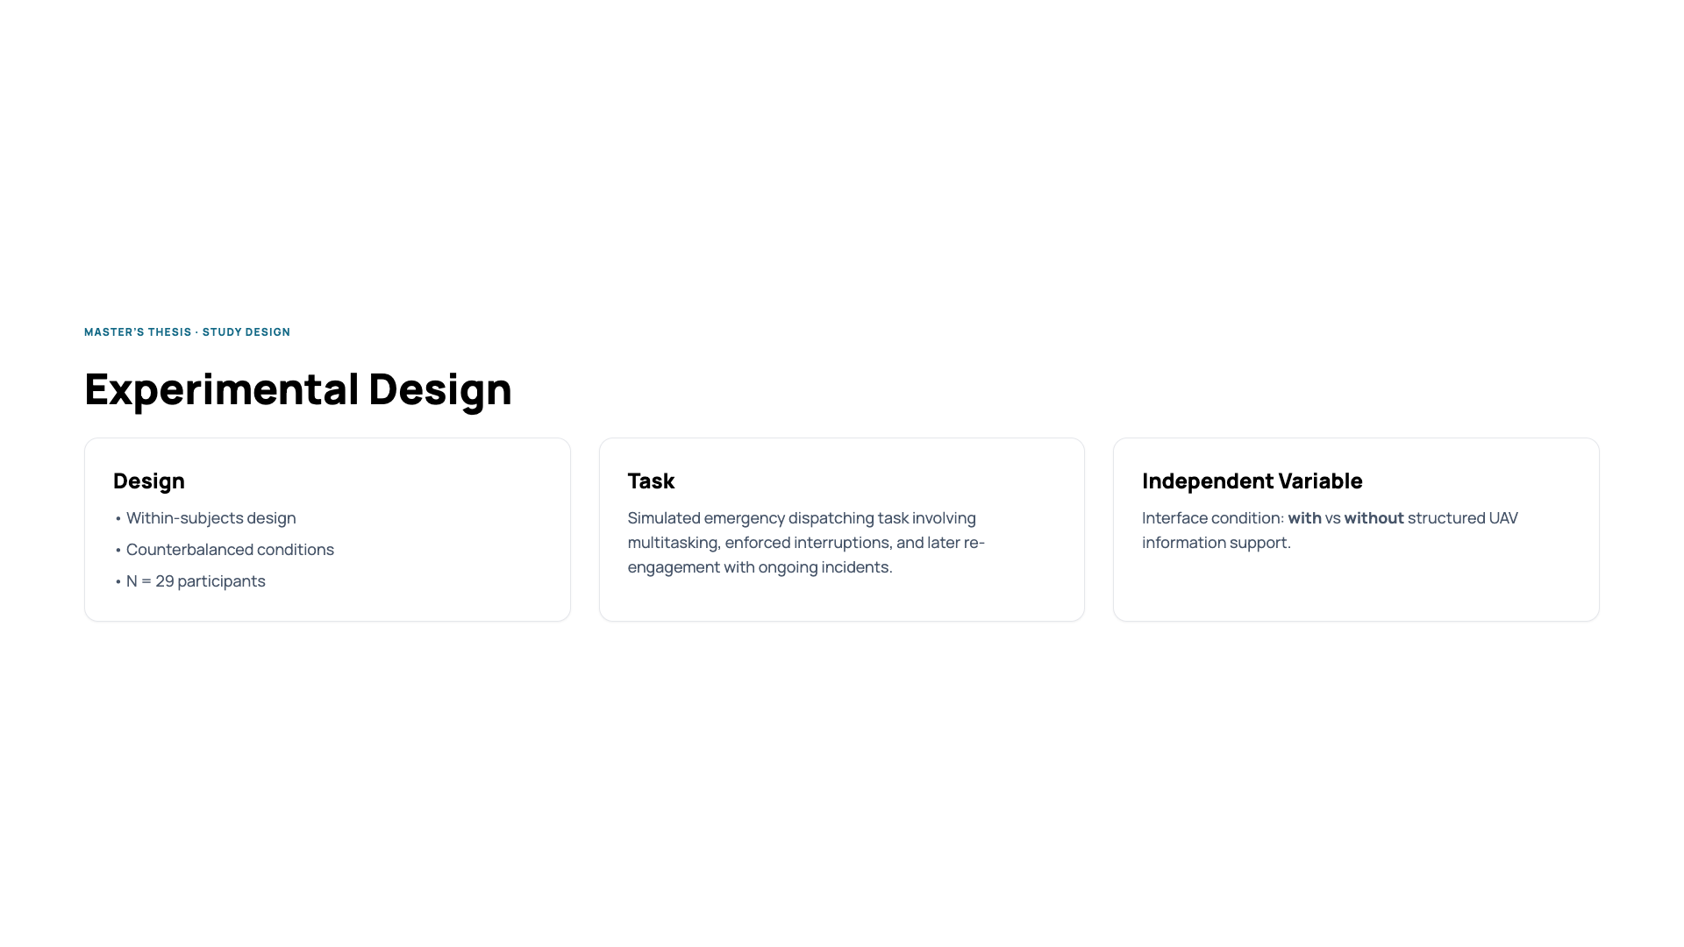
Notes:
“I conducted a within-subjects experiment with 29 participants.”
“Participants performed a simulated emergency dispatching task with enforced interruptions.”
“The independent variable was the interface condition: with versus without structured UAV information support.”
“This allowed us to isolate the effect of interaction design while controlling for individual differences.”

Slide 6
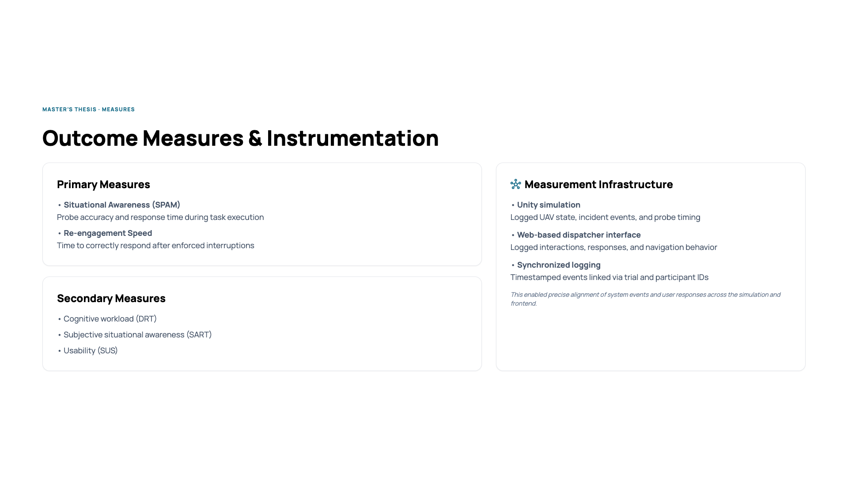
Notes:
“Situational awareness was measured objectively using SPAM probes, focusing on accuracy and response time.”
“Cognitive workload was measured using the Detection Response Task, along with SART and SUS for subjective measures.”
“All measures were instrumented directly in the system.”
“The Unity simulation logged UAV state and event timing, while the web-based dispatcher interface logged interactions and responses.”
“Both were synchronized via timestamps and trial IDs, enabling precise alignment of system events and user behavior.”

Slide 7
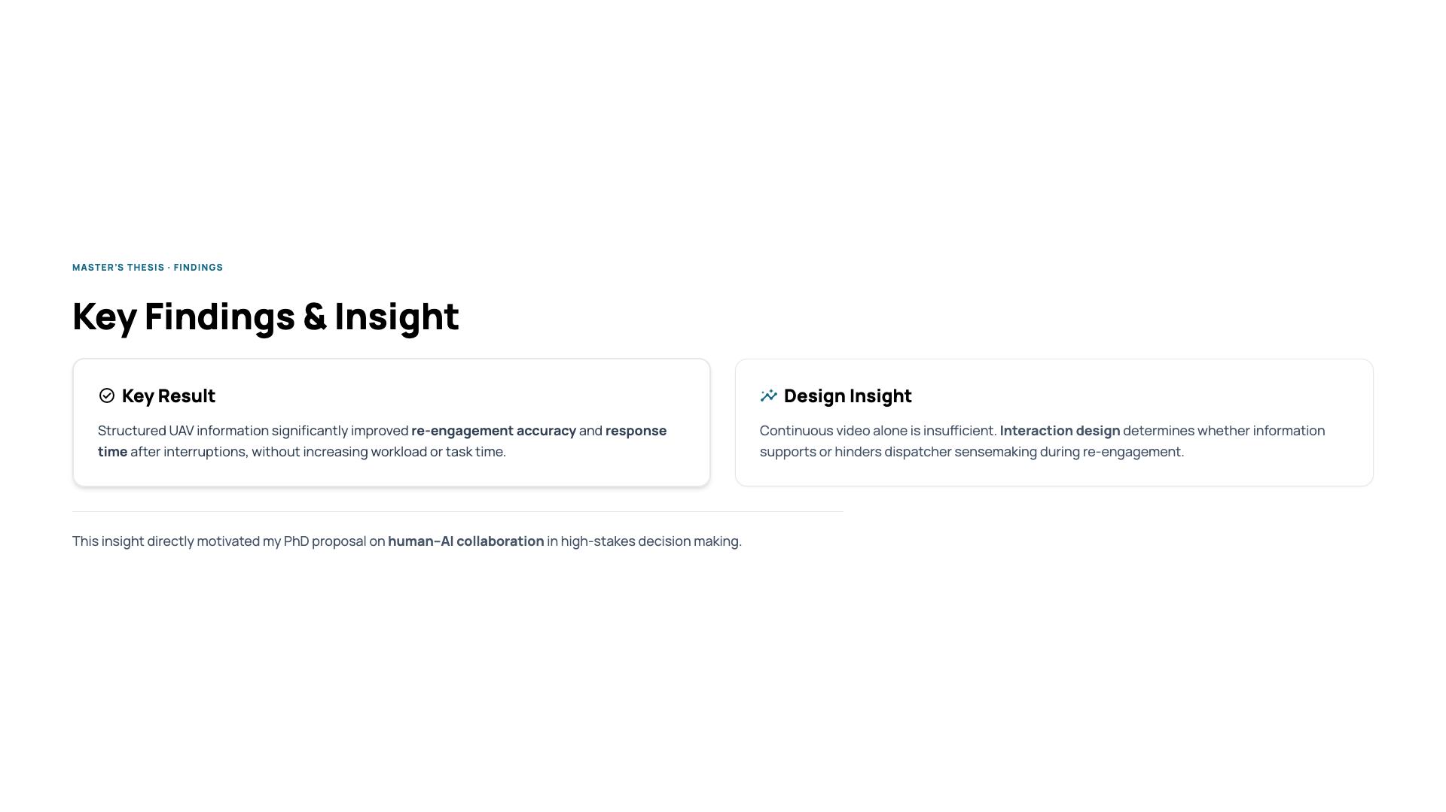
Notes:
“Structured UAV information significantly improved re-engagement accuracy and response time after interruptions.”
“Importantly, these improvements did not come at the cost of increased workload or task time.”
“One key insight is that continuous video alone is insufficient.”
“Interaction design determines whether information supports or hinders sensemaking during re-engagement.”
“This insight directly motivated my interest in human-AI collaboration.”
“This work showed that interaction design shapes how people recover understanding after interruptions.”
“My PhD proposal builds on this by studying how humans and AI can co-construct understanding in high-stakes decision making.”

Slide 8
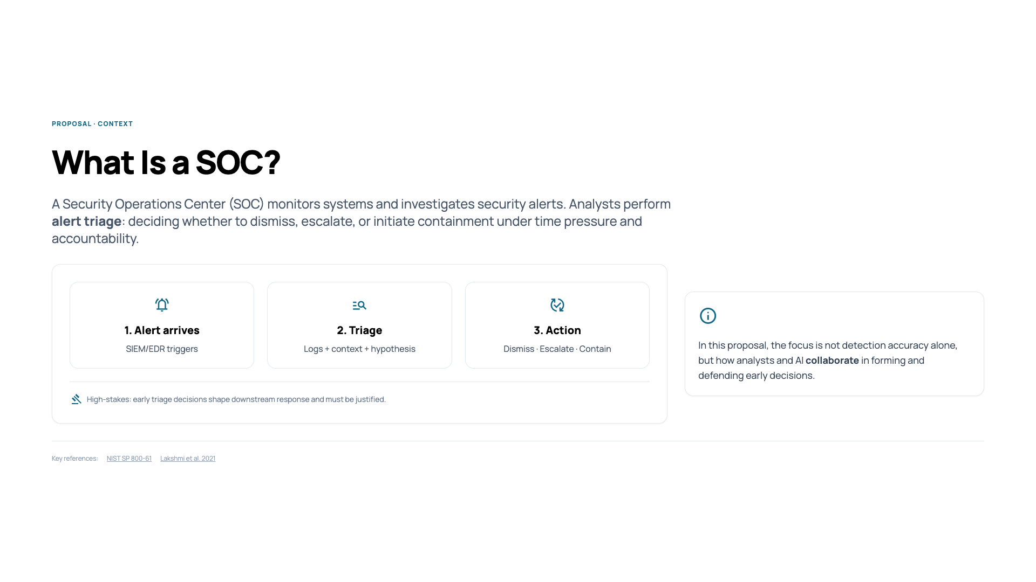
Notes:
“A Security Operations Center, or SOC, is responsible for monitoring systems and responding to security alerts. Analysts perform alert triage: deciding whether an alert should be dismissed, escalated, or trigger containment.”
“This happens under time pressure, with incomplete information, and analysts remain accountable for early decisions.”
“In this proposal, I focus specifically on this early triage phase, where interpretation and responsibility are critical.”

Slide 9
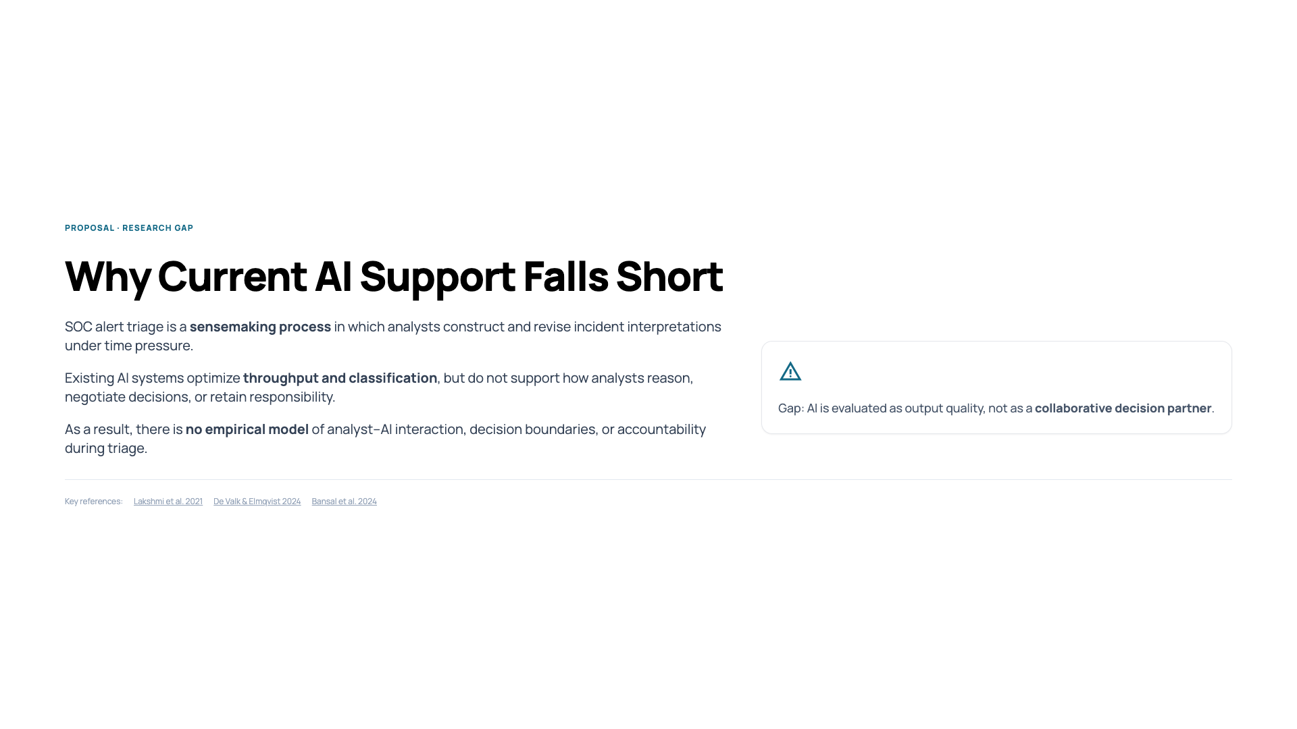
Notes:
“A Security Operations Center, or SOC, is responsible for monitoring systems and responding to security alerts. Analysts perform alert triage: deciding whether an alert should be dismissed, escalated, or trigger containment.”
“This happens under time pressure, with incomplete information, and analysts remain accountable for early decisions.”
“In this proposal, I focus specifically on this early triage phase, where interpretation and responsibility are critical.”

Slide 10
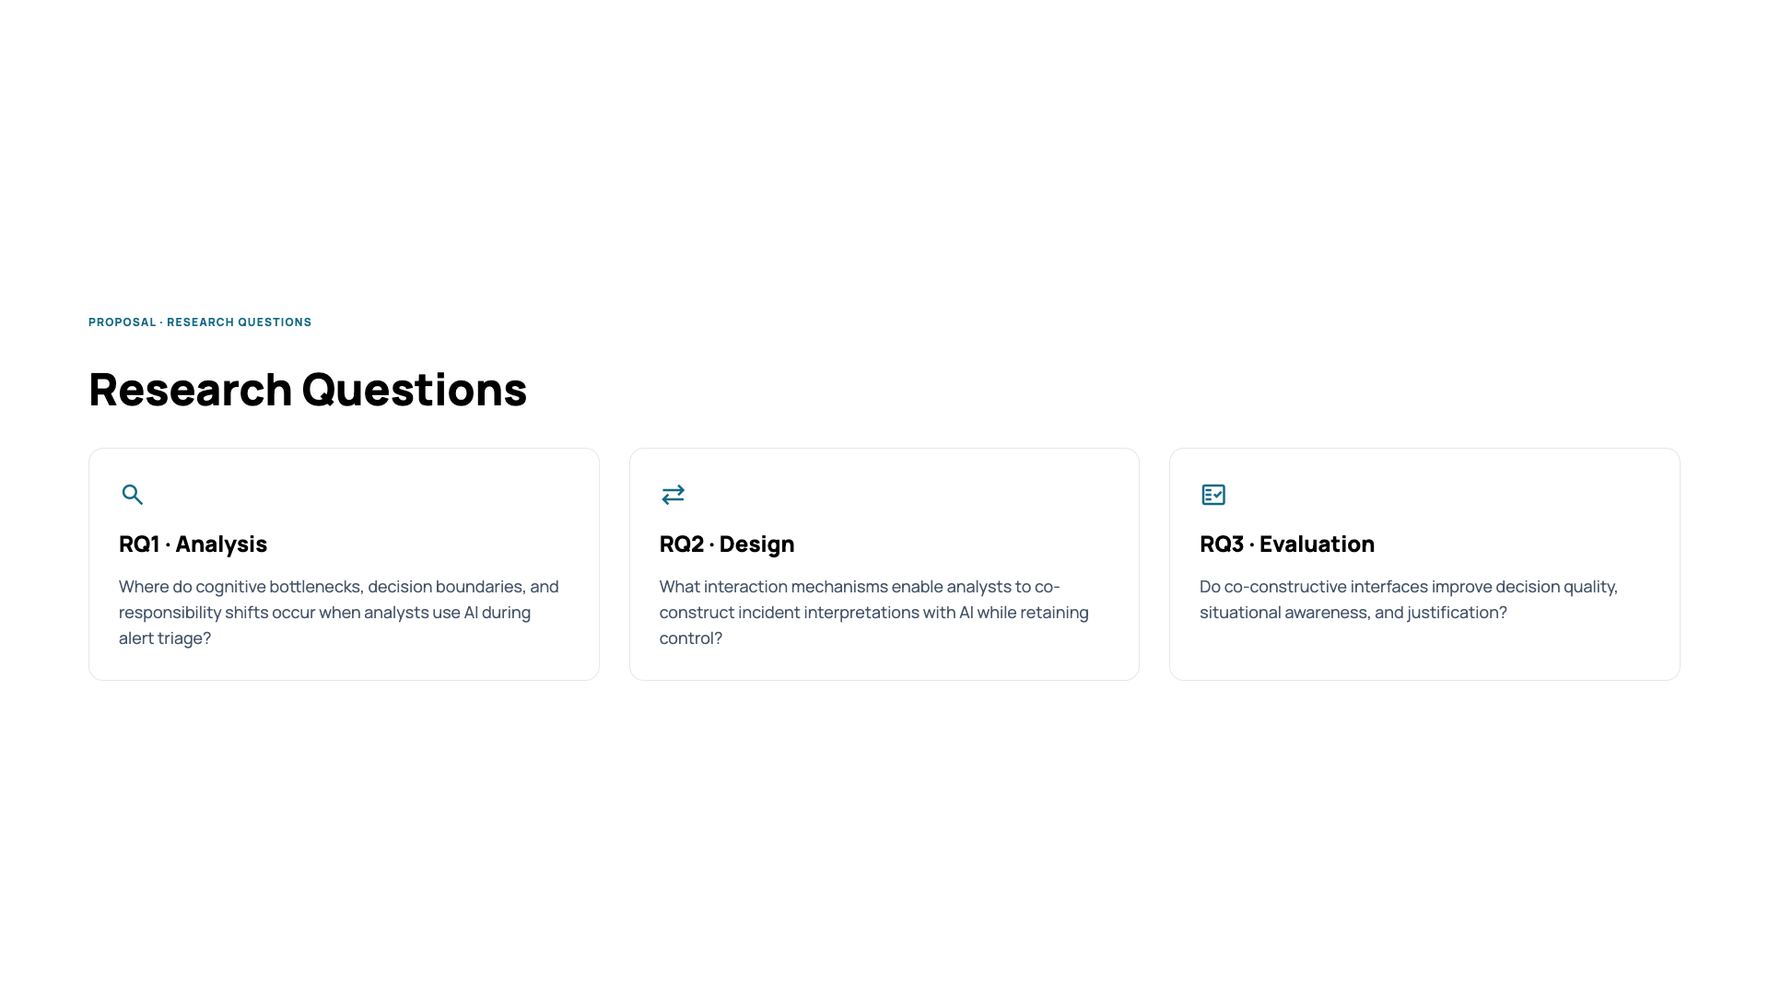
Notes:
“The research questions follow directly from this gap.”
RQ1
“First, I ask where cognitive bottlenecks, decision boundaries, and responsibility shifts occur when analysts use AI during triage.”
RQ2
“Second, I investigate what interaction mechanisms allow analysts to co-construct incident interpretations with AI while retaining control.”
RQ3
“Third, I evaluate whether such co-constructive interfaces actually change decision quality, situational awareness, and justification.”
Meta framing (important):
“RQ1 is descriptive, RQ2 is constructive, and RQ3 is evaluative.”

Slide 11
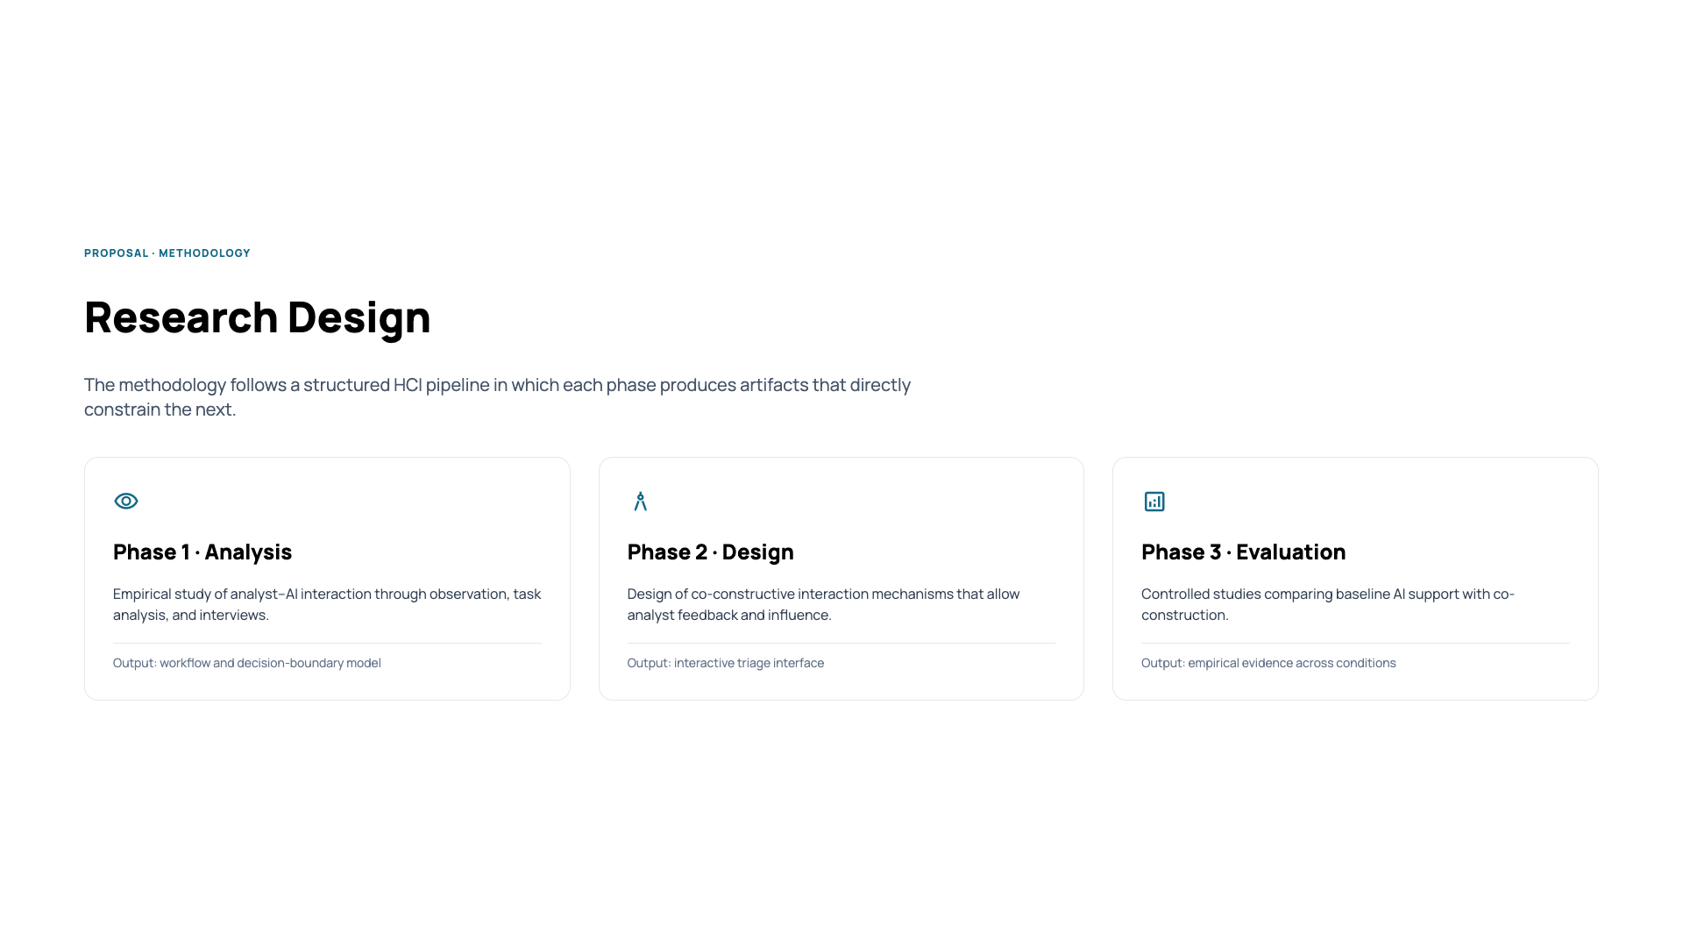
Notes:
“The methodology follows a structured HCI pipeline with three phases.”
Phase 1 — Analysis
“I empirically study how analysts interact with AI-supported triage tools using observation, task analysis, and interviews.”
“The output is a workflow and decision-boundary model that captures breakdowns and responsibility shifts.”
Phase 2 — Design
“These findings directly inform the design of co-constructive interaction mechanisms.”
“The result is an interactive triage interface that allows analyst feedback and influence.”
Phase 3 — Evaluation
“Finally, I evaluate this interface in controlled studies against baseline AI support.”
Key sentence (very important):
“Each phase produces artifacts that directly constrain the next phase.”

Slide 12
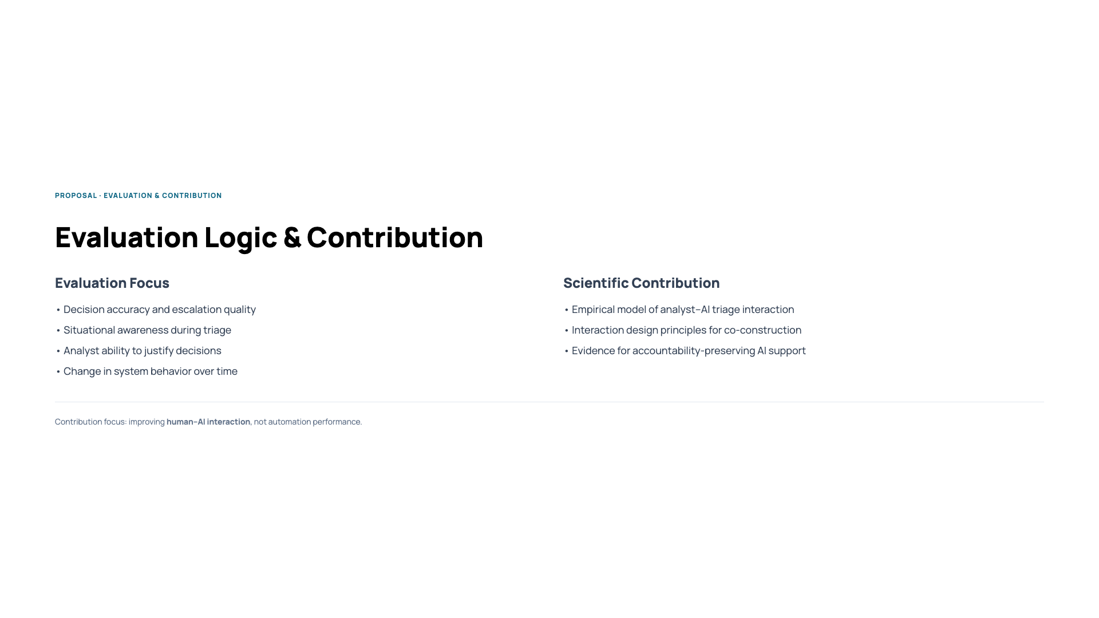
Notes:
“Evaluation focuses on both task outcomes and human factors.”
“I examine decision accuracy, situational awareness during triage, the ability to justify decisions, and changes in system behavior over time.”
“The scientific contributions are threefold.”
“First, an empirical model of analyst–AI interaction during SOC triage.”
“Second, interaction design principles for co-construction in high-stakes cybersecurity contexts.”
“Third, empirical evidence for AI support that preserves accountability rather than obscuring it.”
“The contribution is not a better model, but a better interaction between humans and AI in high-stakes decisions.”

Slide 13
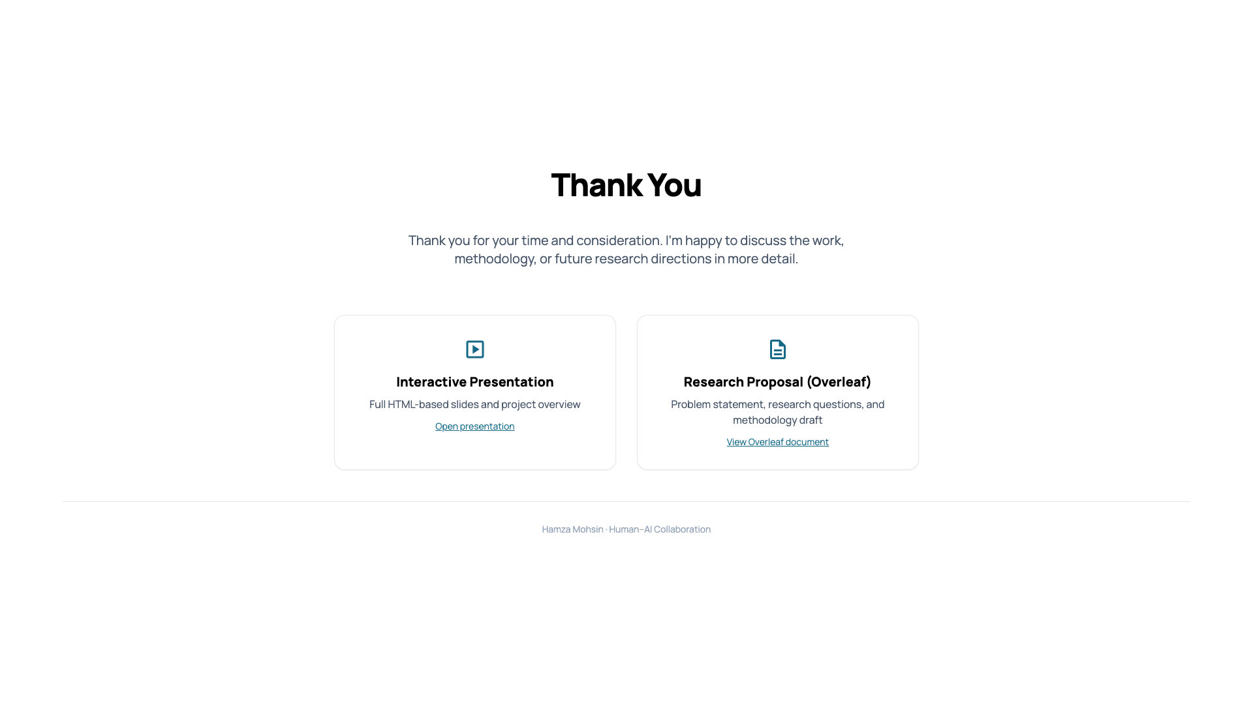
Notes:
SOC PhD Proposal – Slide 12 Clickable reference links preserved.

