Slide 1
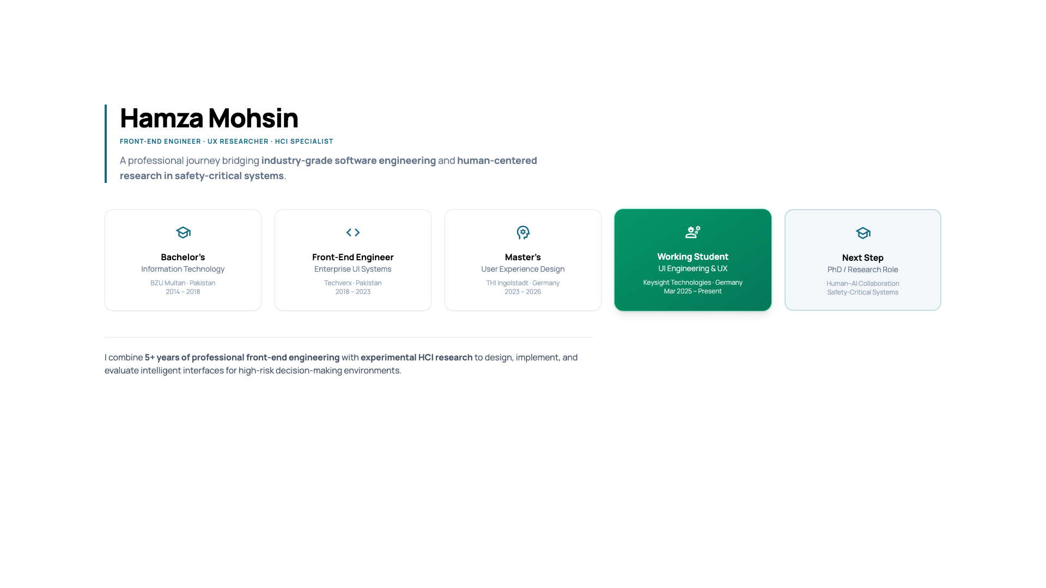
Notes:
Introduce yourself, background, and structure of the presentation.

Slide 2
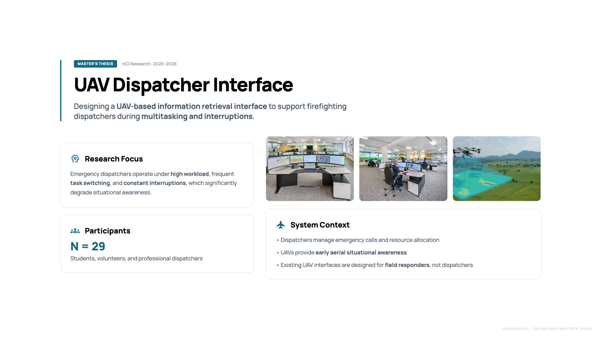
CONFIDENTIAL · UNPUBLISHED MASTER’S THESIS
Notes:
UAV dispatcher interface overview. Emphasize multitasking, interruptions, and research motivation.
⚠️ This slide contains confidential, unpublished thesis work.

Slide 3
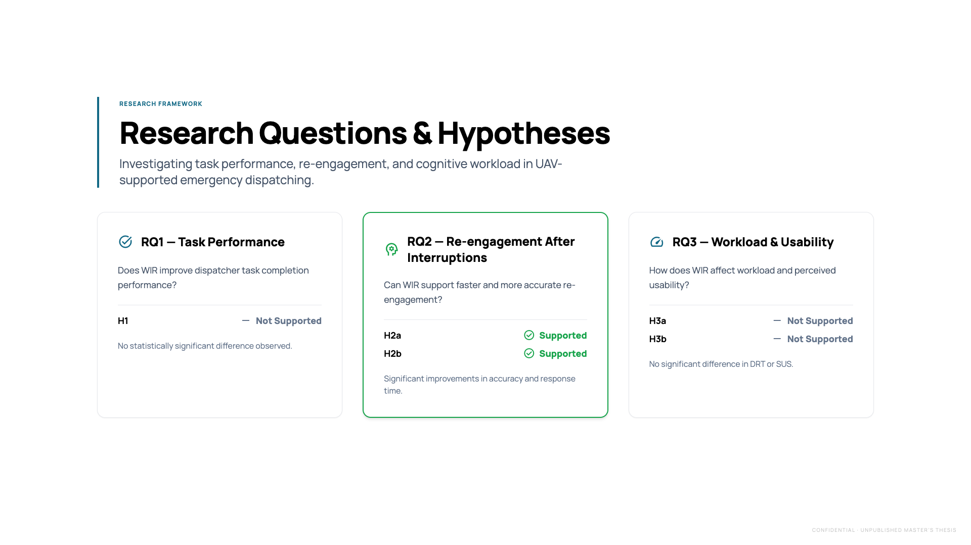
CONFIDENTIAL · UNPUBLISHED MASTER’S THESIS
Notes:
Explain research questions and hypotheses related to situational awareness and re-engagement.
⚠️ This slide contains confidential, unpublished thesis work.

Slide 4
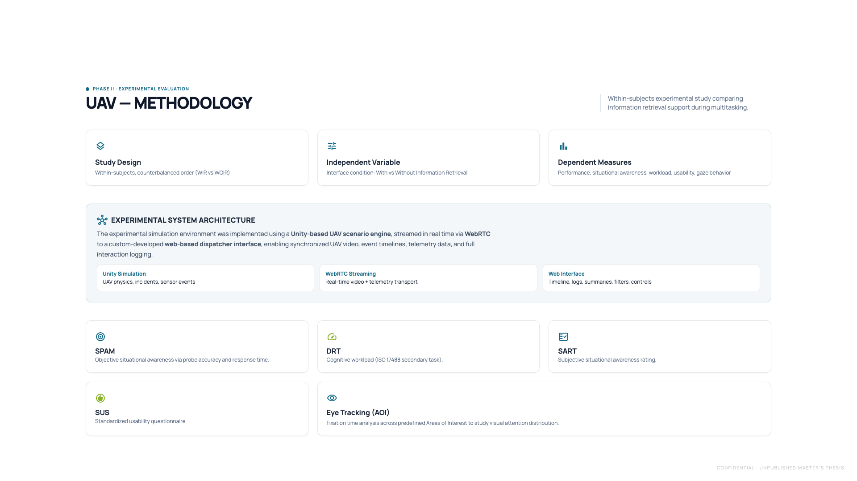
CONFIDENTIAL · UNPUBLISHED MASTER’S THESIS
Notes:
Describe experimental design, participants, measures, and within-subjects setup.
⚠️ This slide contains confidential, unpublished thesis work.

Slide 5
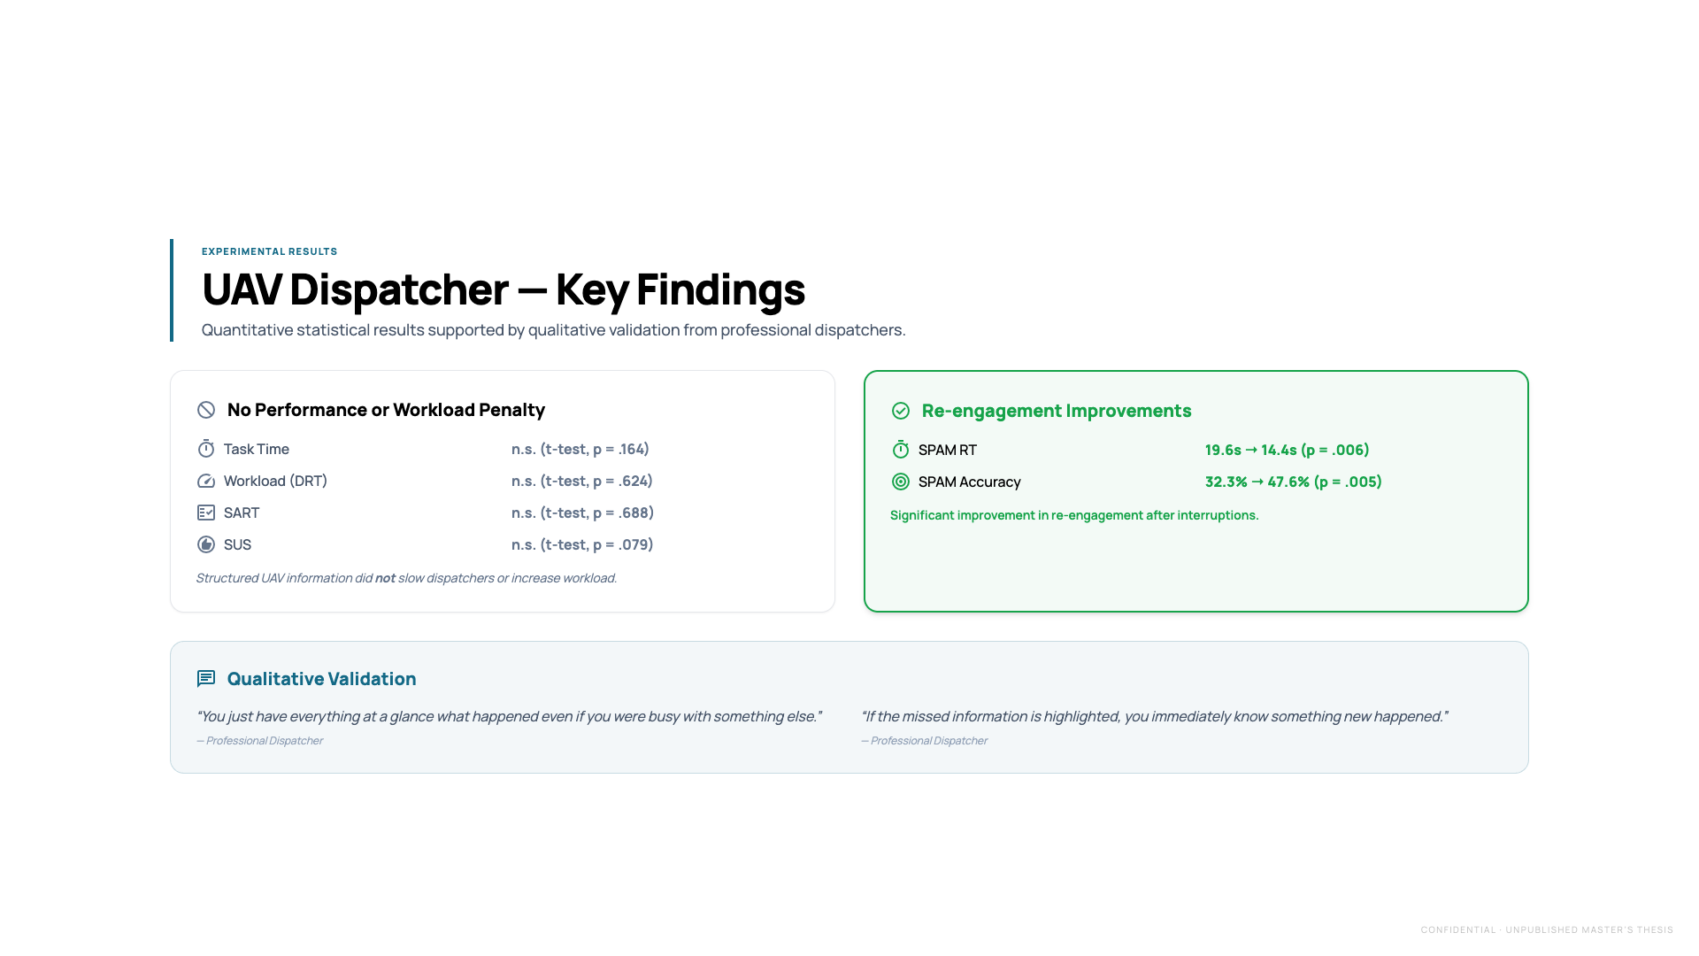
CONFIDENTIAL · UNPUBLISHED MASTER’S THESIS
Notes:
Walk through quantitative results and which hypotheses were supported.
⚠️ This slide contains confidential, unpublished thesis work.

Slide 6
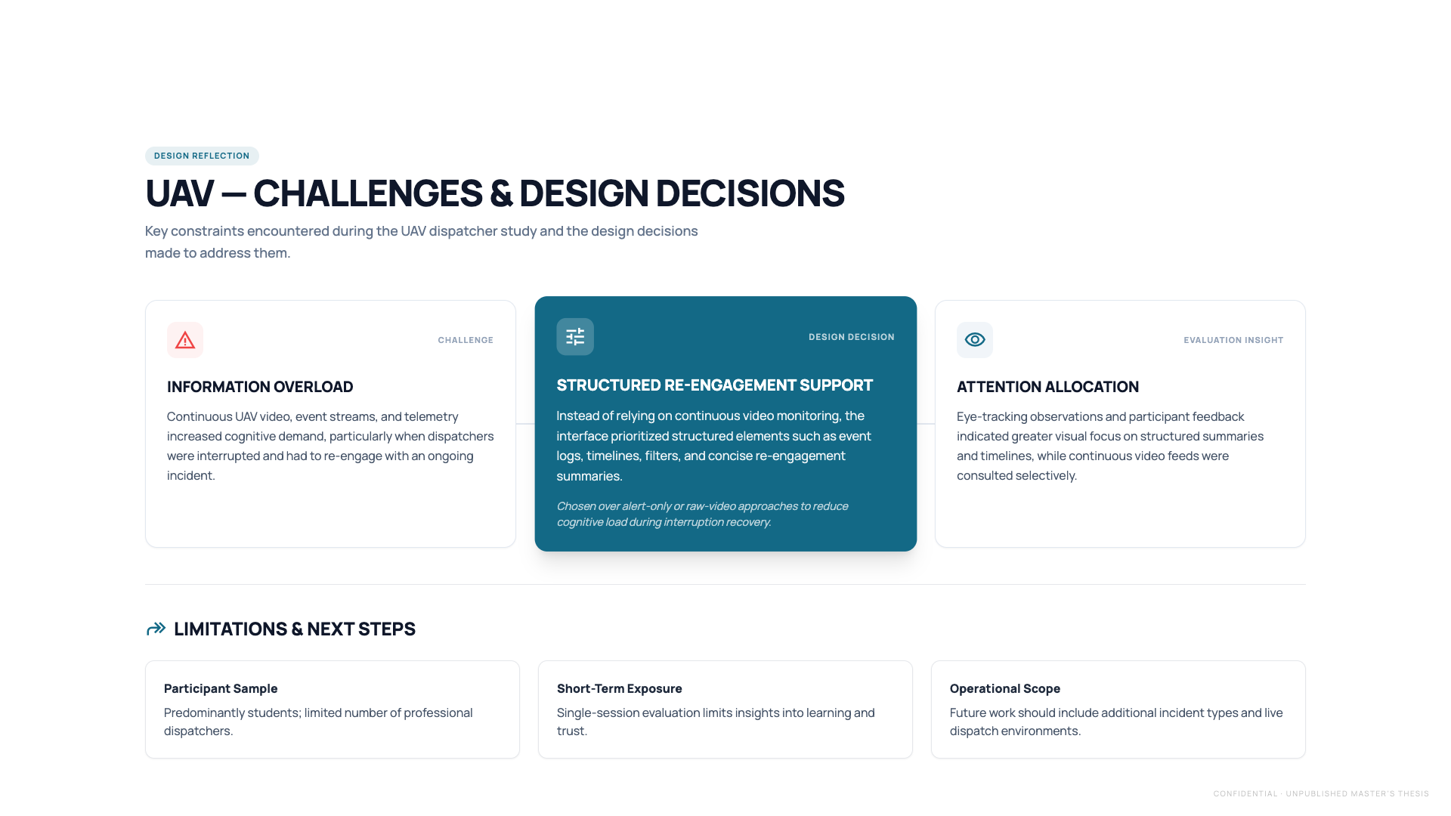
CONFIDENTIAL · UNPUBLISHED MASTER’S THESIS
Notes:
Discuss design challenges, trade-offs, and system limitations.
⚠️ This slide contains confidential, unpublished thesis work.

Slide 7
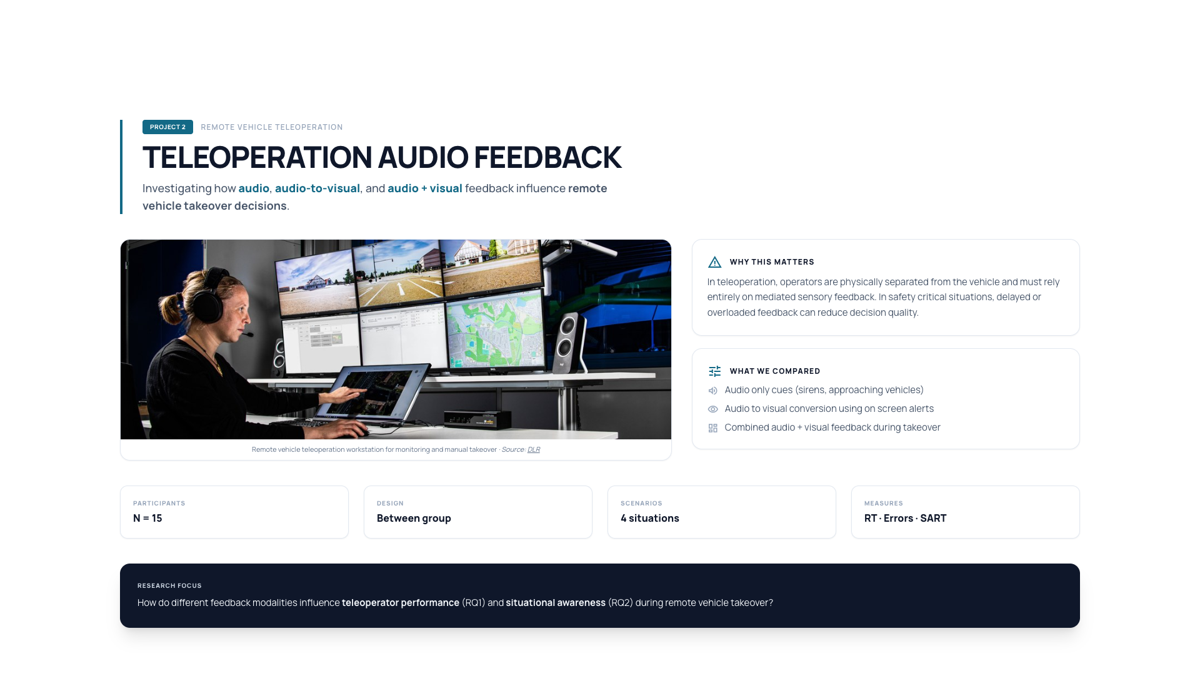
Notes:
Introduce teleoperation study and emergency takeover context.

Slide 8
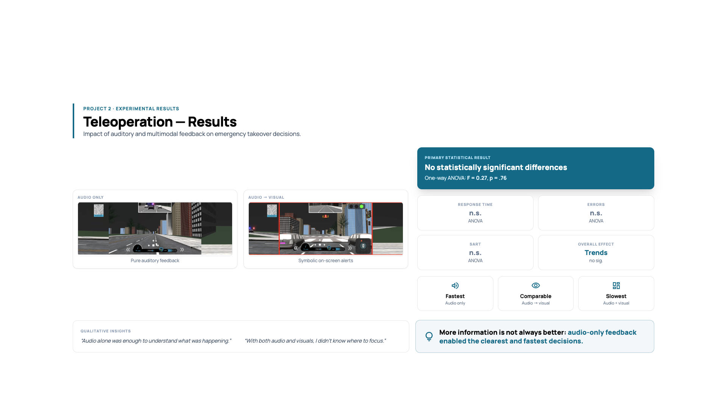
Notes:
Explain response time trends, ANOVA results, and qualitative feedback.

Slide 9
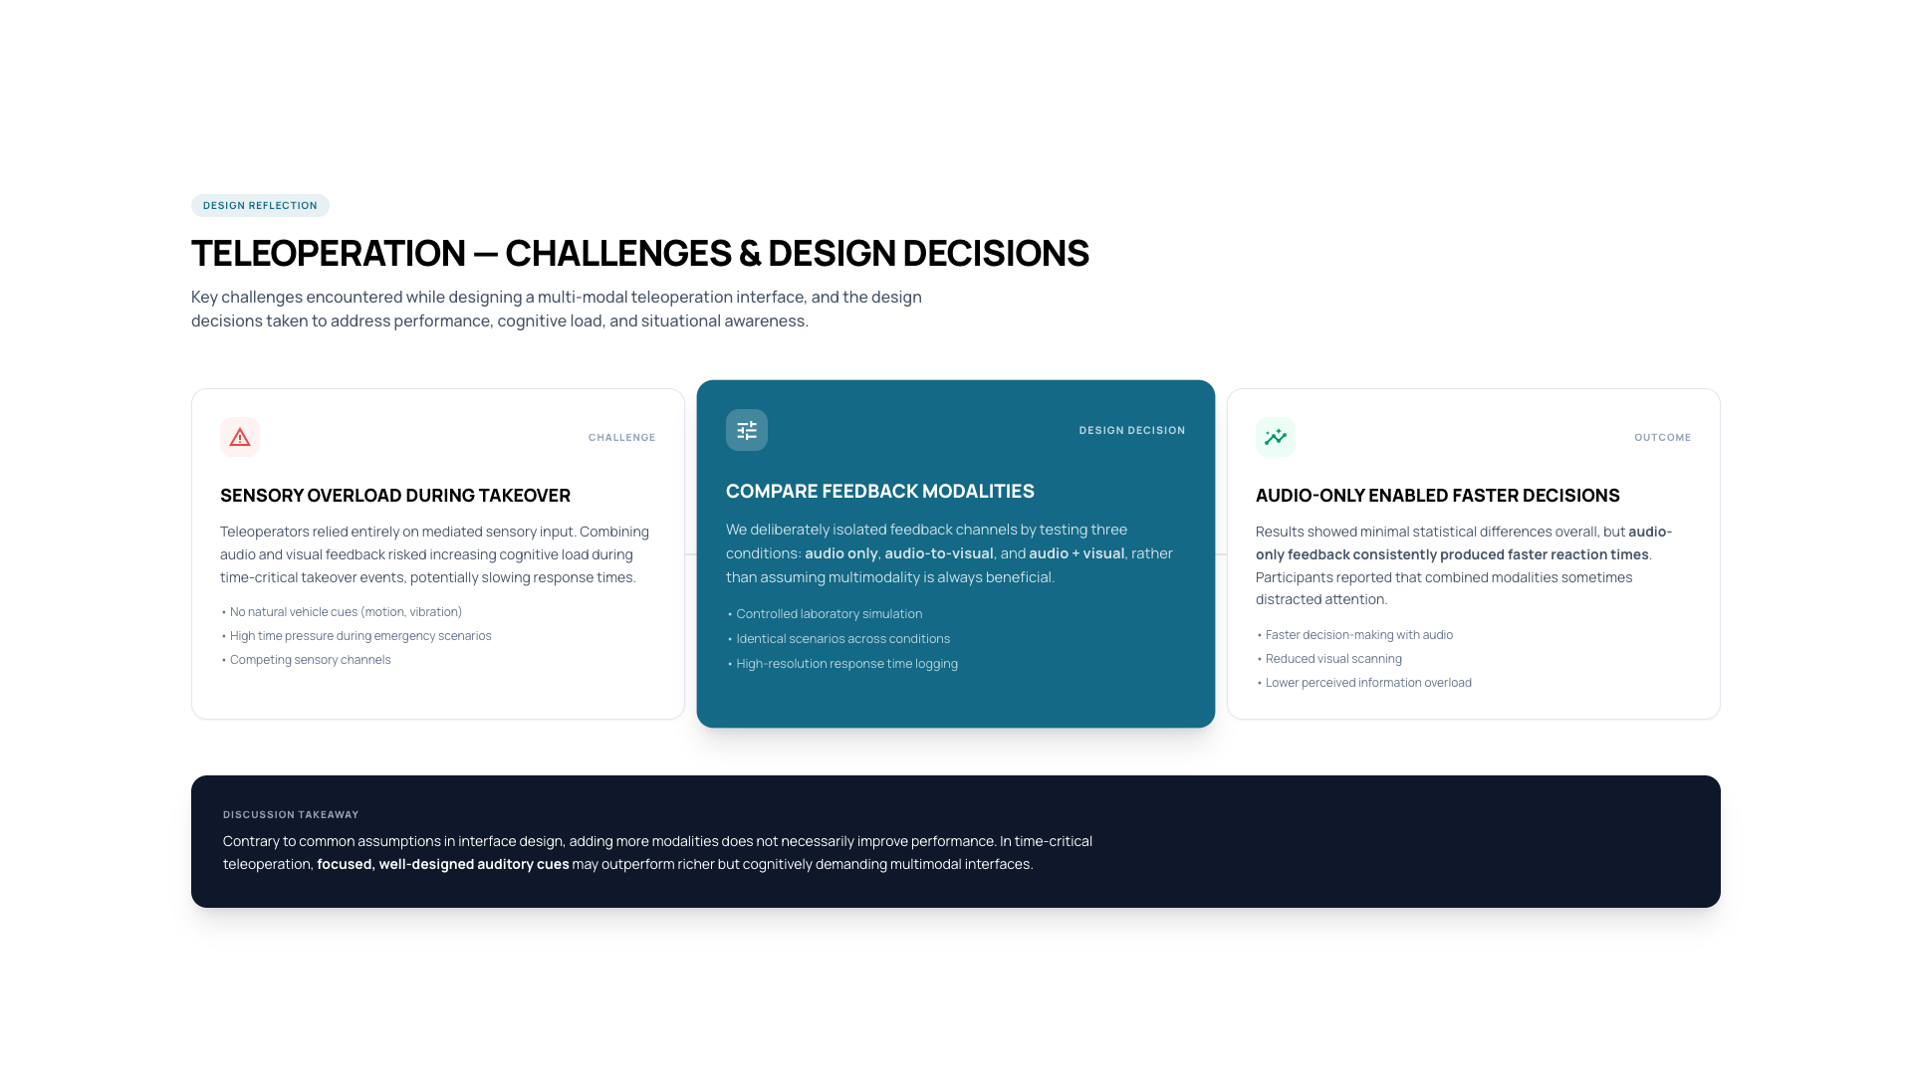
Notes:
Reflect on multimodal overload and design decisions.

Slide 10
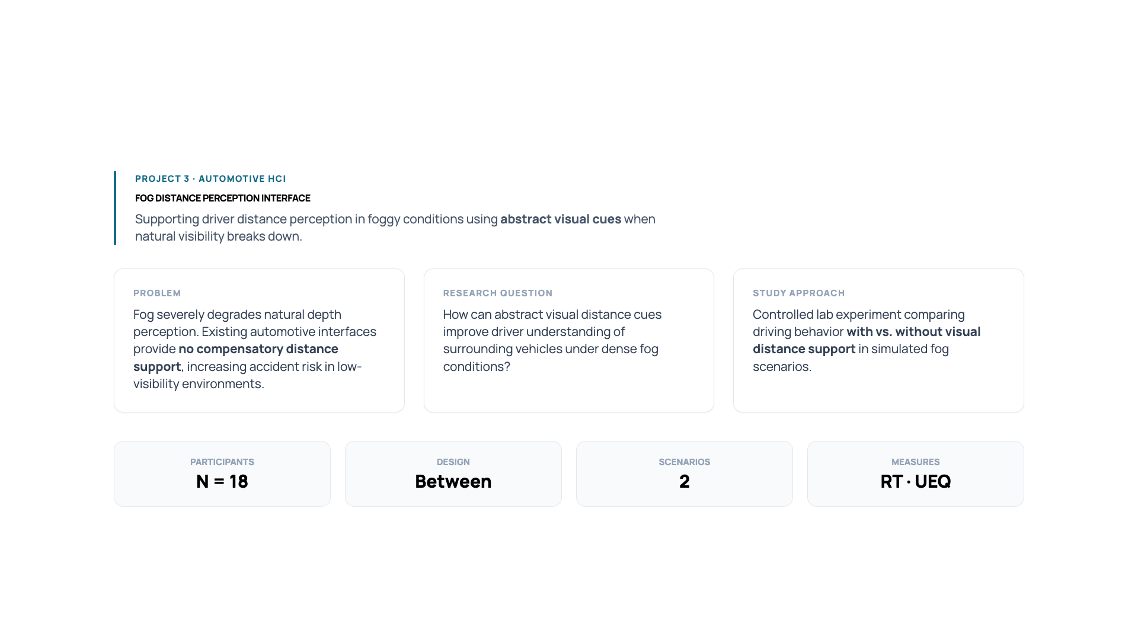
Notes:
Present fog interface motivation and distance perception problem.

Slide 11
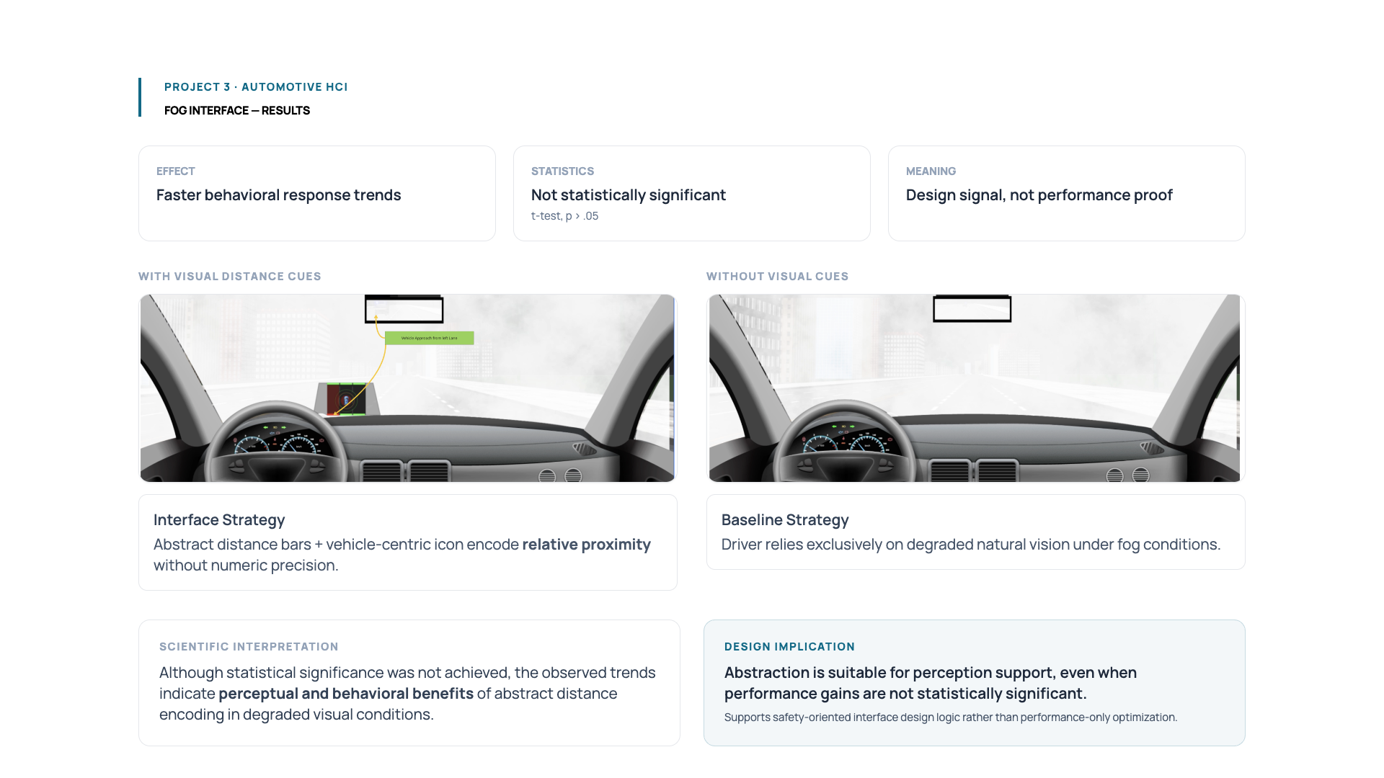
Notes:
Explain t-test results, trends, and why non-significance still matters.

Slide 12
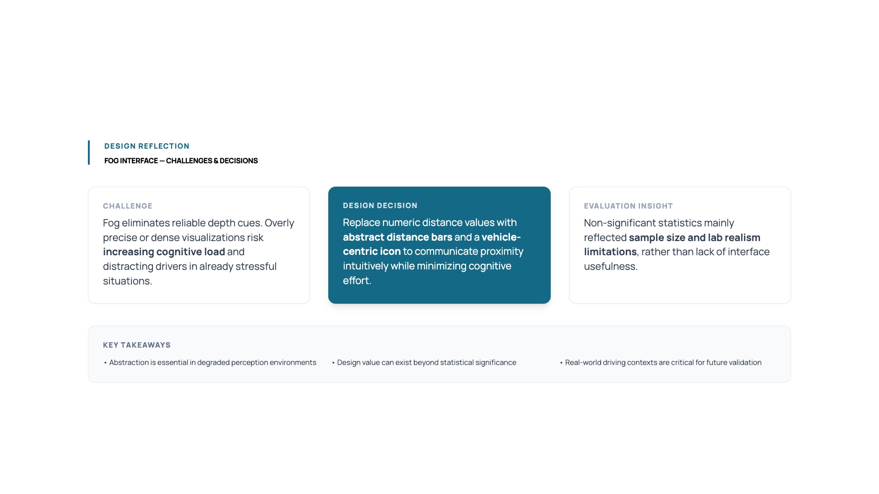
Notes:
Discuss abstraction vs precision and future improvements.

Slide 13
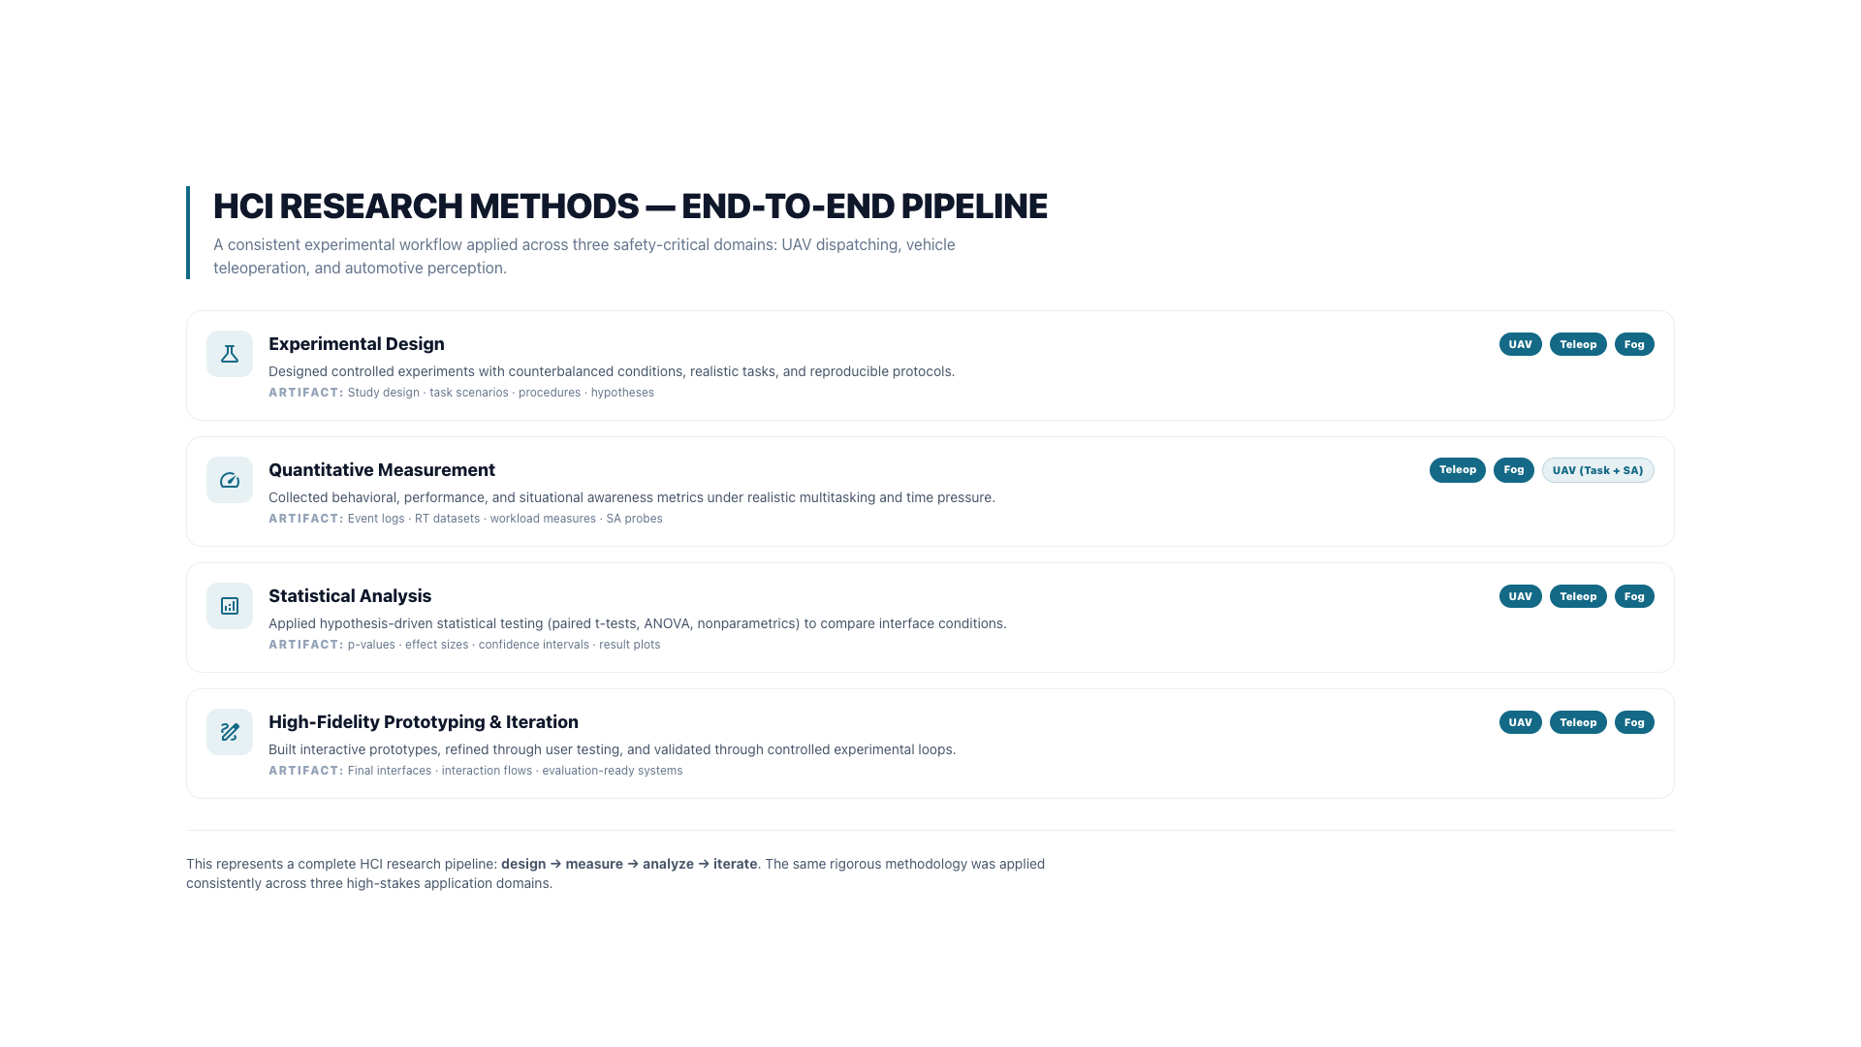
Notes:
Summarize methods across projects and position your research profile.

