Slide 1

Multimodals
Members-
Tariq Mohammad
Hamza Nadeem

Slide 2
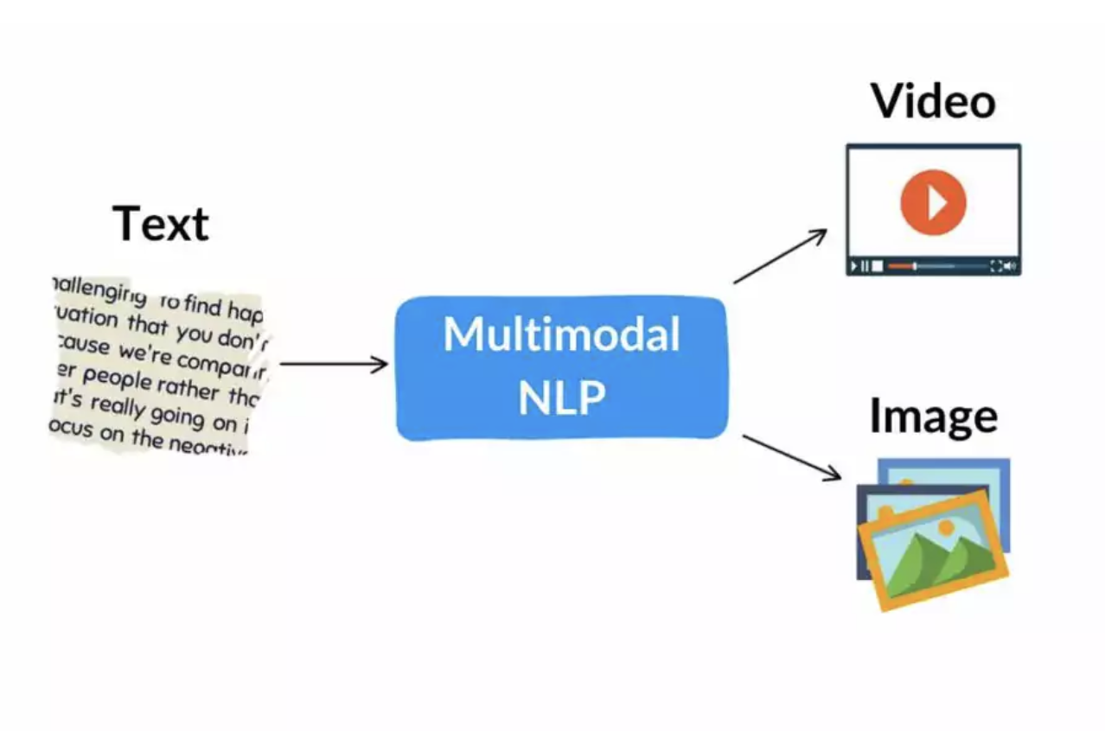
What is Multimodals ?
Multimodal NLP involves the combination of different types of information, such as text, speech, images, and videos, to enhance natural language processing tasks. This allows machines to better comprehend human communication by taking into account additional contextual information beyond just text. For instance, multimodal NLP can be used to enhance machine translation by integrating visual data from images or videos to provide better translations. It can also be used to improve sentiment analysis by incorporating non-textual data such as facial expressions or tone of voice. Multimodal NLP is a growing field of study and is expected to become increasingly significant as more data becomes available across multiple modalities.

Slide 3
The Evolution of NLP
Early Days of NLP
NLP initially focused on processing and understanding textual data. Its roots can be traced back to rule-based systems in the 1950s and 1960s, where researchers attempted to encode grammatical rules to analyse and generate language manually.
Text-Centric Advancements
Advancements in the late 20th century, mainly statistical and machine learning approaches, revolutionised NLP. Techniques like Hidden Markov Models (HMMs) and statistical methods such as n-grams and probabilistic context-free grammars (PCFGs) enabled machines to analyse and generate more nuanced text.
Emergence of Multimodal NLP
However, true breakthroughs in NLP emerged by integrating multiple data modalities. The availability of diverse data types, such as images, audio, and videos, catalysed this shift from unimodal to multimodal NLP. Researchers realised that combining these modalities could significantly enhance language understanding and context.
Milestones in Multimodal NLP
The turn of the 21st century witnessed key milestones in multimodal NLP. Research efforts delved into understanding and processing visual information alongside text. Projects like visible question answering (VQA) and automatic image captioning exemplified the fusion of textual and visual data, marking a pivotal shift in NLP’s trajectory.
The Modern Era
Today, multimodal NLP has evolved into a vibrant field where researchers explore sophisticated models capable of simultaneously understanding, generating, and processing multiple modalities. State-of-the-art models leverage neural architectures like Transformers, which have shown remarkable prowess in handling diverse data types.

Slide 4
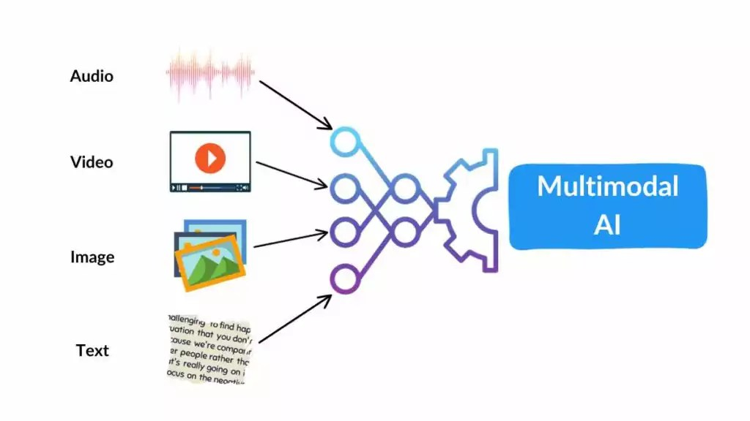
The Significance of Multimodal NLP
The importance of multimodal NLP lies in its ability to bridge the gap between language and other forms of information. By understanding images, videos, and audio alongside textual data, machines can achieve a more holistic comprehension of the world, mirroring human-like understanding.
This evolution from text-centric NLP to multimodal approaches signifies a paradigm shift in how machines perceive and interpret information, setting the stage for more contextually aware and comprehensive AI systems.

Slide 5
Applications of Multimodal NLP
The fusion of text, images, audio, video, and other modalities has opened the door to a wide array of applications in multimodal NLP, transforming how machines understand and interact with diverse forms of information.
Visual Question Answering (VQA)
VQA systems enable machines to answer questions related to images or videos using both textual and visual information. These systems analyse and comprehend the content of an image or video to respond accurately to posed questions, ranging from simple queries about objects to complex contextual understanding.
Automatic Image and Video Captioning
Multimodal NLP powers systems capable of generating descriptive captions for images and videos. These systems provide rich and informative captions by analysing the visual content and combining it with textual descriptions, aiding accessibility and content understanding.
Sentiment Analysis in Multimedia
Understanding sentiments expressed across different modalities—text, audio, or images—enables machines to gauge emotions comprehensively. This facilitates sentiment analysis in multimedia content, allowing businesses to more accurately understand user reactions and sentiments in reviews or social media content.
Multimodal Translation and Transcription
Multimodal NLP enhances translation and transcription services by considering multiple modalities. For instance, in video translation, combining audio, visual context, and subtitles aids in more accurate and context-aware translations.

Slide 6
Enhanced Content Recommendation Systems
By leveraging multimodal understanding, recommendation systems can suggest content—articles, videos, or products—based not only on text but also images, user behaviour, and preferences. This fosters more personalised and accurate recommendations.
Multimodal Assistive Technologies
Incorporating multiple modalities improves assistive technologies for individuals with disabilities. For example, text-to-speech systems coupled with visual recognition assist the visually impaired by providing auditory descriptions of visual content.
Context-aware conversational AI
Multimodal NLP enhances chatbots and conversational AI by enabling systems to understand and respond to text, images, or audio inputs. This fosters more contextually relevant and engaging conversations, simulating human-like interactions.
Healthcare Applications
In healthcare, multimodal NLP aids in analysing medical records, images, and patient data together, facilitating better diagnostics, treatment plans, and patient care through a comprehensive analysis of diverse information sources.

Slide 7
What Specific Techniques and Architectures are Used in Modern Multimodal NLP?
Modern multimodal NLP employs various techniques and architectures to effectively process and analyse information from multiple modalities, such as text, images, audio, and video.
Feature Extraction:
Word Embeddings: Representing words as numerical vectors captures their semantic meaning and allows for meaningful comparisons. Common embeddings include Word2Vec, GloVe, and ELMo.
Image Representations: Extracting features from images using CNNs captures the spatial and structural information. Various CNN architectures like VGGNet, ResNet, and InceptionNet are widely used.
Audio Feature Extraction: Extracting features from audio using techniques like MFCCs, Mel-spectrograms, and pitch detection enables analysis of auditory signals.
Video Representations: Extracting features from videos using 3D CNNs captures the temporal and spatial information. Techniques like optical flow, scene segmentation, and action recognition are employed.
Fusion Techniques:
Early Fusion: Concatenating or averaging features from different modalities at the input layer allows for direct interaction and shared processing.
Late Fusion: Passing features through separate unimodal models and combining their outputs at a later stage preserves the modality-specific information.
Attention Mechanisms: Dynamically weighting and combining features based on relevance allows for selective attention and efficient information processing.

Slide 8
Deep Learning Architectures:
CNN-RNN: Combining CNNs for image processing with recurrent neural networks (RNNs) for sequential data processing enables the modelling of long-range dependencies.
Transformer: A self-attention mechanism-based architecture that allows for parallel processing and captures long-range dependencies without explicit recurrent connections.
Bidirectional Models: Incorporating both forward and backward information flow enables better modelling of contextual relationships, especially for language understanding tasks.
Multimodal Representations:
Joint Embeddings: Learning a shared embedding space for different modalities allows for simultaneous representation and interaction.
Conditional Generative Models: Generating new data from one modality based on information from another modality enables creative applications like image captioning and text-to-image synthesis.
Semantic Alignment: Identifying correspondences between entities and their representations across modalities improves multimodal understanding.
Transfer Learning:
Fine-tuning: Adapting pre-trained models from large language models or image recognition tasks to specific multimodal tasks.
Multimodal Knowledge Distillation: Transferring knowledge from complex multimodal models to simpler ones for efficient inference and deployment.

Slide 9
Various Techniques and Models in Multimodal NLP
Neural Architectures
Transformers: Transformer-based architectures like BERT, GPT (Generative Pre-trained Transformer), and their variants have shown efficacy in handling multimodal data. Initially designed for text, these models have been adapted and extended to incorporate other modalities.
Fusion Techniques
Early Fusion: Combining modalities at the input level, where different modalities are concatenated or processed jointly from the start.
Late Fusion: Merging outputs from separate unimodal models, allowing individual models to specialise in specific modalities before combining their results.
Attention Mechanisms: Techniques that assign different weights or attention to other modalities, enabling models to focus on relevant information.
Cross-Modal Alignment
Embedding Alignment: Aligning embeddings of different modalities into a shared space, enabling direct comparison and fusion.
Cross-Modal Retrieval: Matching information across modalities to retrieve related data, like finding text related to a given image or vice versa.

Slide 10
Pre-trained Models and Transfer Learning:
Multimodal Pre-training: Training models on large-scale datasets incorporating multiple modalities to learn general representations before fine-tuning specific tasks.
Transfer Learning: Leveraging pre-trained models on tasks or modalities different from the original training data, benefiting from learned representations.
Hybrid Architectures and Specialised Models
Hybrid Models: Models that combine different architectures or components to handle multiple modalities effectively.
Specialised Models: Task-specific models tailored to particular applications, optimising performance for specific multimodal tasks like VQA or image captioning.
Ethical Considerations and Bias Mitigation:
Fairness and Bias: Addressing biases in multimodal datasets and models to ensure fairness and mitigate potential ethical concerns in AI systems.
Privacy Preservation: Developing techniques to handle sensitive information across different modalities while preserving user privacy.

Slide 11
Challenges in Multimodal NLP:
Heterogeneity and Complexity: Managing diverse modalities with varying data structures, resolutions, and temporal aspects poses challenges in creating unified representations.
Alignment and Fusion: Achieving effective fusion and alignment of information from different modalities while preserving context and relevance remains complex.
Scalability: Processing large-scale multimodal datasets efficiently requires scalable architectures and algorithms capable of handling vast amounts of diverse data.
Contextual Understanding: Developing models that can comprehend nuanced contextual information across modalities, particularly in ambiguous or abstract scenarios, presents a persistent challenge.
Ethical and Fairness Concerns: Ensuring fairness, transparency, and mitigating biases in multimodal data and models to avoid perpetuating societal biases or misinformation.

Slide 12
References
http://nlpprogress.com/english/multimodal.html
https://aclanthology.org/2022.lrec-1.738.pdf
https://codeit24.blogspot.com/2023/03/the-importance-and-challenges-of.html
https://spotintelligence.com/2023/12/19/multimodal-nlp-ai/#Techniques_and_Models_in_Multimodal_NLP

