Slide 1
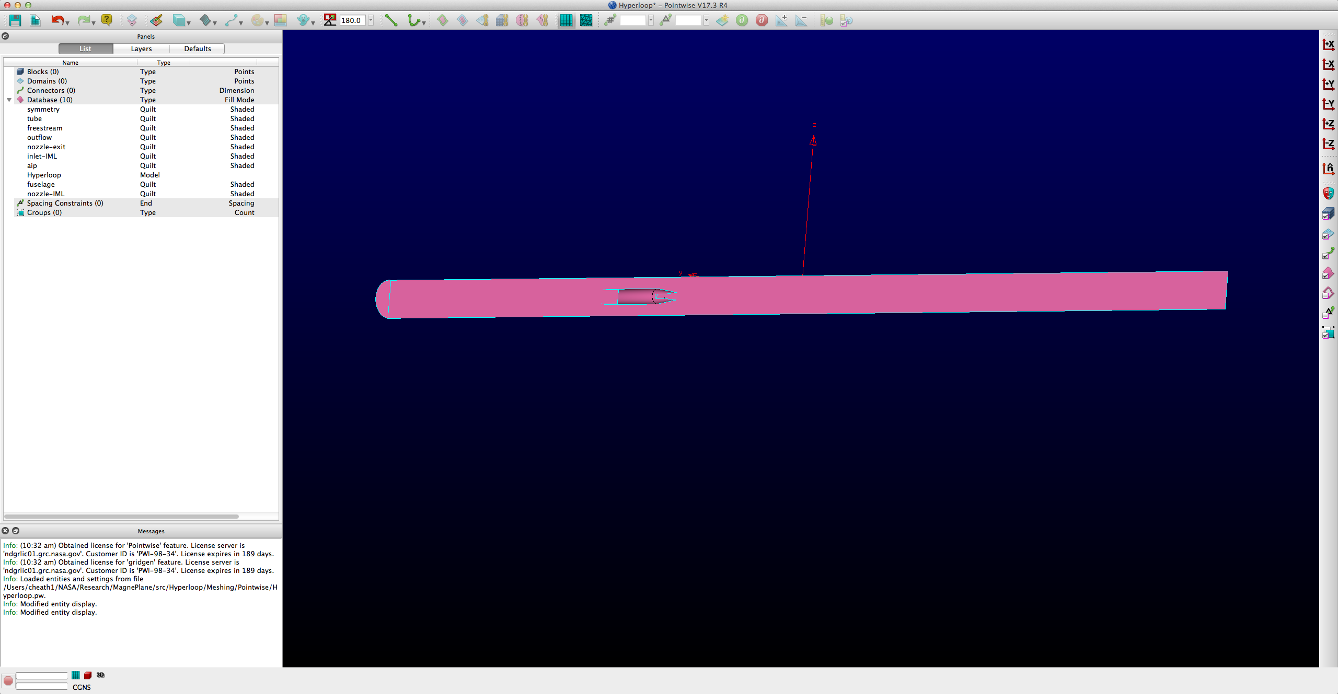

Instructions for viscous volume meshing via Pointwise/AFLR3
Import .IGES geometry into Pointwise from ~/src/Hyperloop/Geometry/GeometryTool directory, where GeometryTool may be either SolidWorks or Engineering Sketch Pad.
Select File->Import->Database, Select “Build Models from Free Surfaces” option and set “Model Assemble Tolerance” to ~1E-4. This attempts to combine all the b-spline surface patches from the .IGES geometry file into a solid, closed, watertight solid. Gaps or poor quality geometry are the leading cause of meshing problems.
2. It’s generally good practice to ensure the imported geometry is closed (no gaps) to a reasonable tolerance. Check for non-manifold edges. Select database mask from the mask selector, Drag-select all of the model databases, then from View menu, select "Attributes" -> "Color Mode" -> "By Topology". All edges should be light blue, none red. If red, try re-importing the geometry file and increasing the assemble tolerance slightly. If there are still issues, you may have poor geometry and need to fix your CAD model.
Database entity
mask

Slide 2
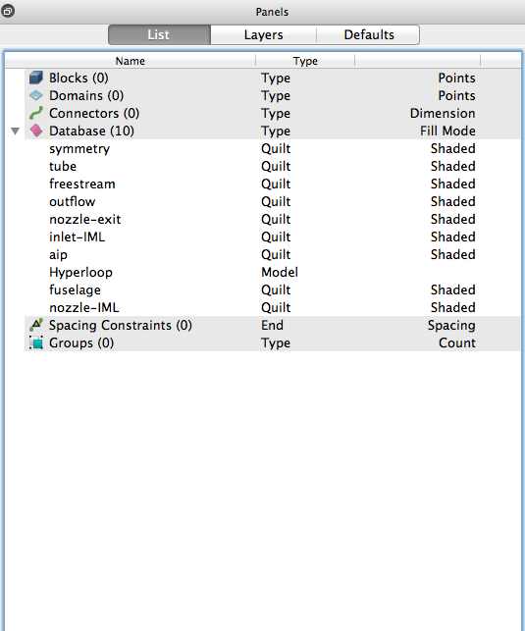
Updated instructions for viscous volume meshing via Pointwise/AFLR3
3. Next we need to simplify the geometric topology, and tag the different geometry patches so that our meshing script can properly identify mesh patches by name ID and apply the correct point distributions. You can cycle through database patches by hovering over them and using the space bar, or directly form the List Panel shown below. Use the left mouse click to select a highlighted patch. To simplify the database topology, select (Create -> Assemble -> Quilts). Rename quilt patches. Surface topology and naming should match that found in ~/src/Hyperloop/Meshing/Hyperloop.pw, included for reference.
The total number of databases has been reduced, and each patch has been given a specific name ID. Names must match exactly with the variable names in the glyph script. This can be a fairly tedious manual step, depending on the number of surfaces you need to combine.
After renaming all the patches, Use File->Save As to save the Pointwise model to Pointwise directory and call it “Hyperloop.pw”. This filename must match the file input name in the Glyph script.

Slide 3
4. In Pointwise, run the Glyph script. Should take a few minutes. Script ->Execute->”Hyperloop-Mesher.glf”. Check overall Pointwise grid output for errors. Warnings are typically OK and for diagnostic purposes. If successful, the Glyph script exports a file called Hyperloop.b8.ugrid and Hyperloop.mapbc that will be written to the AFLR3 directory. It also saves the Pointwise native grid project as filename-Grid.pw. The Hyperloop.b8.ugrid is the native binary grid format for the Fun3D aerodynamic flow solver.
5. Go to the Python directory and run the aflr3 script (i.e. "sh aflr3.script"). This deletes the Pointwise isotropic volume grid, leaving the anisotropic surface grid (Hyperloop.surf.gz), and re-creates the interior volume cells with anisotropic viscous layers. You might inspect the Hyperloop.tags file, to see which grid boundary conditions are being applied in AFLR3. This software may take a significant amount of time to run (several hours) depending on the complexity of the configuration.
The aflr3.script creates a new file in the FUN3D directory called Hyperloop.b8.ugrid. This is an updated grid file, that includes viscous layers in the boundary regions. The Fun3D directory should contain all of the files needed to run an aerodynamic simulation. These can be copied to the cluster and submitted as a job using “qsub qscript”.

