Slide 1
Fake news Detection
Syed Muhammad Ali 17867
Syed Muhammad Shiraz Jafri 17899
Syed Muhammad Hamza Raza 17887

Slide 2
Business Understanding
VOICE OVER: SYED MUHAMMAD ALI

Slide 3
Business Problem
Fake news is providing misleading or false information as ‘real’ news.
Term came to prominence due to 2016 US Presidential elections.
Primary platforms for spreading fake news are social media applications like Facebook and Twitter.
The continuous flow of fake news even in the face of emerging mechanisms to overcome it.
Thus there is always need for better mechanisms for curbing fake news and hence our motivation to work on the problem.
Several measures deployed by social media companies to curb fake news.
Facebook developed better mechanisms to report false stories and creating awareness regarding fake news.
Twitter took initiative to flag and warn users regarding fake news.
The problem which we are dealing is a classification problem.
We need to predict according to the news if news is real or fake.

Slide 4
Data Understanding
VOICE OVER: SYED MUHAMMAD SHIRAZ JAFRI

Slide 5
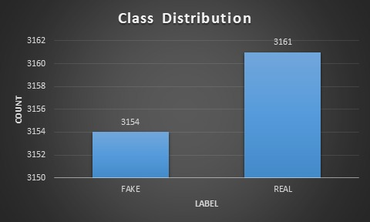
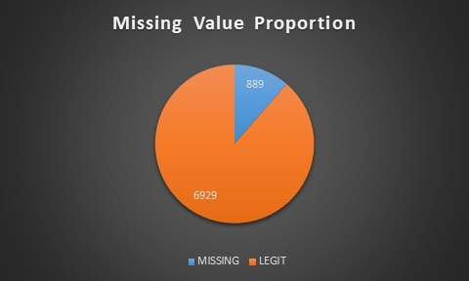
Data Description
The dataset consists of 7817 rows.
With 3 columns of title, news and news type (FAKE or REAL)

Slide 6
Data Processing
VOICE OVER: SYED MUHAMMAD SHIRAZ JAFRI

Slide 7
Data Preprocessing
Converted into lowercase.
Removed punctuations.
Removed stop words.
Removed top 10 most frequent words.
Applied Stemming.
Applied Lemmatization.
Removing all missing values.
Merge the title and news column to gain a better accuracy.
Encoded the text using count and TF-IDF vectorizers for training.

Slide 8
Modelling
VOICE OVER: SYED MUHAMMAD HAMZA RAZA

Slide 9
Modelling
We used in total 6 machine learning models to train.
Naïve Bayes.
Random Forest with number of estimators set to 300.
Xtreme Gradient Boosting with number of estimators set to 200.
Passive Aggressive Classifier number of iterations = 50.
Ada boosting Classifier number of estimators = 100.
Extra Tree Classifier number of estimators = 100.

Slide 10
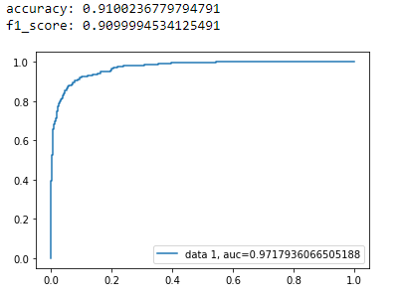
Naïve Bayes
Best accuracy was 91% with max-features of Tf-idf = 25000 and n-gram range = (1,3)

Slide 11
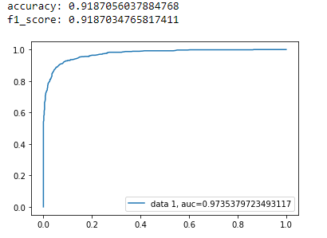
Random Forest
Best accuracy was 91.8% with max-features of Tf-idf = 25000 and n-gram range = (1,3)

Slide 12
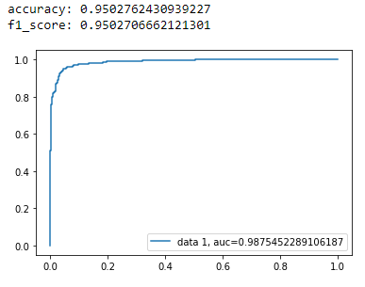
Xtreme Gradient Boosting
Best accuracy was 95% with max-features of Count Vectorizer = 25000 and n-gram range = (1,2) and merging title and text column and this was the best accuracy we got.

Slide 13
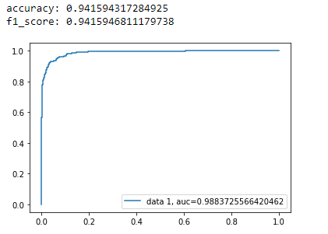
Passive Aggressive Classifier
Best accuracy was 94% with max-features of Tf-idf = 25000 and n-gram range = (1,2) and merging title and text column and this was the best accuracy we got.

Slide 14
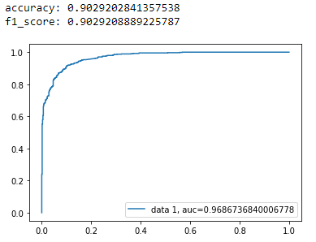
Ada Boost Classifier
Best accuracy was 90% with max-features of Tf-idf = 25000 and n-gram range = (1,3)

Slide 15
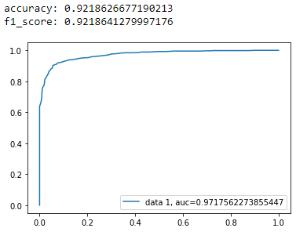
Extra Tree Classifier
Best accuracy was 92.2 % with max-features of Count Vectorizer = 25000 and n-gram range = (1,3)

Slide 16
Findings
VOICE OVER: SYED MUHAMMAD ALI

Slide 17
Findings
Fake news articles less structured and organized as compared to real ones
Higher accuracy achieved despite moderate dataset size
Findings mostly beneficial for social media organizations
Dataset should contain more diverse topics and include more parameters in order to capture details more accurately
The findings expire and do not work for data other than that for 'General Elections’

Slide 18
Challenges
VOICE OVER: SYED MUHAMMAD SHIRAZ JAFRI

Slide 19
Challenges
It took us a lot of time to find a proper problem.
We also talked to some organizations for their data and business problem.
Dataset given by organization wasn’t that large and clean on which we could train.
Needed to revert to online dataset.
We couldn’t train neural networks due to lack of expertise in it.

