Slide 1
DATA STRUCTURES
SHORTEST-PATH FINDER
Syed Muhammad Ali – 17867
Syed Muhammad Shiraz Jafri – 17899
Syed Muhammad Hamza Raza - 17887

Slide 2
ABSTRACT
We have implemented a route-finding algorithm for finding the shortest path between two locations given as input by the user.
The program also provides the distance for the shortest path.

Slide 3
SOFTWARE
NETBEANS 8.0.2 (used Java Swing UI and Java FX for the Graphical User Interface implementation).

Slide 4
DATA

Slide 5
The data points were taken from a file from the Nifty Assignments Stanford.
The file conatined miscellaneous
information regarding locations in a city in US Northwest.
Parameters included name, latitude and longitude for a location.

Slide 6
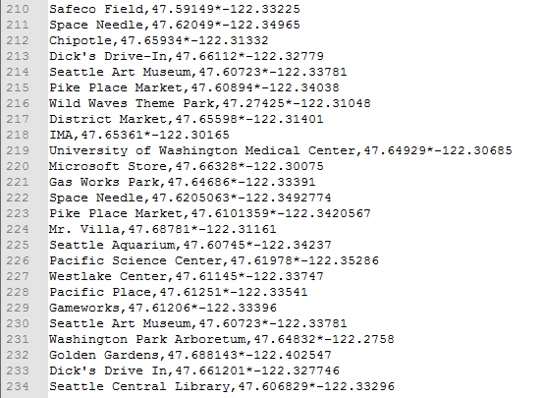

Slide 7
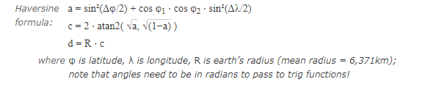
Used Haversine formula to find distance between two locations through their coordinates.

Slide 8
ALGORITHM

Slide 9
The algorithm consists of vertices with each vertex representing a unique location.
An array containing Adjacency List of each vertex and its edges is implemented.

Slide 10
The program traverses through the adjacent vertex of each vertex and then finds the shortest path available.

Slide 11
BREADTH FIRST TRAVERSAL
We have used the Breadth First Traversal (BFS) method to find the shortest distance between two given locations.

Slide 12
TIME COMPLEXITY
Big Oh for inserting a vertex or adding an edge are both constant.
The Time Complexity for the BFS Algorithm used is O(V + E) where V and E denote the number of vertices and edges in the graph respectively.

Slide 13
Data Structures Used
We have made extensive use of Array List and Graph data structures throughout our program.
Also used Queue data structure to implement BFS and used Stack to print the shortest path.

Slide 14
GUI
Used Java FX and Swing UI to implement the Graphical User Interface.
GUI provides User Login to use the program.

Slide 15
The GUI allows user to choose source and destination.
It displays the shortest path through the connected vertices between the selected locations and also its corresponding distance.

Slide 16
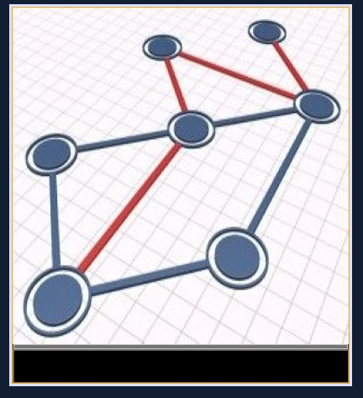

Slide 17
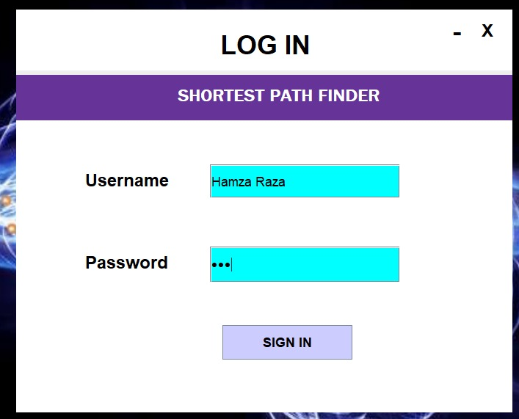

Slide 18
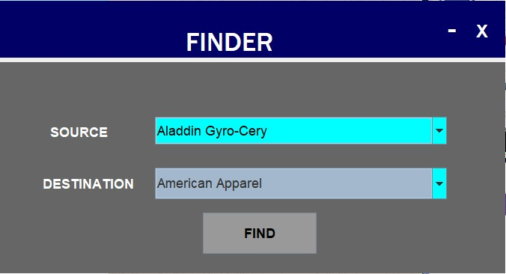

Slide 19
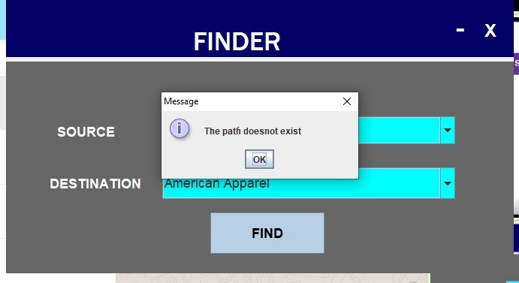

Slide 20
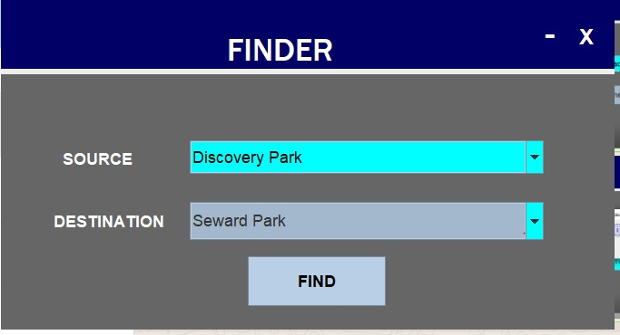

Slide 21
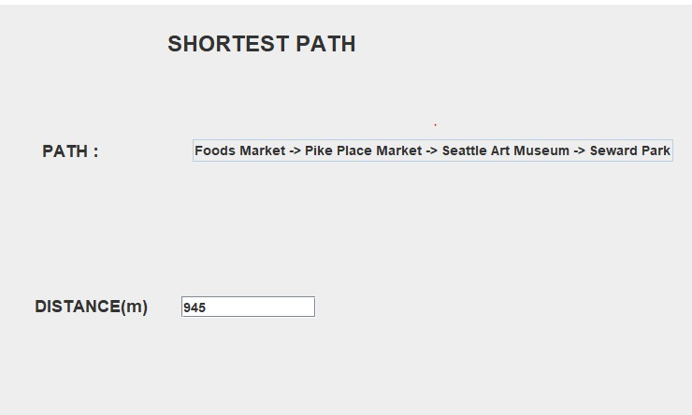

Slide 22
