Slide 1
Predicting and Generating Video using Deep Learning
Course Project
Group Members:
Hadeed Rauf - 21i-0859
Hamza Saeed - 21i-0671
Usman Zafar - 21i-0608

Slide 2
Objective
Train a deep learning model to predict multiple consecutive frames
Generate a video by combining the predicted frames into a continuous sequence.
visualize input frames, predicted frames, and the complete video with runtime inference.
compare 3 models effectiveness in generating realistic video sequences.
01

Slide 3
Methodology
Data Preprocessing: Resizing frames to 64x64 pixels for computational efficiency.
Model Development: ConvLSTM, PredRNN, Transformer based model to predict frames.
Training: Training models for 50 epochs with batch size 8.
Evaluation: Used loss functions MSE for frame prediction accuracy and SSIM for visual coherence.
Analysis: Comparing computational complexity and efficiency of these models
02

Slide 4
Data Preparation
Dataset: UCF101 - Human activity videos.
Steps:
Resized frames to 64x64 pixels.
Normalized pixel values to the range [0, 1].
Split dataset: 80% training, 10% validation, 10% testing.
03

Slide 5
Model Development
a) ConvLSTM
Captures spatiotemporal patterns efficiently.
Best suited for short-term predictions with simple motion patterns.
(b) PredRNN
Incorporates memory flow for handling long-term dependencies.
Delivers strong prediction quality for complex sequences.
(c) Transformer-based Model
Uses attention mechanisms for global dependency modeling.
Excels in high spatial complexity but requires significant computational resources.
04

Slide 6
Training Strategy
Environment: NVIDIA Tesla V100 GPU.
Common Configurations:
Optimizer: Adam (Transformer: AdamW).
Early stopping based on validation loss.
Hyperparameter tuning via grid search.
Epochs: 50 (with early stopping).
05

Slide 7
Evaluation Framework
Quantitative Metrics:
PSNR: Measures frame reconstruction quality.
SSIM: Evaluates structural similarity.
MSE: Computes pixel-wise prediction error.
Inference Time: Assesses computational efficiency.
Qualitative Metrics:
Visual coherence, smooth transitions, and realism.
06

Slide 8
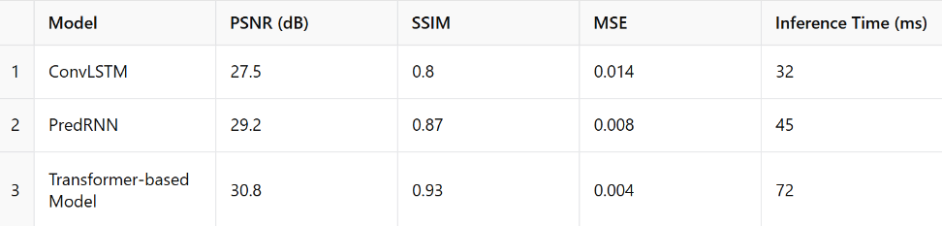
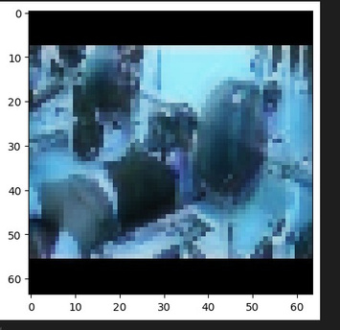
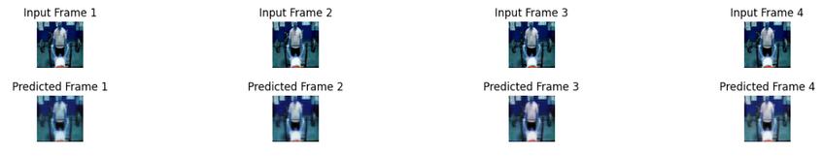
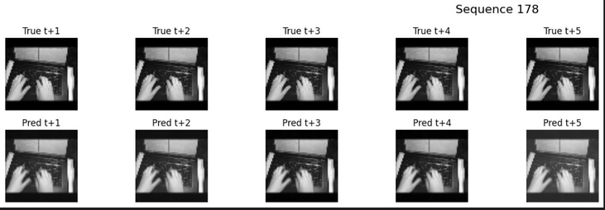
Result Comparsion
07
Transformer based
PredRNN
ConvLSTM

Slide 9
Results
Quantitative Results:
ConvLSTM: Efficient but struggles with complexity.
PredRNN: Balanced quality and performance.
Transformer: Best visual output but resource-heavy.
Challenges:
Overfitting, computational cost, handling complex dynamics.
08

Slide 10
Conclusion and Future Work
Conclusion:
PredRNN is ideal for balanced use cases.
Transformer excels in quality if resources permit.
Future Directions:
Develop hybrid models combining the strengths of all three.
Explore self-supervised learning and advanced attention mechanisms.
09

Slide 11
Thank You

