Slide 1
CRYPTOLOGY

Slide 2
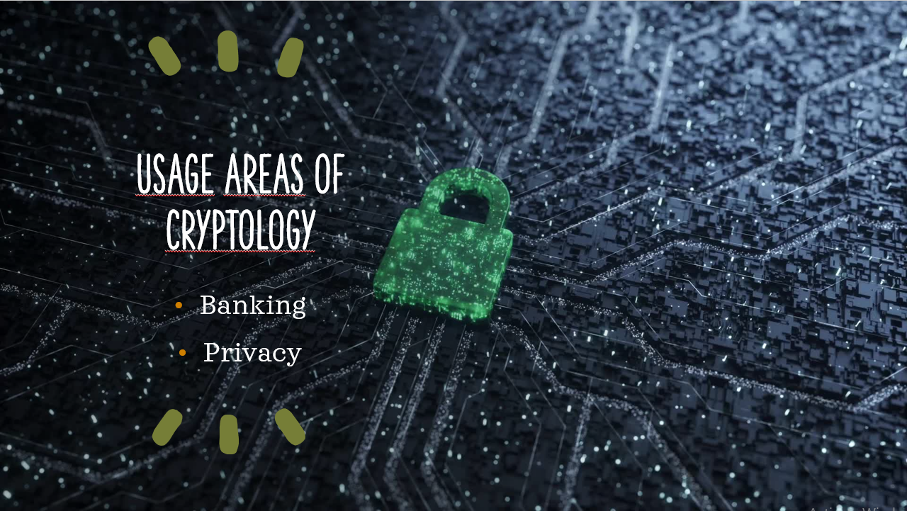

Slide 3
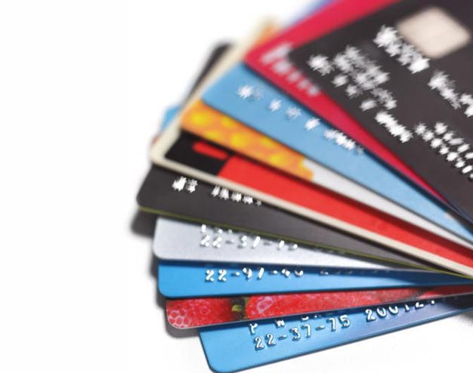
BANKING

Slide 4
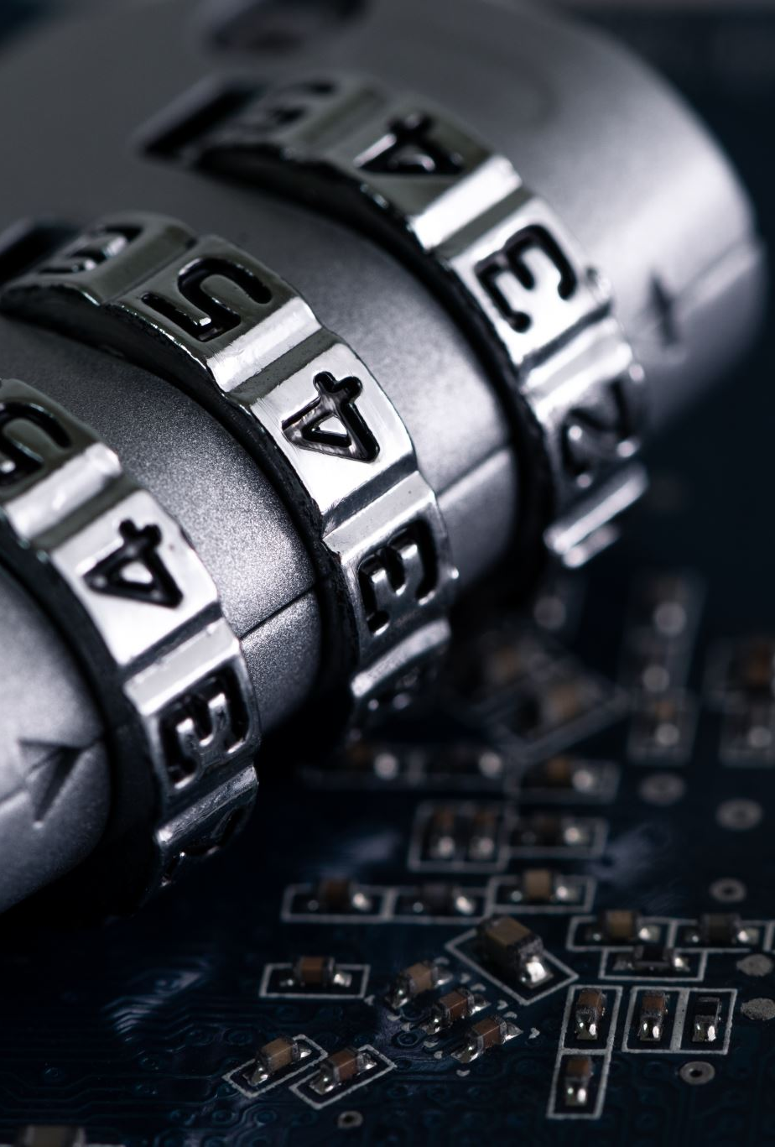
Credit Cards
Most advanced technology to protect the crypto keys.
It is an crypto key.

Slide 5

SSL Protocol
A technique called SSL (Secure Sockets Layer) is used to provide secure connections between networked computers.
Ensures the security of data flow between bank employees.
Prevents external access to bank data.
(SSL Support Team,2021)

Slide 6

One Time Password
Passwords that are generated instantly to authentication.
3D secure system
Internet Banking

Slide 7



PRIVACY

Slide 8
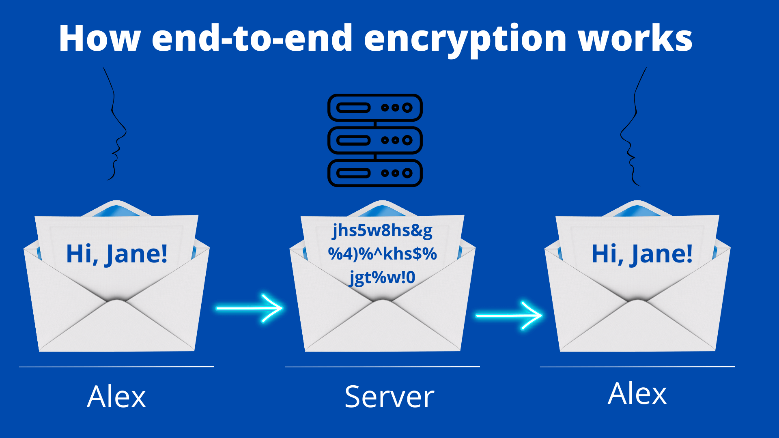
Jane

Slide 9
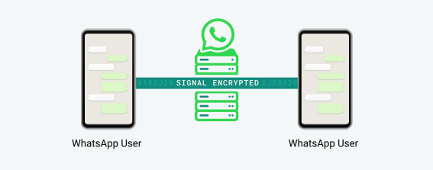
The sender generates a 32-byte Chain Key
The sender generates a Signature Key pair.
The sender combines the 32-byte Chain Key and the Signature Key into a Sender Key message
The sender individually encrypts the Sender Key
The Sender Key message and Chain Key reach to the receiver.
The receiver decrypts The Sender Key message by combining the Chain Key and her own Signature key.
(WhatsApp, 2021)

Slide 10
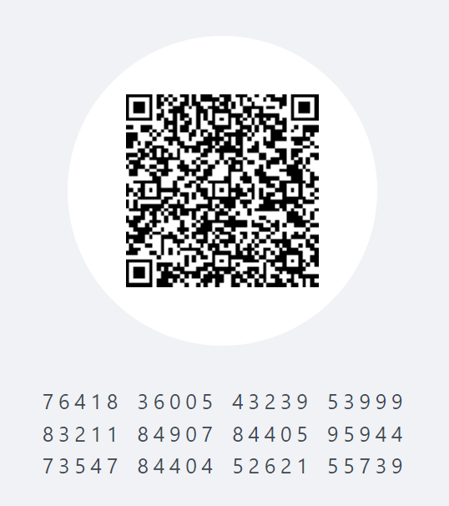


Brute force can check 1 billion password in a second.
10 possible number and 60 digits.
${10}^{60}$ possibilities.
It takes ${10}^{48}$ second, which is equal to centuries.

Slide 11
CONCLUSION

Slide 12
REFERENCES
Grigas, L. (2022, March 8). The Ins and Outs of a Brute Force Attack. NordPass. https://nordpass.com/blog/brute-force- attack/#:~:text=Speed%20depending%20on%20password%20strength,hundred%20 billion%208%2Dcharacter%20passwords.
SSL Support Team. (2021, September 28). What is SSL?. https://www.ssl.com/faqs/faq-what-is-ssl/
WhatsApp. (2021). WhatsApp Encryption Overview. https://scontent.fesb7-1.fna.fbcdn.net/v/t39.8562- 6/309473131_1302549333851760_6207638168445881915_n.pdf?_nc_cat=107&ccb=17&_nc _sid=ad8a9d&_nc_ohc=Hs3J9fvLDjIAX8dbm4e&_nc_ht=scontent.fesb7- 1.fna&oh=00_AfCun2y3UWq425Md709ujlPRJTIVTOxhkl2vE5iWHMqKgA&oe=63A95D1D

