Slide 1
Digital I/O Voltage Level
Standards
Hamza Solmaz
01.08.2025
MEOS ETM

Slide 2
What are ideal conditions?
Reliability
Supply voltage range
Low cost
Low power consumption
High speed

Slide 3
OUTLINE
TTL
CMOS
LVDS
LVPECL
Others
Comparison
Conclusion

Slide 4
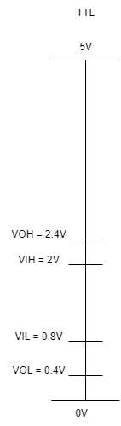
TTL
Operates with 5V
10 ns propagation delay
10 mW steady power consumption
Up to 10 Mbps
Figure 1 I/O Voltage Levels of TTL
Applications
UART
Sub-types
Low-power TTL (33ns, 1mW)
High Speed TTL (6ns, 22 mW)
Schottky TTL (3ns, 19mW)
Low-power Schottky TTL (9.5ns, 2mW)

Slide 5
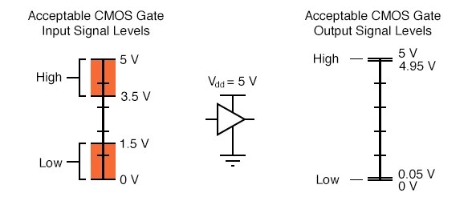
CMOS
Supply voltage may vary between 1.8V-15V
Noise margin is higher than TTL
Speed is higher than TTL
Frequency dependent power consumption
Applications
I2C
SPI
Subtypes
LVCMOS
Advanced CMOS
Bipolar CMOS
HCMOS
Figure 2: Voltage levels of CMOS
(All about circuits)

Slide 6
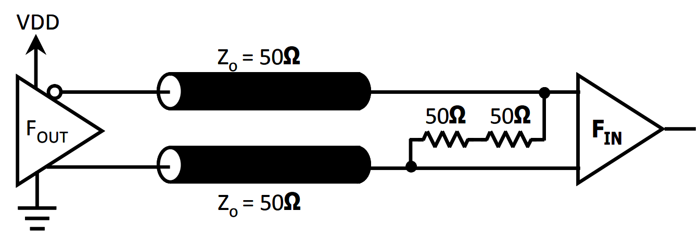
LVDS
Differential data transmission
2.4V-3.3V supply voltage
1.2V common mode voltage
0.4V swing
Consumes constant current (3.5mA)
Lower EMI effect
Low power consumption (8.75mW)
Maximum 4Gbps speed per lane
Applications
Flat Panel Display Link
Gigabit Multimedia Serial Link
Sub-Types
Bus LVDS (Multiple reciever)
SLVS (800 mV supply)
Mini-LVDS
Figure 3: LVDS termination circuit schematic
(Renesas)

Slide 7
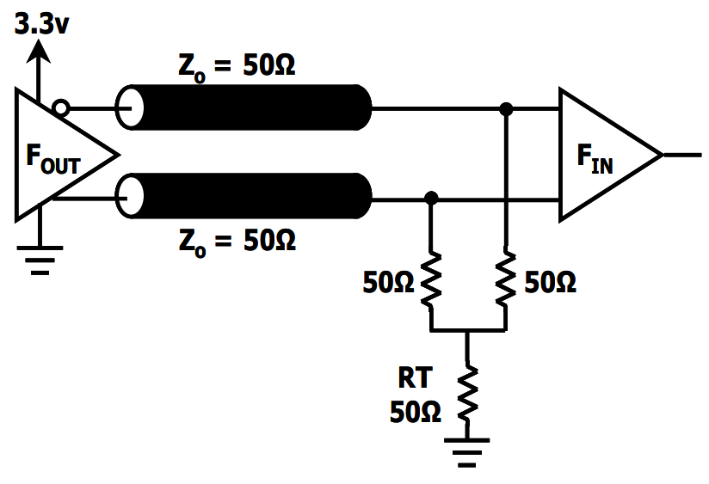
LVPECL
Derived from ECL and PECL
Differential pair
3.3V supply voltage
Vcc-2V common mode voltage
800mV voltage swing
Up to 10 Gbps
Higher power consumption than LVDS
Low noise tolerant
Application
Gigabit Ethernet
Fiber Channel
Optical Communication
Figure 4: LVPECL Y-termination circuit schematic
(Renesas)

Slide 8
Others
HCSL
PCIe reference clock
Low phase jitter
100 MHz
SSTL
Uses a reference voltage (VDD/2)
Swing around Vref
DDR SDRAM
HSTL
Signaling between ICs
0V-1.5V signaling range
Single-ended or differential
Beyond 180 MHz

Slide 9
COMPARISON
Standard | Supply Voltage | Signal Type | Speed | Power Consumption | Cost and Complexity
TTL | 5V | Single-ended | <10 Mbps | 10 mW | Low
CMOS | 1.8V-15V | Single-ended | Depend on MOS characteristics | Depend on switching frequency | Low-medium
LVDS | 2.4V-3.3V | Differential | < 4 Gbps | 8.75 mW | Medium
LVPECL | 3.3V or 2.5V | Differential | <10 Gbps | 50-100 mW | High

Slide 10
Is it possible to communicate
with different logic levels?
Differences
Single-ended / Differential
Voltage Levels
Speed
Converters
Basic resistive voltage dividers
Level shifters or level translators (TXS0102)
FPGA or Microcontrollers (STM32)

Slide 11
CONCLUSION

Slide 12
THANKS FOR LISTENING

Slide 13
Q&A
References
TTL
https://www.techtarget.com/whatis/definition/transistor-to-transistor-logic-TTL
CMOS
https://www.nxp.com/docs/en/user-guide/UM10204.pdf
https://www.allaboutcircuits.com/textbook/digital/chpt-3/logic-signal-voltage-levels
LVDS
https://www.ti.com/lit/an/snla165/snla165.pdf?ts=1753844644513
https://resources.pcb.cadence.com/blog/2023-lvds-signals-crashcourse
LVPECL
https://www.renesas.com/en/document/apn/lvds-pecl-termination-app-note
https://www.ti.com/lit/an/slla120/slla120.pdf
https://www.rfwireless-world.com/terminology/ecl-vs-pecl-vs-lvpecl
General Information
https://ww1.microchip.com/downloads/aemDocuments/documents/VOP/ApplicationNotes/ApplicationNotes/Signal+Types+and+Terminations.pdf

