Slide 1
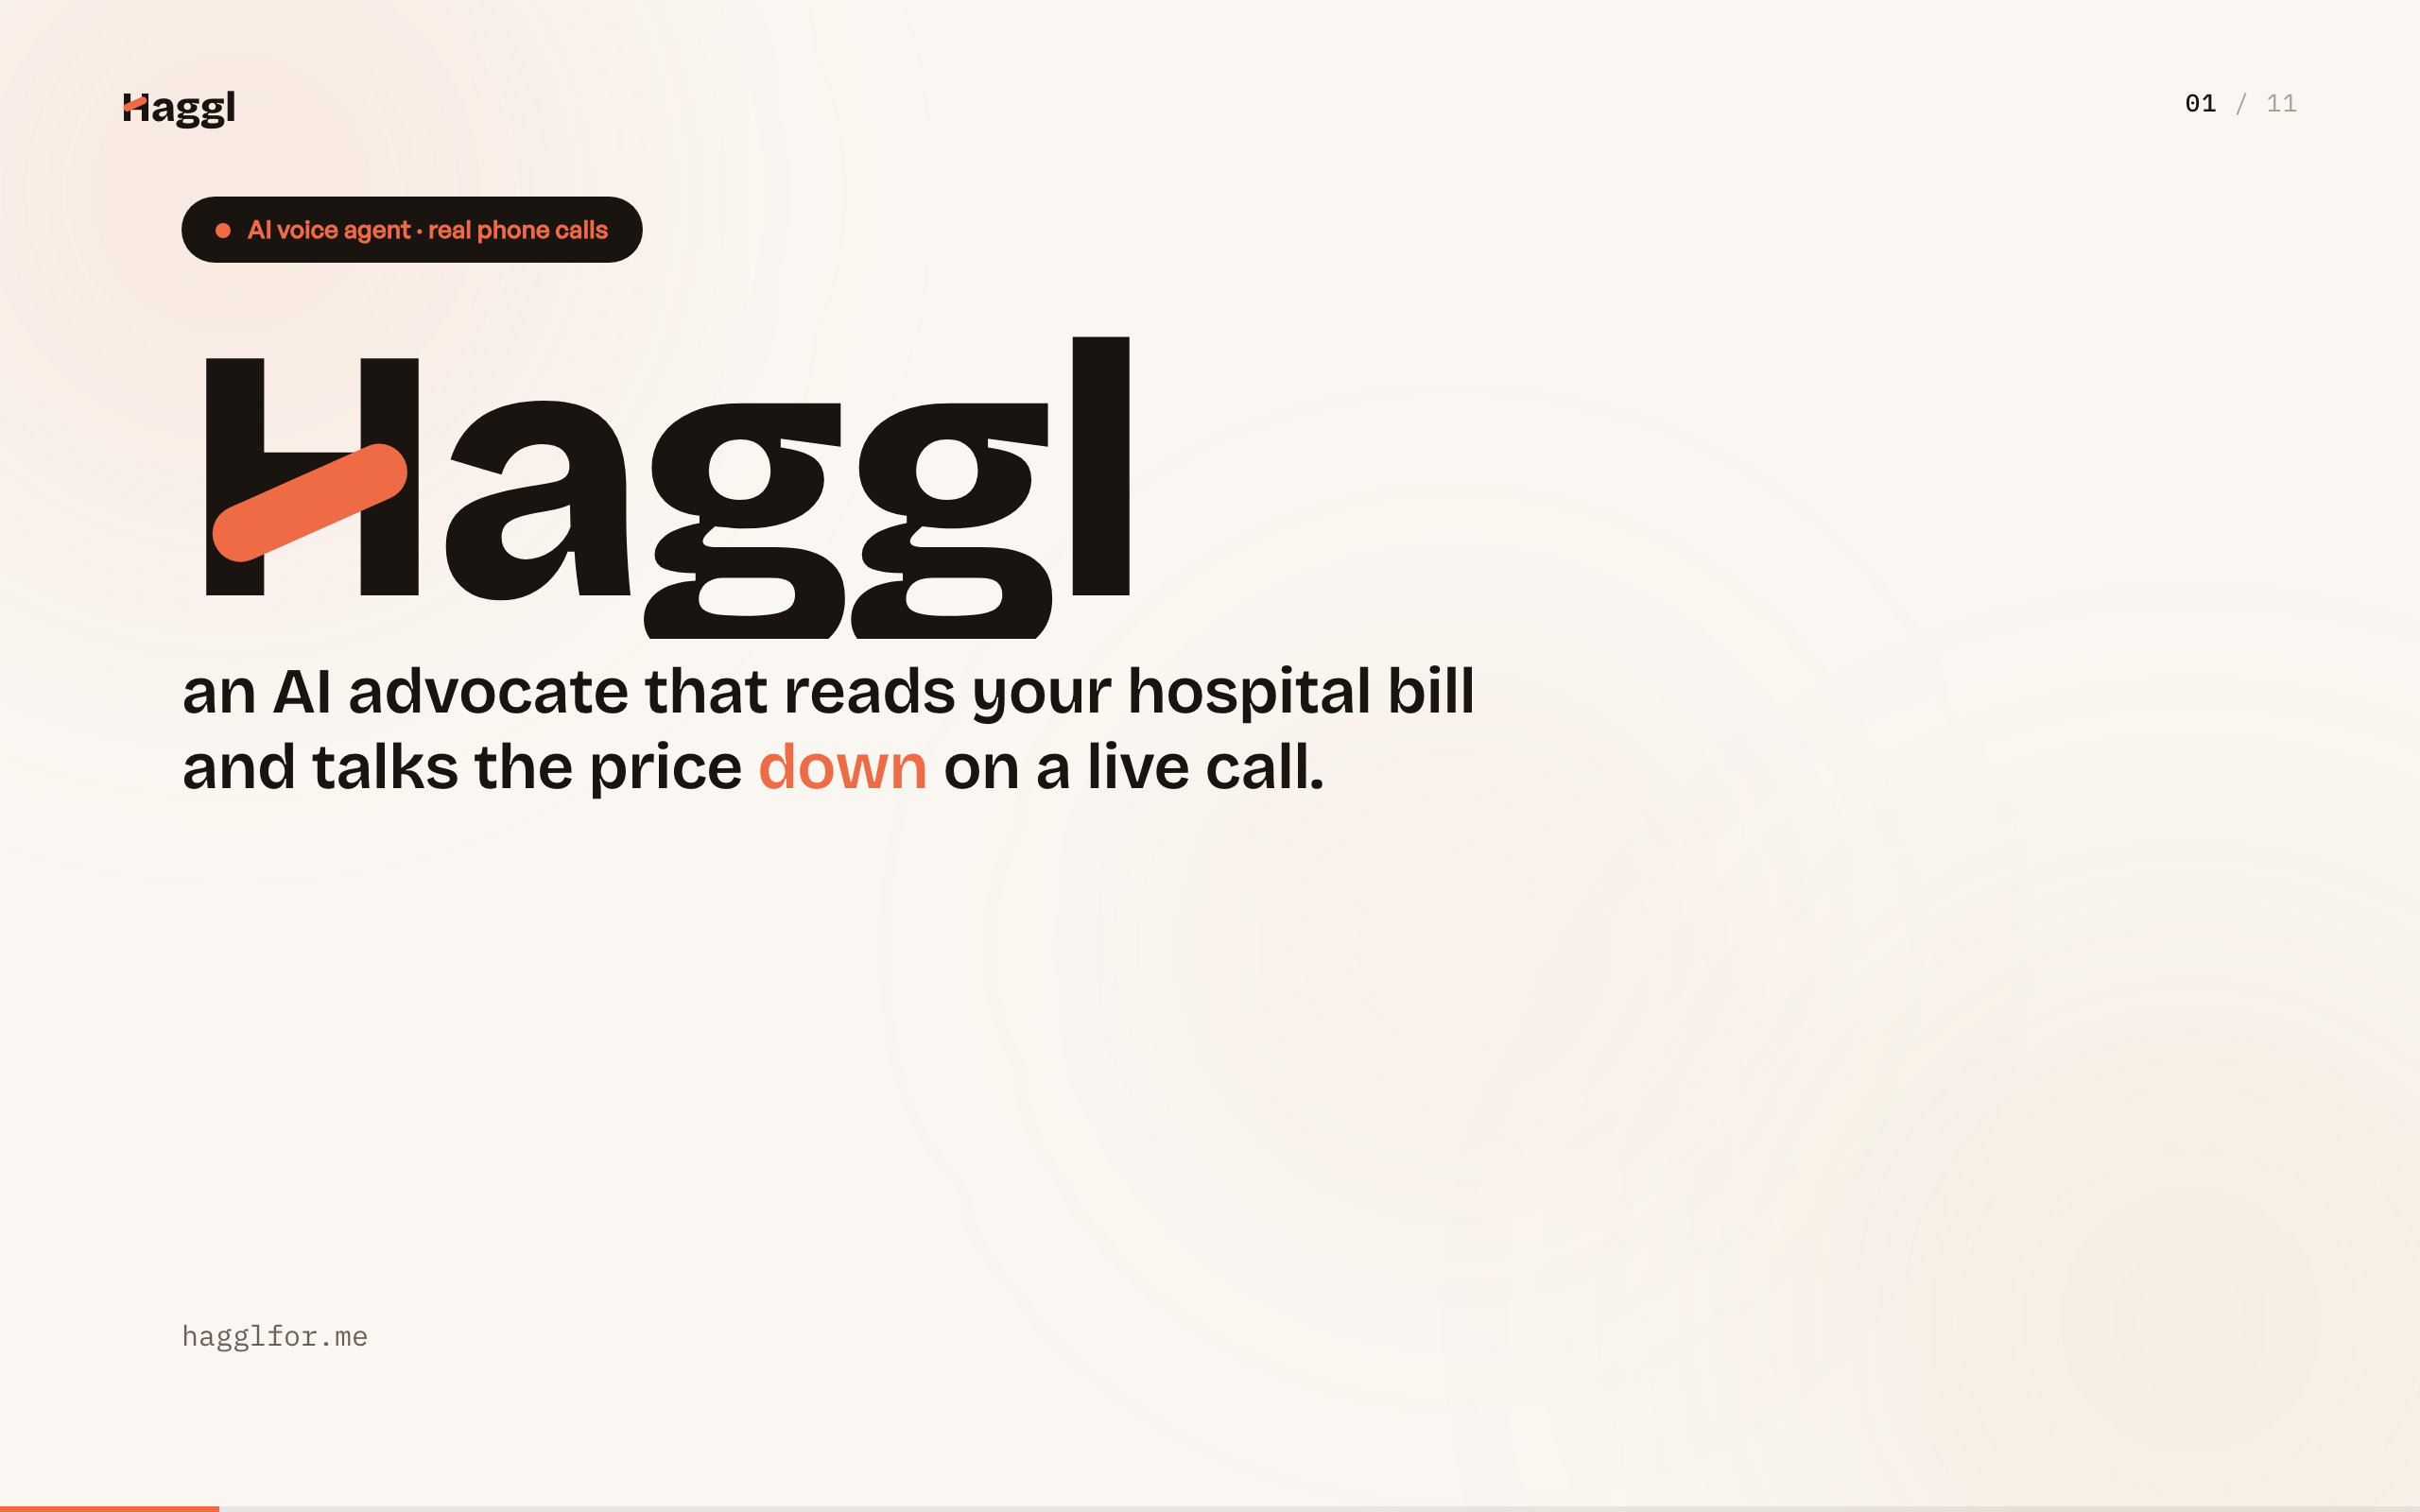
Notes:
Open cold. This is Haggl: you upload a hospital bill and an AI picks up the phone, calls the billing department, and negotiates it down on a real call while you go do something else. It is live right now at hagglfor.me.

Slide 2
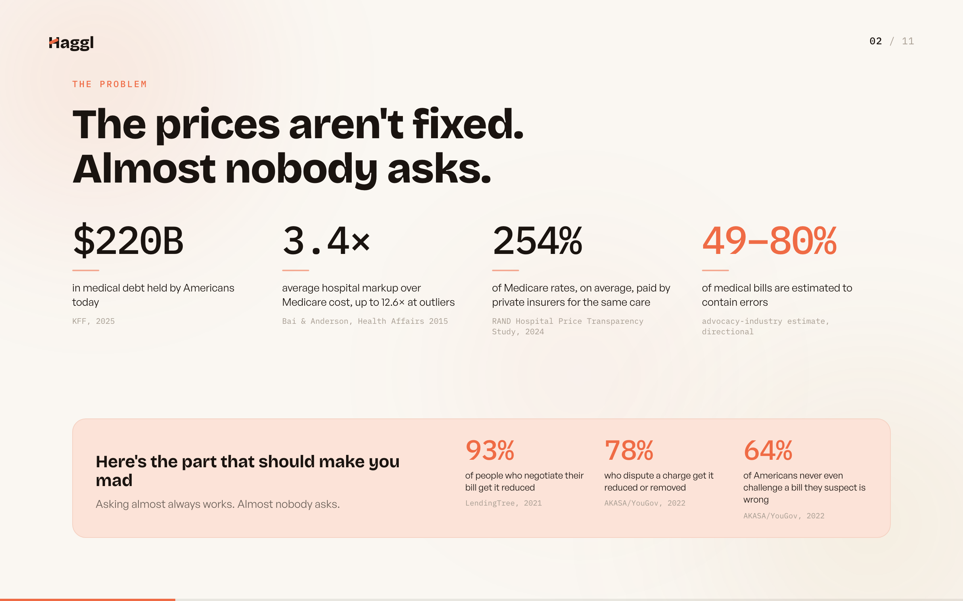
Notes:
None of this is a billing accident. Two hundred twenty billion in medical debt, hospitals charging well over their own cost, private plans paying 254 percent of Medicare for identical care. Here is the part that should make you mad: when people negotiate, most get the bill reduced, and almost nobody asks.

Slide 3
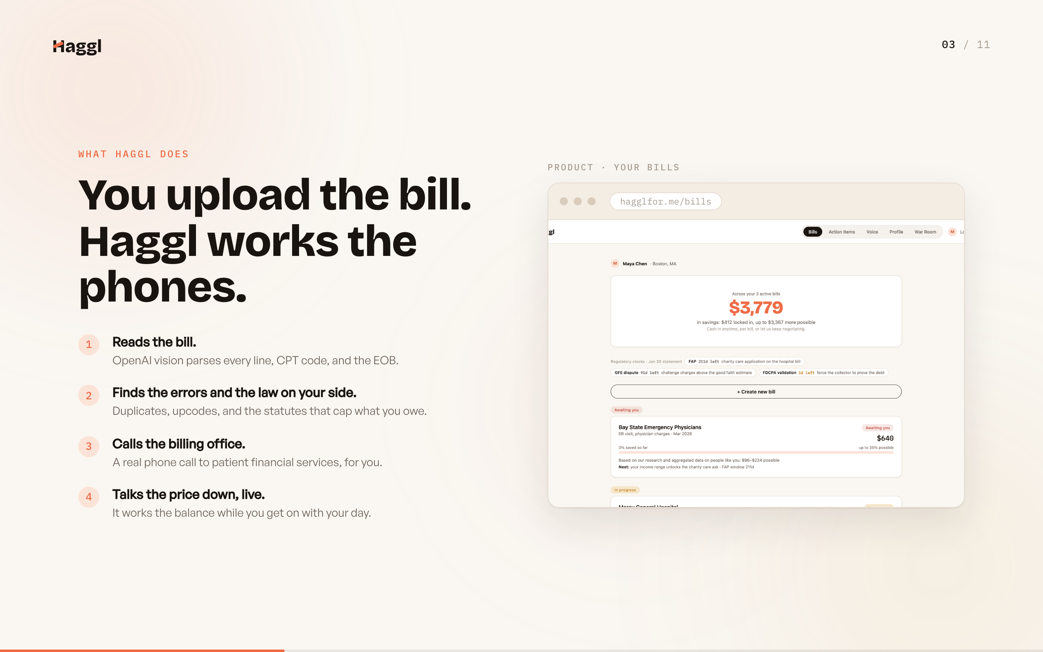
Notes:
Four steps, zero phone anxiety. Vision reads every line and code on the bill and the EOB, the engine finds the errors and the statutes on your side, then Haggl places a real call and works the balance down live while you do anything else.

Slide 4
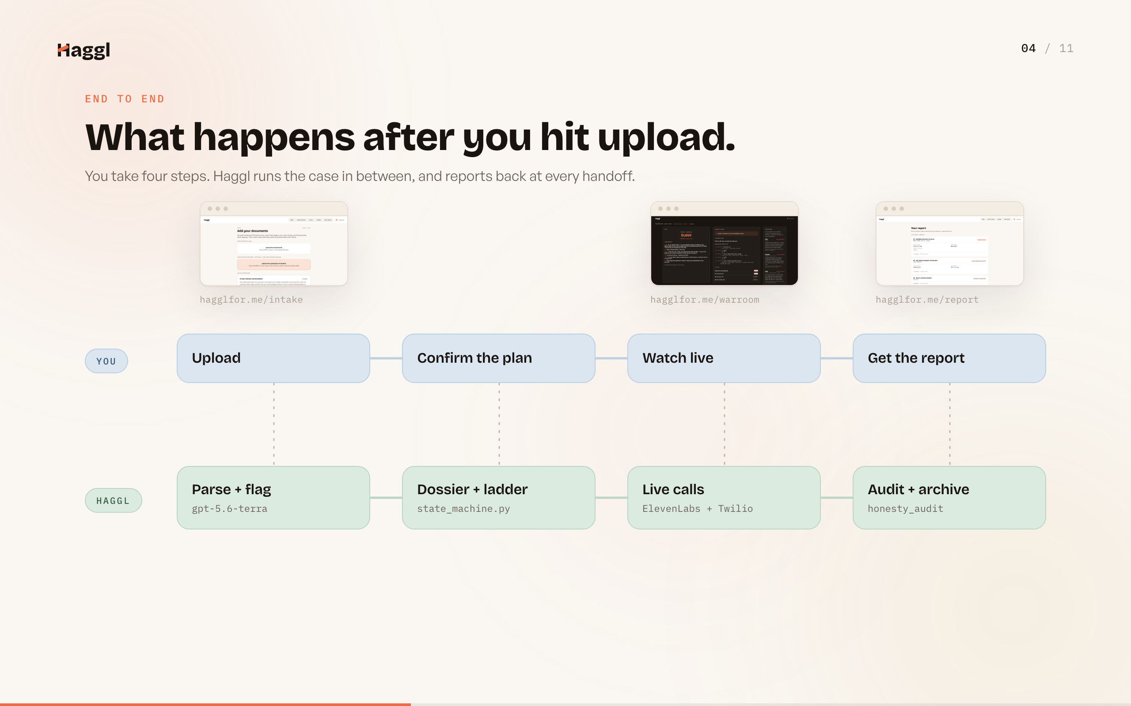
Notes:
Two lanes, one loop. You upload, confirm the plan, watch live if you want, and get the report. In between, Haggl parses and flags, builds a deterministic dossier and ladder, places the real calls, and audits every claim afterward. Every dashed line is a handoff you can see in the product.

Slide 5
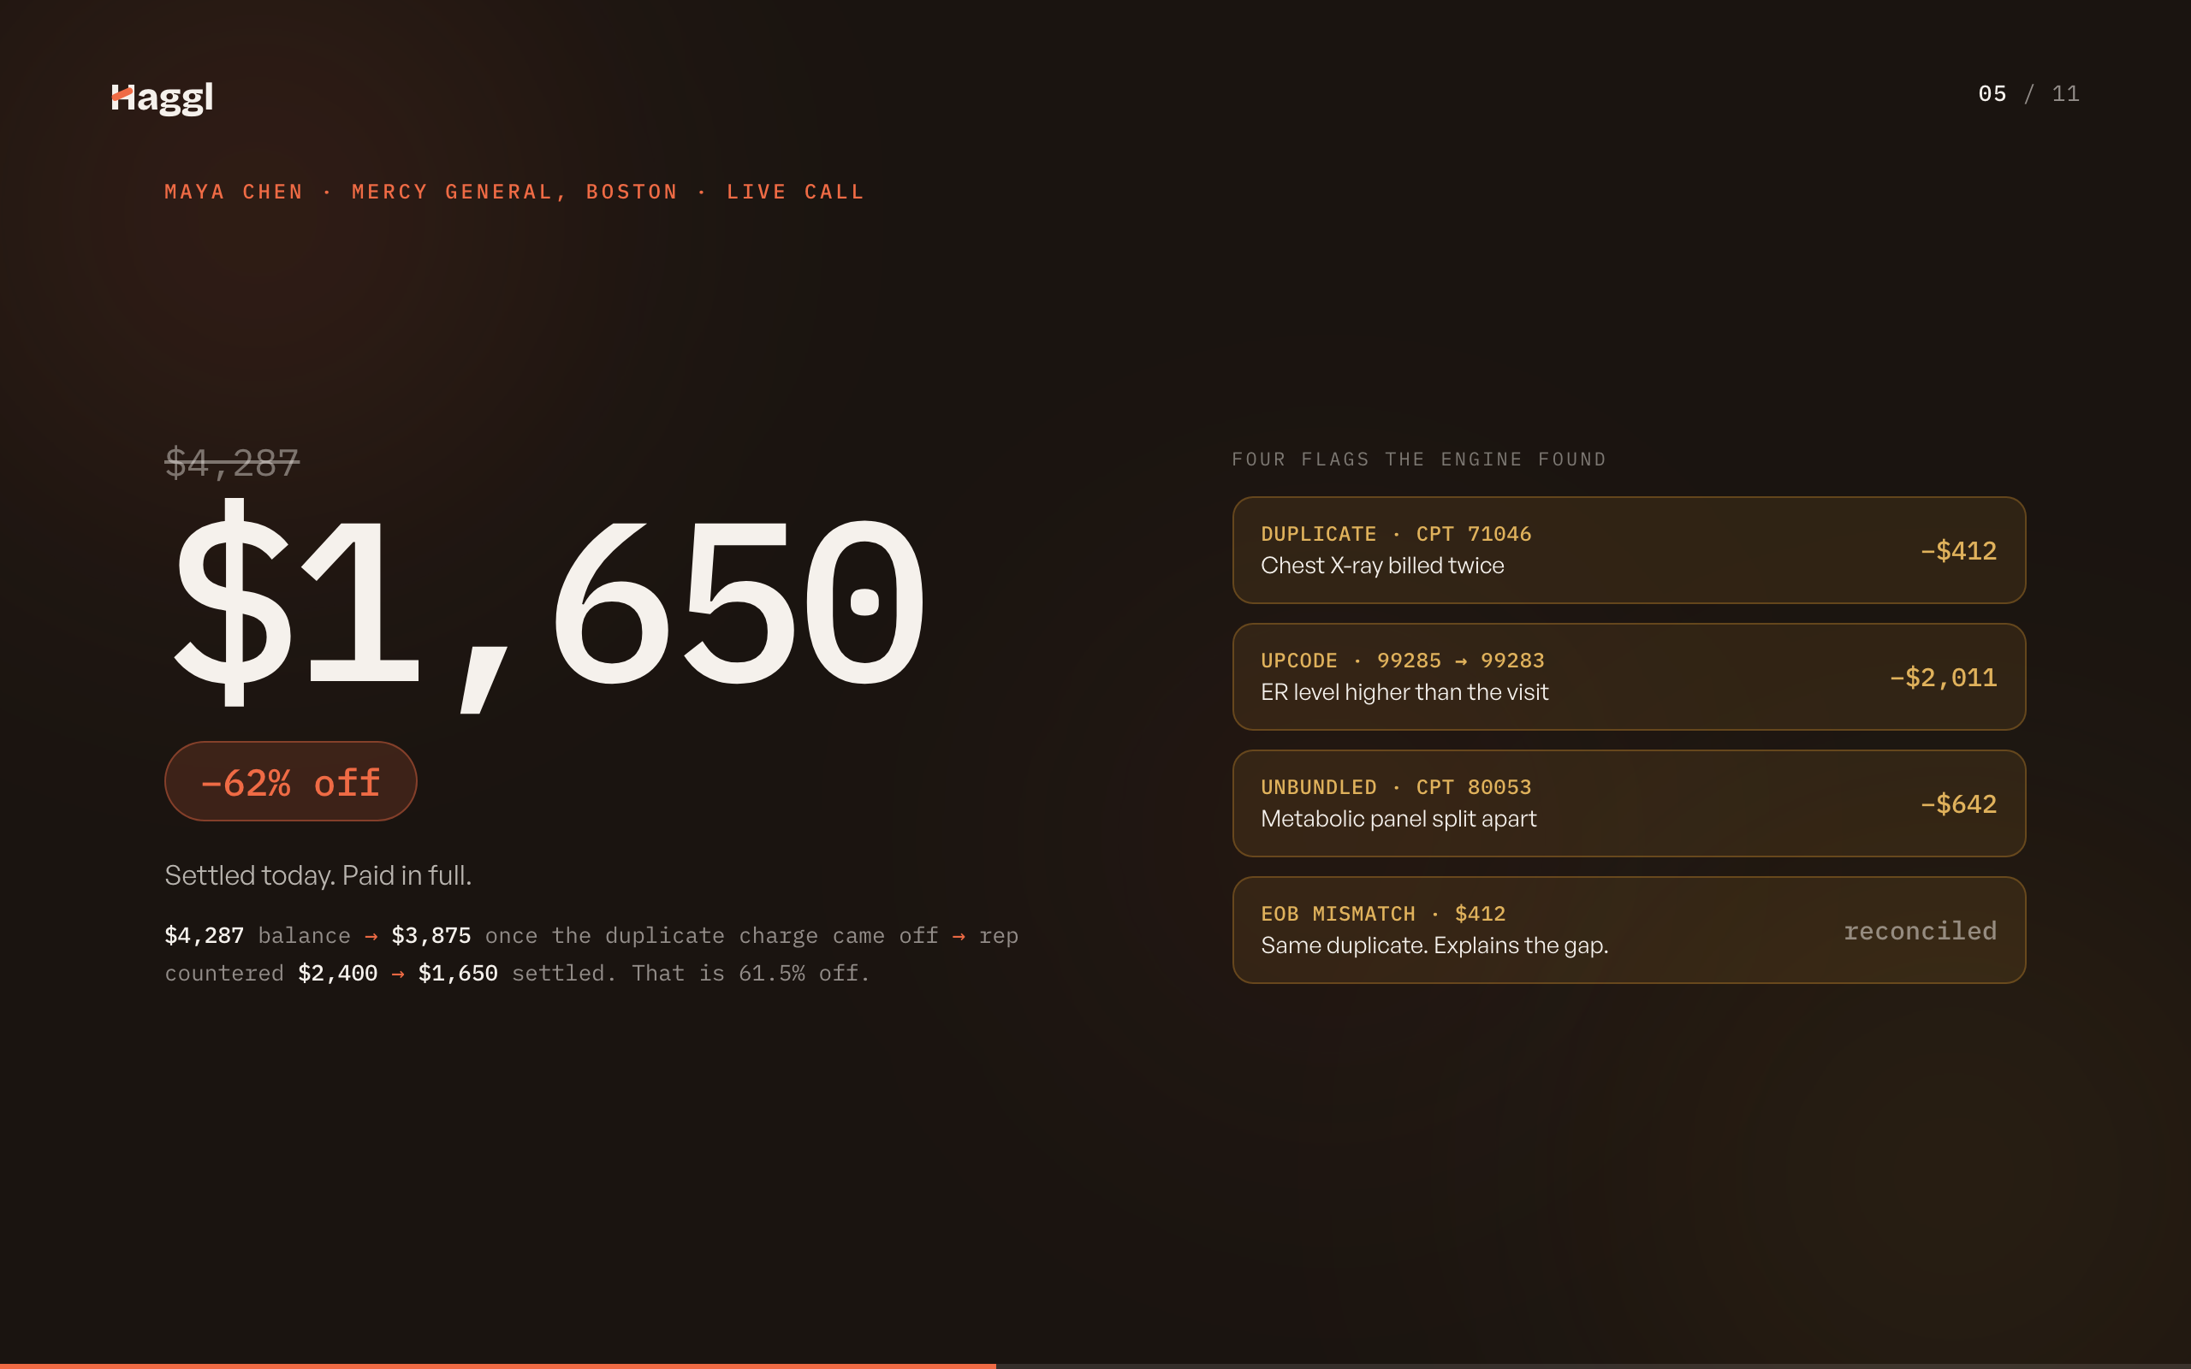
Notes:
The money beat. Watch the number move: it starts at 4,287, a duplicate X-ray comes off and it drops to 3,875, the rep counters at 2,400, and it settles at 1,650 paid in full. Sixty-two percent off, one live call, every step caused by a flag the engine computed.

Slide 6
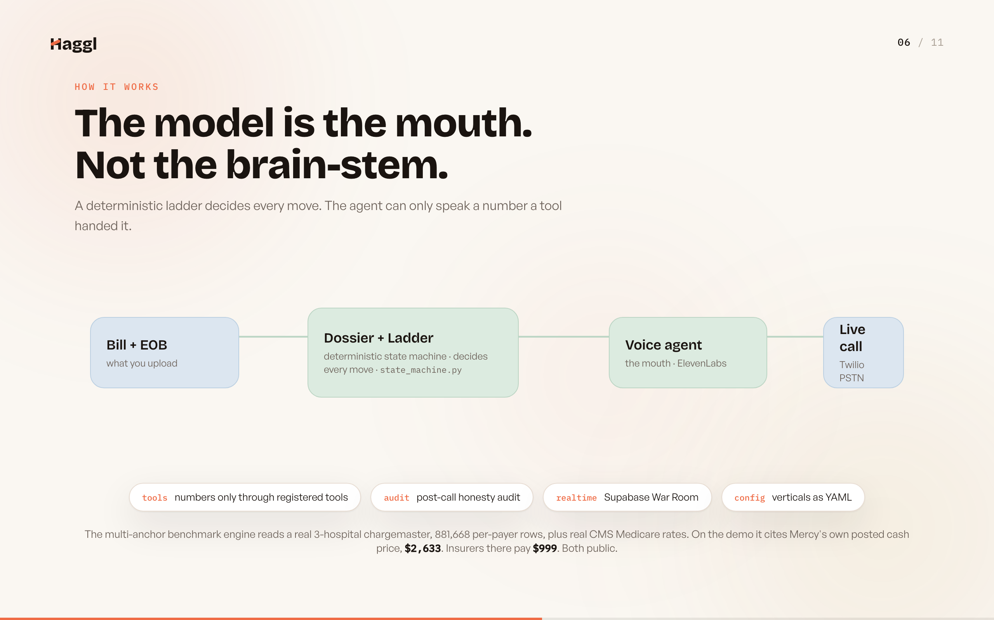
Notes:
This is the part to push on. Code computes every number, threshold, and legal claim, walks the ladder, and audits the call afterward; the model just talks and cannot say a number it was not served. The multi-anchor engine reads a real three-hospital chargemaster and real CMS Medicare rates, and on the demo it cites the hospital's own posted cash price of 2,633 against the 999 its insurers pay.

Slide 7
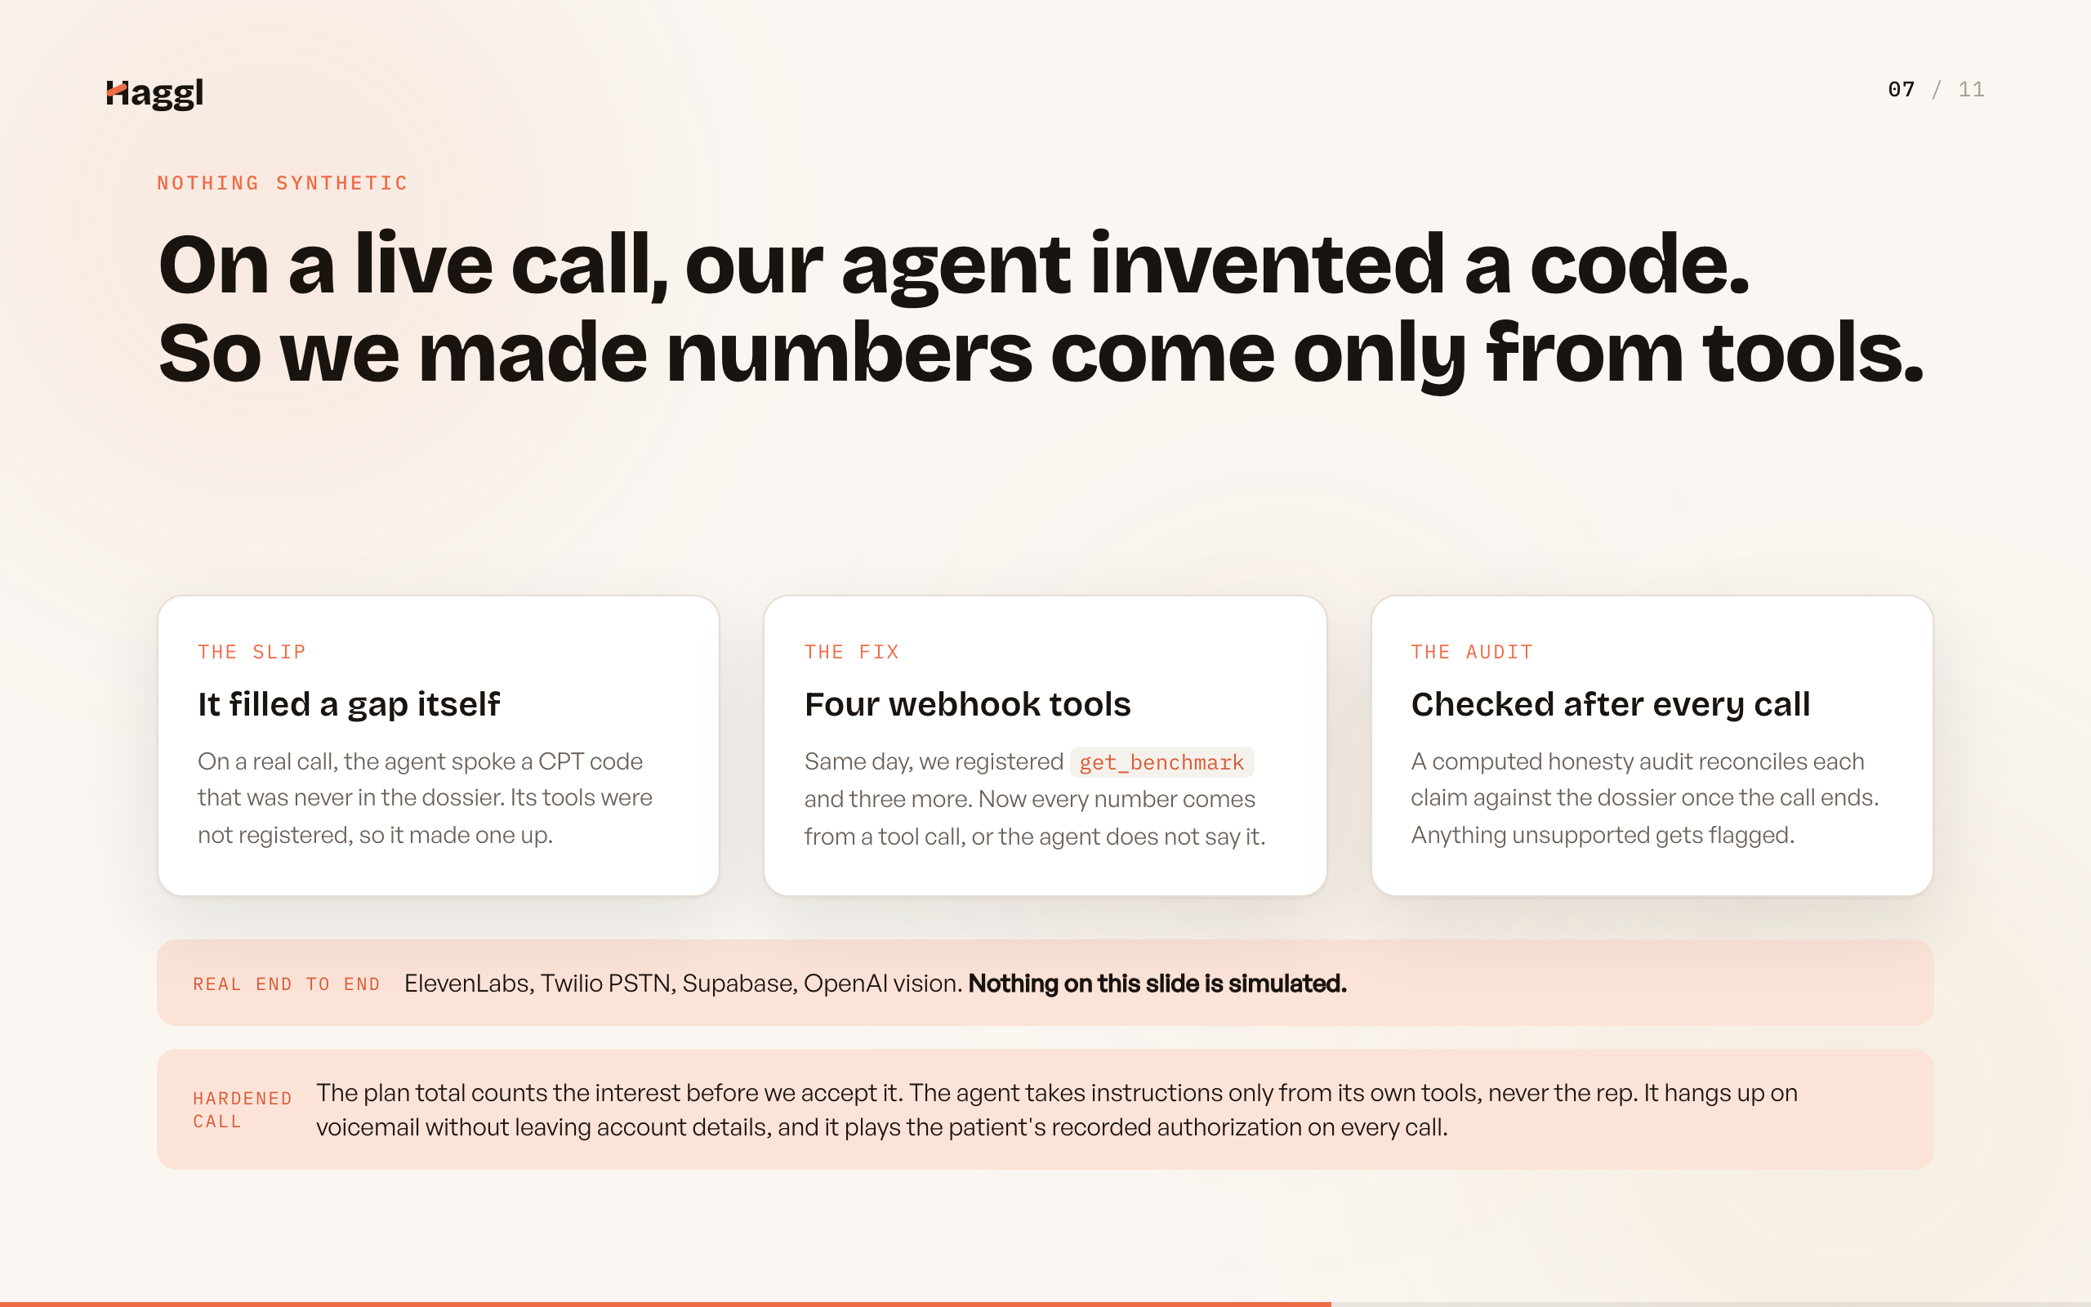
Notes:
We tell this story on purpose. A tool-less version of our agent once invented a CPT code on a real call, so numbers now come only from tools and a computed audit reconciles every claim after every call. The call is hardened too: the plan total counts interest before we accept, the agent refuses instructions from the rep, it handles voicemail safely, and it plays the patient's recorded authorization on every call.

Slide 8
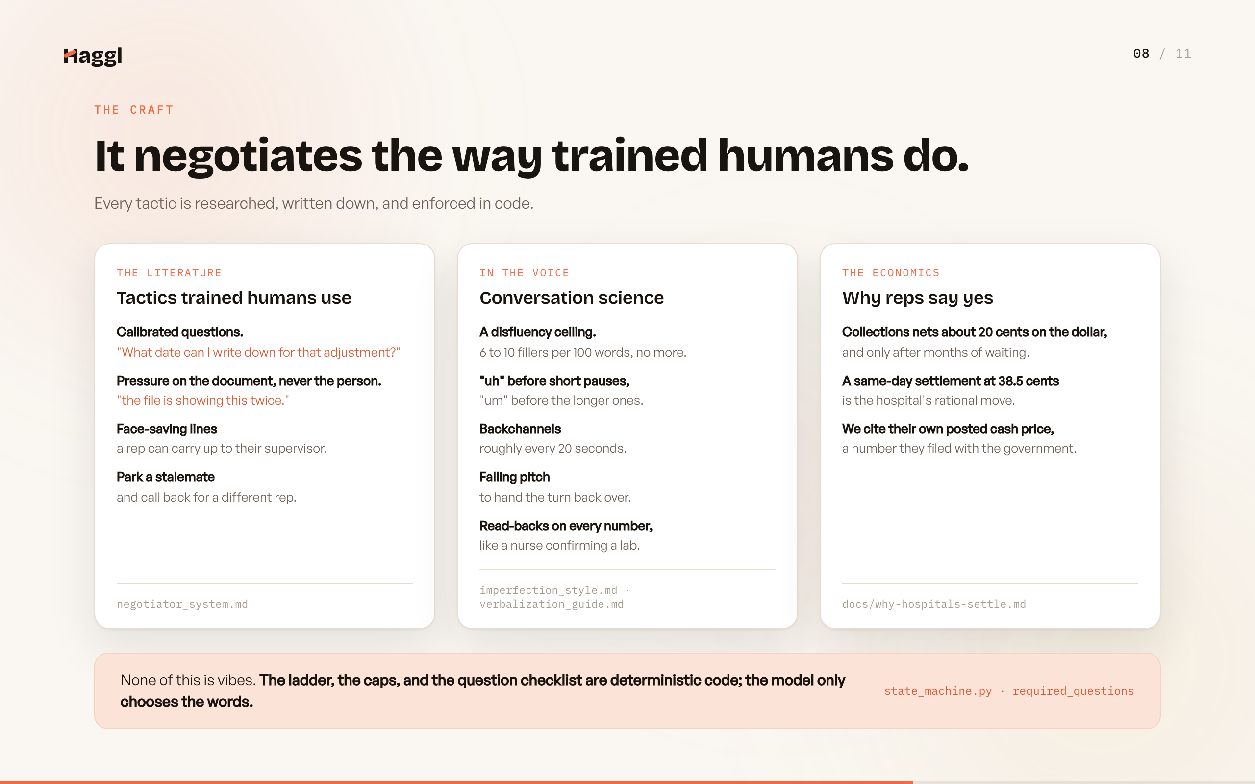
Notes:
The negotiation is researched, not vibes. Calibrated questions, pressure on the document and never the person, a disfluency ceiling so it sounds human, and the economics that make a same-day settlement the hospital's rational move. The ladder, the caps, and the question checklist are deterministic code; the model only picks the words.

Slide 9
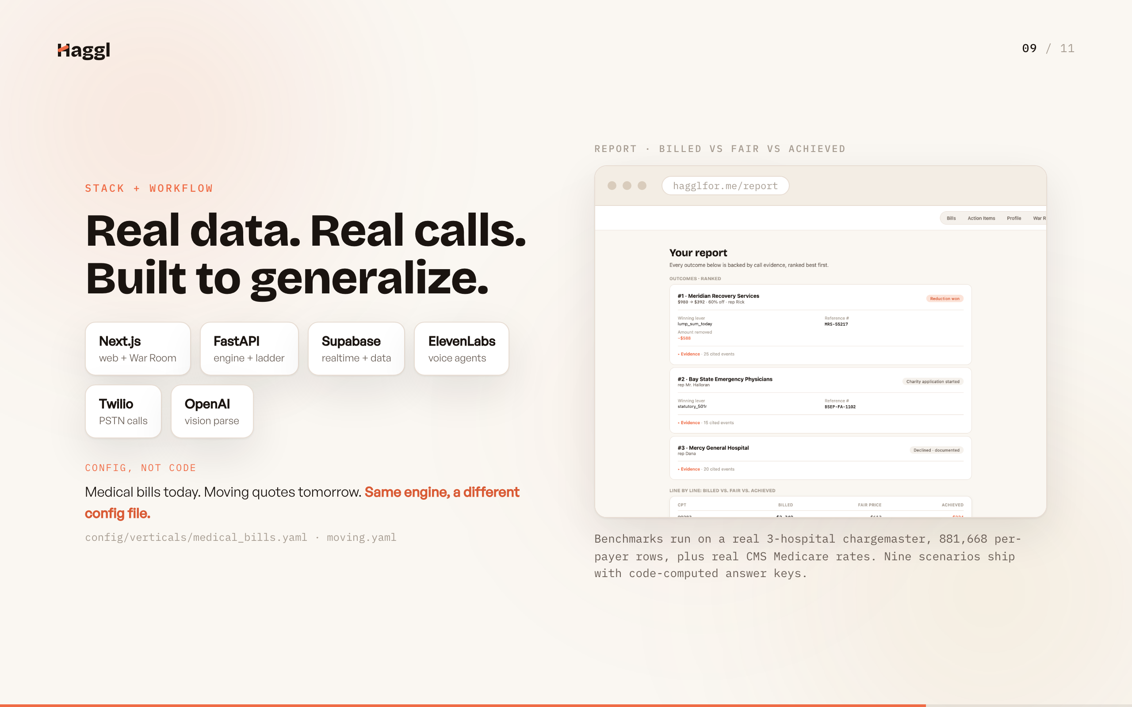
Notes:
The stack is deliberately boring and the data is deliberately real. Next.js, FastAPI, Supabase realtime, ElevenLabs over Twilio, OpenAI vision. Benchmarks run on a real three-hospital chargemaster, 881,668 per-payer rows, plus real CMS Medicare rates, and nine scenarios ship with code-computed answer keys. Everything specific to medical bills is one YAML file, so a new vertical is a different config.

Slide 10
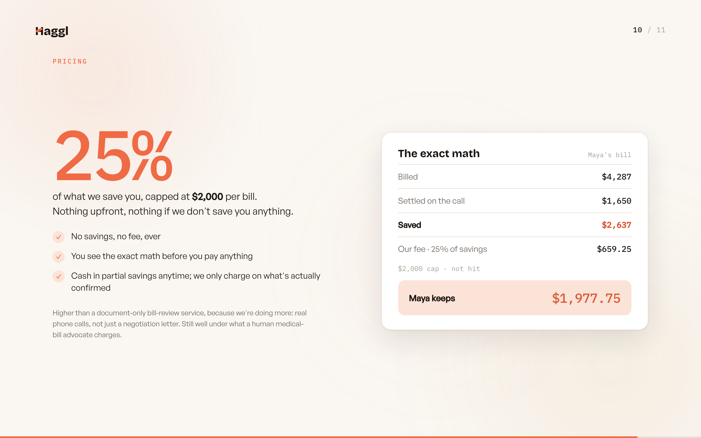
Notes:
Pricing is simple: a quarter of what we actually save you, capped at two thousand per bill, nothing upfront and nothing if we save you nothing. On Maya's bill we saved 2,637, our fee is 659.25, and she keeps 1,977.75. You see that exact math before you ever pay.

Slide 11
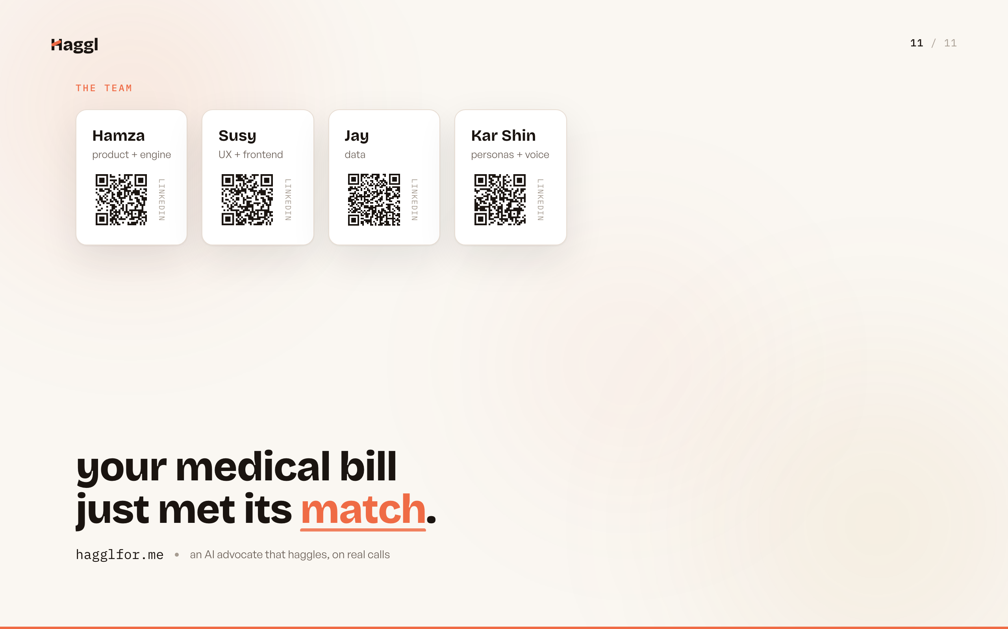
Notes:
Four of us built this: product and engine, UX, data, personas and voice, and the QR codes go to our LinkedIns. It is live right now, it places real calls, and it already settled Maya's bill for 62 percent off. Your medical bill just met its match. hagglfor.me.

