Slide 1
Covid-19 Vaccination Process in Turkey
Hamza YAVUZ
17030411056
Data Visualization Project

Slide 2
The vaccination process in Turkey started with the vaccination of the Minister of Health on 13 January. Vaccinations were started by making an appointment via e-nabız. Which group will be vaccinated is determined by the system and vaccination appointments are opened for that group. The priority was those working in the health sector. Then he continued with the elders. Currently, people over 50 and some special groups are vaccinated.
2 doses of vaccine are administered in Turkey. These vaccines are Sinovac and Biontech vaccines according to the preferences of the people. There are differences in the way vaccines are produced.

Slide 3
Although the state says that vaccination continues rapidly, 14% of the population has been vaccinated since 13 January. The state should regulate its vaccine promotion policy as soon as possible. It was said that they would open a university in September and demand was made for the vaccination of the students. New agreements are being signed to try to speed up the vaccine supply. As there is a worldwide crisis, there may be difficulties in the procurement process of vaccines.

Slide 4
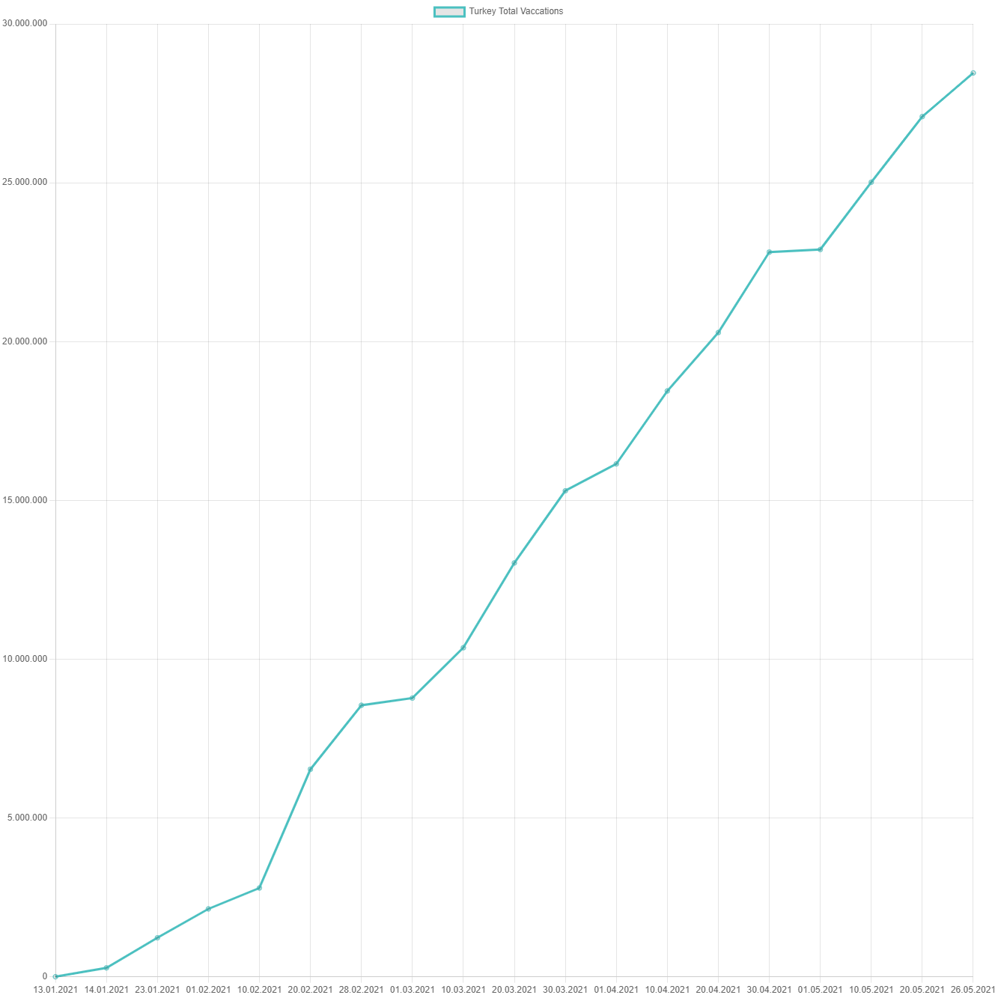
Turkey Total Vaccations
Until May 23, 28 million people were vaccinated in Turkey. This vaccine is the sum of the first and second doses of the vaccines. It corresponds to 33% of the population.

Slide 5
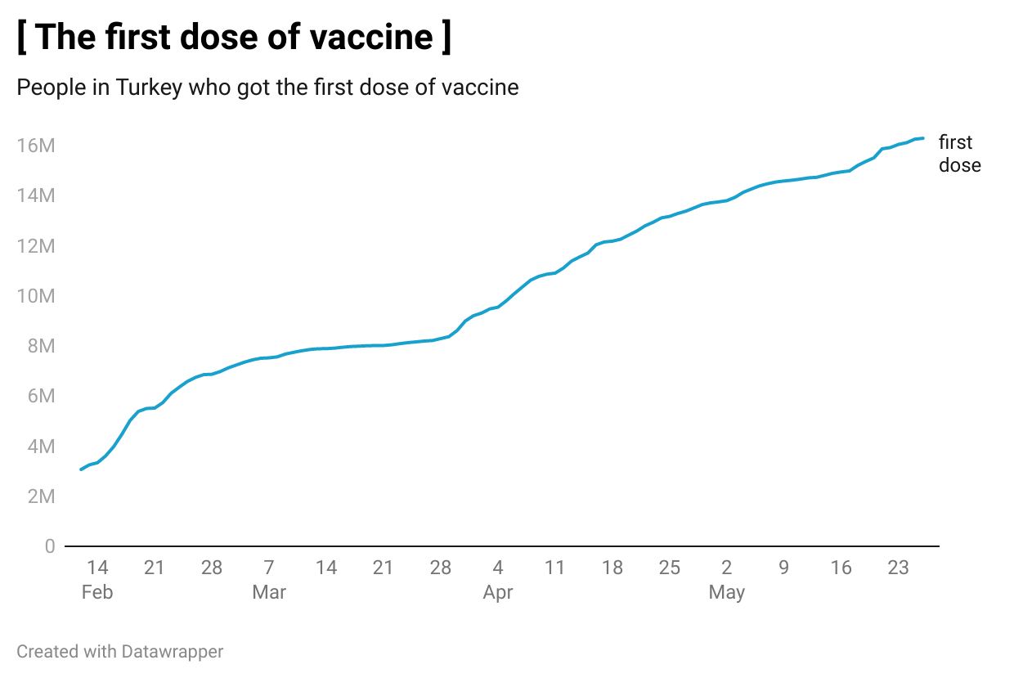
Turkey First Dose Vaccations
As of May 23, the number of people who received the first dose of Covid-19 vaccine in Turkey is 16 million. This rate constitutes 19% of Turkey's population ratio.

Slide 6
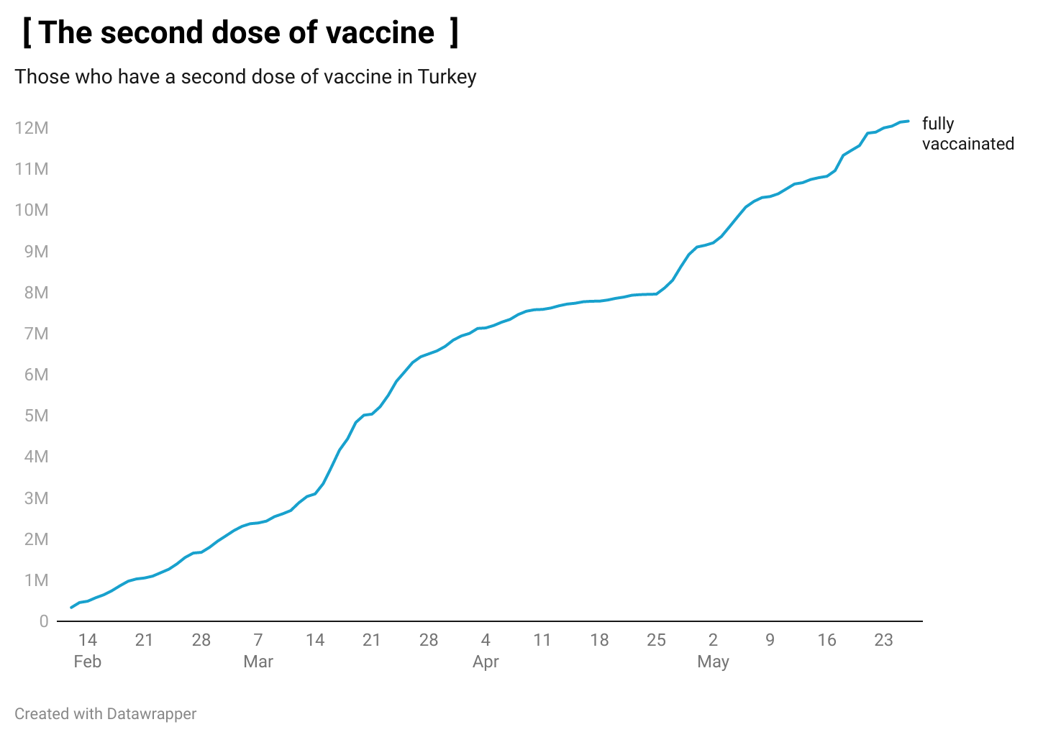
Turkey Second Dose Vaccations
As of May 23, the number of people who received the second dose of Covid-19 vaccine in Turkey is 12 million. This rate constitutes 14% of Turkey's population ratio.

Slide 7
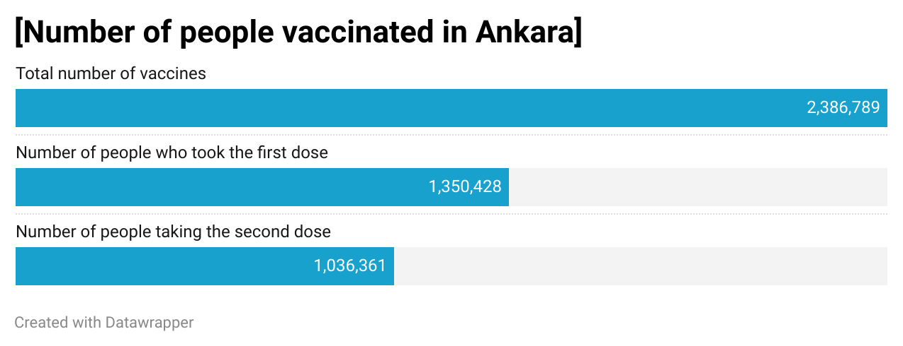
Number of people vaccainated in Ankara
In this graph, the total number of people vaccinated in Ankara, the number of people who received the first dose of vaccine and the number of people who received the second dose of vaccine are shown.

Slide 8
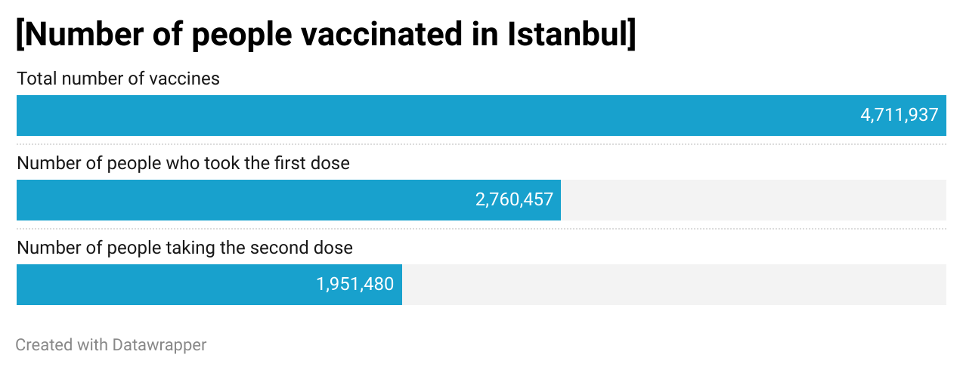
Number of people vaccainated in Istanbul
In this graph, the total number of people vaccinated in Istanbul, the number of people who received the first dose of vaccine and the number of people who received the second dose of vaccine are shown.

