Slide 1


Projects
Clinical services improvement unit

Slide 2
Projects Name | Assigns to | Start Date | End Date | Status
Workplace wellness program | Dr. Zahra Almajed Dr. Wejdan Al Arqan Fatima Al Eid | 19/09/2022 | Continues | Continues
Antenatal Health Passport Project | Dr. Zainab Al Shams Fatima Al Eid Aminah Alsaleem | 1/9/2022 |  | Almost done
Pediatrics ER Sickle cell Patients MCHD | Dr. Zahra Almajed Fatima Al Eid | 1/9/2022 |  | in progress
Enhanced Recovery After Surgery (ERAS) | Dr. Fatimah Al- Shehab Aminah AL -Saleem | 20/07/2022 |  | in progress
Home Health Care | Dr. Fatimah Al- Shehab Aminah AL -Saleem | 27/06/2022 |  | in progress
Outpatient Coding In MCH | Aminah Alsaleem | 27/07/2022 |  | in progress
Trigger tool | Dr. Zahra Almajed Dr. Maryam Almazen Dr. Fatima Al Shehab |  |  | in progress
Digital Health Program | Dr. Maryam Almazen | 13/09/2022 |  | in progress
newborn discharge | all team
newborn reports | Dr. Wejdan Al Arqan | 29/09/2022 |  | in progress
CHI | Dr. Wejdan Al Arqan |  |  | in progress
Projects Dashboard

Slide 3
Work place wellness program
Dr. Zahra Almajed
Dr. Wejdan Alarqan
Fatima Al Eid

Slide 4
Definition and aims
It is a project to Increase wellness and awareness of common staff complaints
To increase the awareness of common disease

Slide 5
Action plan/Tasks (Breast cancer)
Project start date: 19/09/2022 Status: continues
Task | Date | Assign to | note | Status
Meeting with Dr. Ahmed | 22-sep | Dr. Zahra Dr. Wejdan Fatima AlEid |  | done
Breast cancer campaign | 6-oct | Dr. Zahra Dr. Wejdan Fatima AlEid |  | done
Breast cancer survey | All october |  | By emails + round | In progress
Breast cancer education | All octeber |  | By emails + round + on staff clinic | In progress
Breast feeding session | 19 oct | Ms. Hannan breast feeding educator |  | done

Slide 6
Action plan/Tasks (Breast cancer)
task | Assign to | date | note | status
Collect data for the Mammogram | Dr. Zahra Dr. Wejdan Fatima AlEid |  | Collecting data from HR and filter it in excel sheet + using HIS for taking Mobile number for each staff | In progress
Mammogram appointment | Dr. Zahra Dr. Wejdan Fatima AlEid | 23-October | Calling each staff to arrange appointment to reach our target 60% | In progress
Report EHC | Dr. Zahra Almajed | End of october |  | In progress
Deadline | End Of October | End Of October

Slide 7
Action plan/Tasks (Workplace Wellness Workshops )
task | Assign to | date | note | status
Meeting with nutrition | Dr. Zahra Dr. Wejdan Fatima AlEid
Meeting with physiotherapy | Dr. Zahra Dr. Wejdan Fatima AlEid
Meeting with mental health | Dr. Zahra Dr. Wejdan Fatima AlEid
Deadline | December | End Of October

Slide 8
task | Assign to | date | note | status
Survey for arrangements | Dr. Zahra Dr. Wejdan Fatima AlEid |  | By emails | In progress
Send invites | Dr. Zahra Dr. Wejdan Fatima AlEid |  | By emails | In progress
Work shops | Dr. Zahra Dr. Wejdan Fatima AlEid | Start in November and it will be continues |  | In progress
Survey | Dr. Zahra Dr. Wejdan Fatima AlEid | End of each workshop |  | In progress
Report | Dr. Wejdan | End of workshops |  | In progress
Deadline | December | End Of October

Slide 9
Antenatal Health Passport
Project
Members:
- Dr.Zainab Alshamis
- Fatimah Al-Eid
- Aminah Al-Saleem

Slide 10
Definition and Aims
It is a document for the mother from the beginning of her pregnancy to six weeks after birth, and the Baby from his birth until he reaches twenty-eight days
Aims:
Reduce infant mortality
Ensure good health of mother and infant during pregnancy and delivery.
Monitor the health of both mother and child.
Improve quality of health care and awareness.

Slide 11
Action plan / Tasks
Action | Status | Responsible
Pregnancy Classes pathway | Done | Ms.Aminah Al-Saleem
Dashboard | Done | Ms.Fatimah Al Eid
Technical part | Done | Dr. Ahmed Alghanem
Safe Birth Pathway | Done | Dr. Nada Al-faleh
Midwife Clinic | Pending | Ms.Naflah
Arrangement with AL-Nour PHC & Bader PHC | Done | Dr.Fdia (Bader PHC) Dr.Murtadah (Al-Nour PHC)
GO LIFE | October | All Team
Tracking (Coordinators ) | Done | MCHD PHC

Slide 12
Pediatrics ER Sickle cell Patients MCHD
Members:
- Dr. Zahra Almajed
- Fatimah Al-Eid

Slide 13
Definition and Aims
It is a project for Sickle Cell Patients who arrive at the hospital through the ER and take time to receive the Painkiller for more than 30 Minutes
Aims:
To Provide effective care within 30 minutes and meet patients needs.
Reduce the Number of Patients who didn’t receive Painkiller with 30 minutes.
Improve the Quality services in ER.
Meet 85% of the patient’s satisfactions.
Increase up to 70% of the patient’s awareness.

Slide 14
Action plan / Tasks

Slide 15
Enhanced Recovery After Surgery (ERAS) Program In MCH
Members:
- Dr. Fatimah Al- Shehab
- Aminah AL -Saleem
- Esraa Al-Faraj

Slide 16
Definition and Aims
Enhanced Recovery After Surgery (ERAS) is a multimodal perioperative care pathway ,designed to achieve early recovery for patients undergoing surgery.
Aims:
High quality care for less cost
20-40 % reduction in non surgical complication
20-40 % reduction in hospital length of stay.
40 % reduction in post surgical care cost.

Slide 17




Enhanced Recovery After Surgery (ERAS)
ERAS Detention
Enhanced Recovery After Surgery (ERAS) is a multimodal perioperative care pathway designed to achieve early recovery for patients undergoing surgery.
ERAS will enhance:
Reduce length of stay & Better Health Outcome
Reduce length of stay & Better Health Outcome
Quality of Care
Quality of Care
Patient Safety
Patient Safety
Health Outcome
Health Outcome
ERAS Focus Group:
ERAS in this initiative focus on giving standardized guidelines and recommendations for perioperative care, intraoperative, and postoperative phases to reduce length of stay of women after cesarean delivery.
Patient
Health

Slide 18
Action plan / Tasks
Task | Action plan | Responsibility | Timeframe | Outcome | Status
1 Workflow | Clear multidisciplinary pathway of ERAS patient. | Dr.Ayman Azab ( Anesthesia – Chairman Eras) | 20-8-2022 |  | Done
2 Patient Awareness | Education and increase awareness | Dr.Ghada Al-Olyani (OB-Gyne Nadia Al -Jishi(Health Education) | 26-7-2022 |  | Done
3 Medications | Request medication | Abdullah Al-Nahawi ( Head of pharmacy) | 16-8-2022 | In progress | Partially Done
4 KPIs | Will be collected by OR access team , post operative department and OR team then submitted to ADAA | Zahra Al –Zaher(Head Nurse Of Post Operative Department ) Eman Al- Galaf (OR Access team ) Mehad Zahra Al Muslim (ADAA) | 30-12-2022 |  | In Progress

Slide 19
Task | Action plan | Responsibility | Timeframe | Outcome | Status
5 Policy | Review and modify the policy with multidisciplinary department | Aymen Azeb( Anesthesia – Chairman Eras) Dr.Gada Al-Oliani (OB-Gyne Consultant) Mai Al-Omairi Sukaina Al-Moaliem (QIPS) Alia Al- Binali (Nursing Department) Nadia Al-jishi (Education Department Hanan Al-Qahtani(Dietitian Dept.) Thurya Al-shiek(Physiotherapy Department) Hameeda Fatimah Al-Shehab(project Leader) Esraa Al-Faraj (Clinical Audit ) Aminah al-Saleem(Clinical improvement service coordinator) | 6-10-2022 |  | done
6 HHC | Adding ERAS patient to home health care visit | DR. Hassan Al Hashem (head of HHC Department) HHC team | 30-11-2022 | Education and training | In progress

Slide 20
Definition and Aims
It is a health or supportive care provided by a professional care giver at patient home .
Aims:
Number of new patients added to the HHC program: expect to add 15-20 patients every
Number of wound infection decrease by 50%
increase the number of patient accepting ERAS by 20% every quarter.
Improve the Quality services in HHC.
Meet 80% of the patient’s satisfactions.
Increase up to 80% of the patient’s and health care provider awareness.

Slide 21
Action plan / Tasks (ERAS)
Task | Responsibility | Resources | Timeframe | Outcome | Status
Meet the involved staff to agree about the broad lines | Dr. Hattem Al-Hani. Dr. Mai Omairi Dr. Fatimah Al-Shehab Esraa Al –Faraj Aminah Al-Saleem Dr. Hassan Alhashem | Meeting and brain storming | 5/10/2022 | Agreement about the project and assignment of team | Done
Start educating HHC nursing staff on wound care. | Dr. Hattem Al-Hani Education department (Nahed Abozaid) | Lectures and hands on. | 27-10-2022 | Improve the staff competency and adding new scope of services. | pending
Giving privilege to nursing staff on wound care | Wound care nurse + surgeons |  | 27-11-2022 |  | Pending
Screening of the candidate patient based on fit criteria by Ob/Gyn assigned staff | Ob/Gyn nurse. | HIS, geographic area | 27-11-2022 | Include the final fit patients to our HHC services. | Pending
Schedule the fit patient to our HHC program for first visit within 1 week | HHC coordinator | HIS | 1-12-2022 |  | pending

Slide 22
Action plan / Tasks(ERAS)
Task | Responsibility | Resources | Timeframe | Outcome | Status
Train and privilege more nursing staff to enable them taking care of Ob/Gyn patient | Nurse Abdullah Haran. Nurse: Shwga Nurse Fatimah Jaroudy |  | 27-10-2022 | Increased the number of privilege nurses. | Pending
Continues Monitor An Aggregation Of The KPI Result , And Follow Up Action Progress | Majd Almarhoun Zahra almuslim | Ada’a KPI | 1-12-2022 | improving the results of KPI | pending

Slide 23
Action plan / Tasks(Gastrostomy)
Task | Responsibility | Resources | Timeframe | Outcome | Status
Meet the involved staff to agree about the broad lines | Dr. Fatimah AlSheheb Esraa Al-Faraj Aminah Al-Saleem Dr. Hassan Alhashem | Meeting and brain storming | 31th July 2022 | Agreement about the project and assignment of team | Done
Assign surgical nurse expert in gastrostomy care and privileged to changed the tube to be part of project team. | Dr. Abbas makki |  | 10th August 2022- 30 September 2022 | Improve the staff competency and adding new scope of services. | done
Provide the list of candidate patient for this services | Surgical nurse | HIS | 1st September - 30 September 2022 |  | done
Screening of the candidate patient based on fit criteria | Dr.Faisal Alseraihi HHC coordinator Nurse.Rahma Alshargawi | HIS, geographic area and phone calls | 1st September-30 September 2022 | Include the final fit patients to our HHC services. | done

Slide 24
Action plan / Task (Gastrostomy)
Task | Responsibility | Resources | Timeframe | Outcome | Status
Schedule the fit patient to our HHC program for final visit. | HHC coordinator + Surgical nurse | HIS | 18th September-20th October 2022 |  | done
Continues Monitor An Aggregation Of The KPI Result , And Follow Up Action Progress | Majd Almarhoun Zahra almuslim | Ada’a KPI | 1st September – 29th december 2022 | improving the results of KPI | Pending

Slide 25
Outpatient Coding In MCH
Members:
- Fatimah Jaber
- Aminah Al-Saleem

Slide 26
Definition and Aims
It is a project amid to set all locations in HIS to be related to MCH service only and exclude the unknown one with an accurate coding to all health care provider in HIS .
Aims:
To Provide accurate data to the health care provider . Reduce the.
Improve the input in the statistics department .
Code all care giver with a proper and clear way.
Eliminate all useless data which will give inaccurate result to the statics department and Data Center .

Slide 27
Action plan / Tasks
Task | Responsibility | Timeframe | Outcome | Status
1 Set all locations in HIS and exclude all unknown locations | Statics department HIS team(WED) Fatimah Jaber(Data Center) Aminah AL-SaleemAL-Saleem(Clinical Improvement Service Coordinator) | 15-8-2022 | All locations set up accurately. | done
2 Coding all care giver in HIS . | Dr. Nada Al-Faleh(head of Gyne OPD) Dr.Fahad AL-Harbi(Head of Pedia OPD) HIS Team(Maha AL-Jamea) Fatimah Jaber(Data Center) Aminah AL-Saleem(Clinical Improvement Service Coordinator) Mohammad AL-Omran (head of Allied Department ) | 15-11-2022 |  | In progress

Slide 28
Trigger tool
Members:
- Dr. Zahra Almajed
- Dr. Fatimah Al shehab
- Dr. Maryam Almazen

Slide 29
Definition and Aims
The Trigger Tool methodology isa retrospective review of closed medical records using “triggers” (or clues) to identify possible adverse events
Aims:
Measuring Adverse Events.
help accelerate change by improving patient care and turning this ideas into actions
improving quality and safety in MCH services
improve the quality of health care provider documentation.

Slide 30
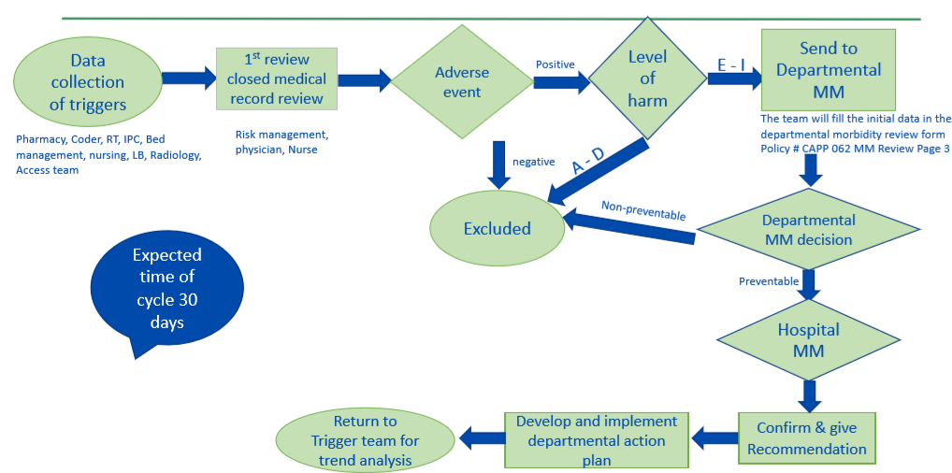
Action plan/ tasks

Slide 31
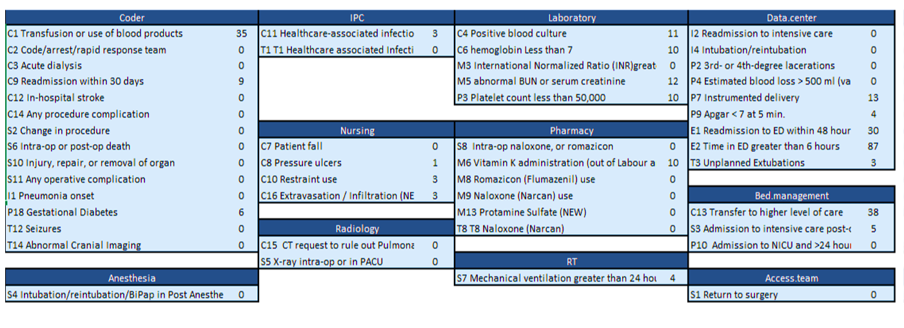
List of triggers

Slide 32
Newborn discharge
All unit Members

Slide 33
Aims
To reduce the time of newborn discharge
Improve discharge process

Slide 34
Other Projects and Unit activities

Slide 35
Project / activity | members | Start date | Status
Review of unplanned readmitted patients within 30 days in MCHD during 1st and 2nd quarter of 2022 | Dr Zainab Alshams Dr. Maryam Al Mozain | 18/08/2022 | Completed on 28/08/2022
Renew of disclosure of patient safety event policy |  | 10/08/2022 | Completed on 08/09/2022
Renew of assessment and reassessment of patient policy |  | 10/08/2022 | Completed on 27/09/2022
Review of long stay in NICU for month of June / July/ August |  | 14/09/2022 | In progress
Review of unplanned readmitted patients within 30 days in MCHD during 3rd and 4th quarter of 2022 |  | 02/10/2022 | In progress
Activation of Ob/Gyn Employee clinic |  | 30/08/2022 | completed
Creating a policy of Ob/Gyn Employee health care clinic |  | 30/08/2022 | In progress
Digital Health Program | Dr. Maryam Al Mozain | 13/09/2022 | In progress
Activation of safe birth clinic | Dr Zainab Alshams | 30/08/2022 | In progress

