Slide 1
UniShell: Your Personal Assistant for a Balanced Work-Life
Hamza zarah & Albert jasari
Notes:
Student A
Good day, everyone. We are excited to present our project, UniShell: Your Personal Assistant for a Balanced Work-Life. I am Hamza and my colleague is Albert

Slide 2
Problem: Definition and explanation of the project idea
Working on a computer for extended periods can lead to health and productivity issues
Lack of movement, dehydration, and poor time management are common problems
Need for reminders to take breaks, drink water, and manage time effectively
Notes:
Student A
The core problem we identified is the challenge of health and productivity issues associated with prolonged computer use. Many of us, whether studying or working, tend to sit in front of a computer for extended periods, leading to problems like lack of movement, dehydration, and poor time management. Our project idea is rooted in the need for a solution that provides reminders to take breaks, drink water, and manage time effectively.

Slide 3
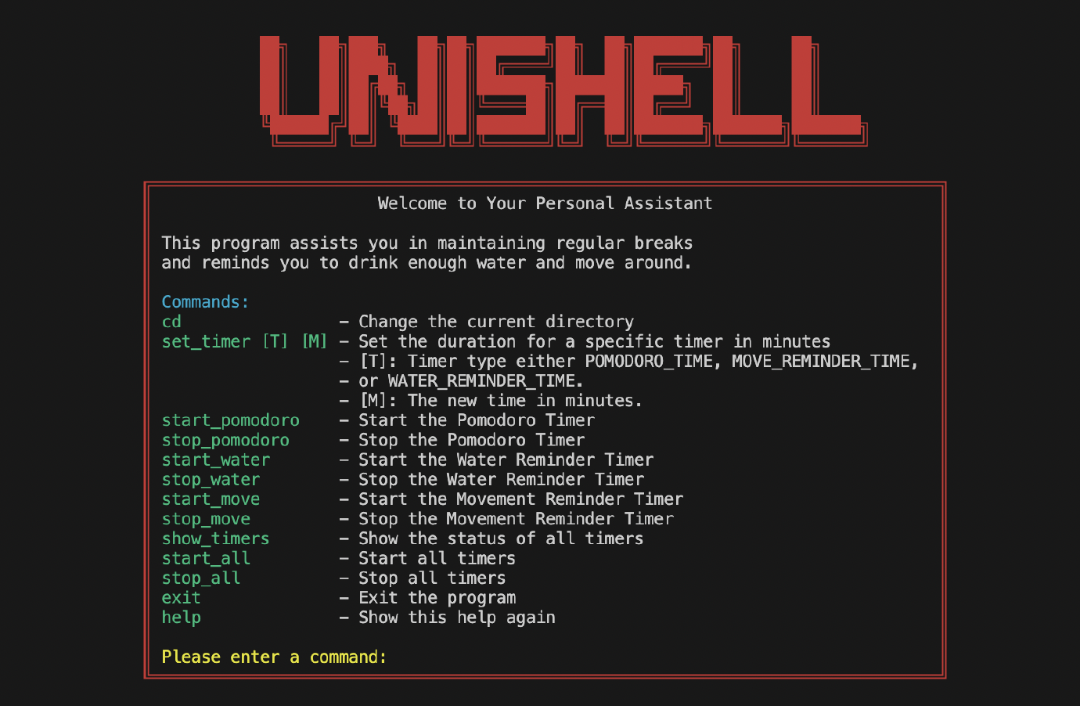
Solution: Introduction to UniShell
Developed Unishell – a personal productivity assistant in the shell
Implemented in C, utilizing multithreading and signal handling
Provides reminders for Pomodoro technique, hydration, and physical movement
Notes:
Student B
As a solution, we developed UniShell, a personal productivity assistant that resides right in your shell. It is implemented in C, and uses multithreading and signal handling to perform its tasks. It provides reminders based on the Pomodoro technique for efficient time management, as well as reminders for staying hydrated and encouraging physical movement.

Slide 4
Solution
Pomodoro Technique
Hydration Reminder
Movement Reminder
Pomodoro Technique breaks work into intervals separated by short breaks
Helps maintain focus and prevent burnout
Unishell’s Pomodoro Timer implements this technique
Dehydration can lead to decreased cognitive performance
UniShell’s Hydration Reminder encourages regular water intake
Periodic notifications remind the user to stay hydrated
Extended periods of sitting can lead to health issues
UniShell’s Movement Remider encourages regular physical activity
Regular prompts to get up and move around
Notes:
Student B
The Pomodoro Technique implemented in UniShell breaks work into intervals separated by short breaks. This helps maintain focus and prevent burnout. Our Hydration Reminder system periodically notifies the user to take a water break to prevent dehydration. And, last but not least, our Movement Reminder, rather than encouraging users to get up and move around, suggests various desk-friendly exercises to keep the body active and relaxed. These exercises include neck stretches, shoulder shrugs, hand and wrist stretches, seated spinal twists, leg extensions, ankle rolls, and deep breathing. These simple movements can help counteract some of the physical strain associated with prolonged sitting and computer use.

Slide 5
demo
Notes:
Student A
[Present a live demo or a recorded video demo of UniShell. Walk the audience through a typical use case, highlighting the features and functionality. Explain what is happening at each step of the demo.]

Slide 6

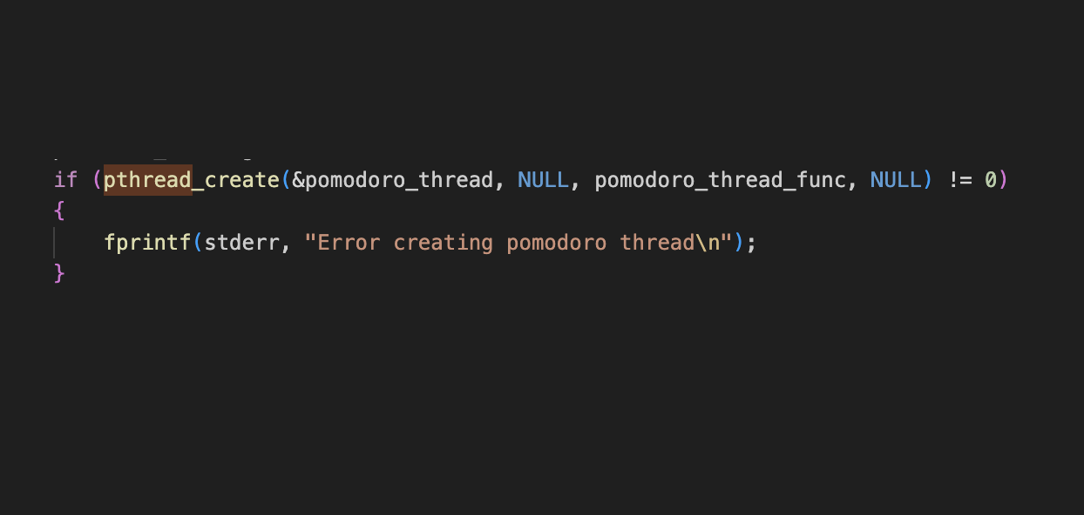
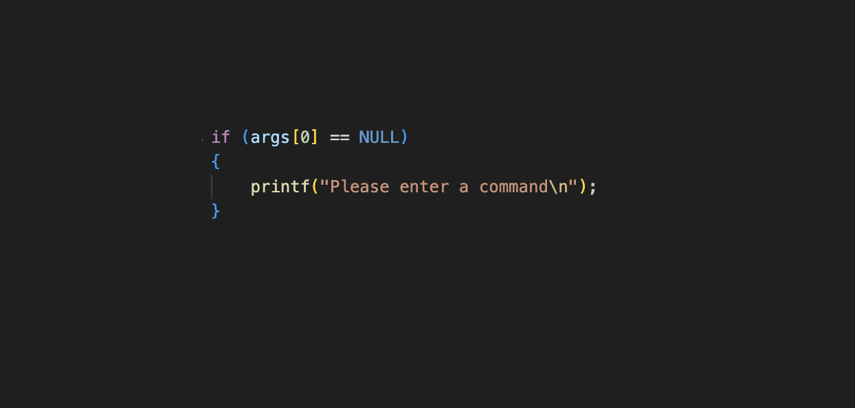
Lessons learned
C Programming
Multithreading and signal handling
Error checking and exception handling
Gained experience with C programming
Learned about multithreading and signal handling
Importance of error checking and exception handling in software development
Notes:
Student B
Throughout this project, we've learned a great deal. We've gained valuable experience with C programming. We've learned about the intricacies of multithreading and signal handling. We also realized the importance of error checking and exception handling in software development to create robust and reliable applications.
Take, for instance, the concept of multithreading. To allow Unishell to perform several tasks simultaneously, we used multiple threads. Here, for example, is a snippet of our code where we create a separate thread for the Pomodoro timer.
This piece of code initiates the Pomodoro timer in a new thread. If the creation fails, an error message will be displayed, ensuring that any failure in thread creation doesn't cause the whole program to crash. And here is an other example where we used error checking in our command processing: In this code snippet, we check if the user has inputted a command or not. If not, the application prompts the user to enter a command, ensuring that the program doesn't try to execute an empty command, which could lead to unexpected behavior or errors.

Slide 7
CONCLUSION
UniShell is an effective tool for improving productivity and maintaining health
Future improvements: customize reminder messages, add more productivity techniques
Thank you! Questions?
Notes:
Student A
In conclusion, we believe UniShell is an effective tool for improving productivity and maintaining health during long work sessions.
Student B
For future improvements, we are considering allowing users to customize reminder messages and adding more productivity techniques.
Student A
Thank you for your attention! We'd be happy to answer any questions you may have.

