Slide 1
TrackMate: University Bus Tracking System
Groups Members
M Hamza 23-NTU-CS-1186
M Hassan 23-NTU-CS-1036
M Zarar 23-NTU-CS-1030

Slide 2

The Problem: Untracked Buses
National Textile University (NTU) lacks a real-time bus tracking system. Students face inconvenience, missed buses, and unnecessary waiting due to:
Estimated timings and manual coordination.
No visibility into bus movement or delays.
Reduced efficiency in university transportation.

Slide 3
Our Solution: TrackMate Objectives
2
Real-time Tracking
Live Location
Route Visualization
Design and develop a system for NTU buses.
Track bus location using GPS technology.
Display bus routes and stops on a digital map.
Status Determination
Scalable System
Identify bus status (moving, stopped, in traffic).
Build a system expandable to multiple buses.

Slide 4
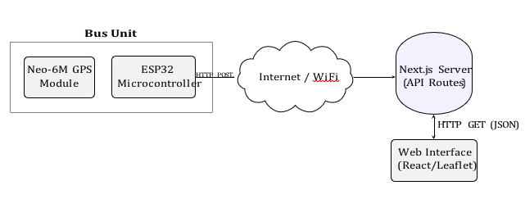
System Architecture
TrackMate uses a client-server architecture. An ESP32 with a Neo-6M GPS module sends data to a Next.js backend. The backend processes data, stores it, and exposes APIs for a web-based frontend.

Slide 5




Key Components
ESP32 + Neo-6M GPS
Collects real-time latitude and longitude data.
Backend Server
Next.js API for data processing and storage.
Web Frontend
Interactive map interface for display.
Internet / Wi-Fi
Network for data transmission.

Slide 6
Hardware & Software
Hardware Components
Software Components
Next.js (JavaScript): Backend API development and frontend integration.
ESP32 Microcontroller: Processes GPS data, sends to server via Wi-Fi.
Node.js: Runtime environment for server execution.
Neo-6M GPS Module: Provides real-time geographical coordinates.
Leaflet (Map Library): Displays routes, stops, and live bus location.
(Currently, one ESP32 and one GPS module represent one bus.)

Slide 7
Start: ESP32
Operational Flowchart
Initialization
Input: Read GPS
(
Lat, Lon, Speed
)
Output: HTTP POST
to Backend
Backend: Store
Data in Memory
The Flowchart illustrates the step by step logic, from hardware initialization to real time web visualization.
Status = Stopped
≤
1
v
≥
10
Status = Moving
)
(
v
≤
1
km/h)
Check Speed (
(
v
≥
10
km/h)
1
<
v
<
10
Status = Traffic
(
1
<
v
<
10
km/h)
Input: Frontend
HTTP GET Fetch
Update Map
Marker & Path

Slide 8





Methodology: How It Works
GPS Data Reading
GPS module continuously reads bus location.
Data Transmission
ESP32 sends GPS data to backend via HTTP POST.
Backend Processing
Backend stores data, calculates bus status.
Frontend Fetching
Frontend fetches latest bus data via GET requests.
Map Display
Live location, route, and stops shown on map.

Slide 9
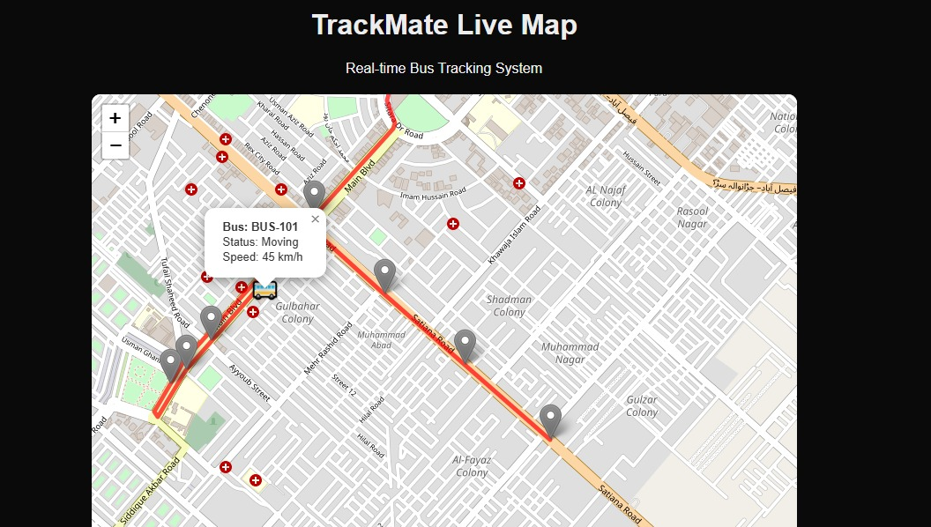
TrackMate in Action
The system successfully tracks and displays real-time bus location, status, routes, and stops on a digital map. Backend APIs are reliable and responsive.

Slide 10
Conclusion & Future Scope
Conclusion
Future Scope
TrackMate effectively solves university bus tracking, integrating IoT, web technologies, and real-time data. It's a strong foundation for scalable transportation monitoring.
Multiple bus integration with unique IDs.
GSM module for mobile data communication.
Real-time notifications for students.
Bus arrival time prediction.
Admin dashboard for route management.
Mobile applications (Android/iOS).

