Slide 1
Strategic Performance Audit: Path to Profitability
Analysis of the Superstore Sales Ecosystem (2014–2017)

Slide 2
Business Context
Operating in 48 States.
Challenge: High revenue growth vs. inconsistent profit margins.
Goal: Identify "Profit Leaks" and optimize discounting.

Slide 3
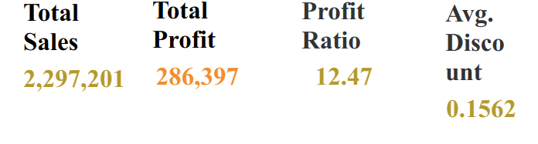
Data Overview
9,900+ Transactions.
$1.9M Total Sales | $239K Total Profit.
Categories: Furniture, Office Supplies, Technology.

Slide 4
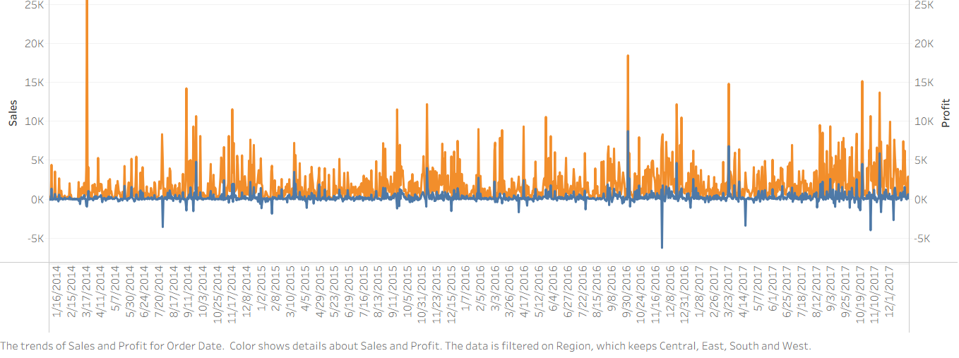
Sales Trends (The Growth Story)
Steady year-over-year growth.
Significant Q4 seasonality.

Slide 5
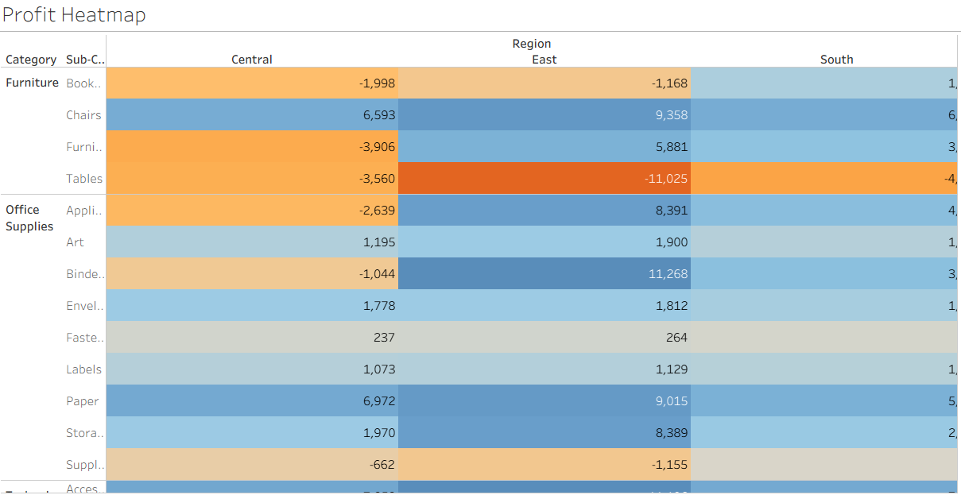
Profitability Analysis (The Category Problem)
Technology is the leader.
Furniture (Tables/Bookcases) is underperforming.

Slide 6
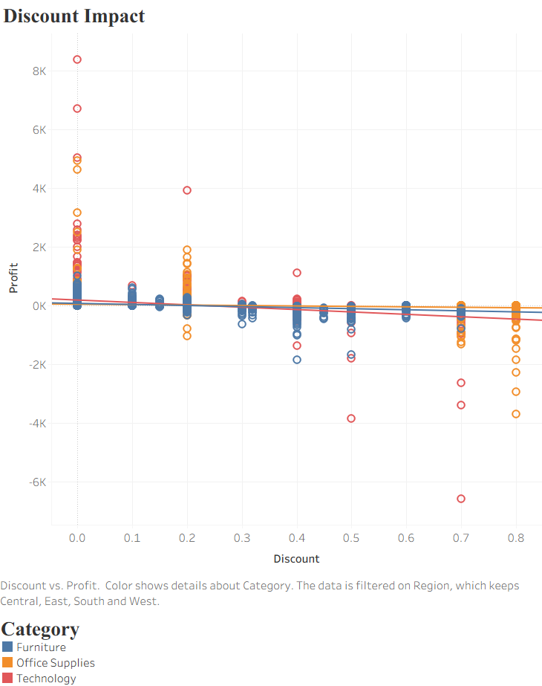
Discount Strategy (The 'Why')
Average Discount: 15.8%.
The "20% Breaking Point."

Slide 7
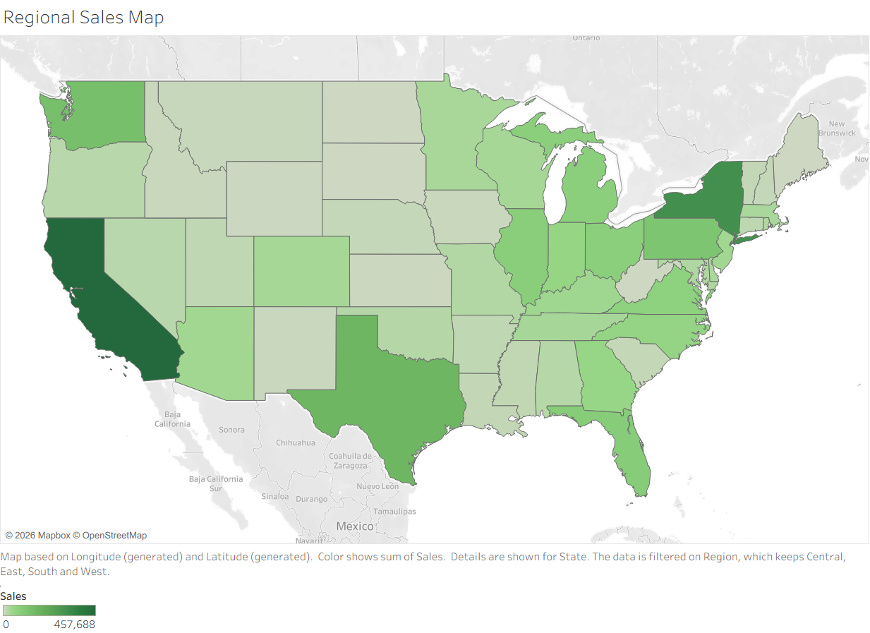
Regional Performance (The 'Where')
Top States: NY & CA.
Problem State: Texas (-$25k loss).

Slide 8
Key Recommendations
The 20% Rule: Cap discounts on Furniture.
2. Texas Audit: Investigate logistics/shipping costs in the South.
3. Pivot to Tech: Reallocate marketing budget to high-margin electronics.

Slide 9
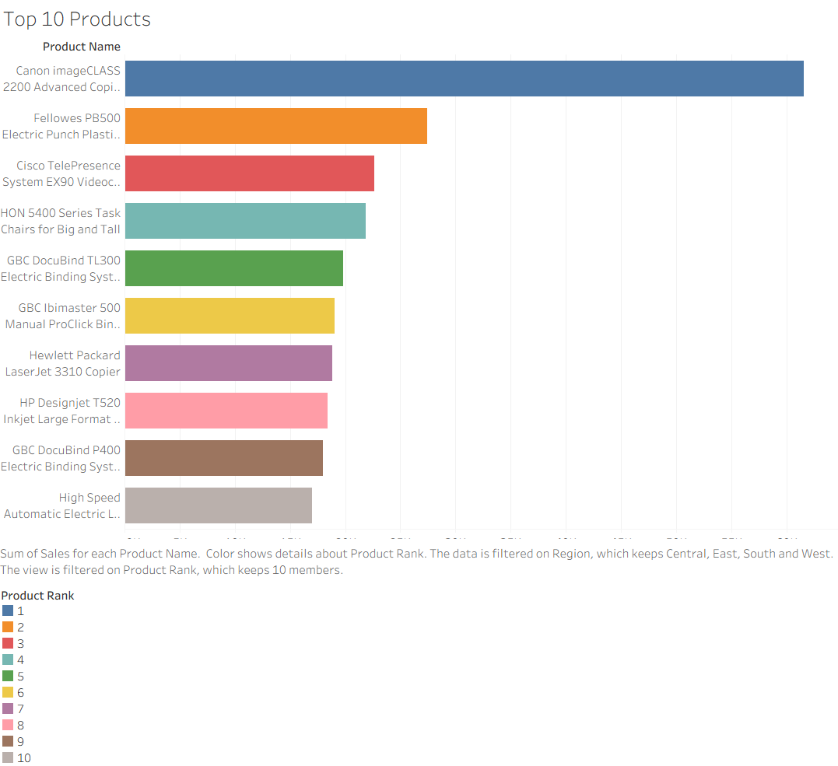
Conclusion
Data-driven decision making.
Target: 18% Profit Ratio.
Questions?

