Slide 1
Capstone 2: Business Analysis with Python
Hamzah Alssoudi
05/29/2026
Northeast Region Analysis
Maryland & Massachusetts Territories

Slide 2
BUSINESS QUESTIONS
Python sales analysis project
Analyzed Maryland and Massachusetts territories
Used Jupyter Notebook with Pandas, NumPy, and Matplotlib
Same region (Northeast), 2022 through 2025
Goal: identify trends and where to focus marketing next quarter
2

Slide 3
QUESTION 1: TERRITORIES
Maryland
Massachusetts
Manager: Shruti Reddy
Manager: Bo Heap
9
18
stores
stores
Annapolis, Back River, Baltimore, Germantown, Howard, North Harford, Parkville, Queen Anne's County, Ridgely
Boston, Attleboro, Falmouth, Framingham, Haverhill, Hingham, Holyoke, Leominster, Lowell, Lynn, Nantucket, New Bedford, Northampton, Pittsfield, Provincetown, Quincy, Somerville, Worcester
3

Slide 4
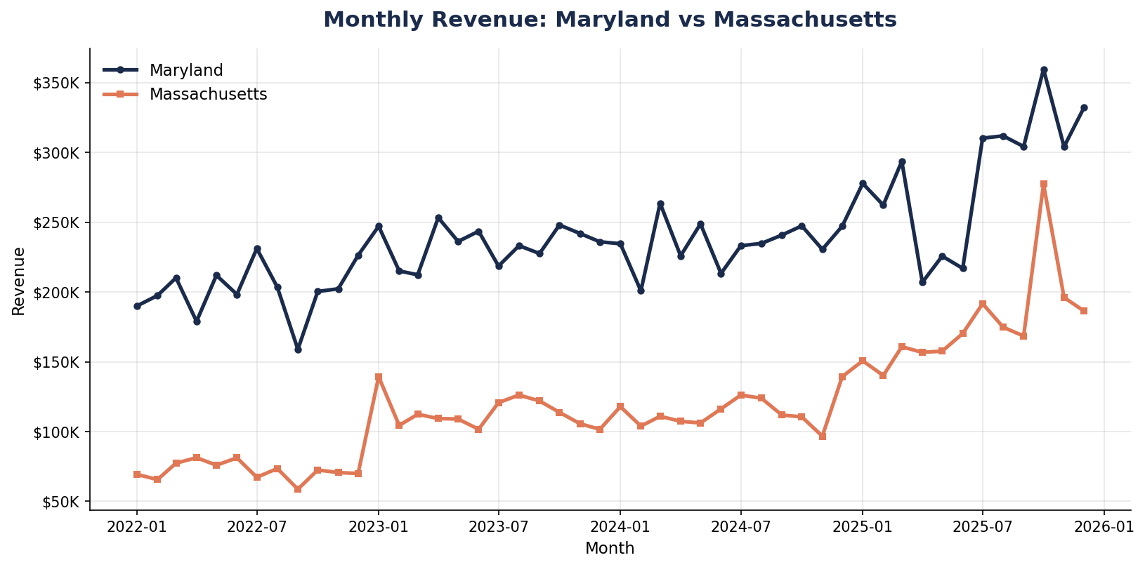
QUESTION 2: MONTHLY REVENUE
Finding
Maryland out-earns Massachusetts every single month, even with half the stores.
Both have seasonal peaks (back-to-school). Both trend up over time.
4

Slide 5
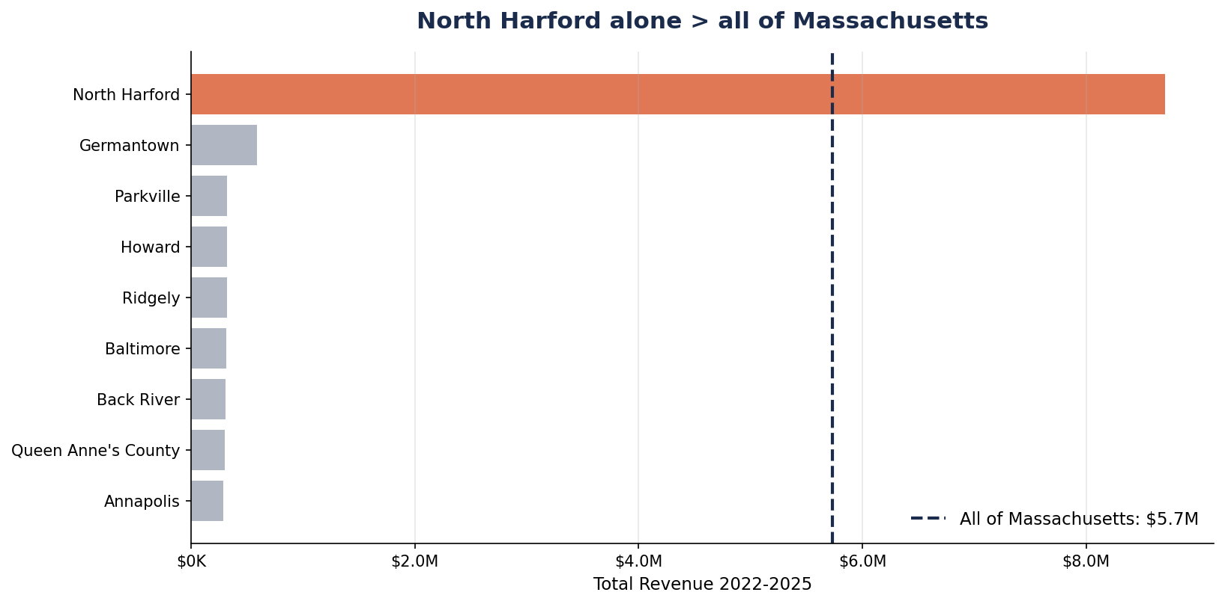
QUESTION 3: STORE PERFORMANCE
The Key Finding
$8.8M
North Harford alone
More than all 18 Massachusetts stores combined ($5.7M).
5

Slide 6
QUESTION 4: TOP CUSTOMERS
Joining rewards data
Joined sales to customer list on RewardsID = cust_id.
Only 10% of transactions are linked to a known customer — the other 90% are anonymous.
Top spenders are the natural targets for loyalty offers and re-engagement.
Top 5 customers (Maryland)
Cust ID | Name | Total Spend
180 | Cole Brown | $7,602.28
355 | Donna Hayward | $7,081.17
467 | Avon Barksdale | $6,172.68
99 | Trent Lane | $6,076.89
75 | Magnitude | $5,916.81
6

Slide 7
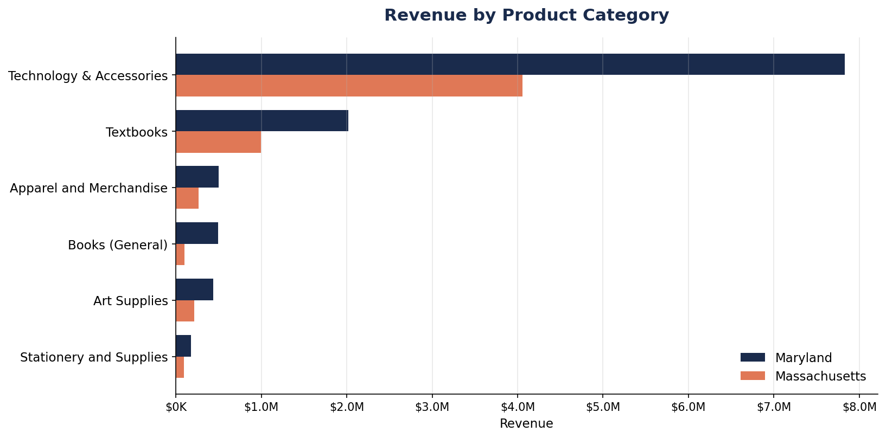
QUESTION 5: PRODUCT CATEGORY ANALYSIS
Finding
Tech & Textbooks drive almost all revenue in both territories.
Smaller categories (Books, Art Supplies, Stationery) are growth opportunities, especially in Massachusetts.
7

Slide 8
QUESTION 6: FINAL RECOMMENDATION
Focus marketing on Massachusetts. Diversify Maryland's risk. Grow rewards.
1
Focus marketing on Massachusetts
18 stores all averaging only $319K each — huge per-store headroom. A territory-wide campaign lifts many stores at once. Momentum already there in 2025.
2
Diversify Maryland
North Harford carries the whole territory — that's a risk, not growth. Build up the other 8 stores so MD doesn't depend on one location.
3
Grow the rewards program
Only 10% of customers are identified. More sign-ups = better targeting on every future campaign in both territories.
8

Slide 9
Thank you
HAMZAH ALSSOUDI / CAPSTONE_2
github.com/hamzahalssoudi/Capstone_2

