Slide 1
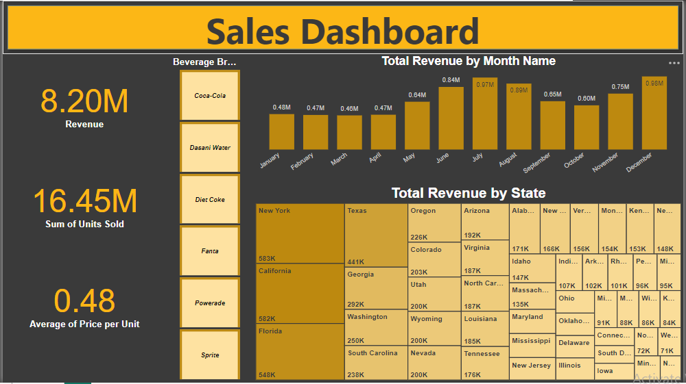
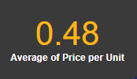
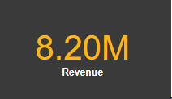
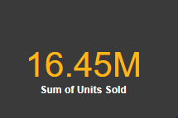
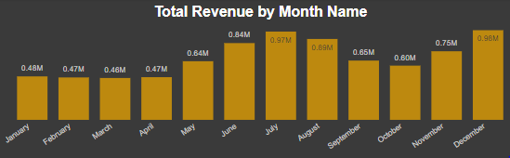
Beverage Sales Analysis by Data Visualization
Combines data cleaning, integration & visualization to uncover insights from U.S. beverage sales data
Hamzah Asghar Farooqi
December 2024

Slide 2
Project Overview
Objective
Analyze U.S. beverage sales data using interactive dashboard to actionable insights into revenue, sales volume & pricing
Key Questions
Total revenue across all brands
Total number of units sold?
Average price per unit across all brands?
Months experience the highest & lowest sales revenue?
Best beverage brand performs well in terms of revenue and units sold?

Slide 3
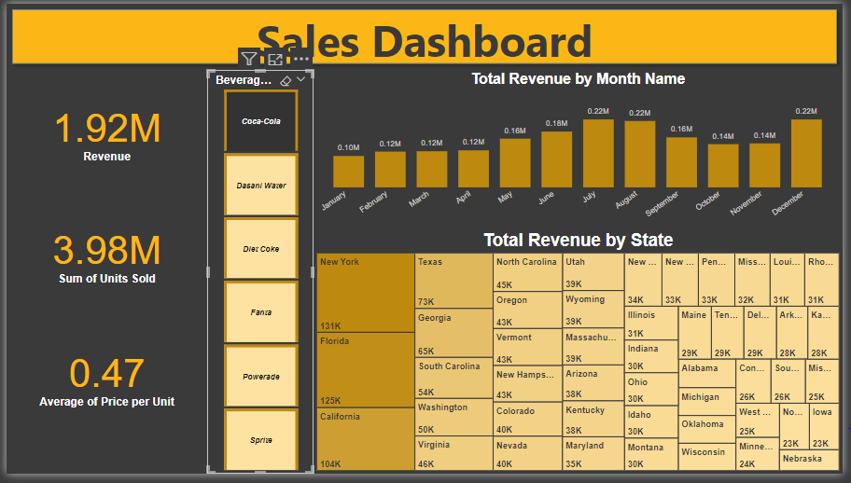
Total Revenue
The total revenue across all beverage brands is $8.20M.
Coca Cola has highest total revenue $1.92M
However, Fanta has $967.88k revenue, the lowest one.

Slide 4
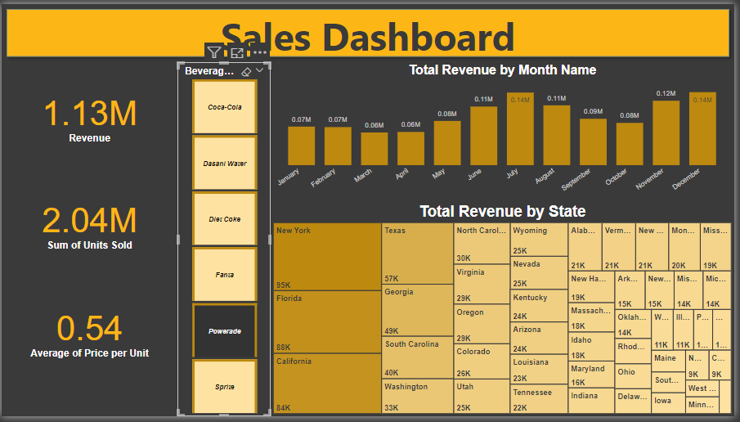
Units Sold
The total units sold is 16.45M units.
Coca Cola has highest Unit sold 3.98M
While, Powerade has 2.04M Sold Unit, the lowest one.
Large volume of sales, reflecting strong market demand for beverages.

Slide 5
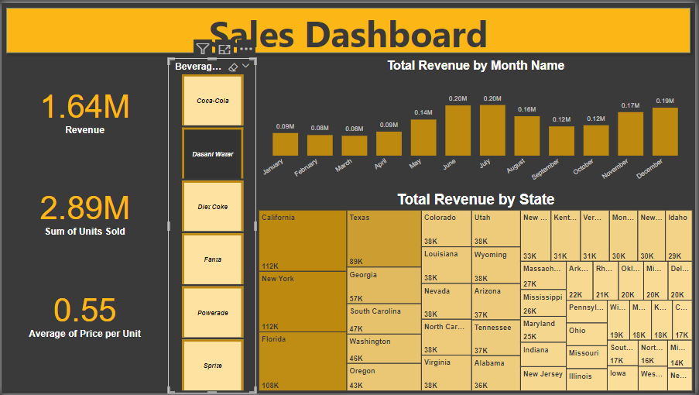
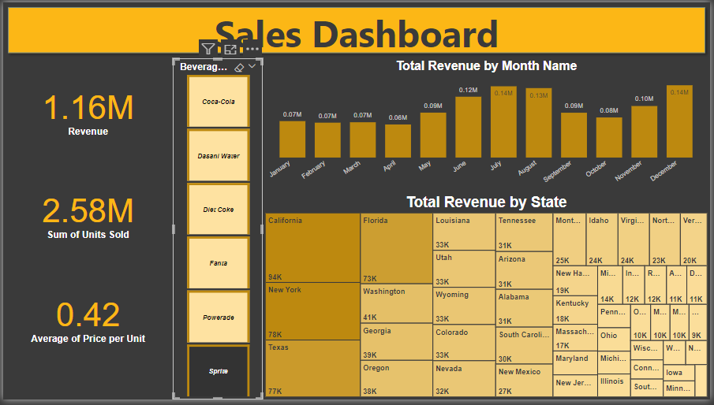
Average Price Per Unit
The average price per unit is $0.48.
Dasni water has highest Price Per Unit is $0.55
While, Sprite has $0.42 Price Per Unit, the lowest one.

Slide 6
Highest & Lowest Sales by Months
Highest Revenue Months:
December: $0.98M
July: $0.97M These months align with holidays or summer peak demand
Lowest Revenue Months:
March: $0.46M
February & April: $0.47M Post holiday slumps or reduced consumer spending during winter months.

Slide 7
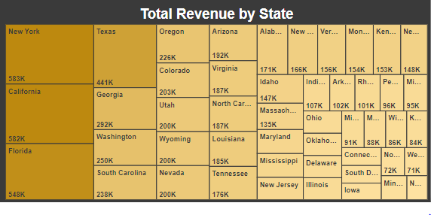
State Level Breakdown
Highest revenue contributors: New York (583K), California (582K) and Florida (548K).

Slide 8
Key Observations & Insights
Sales peak in summer (July) and during year end holidays (December), suggesting opportunities for targeted campaigns during these times.
Coca-Cola regularly outperforms other brands, have strong brand loyalty, effective marketing or higher distribution reach.
The average price per unit of $0.48 indicates an affordable pricing model, likely aimed at maximizing volume.
January to April are weak months presenting opportunities for promotional strategies to boost sales.

Slide 9
Recommendations
Expand Coca-Cola’s product offerings or promotional efforts to maintain and grow its dominant position.
Intensify marketing and inventory planning during July and December to capitalize on peak sales periods.
Introduce discounts, campaigns or bundled offers in January and April to drive sales during these slow months.
Focus on top performing states like New York, California for expansion or targeted campaigns as they contribute significantly to overall revenue.

