Slide 1
Analysis of Cyber Crime Classifications

Slide 2
Agenda
Scope
Analytics Workflow
Results
Conclusion

Slide 3
Scope
Analysis of Cyber Crime Classifications
Databreach
Gov Impersonation
Romance
Business Email Compromise (BEC)
Credit Card

Slide 4
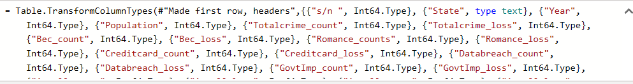
Analytics Workflow - Cleaning the Data
Deleted null rows
Made column title as the headers
Checked the type – Used the query bar
Problem: Tried changing the ‘Year’ data type to DATE – Formatted to 12/07/1995 and 13/07/1995

Slide 5
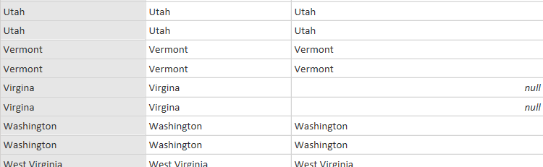
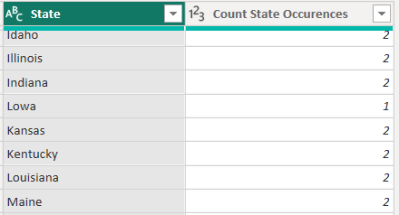
Analytics Workflow - Cleaning States Col
Trimmed column entries
There are 50 states – But there are 51 entries for each year (District of Columbia)
Check for spelling
Found external data on the US states States - United States of America — Opendatasoft
Created a new table of just the original states “Original States”
Then merged the “Original States” with external data
Check for duplicates
Created a new table using DAX
Simultaneously checked for spelling - Lowa

Slide 6
Catch Up
Defined a Scope
Cleaned the Data
Cleaned the States Col
Brief EDA
Results

Slide 7
Key Takeaways & Next Steps
Key Takeaways
Total Number of Cyber Crimes decreased
Databreach and BEC are an area of concern
Loss Increased Significantly
Cyber Crime popular in California and Texas
Next Steps
Track the Number of Cyber Crimes over time
Place measures in California and Texas
Employee opportunities

Slide 8

Thank you
Any Questions?

