Slide 1


Master Big Data Analytics & Smart Systems
Etude de cas en data mining et
analytics
Angine de poitrine
Supervised BY
Prof Mohamed Elfar
Realized BY
Hamza kardate

Slide 2
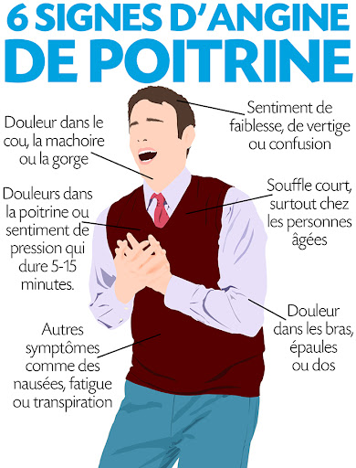
1 -Angine de poitrine :

Slide 3
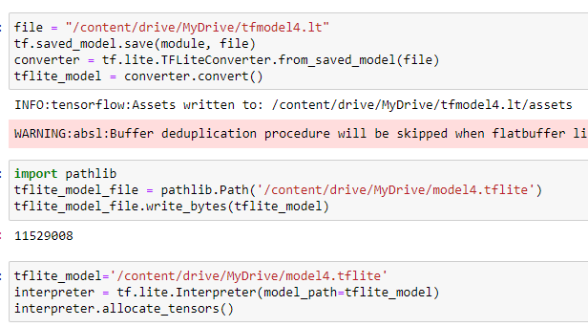

2-TensorFlow lite?

Slide 4
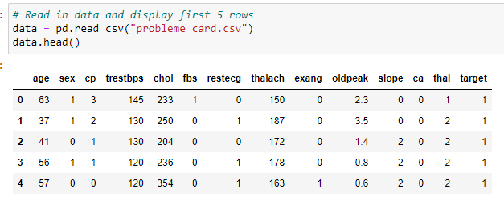
3-Dataset :
https://drive.google.com/drive/folders/1sYT8slzpr1k5usdPitvhKvx3f_3sL1Yh

Slide 5
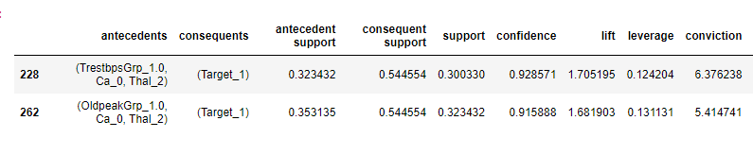
4- Régle d'association :

Slide 6
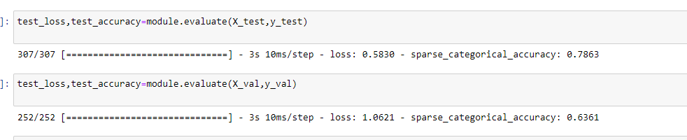
5- module lite tensorflow :

Slide 7


5-Android studio ou kivy ?

Slide 8
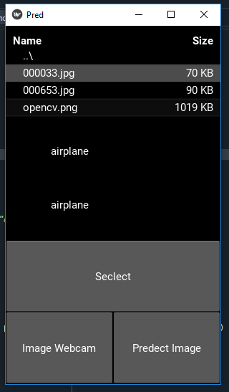

Slide 9
Interface
Android
Studio :

Slide 10


