Slide 1
Instructions for Visualization and Analysis Demos
You have 3 minutes to present – be ready to share your screen, practice first. We can only offer you one opportunity to present. Present your slides in “Slide Show” mode. Presentations will take place during the module Tutorial slots (see Announcements for links to join the Tutorials via Teams).
The next few slides give you all the alternatives for how to present your Visualizations. You will select only one as fits your RQ. Before presenting DELETE all text (and instructions) that you do not use (including this slide). You can then enlarge your selection, so it is clearly visible on the slide.
Appointment slots will appear on Canvas soon (calendar-7com1079-24). Sign up early. When space runs out, we cannot issue any further slots for this week. If you do not turn up for your slot you will not be given another opportunity. Ideally, all the group members should attend but select one person to present. DO NOT SIGN UP unless once of your group can attend and present. You will not be graded on this.
We look forward to giving you feedback. If your group is not presenting, still attend the tutorial as the feedback will help you too.
At this point we assume you are using your allocated datasets (see RQ coursework spec). Any changes to the Kaggle.Data.world csv/xlxs file you make such as merges, grouping, or size reduction must be done via an R script, not manually, not in excel.

Slide 2

Visualization and Analysis – Tutorial Presentation for Feedback Date:
Group Id: 58A Name of Student Presenting: MAQADAS

Slide 3
If you have not defined your Research Question (RQ) yet, please do not attempt to present Visualisations and/or analyses of your data. Go to Canvas, announcements on RQ presentations, and use the PowerPoint template provided for you to present your RQ. You can use the time slot to present your RQ instead of the Visualisation.
Part 1: VISUALISATION

Slide 4

We are using the dataset (DS227 and prevalence-of-anxiety-disorders-males-vs-females.csv) to answer our Research Question “Is there a significant difference in anxiety prevalence between males and females over time across countries or regions?”
We are using the Heart Disease Prediction dataset (56395 rows and 7 variables). Relevant variables Year as the dependent variable and Prevalence of Anxiety Disorders (for Males) as the independent variable. Below is a sample of the dataset
¹ Be sure you follow one of the three prescribed RQ Templates – identifying the type of statistical analysis you will be using. If you do not have the correct RQ, we will stop your presentation here.
² The variable name in your RQ may be different from the column name in cases where the column names are abbreviations.
^{3.4.}Be sure to identify which variable is your dependent variable and which one is your independent variable on this slide

Slide 5
1. A scatterplot to include the linear trendline (ensuring your dependent variable is on the y-axis) 2. A histogram to include the normal curve overlay. The histogram plots data from your dependent variable only. Clearly label you axes to include variable name and units of measurement. Include a title to give your plot/visualization a context.
1. Where your research question asks about Correlation: Include two visualizations
Correlation analyses how an ordinal/interval dependent var correlates to an ordinal/interval independent variable

Slide 6
1. Boxplots (to include outliers) (place the dependent variable on the y-axis and independent variable sub-categories on the x axis) 2. A histogram to include the normal curve overlay. The histogram plots data from your dependent variable only. Clearly label you axes to include variable name in proper English, and units of measurement (e.g. currency $, type of weight kg, etc). Include a title to give your plot/visualisation a context.
2. Where your research question asks about Comparison of means/medians: Include two plots
Comparison of means (or medians) analyses the difference between the mean (or median) value of a characteristic shared by members of two (or more) different populations.

Slide 7
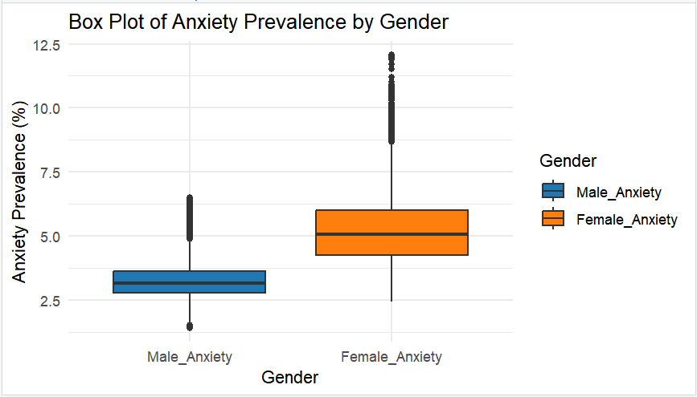

Slide 8
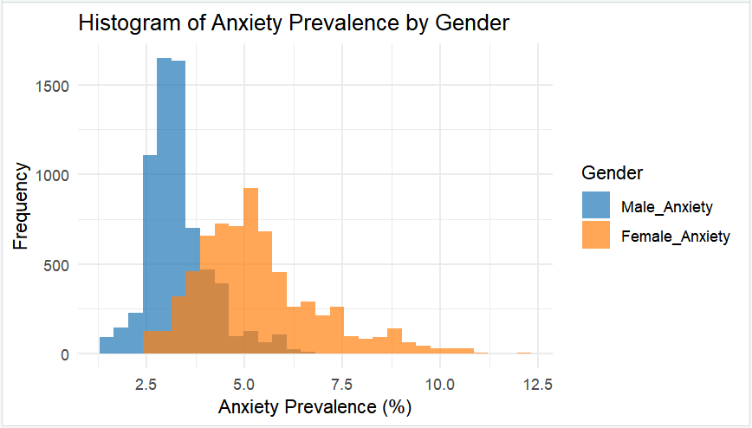

Slide 9
1. A normalised stacked bar chart (with your independent variable sub types on the x axis). As your raw data is likely to contain data of different sample sizes, you must normalize your data. I.e. convert your data to a percentage, so that totals all equal 100. Your stacked bar charts will now all be the same height, for a fair comparison. Clearly label you axes to include variable name and units of measurement. Include a title to give your plot/visualisation a context.
3. Where your research question asks about Comparison of proportions include one plot only
Comparison of proportions analyses the difference in proportions of a characteristic shared by members of two different populations.

Slide 10
Only attempt this Analysis part of the demo if you have completed your Visualization(s). Otherwise end your demo after the Visualization for feedback.
Part 2: Analysis (building on your Visualizations)

Slide 11
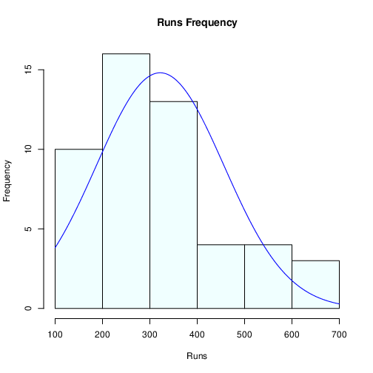
Here is a Histogram showing the frequencies of our dependent variable to include the normal curve overlay.
Our RQ asks about Correlation
For example:
Choose one:
1. The blue normal curve overlay follows the contours of the underlying data, so for our analysis we will use a parametric test for correlation: Pearson’s r
OR
The normal curve overlay does not follow the shape of the underlying data, so for our analysis we use the non-parametric test for correlation that does not assume normality: Spearman’s Rho or Kendal’s Tau
The example here is borderline, in terms of shape, so when in doubt choose the non-parametric equivalent.

Slide 12
Here is a Histogram showing the frequencies of our dependent variable to include the normal curve overlay (shown in blue).
Our RQ asks about Differences in means/ medians
For example:
Choose one:
1. The normal curve overlay follows the contours of the underlying data, so we use the parametric test: t-test.
OR
2. The normal curve overlay does not follow the shape of the underlying data, so we use the non-parametric test that does not assume normality: Wilcoxon also known as the Mann Whitney U Test.
The example here is borderline, in terms of shape, so when in doubt choose the non-parametric equivalent.

Slide 13
Here is a table (matrix/cross tabulation) showing our dependent variable as rows, and our independent variable as columns. We have at least two values for both variables that are independent of each other (no overlap).
For example:
Our RQ is about Differences in proportions
Dependent Variable: Male_Anxiety
Independent Variable: Year
For comparison of proportions analysis, we will use a chi-square test to check for the likelihood that there is a relationship between the two nominal variables (reason for absenteeism and age group in example). This non-parametric test makes no assumptions about the shape of the data (which is nominal, not interval) so we do not include a histogram for this test.

Slide 14
R Script and Results (For ALL types of test) – The Analysis
PRE 7COM1079-2022 Student Group No: ?????
Include a snippet of the R code you use to calculate your test statistic.
Give the value of the test statistic.
Tell us the p-value. Is it > or < 0.05?
Is the result significant?
Do you accept or reject the null hypothesis?
What does the result actually mean in the wider context of learning something useful / answering your RQ?

