Slide 1
SMART CLASSROOM
AI-Powered Engagement &
Attention Tracking System
Computer Vision • Deep Learning • IoT • Full-Stack Engineering
Final Year Project | Department of Computer Science and Engineering

Slide 2
THE PROBLEM
Engagement is invisible at classroom scale
01
02
03
No objective signal
No early warning
No longitudinal data
Instructors rely on a visual scan of the room — subjective, unrecorded, and impossible to scale past ~20-30 students.
Disengagement (drowsiness, distraction) is noticed only after it has already cost learning time.
Nothing is logged, so patterns across a semester — or across a whole class — are invisible.
SMART CLASSROOM
02

Slide 3
OBJECTIVES
What the system sets out to do
Real-time multi-face detection & landmark tracking on a standard webcam
1
A configurable weighted attention-scoring engine — not hardcoded thresholds
2
Automated attendance via face recognition
3
Cloud-persisted analytics (Firestore) for longitudinal insight
4
A live dashboard for instructors, plus optional IoT hardware alerts
5
SMART CLASSROOM
03

Slide 4
SYSTEM ARCHITECTURE
Layered, dependency-injected pipeline
Client
API
CV Modules
Persistence
Hardware
React Dashboard
Flask REST API
Face Detect/Recognize
Firestore
ESP32
Webcam Capture
›
Classroom Pipeline
›
Eye Track • Head Pose
›
Attendance • Alerts
›
LED • Buzzer • LCD
Sleep/Yawn • Attention
SMART CLASSROOM
04

Slide 5
THE CORE ALGORITHM
A weighted, configurable attention score
Seven signals, one score (0-100)
Formula
Eye Aspect Ratio
20%
A = Σ w_{i} · S_{i} , subject to Σ w_{i} = 1
Head Pose
20%
Face Presence
15%
Each raw signal Si is normalized to 0-100 by a piecewise-linear function against configured thresholds, then combined by weight and smoothed across frames by exponential moving average — preventing single-frame jitter from swinging the score.
Sleep Duration
15%
Blink Rate
10%
Yawn Count
10%
All weights & thresholds live in attention_weights.json — retune without touching code.
Emotion
10%
SMART CLASSROOM
05

Slide 6
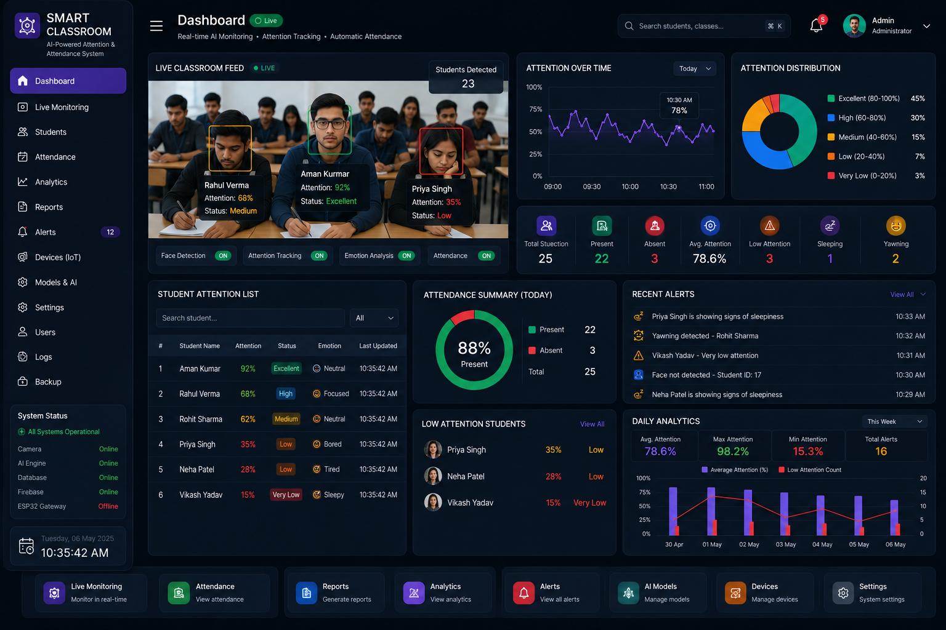
LIVE DASHBOARD
Real-time monitoring for instructors
SMART CLASSROOM
06

Slide 7
HARDWARE INTEGRATION
ESP32-driven physical alerts
Components
JSON Command Protocol
• ESP32 DevKit V1
{
"cmd": "alert",
"severity": "critical",
"led": "red",
"buzzer_ms": 800,
"lcd_line1": "ALERT",
"lcd_line2": "Low Attention"
}
• 3x status LED (green / yellow / red)
• Active piezo buzzer
• 16x2 I2C LCD
• Reserved GPIO for future servo
POST over WiFi to the ESP32's local HTTP server — fails gracefully (logged, non-fatal) if hardware is offline.
SMART CLASSROOM
07

Slide 8
VALIDATION
Clear separation between attention states
Automated Test Suite
21 / 21
assertions passing
3
modules under test
0
known open bugs
SMART CLASSROOM
08

Slide 9
FUTURE SCOPE
Where this goes next
Edge Deployment
Servo-Actuated Camera
Quantized on-device models for classroom-local hardware without a GPU server.
Multi-angle coverage — firmware protocol already reserves a servo command slot.
Semester-Long Trends
Stronger Privacy
Longitudinal engagement modelling correlated with assessment outcomes.
Federated or on-device face-encoding storage beyond server-side Firestore.
SMART CLASSROOM
09

Slide 10
Thank You
Smart Classroom — AI-Powered Engagement & Attention Tracking System
Questions & Discussion

