Slide 1
Modern Block Ciphers
Introduction to Network Security

Slide 2
Basic idea of modern block ciphers
From classical ciphers, we learn two techniques that may improve security:
Encrypt multiple letters at a time
Use multiple ciphertext alphabets (Polyalphabetic ciphers)
Combining these two techniques
encrypt eight (or more) letters at a time
called a block cipher
and use an extremely large number of ciphertext alphabets
will be called modes of operation

Slide 3
What is Simplified DES
Developed 1996 as a teaching tool
Santa Clara University
Prof. Edward Schaefer
Takes an 8-bit block plaintext, a 10 –bit key and produces an 8-bit block of ciphertext
Decryption takes the 8-bit block of ciphertext, the same 10-bit key and produces the original 8-bit block of plaintext

Slide 4
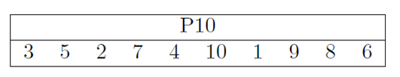

Simplified DES
Generate k1, k2
A- Apply P10 on the key
B- Shift one to the left
C- Apply P8 → k1
D- Again, apply p10 on the key
E- Shift 3 to the left
F- Apply p8→ k2

Slide 5
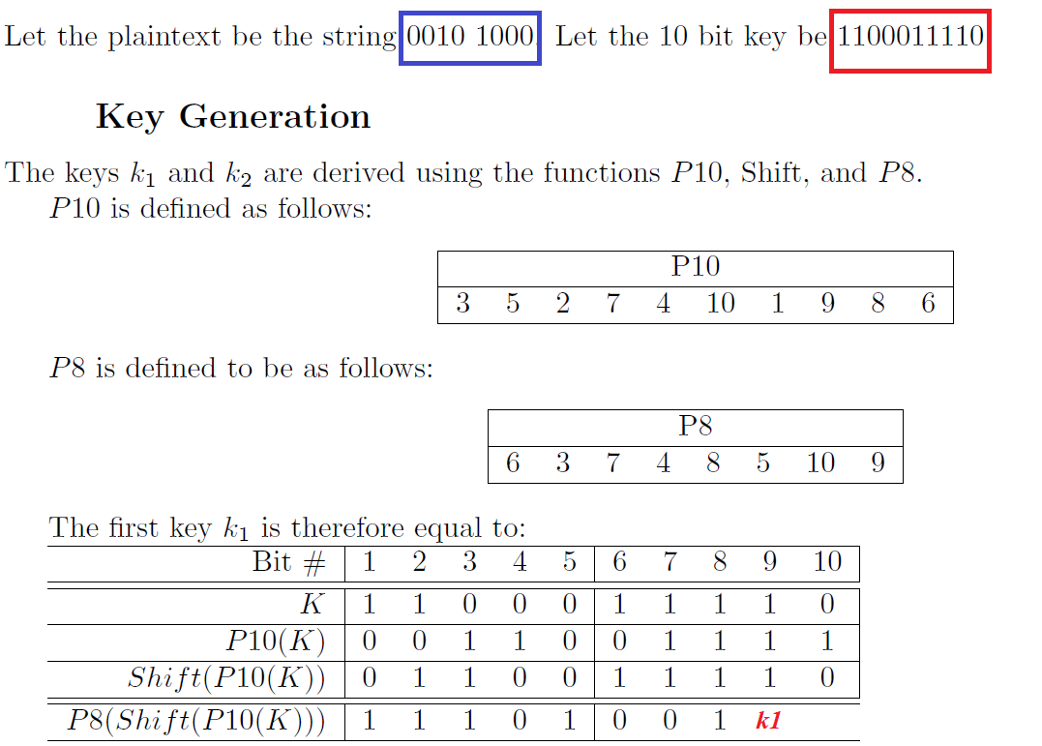


Slide 6
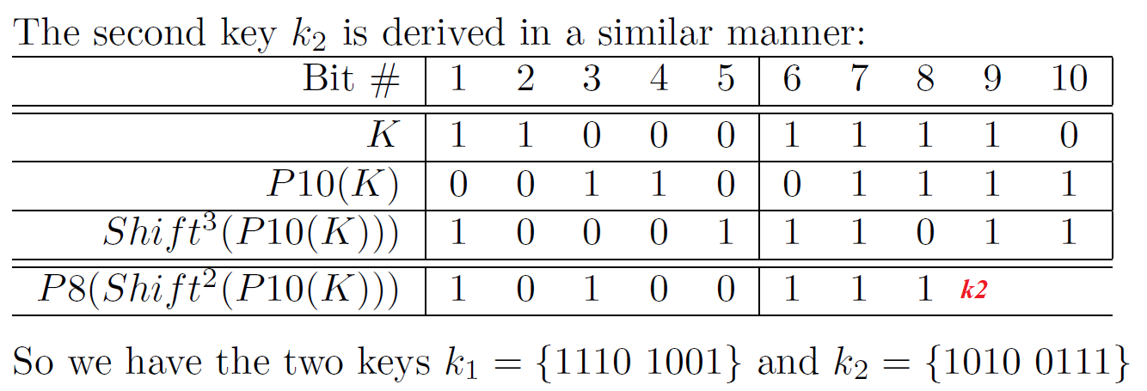

Slide 7
2) Encrypt the plain text
A- Apply an initial permutation (IP)
B- Find f_{k1} which is a complex 2-input function
C- Apply the switch function which is a simple permutation that swaps the two parts
D- Again, find f_{k2 ,} but this time on k2
E- Apply inverse permutation (IP⁻¹)

Slide 8
2) Encrypt the plain text (in more details)
Then the steps for encryption are:
1. Apply the initial permutation, IP, on P
2. Assume the input from step 1 is in two halves, L and R
3. Expand and permutate R using E/P
4. XOR input from step 3 with K1
5. Input left half of step 4 into S-Box S0 and right half into S-Box S1
6. Rearrange outputs from step 5 using P4
7. XOR output from step 6 with L half from step 2
8. Now we have the output of step 7 as the left half and the original R as the right half (Switch the halves and move to round 2)
9. E/P with right half
10. XOR output of step 9 with K2
11. Input left half of step 10 into S-Box S0 and right half into S-Box S1
12. Rearrange output from step 11 using P4
13. XOR output of step 12 with left half from step 8
14. Input output from step 13 and right half from step 8 into inverse IP
f_{k1}
f_{k2}

Slide 9
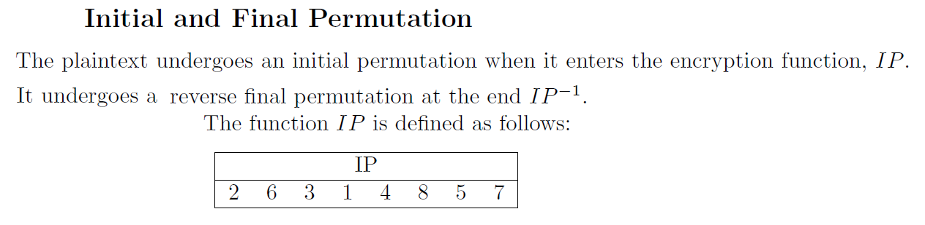
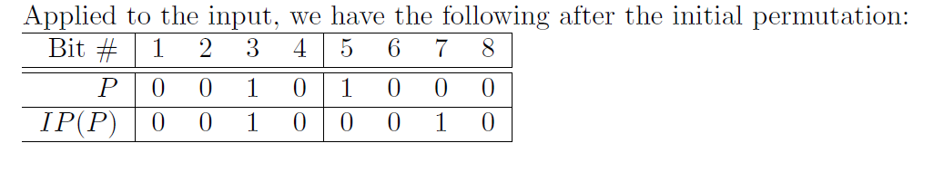
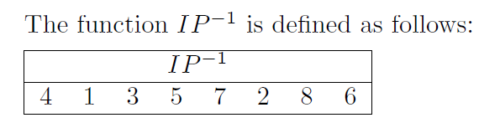

Slide 10
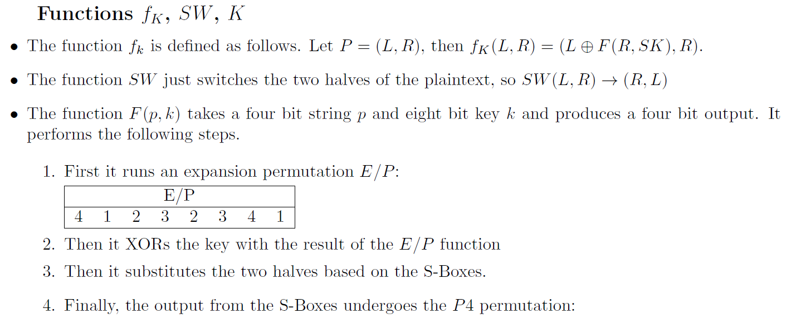
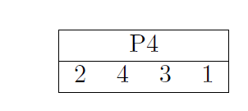

Slide 11
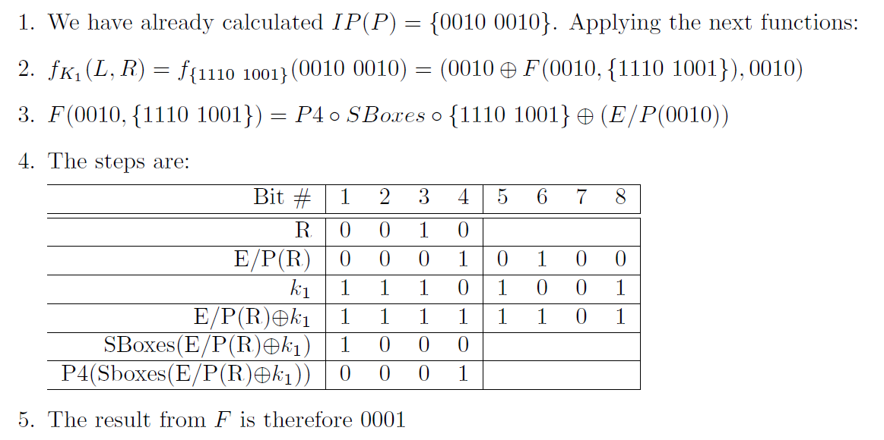

1 0 3 2
3 2 1 0
0 2 1 3
3 1 3 2
s0
0 1 2 3
2 0 1 3
3 0 1 0
2 1 0 3
s1

Slide 12
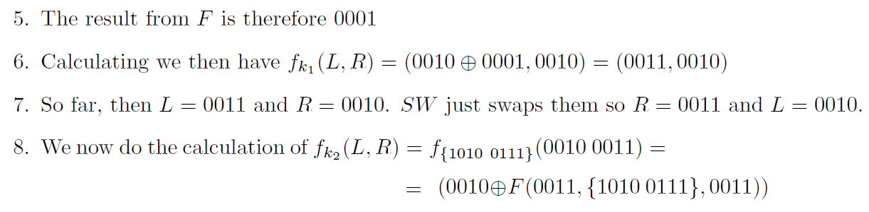

Slide 13
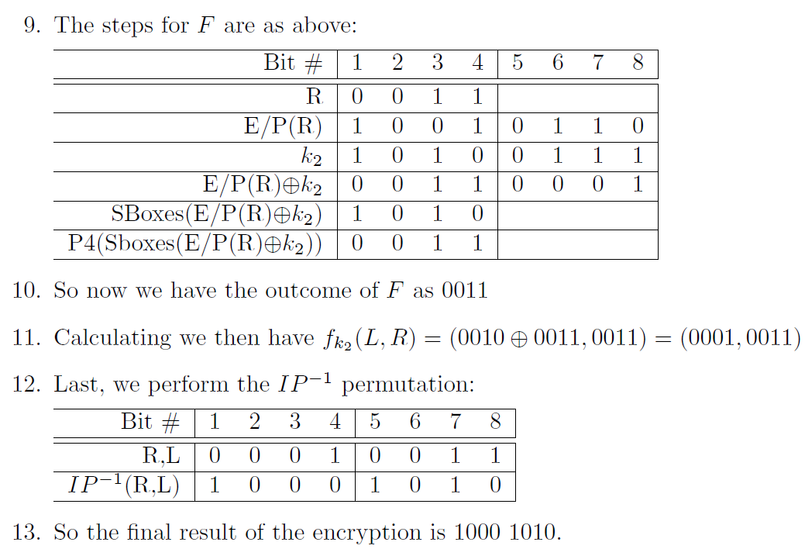
1 0 3 2
3 2 1 0
0 2 1 3
3 1 3 2
s0
0 1 2 3
2 0 1 3
3 0 1 0
2 1 0 3
s1

Slide 14
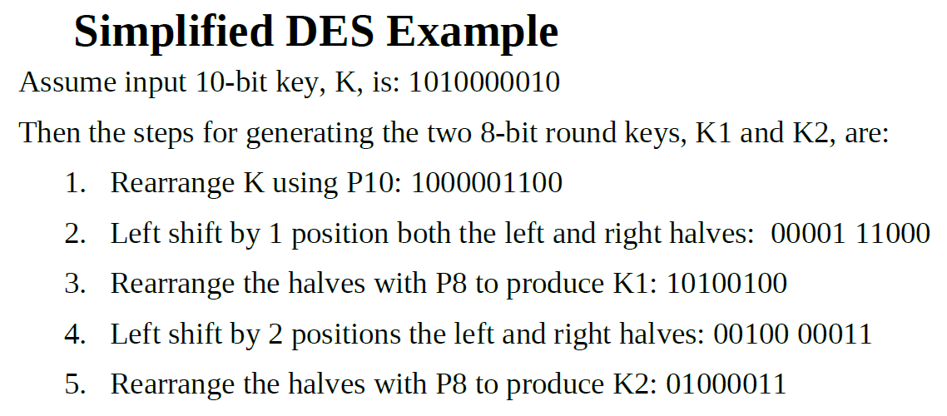
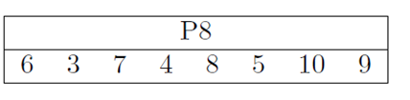

Slide 15
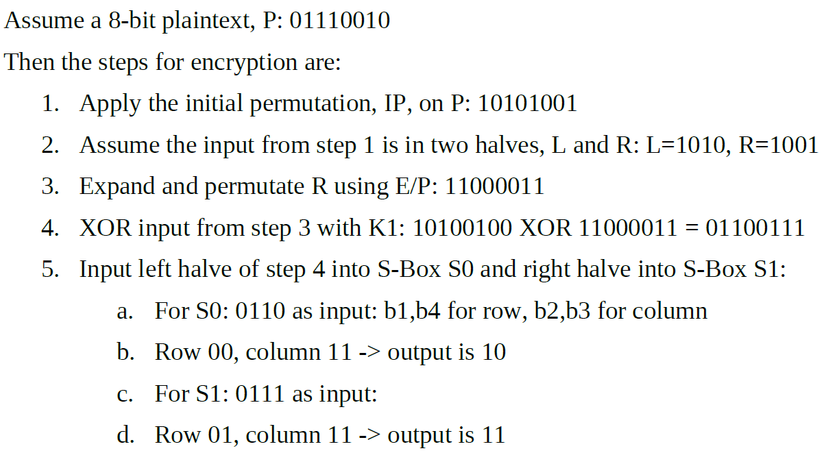

Slide 16
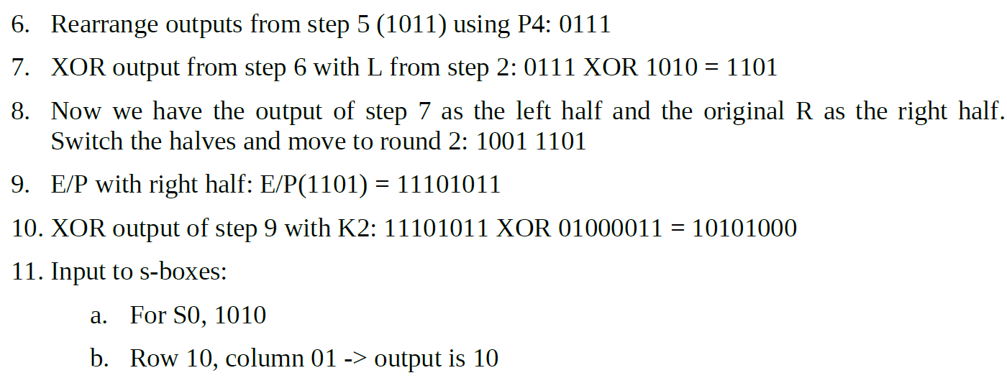

Slide 17
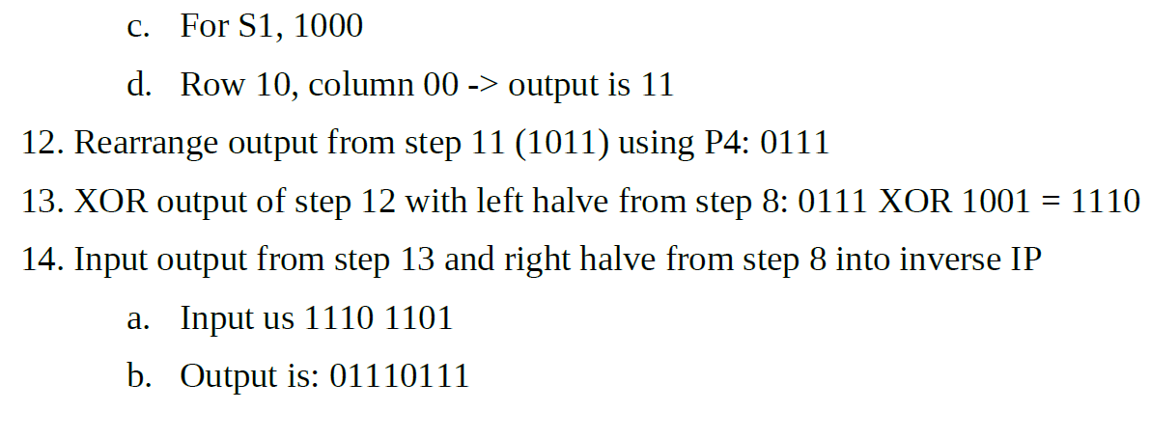

Slide 18
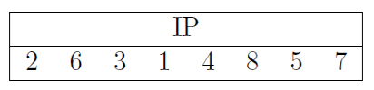
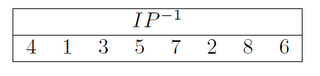
Appendix
s0
s1
1 0 3 2
3 2 1 0
0 2 1 3
3 1 3 2
0 1 2 3
2 0 1 3
3 0 1 0
2 1 0 3

Slide 19
Key Generation
Operations
(A) Apply permutation P10:
(B) Apply LS-1 (left shift 1) to each 5-bit group.
(C) Apply permutation P8:
(D) Apply LS-2 (left shift 2) to each 5-bit group.
10
P10
5
5
LS-1
LS-1
5
5
1 | 0 | 1 | 0 | 0 | 0 | 0 | 0 | 1 | 0
Key
P8
8
1 | 0 | 0 | 0 | 0 | 0 | 1 | 1 | 0 | 0
P10
K₁
0 | 0 | 0 | 0 | 1
1 | 1 | 0 | 0 | 0
LS-1
LS-2
LS-2
1 | 0 | 1 | 0 | 0 | 1 | 0 | 0
P8 ➔ K1
5
5
1 | 0 | 0 | 0 | 0 | 0 | 1 | 1 | 0 | 0
P8
0 | 0 | 1 | 0 | 0
0 | 0 | 0 | 1 | 1
LS-2
8
P8 ➔ K2
K₂
0 | 1 | 0 | 0 | 0 | 0 | 1 | 1

Slide 20
S-box Operation
(1) First and fourth bits give row number (2) Second and third bits give column number (3) Look up number in specified row and column (4) Convert to binary
0 | 1 | 1 | 0
0 | 1 | 1 | 1
S0
Row = 00 ➔ 0
Col = 11 ➔ 3
➔ 2 ➔ 10
S1
Row = 01 ➔ 1
Col = 11 ➔ 3
➔ 3 ➔ 11
S0:
S1:
1 0 3 2
3 2 1 0
0 2 1 3
3 1 3 2
0 1 2 3
2 0 1 3
3 0 1 0
2 1 0 3
1 | 0
1 | 1
0 | 1 | 1 | 1
P4
1 | 0 | 1 | 0
First 4 bits
1 | 1 | 0 | 1
The function F_{K}( 8-bits ) ---------> ( 8-bits )
Let L, R be the left 4 bits and right 4 bits of the input. Then
F_{Key}( L , R ) = (L XOR f(R, Key), R)
1 | 1 | 0 | 1
0 | 0 | 1 | 0
The right half and swap
0 | 0 | 1 | 1
1 | 1 | 0 | 1

Slide 21

Encryption Detail
I P
4
E/P
8
K ₁
4
4
4
S0
S1
2
2
P4
4
SW
The permutation IP
0 | 1 | 1 | 1 | 0 | 0 | 1 | 0
PT
E/P
The permutation IP⁻¹
K ₂
1 | 0 | 1 | 0 | 1 | 0 | 0 | 1
IP
1 | 0 | 1 | 0
1 | 0 | 0 | 1
(A) Apply expansion/permutation E/P to input 4 bits
(B) Add the 8-bit key (use XOR)
(C) Pass the left 4 bits through S-box S0 and the right 4 bits through S-box S1
(D) Apply permutation P4:
S0
S1
1 | 1 | 0 | 0 | 0 | 0 | 1 | 1
E/P
1 | 0 | 1 | 0 | 0 | 1 | 0 | 0
K1
P4
0 | 1 | 1 | 0 | 0 | 1 | 1 | 1
0 | 1 | 1 | 0
0 | 1 | 1 | 1
I P ⁻¹

Slide 22
S-DES Scheme
Encryption
Decryption
P10
8-bit plaintext
8-bit plaintext
SHIFT
IP
IP ⁻ ¹
P8
K₁
K₁
f_{k}
f_{k}
SHIFT
SW
SW
K₂
P8
K₂
f_{k}
f_{k}
IP ⁻ ¹
IP
8-bit ciphertext
8-bit ciphertext

