Slide 1
Polyalphabetic Substitution Ciphers
A polyalphabetic cipher is any cipher based on substitution, using multiple substitution alphabets.
A sequence of monoalphabetic ciphers (M₁, M₂, M₃, ..., M_{k}) is used in turn to encrypt letters.
A key determines which sequence of ciphers to use.
Each plaintext letter has multiple corresponding ciphertext letters.
This makes cryptanalysis harder since the letter frequency distribution will be flatter.

Slide 2
Vigenère Cipher
Simplest polyalphabetic substitution cipher
Consider the set of all Caesar ciphers:
{ C_{a}, C_{b}, C_{c}, ..., C_{z} }
Key: e.g. security
Encrypt each letter using C_{s}, C_{e}, C_{c}, C_{u}, C_{r}, C_{i}, C_{t}, C_{y} in turn.
Repeat from start after C_{y}.
Decryption simply works in reverse.

Slide 3
Example of Vigenère Cipher
Keyword: deceptive
  key: deceptivedeceptivedeceptive
  plaintext: wearediscoveredsaveyourself
  ciphertext: ZICVTWQNGRZGVTWAVZHCQYGLMGJ

Slide 4
a | b | c | d | e | f | g | h | i | j | k | l | m | n | o | p | q | r | S | t | u | v | w | x | y | z
0 | 1 | 2 | 3 | 4 | 5 | 6 | 7 | 8 | 9 | 10 | 11 | 12 | 13 | 14 | 15 | 16 | 17 | 18 | 19 | 20 | 21 | 22 | 23 | 24 | 25
  key: deceptivedeceptivedeceptive
  plaintext: wearediscoveredsaveyourself
  ciphertext: ZICVTWQNGRZGVTWAVZHCQYGLMGJ
Key | 3 | 4 | 2 | 4 | 15 | 19 | 8 | 21 | 4
PT | 22 | 4 | 0 | 17 | 4 | 3 | 8 | 18 | 2
CT | z | i | c | v
Mode 26
The key length is 9, the cipher consists of 9 Caesar ciphers.
Plaintext letters at positions 0, 0+9, 0+2*9, 0+ 3*9, etc.

Slide 5
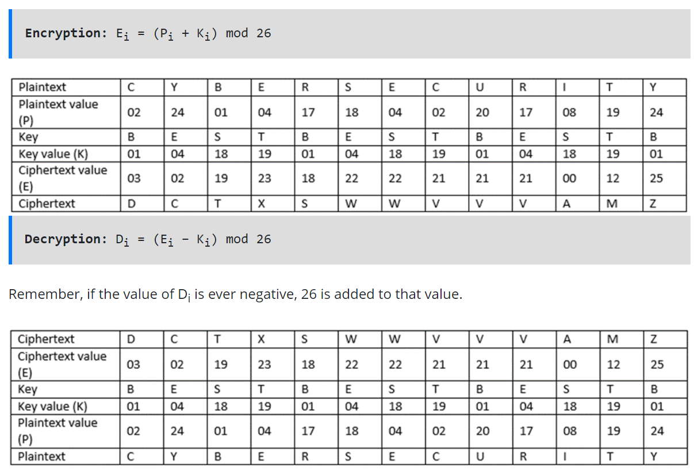
The key can be BEST

Slide 6
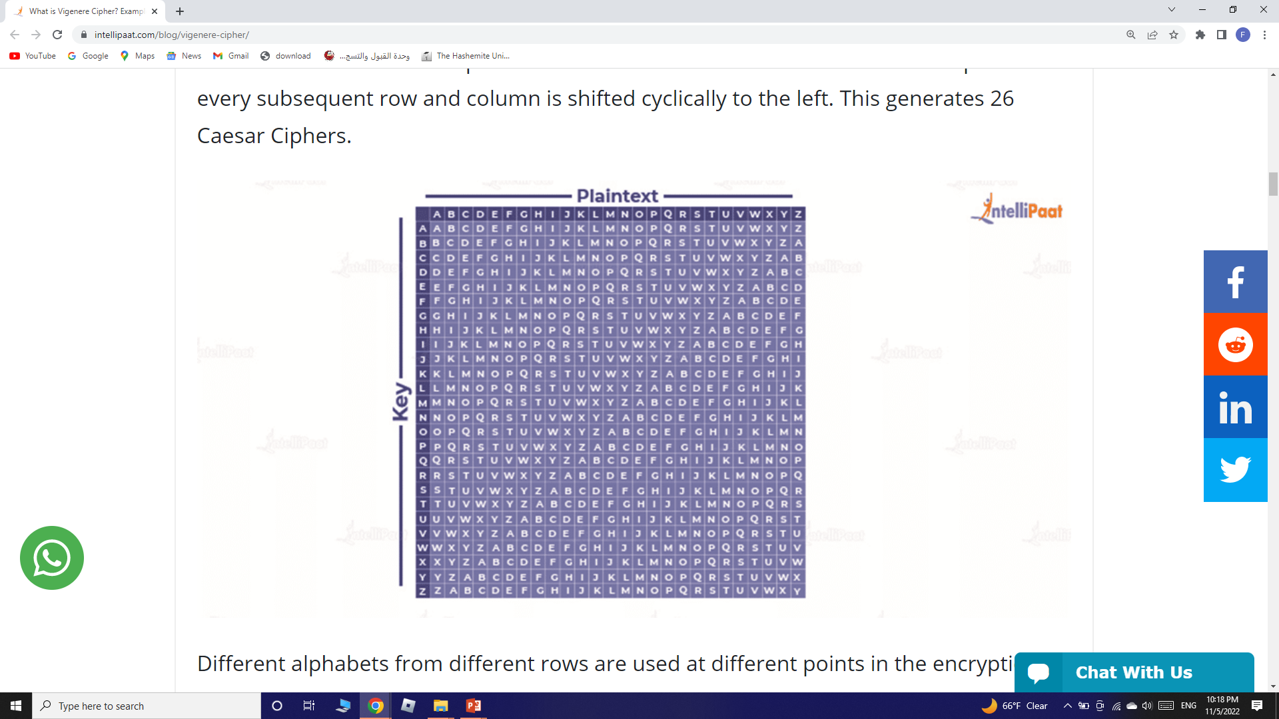
Vigenere Cipher Table
It consists of all the alphabets written 26 times in different rows. Each alphabet in every subsequent row and column is shifted cyclically to the left. This generates 26 Caesar Ciphers.

Slide 7
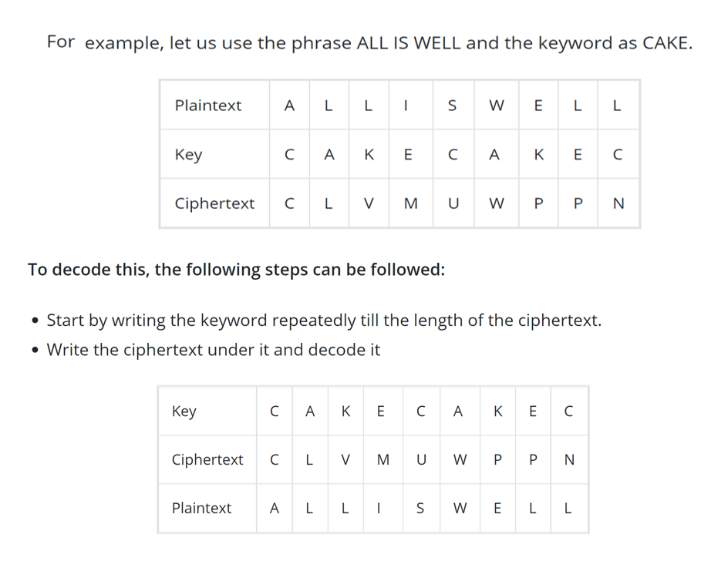

Slide 8
Security of Vigenère Ciphers
There are multiple (how many?) ciphertext letters corresponding to each plaintext letter.
So, letter frequencies are obscured (confused) but not totally lost.
To break Vigenere cipher:
  Try to guess the key length. How?
  If key length is N, the cipher consists of N Caesar ciphers. Plaintext letters at positions k, k+N, k+2N, k+3N, etc., are encoded by the same cipher.
  Attack each individual cipher as before.

Slide 9
Guessing the Key Length
Main idea: Plaintext words separated by multiples of the key length are encoded in the same way.
In our example, if plaintext = “…thexxxxxxthe…” then “the” will be encrypted to the same ciphertext words.
So look at the ciphertext for repeated patterns.
E.g. repeated “VTW” in the previous example suggests a key length of 3 or 9:
  ciphertext: ZICVTWQNGRZGVTWAVZHCQYGLMGJ
However, the cryptanalysis of Vigenère Ciphers is not easy but it could be with many further computations. The following videos are useful for self studying
https://youtu.be/LaWp_Kq0cKs
https://www.youtube.com/watch?v=P4z3jAOzT9I

Slide 10
Rotor Cipher Machines
Vigenere can be broken once somebody finds the key length ! How to have a longer key?
! Idea: ! Multiple rounds of substitution, encryption consists of mapping a letter many times ! Mechanical/electrical wiring to automate the encryption/decryption process ! A machine consists of multiple cylinders (rotors) that map letters several times

Slide 11
Rotor Cipher Machines
Before modern ciphers, rotor machines were most common complex ciphers in use.
Widely used in WW2.
Used a series of rotating cylinders.
Implemented a polyalphabetic substitution cipher of period K.
With 3 cylinders, K = 26³ =17,576.
With 5 cylinders, K = 26⁵ =12 x 10⁶.
What is a key?
  If the adversary has a machine
  If the adversary doesn’t have a machine

Slide 12
Rotor Cipher Machines
Each rotor has 26 states (as many as the alphabet) !
At each state there is a substitution cipher: the wiring between the contacts implements a fixed substitution of letters !
Each cylinder rotates to change states according to a different schedule changing the substitution ! A m-cylinder rotor machine has 26m different substitution
Most famous rotor machine is Enigma

Slide 13
The next major advance in ciphers required use of mechanical cipher machines which enabled to use of complex varying substitutions.
A rotor machine consists of a set of independently rotating cylinders through which electrical pulses can flow.
Each cylinder has 26 input pins and 26 output pins, with internal wiring that connects each input pin to a unique output pin. If we associate each input and output pin with a letter of the alphabet, then a single cylinder defines a monoalphabetic substitution.
After each input key is depressed, the cylinder rotates one position, so that the internal connections are shifted accordingly.
The power of the rotor machine is in the use of multiple cylinders, in which the output pins of one cylinder are connected to the input pins of the next, and with the cylinders rotating like an “odometer”, leading to a very large number of substitution alphabets being used, eg with 3 cylinders have 26³=17576 alphabets used.
They were extensively used in world war 2, and the history of their use and analysis is one of the great stories from WW2.

Slide 14
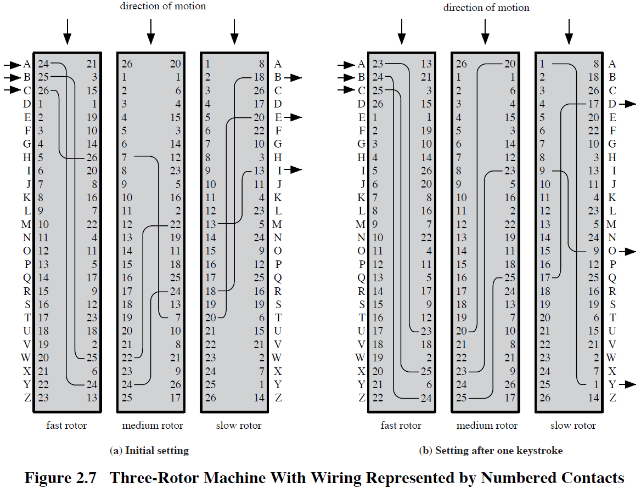
Assignment Decryption

Slide 15
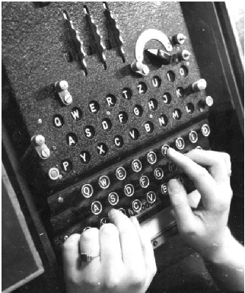
Enigma Rotor Machine

Slide 16
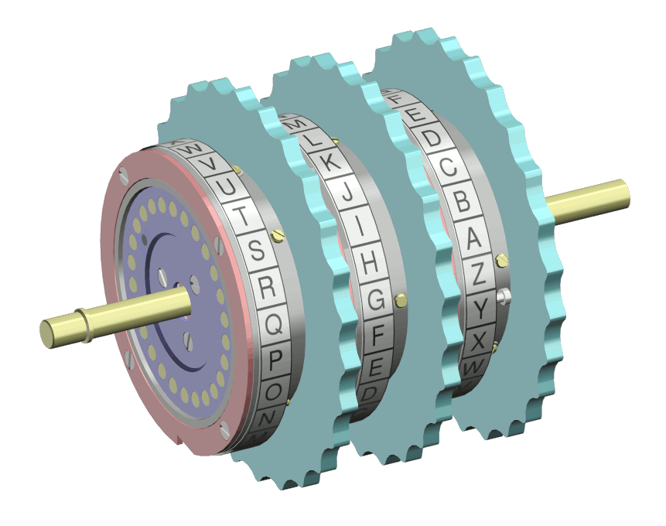
The Rotors

Slide 17
Transposition Ciphers
Also called permutation ciphers.
Shuffle the plaintext, without altering the actual letters used.
Example: Row Transposition Ciphers

Slide 18
Row Transposition Ciphers
Plaintext is written row by row in a rectangle.
Ciphertext: write out the columns in an order specified by a key.
  Key: 3 4 2 1 5 6 7
  Plaintext:
  Ciphertext: TTNAAPTMTSUOAODWCOIXKNLYPETZ
a | t | t | a | c | k | p
o | s | t | p | o | n | e
d | u | n | t | i | l | t
w | o | a | m | x | y | z

Slide 19
Product Ciphers
Uses a sequence of substitutions and transpositions
  Harder to break than just substitutions or transpositions
This is a bridge from classical to modern ciphers.

Slide 20
Product Ciphers
Ciphers using substitutions or transpositions are not secure because of language characteristics
Hence consider using several ciphers in succession to make harder, but:
  Two substitutions make another substitution
  Two transpositions make a more complex transposition
  But a substitution followed by a transposition makes a new much harder cipher
This is bridge from classical to modern ciphers

Slide 21
Unconditional & Computational Security
A cipher is unconditionally secure if it is secure no matter how much resources (time, space) the attacker has.
A cipher is computationally secure if the best algorithm for breaking it will require so much resources (e.g., 1000 years) that practically the cryptosystem is secure.
All the ciphers we have examined are not unconditionally secure.

Slide 22
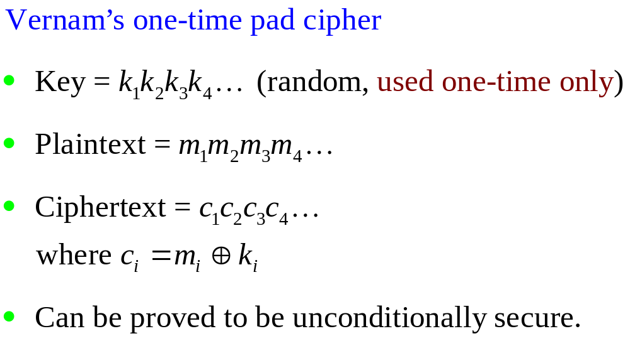
An unconditionally Secure Cipher

Slide 23
XOR truth table
Input |  | Output
A | B
0 | 0 | 0
0 | 1 | 1
1 | 0 | 1
1 | 1 | 0
1 1 0 1 1
1 1 1 1 0
XOR
0 0 1 0 1
XOR
1 1 0 1 1
1 1 1 1 0

Slide 24
Steganography
Hide a message in another message.
E.g., hide your plaintext in a graphic image
  Each pixel has 3 bytes specifying the RGB color
  The least significant bits of pixels can be changed w/o greatly affecting the image quality
  So can hide messages in these LSBs
Advantage: hiding existence of messages
Drawback: high overhead

Slide 25
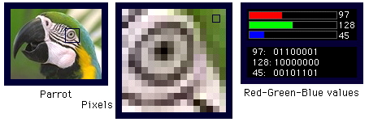
Take a 640x480 (=30,7200) pixel image.
Using only 1 LSB, can hide 115,200 characters
Using 4 LSBs, can hide 460,800 characters.

Slide 26
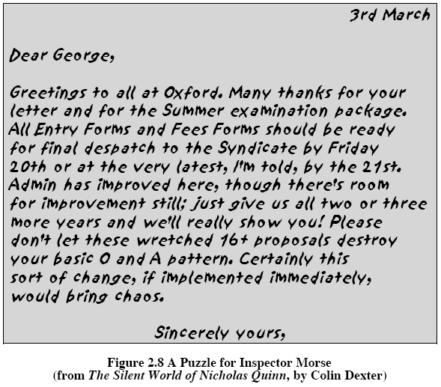

Slide 27
Summary
Have considered:
  classical cipher techniques and terminology
  monoalphabetic substitution ciphers
  cryptanalysis using letter frequencies
  Playfair cipher
  polyalphabetic ciphers
  transposition ciphers
  product ciphers and rotor machines
  stenography

