Slide 1
A.L.D.A
(AGP3 Lessons-Learned, Decisions, and Action items)
February 2022

Slide 2

What is AGP3?

Slide 3
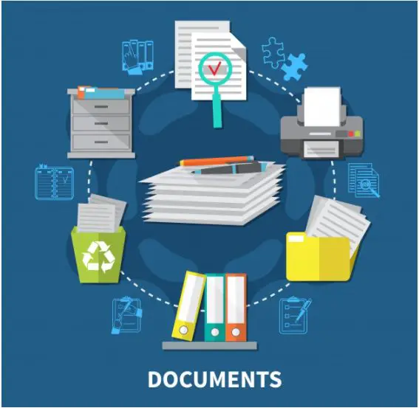
AGP3 is the final stage of the architecture review process.
The Document is divided into 3 parts
Decision Criteria
Lessons Learned
Action Items

Slide 4

What Is A.L.D.A ?

Slide 5

A.L.D.A is an automation tool that helps architect to review the summarized version of the project outcomes (AGP3).
The report produced by the bot comprise of two points:
Summarized version
Scraped Version

Slide 6
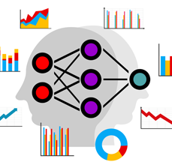
Use Cases

Slide 7
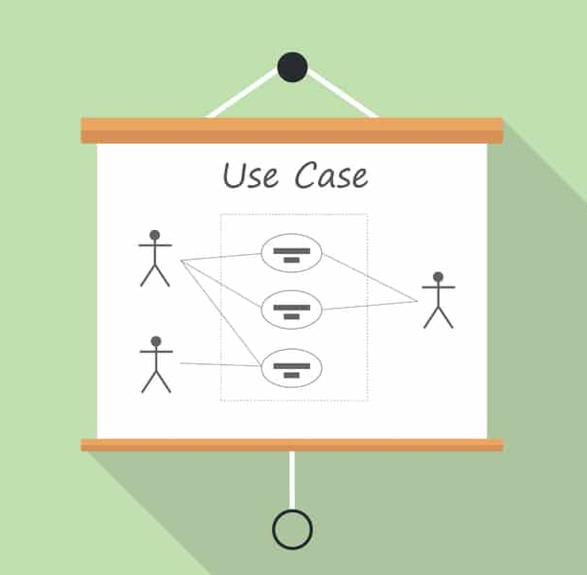
Architects will have an easier time looking through the summary of the review process rather than going through the whole AGP3 document.
Will allow easier access for architects looking for lessons learned from previous AGP3 reports.
Adding a search function will help users to search for specific AGP3 summaries to find specific reports

Slide 8

What Technologies Are Used ?

Slide 9
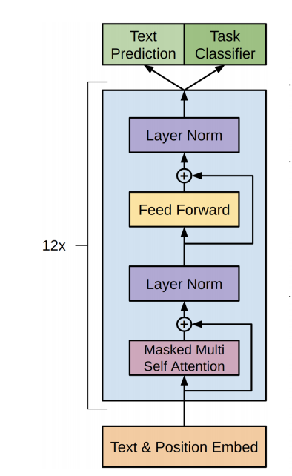
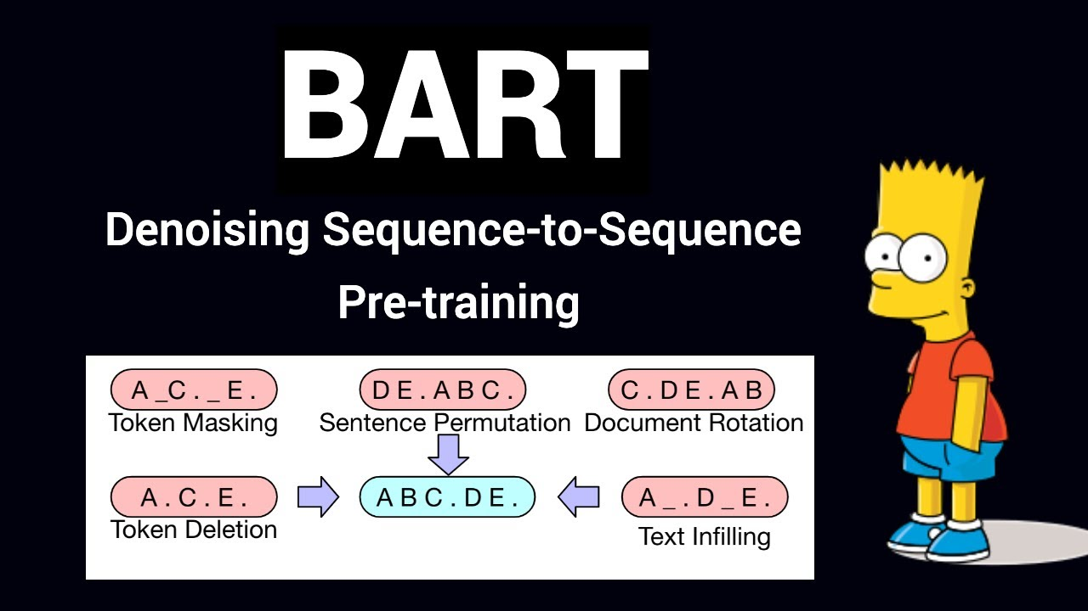

Slide 10


Slide 11
Presentation By EAO

