Slide 1
WASIM: A Word-level Abstract Symbolic Simulation Framework
Wenji Fang¹
wfang838@connect.hkust-gz.edu.cn
Hongce Zhang^{1,2}
hongcezh@ust.hk
¹ Microelectronics Thrust, Function Hub
Hong Kong University of Science and Technology (Guangzhou)
² Division of Emerging Interdisciplinary Areas
Hong Kong University of Science and Technology
Notes:
Hi, this is XXXX and today we are going to present our work on hardware symbolic simulation

Slide 2
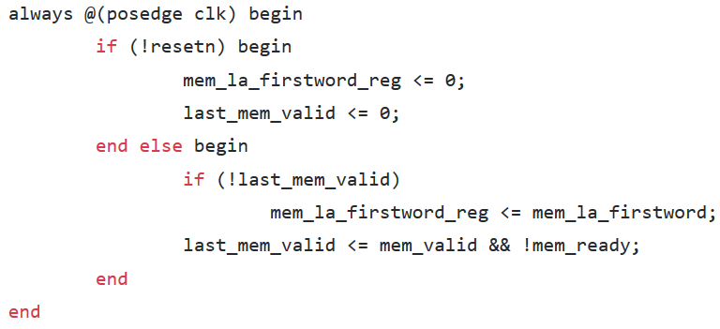


Model Checking
A common method for formal property verification
RTL for hardware design
SystemVerilog Assertions
assert property (
ready => ##[3:5] valid ##1 finish);
Notes:
For hardware design, usually we start from some hardware description language (this is referred to as RTL).
There could be bugs in the hardware designs, and to verify the correctness criterias, we can write some properties. with some property language, for example, SVA).
There are such tools to check properties, commercial/open-source. We call this approach MC.

Slide 3
Model checking sometimes does not work well
E.g., instruction-set compliance checking for processors
ISA specification
ADD: r’_{d}=r_{s1}+r_{s2} , pc’=…
pc, r₀, r₁, r₂, …
pc’, r’₀, r’₁, r’₂, …
Matched
Matched w. Spec?
ADD
ADD
Notes:
processor implements ISA
for the funtion of instruction, specifies how this instruction updates the state, from a pre-state pc, r0, … to pc’, r0’, …. On the hardware description, you can
we need to check if the states are updated according to the instruction specification.
If we are going to use the off-the-shelf model checkers to verify this, we need to formulate this as a model checking problem.

Slide 4
Symbolic Simulation?
From symbolic pre-state, compute symbolic post-state, then compare this function with the spec.
Symbolic pre-state:
pc, r₀, r₁, r₂, …
Symbolic post-state:
F( pc, r₀, r₁, r₂, … )
ADD
ADD
Notes:
Conceptually this can be done by symbolic simulation, you compute the function, do the comparison, but this is …
symbolic simulation ：But on the other hand, this conceptually can be done by symbolic simulation, where you simulate the RTL model from a symbolic starting state till the instruction finishes, so you get the symbolic post state which should be a function of the symbolic starting state. Then you can compare this function with the one in instruction specification.

Slide 5
Challenges
Lack of tool support
Need symbolic simulators, not just autonomous model checkers
Need interface for human guidance in simulation
Needs abstraction
E.g., to cover unbounded traces using bounded-step simulation
Notes:
In this …
Pp5. Although some problems, like instruction set compliance checking , can be verified via symbolic simulation, there isn’t a handy tool to support this. Many off-the-shelf tools are just autonomous model checkers ---After you formulate the properties, you can just leave these for the tool to verify. You cannot intervene throughout its verification process. But verification expers usually have some insights here --- for example, how many cycles it may take for an instruction to finish, but we don’t have an interface to tell the tool about this. so that we also need to apply suitable abstraction in symbolic simulation

Slide 6
Our Tool: Word-level Abstract Symbolic Simulator
WASIM
User Interface
Input Processing
FV Application
RTL Design
(Verilog)
Yosys
Btor
Parser
STS
Formal Property
Verification
Traces of Abstract States
User Input
Script
Inductive
Invariant
Simulator
State Representation
SMT formulas
Simulation Control
Abstraction Function
State Extraction &
Manipulation
Symbolic Simulation
substitution
Abstraction Refinement
concrete-abstract mapping
State Simplification
‘X’- agnostic
‘X’- aware
Notes:
Due to the lack of tool support, we would like to build our own tool for symbolic simulation ,
whole work flow of our tool wasim, three parts
1. user interface:
1.1 load the DUV
1.2 python API User customize python Script: control the simulation, change abstraction function, extract states in simulators
2. Having the designs and script, we can implement the symbolic simulation and extract traces of abstract states
3. The states can be further used for FPV and construction of II

Slide 7
Verilog Frontend
User Interface
Input Processing
RTL Design
(Verilog)
Yosys
Btor
Parser
STS
Yosys as Verilog frontend
Full support for synthesizable Verilog
Notes:
Describe the flow in the figure, then emphasize full support for synthesizable Verilog

Slide 8
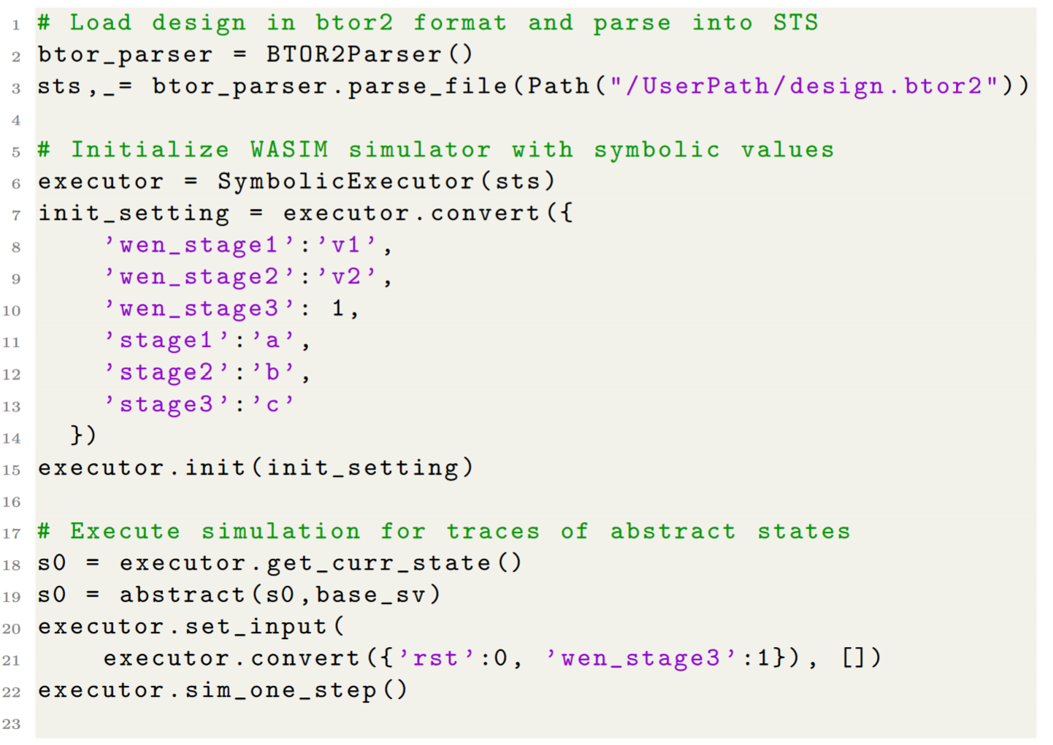
Python API for Symbolic Simulation
Load design
User Interface
RTL Design
(Verilog)
Yosys
Set symbolic
pre-state
User Input
Script
Simulation Control
Abstraction Function
State Extraction &
Manipulation
Extract state
representation
Apply
abstraction
Simulation
Notes:
Explain these operations. Symbolic values, concrete values

Slide 9
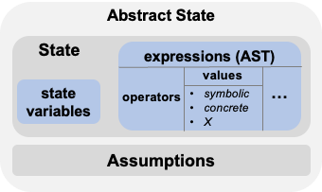
Core Simulation Function
State Representation: in SMT formulas
Symbolic assignment + assumptions
Support using undetermined values (‘X’ values)
Simulator
State Representation
SMT formulas
Symbolic Simulation
substitution
Abstraction Refinement
concrete-abstract mapping
State Simplification
‘X’- agnostic
‘X’- aware
Notes:
State is represented using SMT formulas
One for each state variable assignment
Assumptions -- capture the additional constraints (e.g., certain input combinations will never happen)
Undetermined values (‘X’ values)

Slide 10
Core Simulation Function
Simulation: essentially through substitution
Two modes: single-step vs. run till fixed-point (fixed-point in abstract domain)
Fixed-point is checked via SMT queries
Simulator
State Representation
SMT formulas
Symbolic Simulation
substitution
Abstraction Refinement
concrete-abstract mapping
State Simplification
‘X’- agnostic
‘X’- aware
Notes:
Of course, the fixed-point here is usually a fixed-point in some abstract domain, because you will very likely apply some abstraction to the states, otherwise there will be too many states anyway.
Unlike BDD based techniques, we check if we get a fixed-point through SMT queries.

Slide 11
Enabling Efficient Symbolic Simulation
Simplification and abstraction
Simplification: reduce the size of the SMT expressions
Abstraction: reduce the size of state space
Simulator
State Representation
SMT formulas
Symbolic Simulation
substitution
Abstraction Refinement
concrete-abstract mapping
State Simplification
‘X’- agnostic
‘X’- aware
Notes:
In order to make Symbolic simulation tractable. We need . Simplication is to … abstraction is to reduce the size of state space

Slide 12
Simplification
`X`-agnostic
SMT solvers’ built-in rewriting
Heuristics (e.g. in ite(c,t,f), check if c is fixed under assumptions and reduce the expression)
`X`-aware: try to remove `X` when possible
Use SMT queries to check if expression is independent of an `X` variable
Use heuristic approaches + SyGuS in CVC5 to rewrite
Simulator
State Representation
SMT formulas
Symbolic Simulation
substitution
Abstraction Refinement
concrete-abstract mapping
State Simplification
‘X’- agnostic
‘X’- aware

Slide 13
Abstraction and Refinement
Application-specific and user-dependent
Allow users to use their own abstraction function and refinement functions
Simulator
State Representation
SMT formulas
Symbolic Simulation
substitution
Abstraction Refinement
concrete-abstract mapping
State Simplification
‘X’- agnostic
‘X’- aware
Notes:
Becauise the suitable abstraction is dependent on application
Bring your own abstraction/ refinement

Slide 14
Abstraction and Refinement (cont’d)
An example in processor verification: stage-based abstraction
Instruction @ stage1
Instruction @ stage2
Instruction @ stage3
!stall
stall
Instruction can stall in stage 1, but we can abstract it with only finite (abstract) states
Similar for other stages
Notes:
One such example is when we verify processors, we would-like to apply stage-based abstraction.

Slide 15
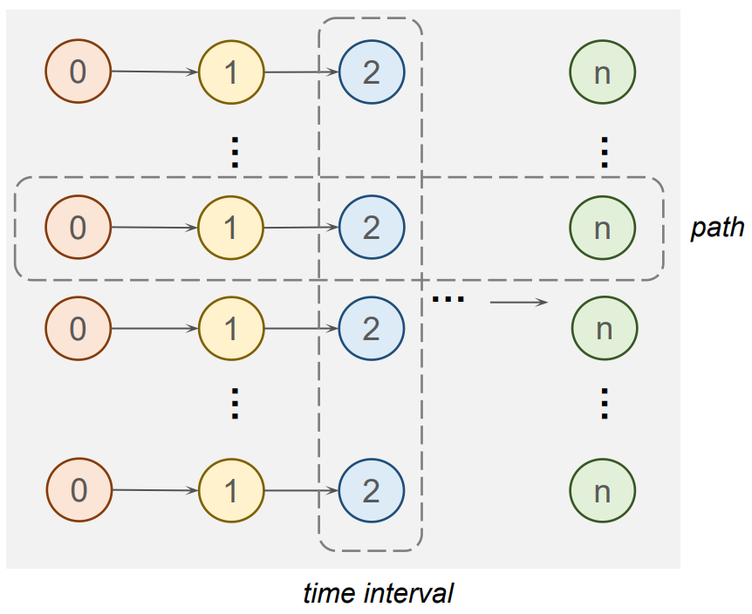
Extracting Simulation Traces
FV Application
Property verification
E.g., check safety properties ⬄ check all states in a fixed-point meets the property
Proof generation
Extract all states in the fixed-point (in some abstract domain) and see if that makes an inductive invariant
Formal Property
Verification
Traces of Abstract States
Inductive
Invariant

Slide 16
Empirical Results
Verifying pipelined hardware designs are compliant with non-pipelined function models
Used to verify certain designs that are hard for IC3/PDR
Design name |  | #. State bit | #. Logic gate | IC3/PDR | Simulation + FPV + Inv Check
Simple MAC | w.o. stall | 27 | 180 | 0.03s | 0.39s
 | w. stall |  | 234 | 0.03s | 8s
3-stage-pipe | ADD | 199 | 3153 | > 72 hr | 1min 59s
 | NAND |  | 2187 |  | 1min 59s
 | SET |  | 2681 |  | 1min 22s
 | NOP |  | 2421 |  | 59s

Slide 17
Summary
WASIM: an open-source tool for hardware symbolic simulation
Word-level, SMT-based
Python API to incorporate human guidance
Bring your own abstraction
Useful when autonomous model checking gets stuck
Available at: https://github.com/fangwenji/tacas23-wasim
Notes:
If you are interested in our work, feel free to check and use our tool through the github link here

