Slide 1
Weekly Meeting
2026.06.19 · Jaehun Han

Slide 2
RECAP
Last meeting — Phase 0 (naive, frozen)
• d=3 rotated surface code, toy sequential schedule (PennyLane state-vector).
• Correlated error fixed to a narrow case: one faulty CNOT (1 of 24), recurring.
• Task: identify which CNOT, from syndrome data — two data views, both classified well:
– Sequential (T, d²−1) long stream → GRU 95.3 % / 91.2 %
– Spatial (N, d, d²−1) bag-of-shots → LogReg 93.9 % (N=300)
– Within-distance ambiguity groups (e.g. {6,7}, {14,15,17}) cap per-class accuracy.

Slide 3
PLAN
Direction for this phase
• Implement a realistic, general-d, constant-depth surface code.
• Implement compatible MWPM decoding (open-source allowed).
• Repeat the Phase 0 classification on the realistic circuit.
– Spatial data: use (N, d·k, d²−1) instead of (N, d, d²−1) — length-d·k shots, k = 1,2,3.
– Decoding per d rounds may be added later; not applied for now.

Slide 4
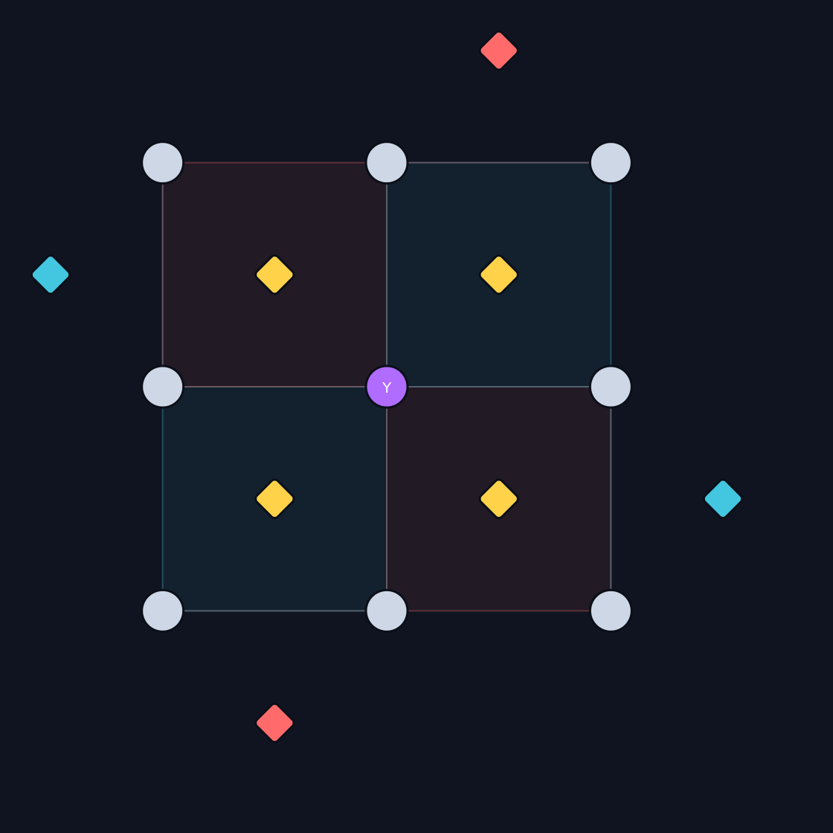
DONE
Progress 1 — General-d surface code
• Constant-depth 4-tick parallel schedule (depth independent of d).
• Built from first principles, validated against Stim:
– ancilla set + CNOT schedule == Stim generator (bit-for-bit)
– code distance == d ; logical-error-rate matches (d=3/5/7)
• Backend: Stim (Clifford) — scales where state-vector cannot (d=5 → 49 qubits).
d=3 lattice (data · X/Z stabilizers)

Slide 5
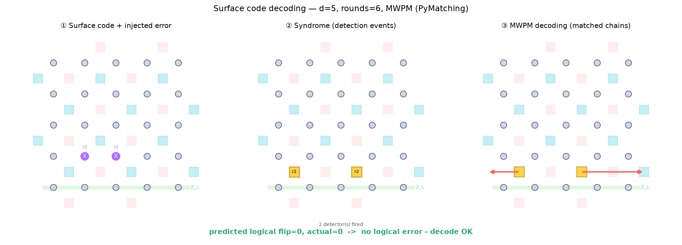
DONE
Progress 2 — MWPM decoding
• MWPM = standard surface-code baseline; via PyMatching 2.
• Driven by the circuit's detector error model (DEM) — no extra modeling.
– noiseless → 0 logical errors ; below-threshold LER ↓ as d ↑
• Works d=3…9. Code → error → syndrome → matching → verdict visualized.
decode pipeline (d=5): error → detection events → MWPM → no logical error

Slide 6
IN PROGRESS
Progress 3 — Realistic correlated-noise model
• Move beyond the artificial single-CNOT fault → physically-grounded correlated channels (survey).
• Candidate correlated locations = all qubit pairs within distance ≤ 2:
– d=3: 24 data–anc + 12 data–data + 8 anc–anc = 44 pairs ( + None )
• Channel per mechanism:
– data–anc : stray ZZ during the gate data–data : always-on ZZ
– anc–anc : readout crosstalk (XX) background : i.i.d. (= None class)
• Task → which pair (or None) is correlated, from (N, d·k, d²−1) syndrome data.

Slide 7
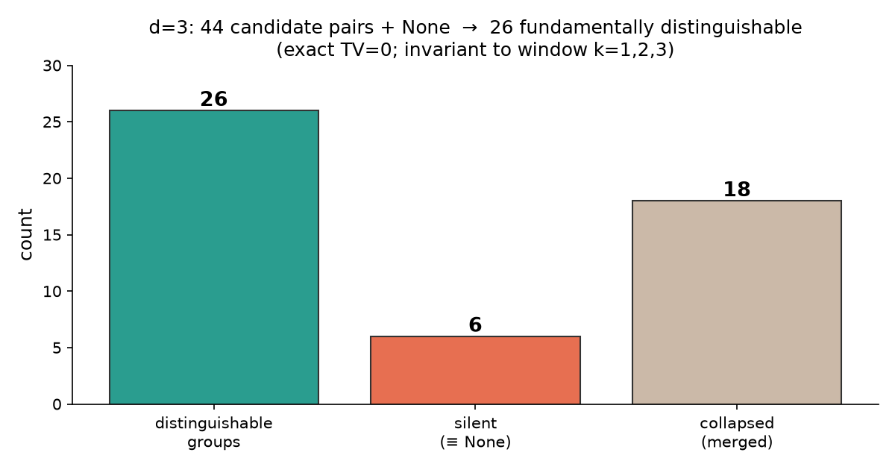
RESULT
Key finding — fundamental distinguishability
• Exact test (Phase-0-style TV = 0): two classes are indistinguishable for ANY N iff their correlated error gives the same syndrome signature.
– d=3: 45 classes → 26 fundamentally distinguishable ; 6 silent (≡ None)
– Invariant to window k (k=1,2,3) and to sample count N.
• Collisions only among ZZ channels; every anc–anc (readout) class is unique.
• Reason: syndrome sees only the net data Pauli (mod stabilizer) — same structure as Phase 0's ambiguity groups.

Slide 8
DISCUSSION
Implications & open question
• Perfect 44-way classification is impossible — like Phase 0's ambiguity groups.
• Honest target = classify the distinguishable equivalence groups (coarsened labels).
• Open modeling decision (input wanted):
– the exact silent/collision set depends on the stray-ZZ injection convention
– (where in the round the correlated error is applied) — to be pinned down.

Slide 9
NEXT
Next steps
• 1. Fix the correlated-noise injection convention (physical stray-ZZ timing).
• 2. Generate the (N, d·k, d²−1) bag dataset per class, no decoding.
• 3. Train the bag-of-shots classifier (reuse Phase 0 pipeline); target = distinguishable groups.
• 4. Accuracy vs (N, k); compare to the TV=0 ceiling.
• Infrastructure (surface code + MWPM + correlated model) is ready.

