Slide 1
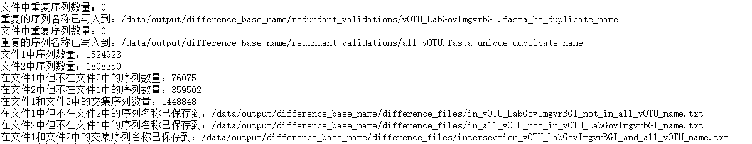
Redundancy inspection
----Input
File_1=“../govc/Input/fromCooperate/marine-bgi/vOTU_LabGovImgvrBGI.fasta”
File_2=“../ govc/Input/fromCooperate/marine-bgi/all_vOTU.fasta"
----Based ID
--Output
--Analysis
—

Slide 2
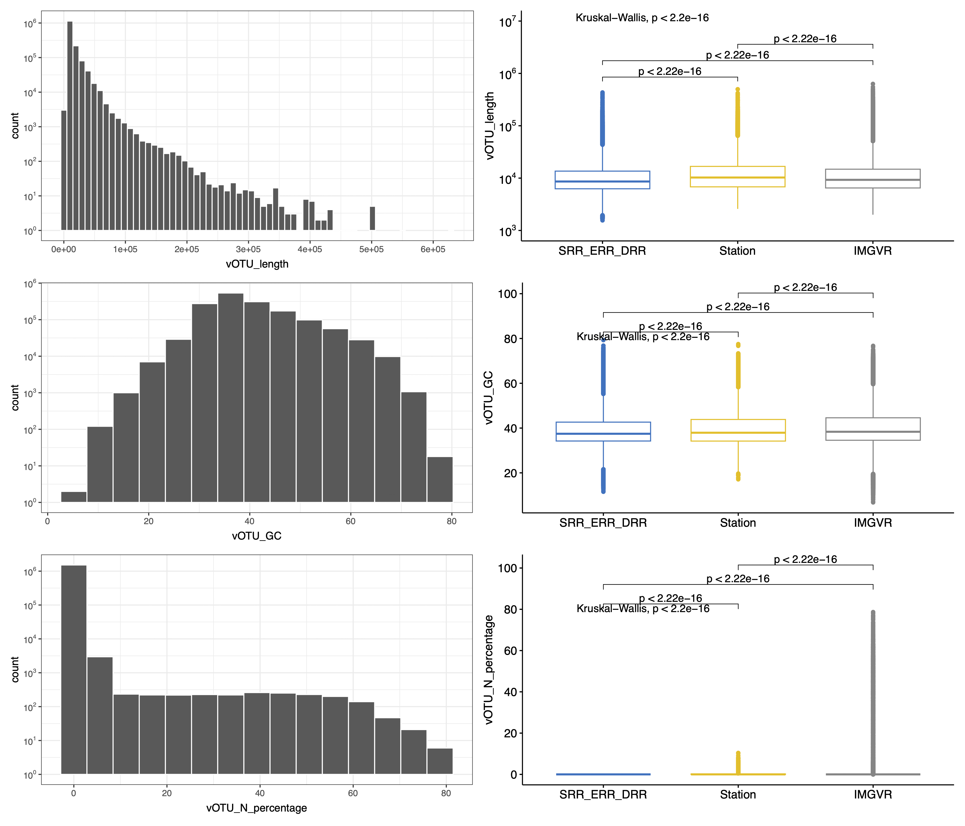
Basic Statistics – vOTU Fasta
file | num_seqs | max_len | min_len | avg_len
vOTU_LabGovImgvrBGI.fasta.gz | 1,524,923 | 630,638 | 1,558 | 13,345.5
Clean virus seq? Jumbo phage?
Quality control cutoff？
N percentage = N number/vOTU length %

Slide 3
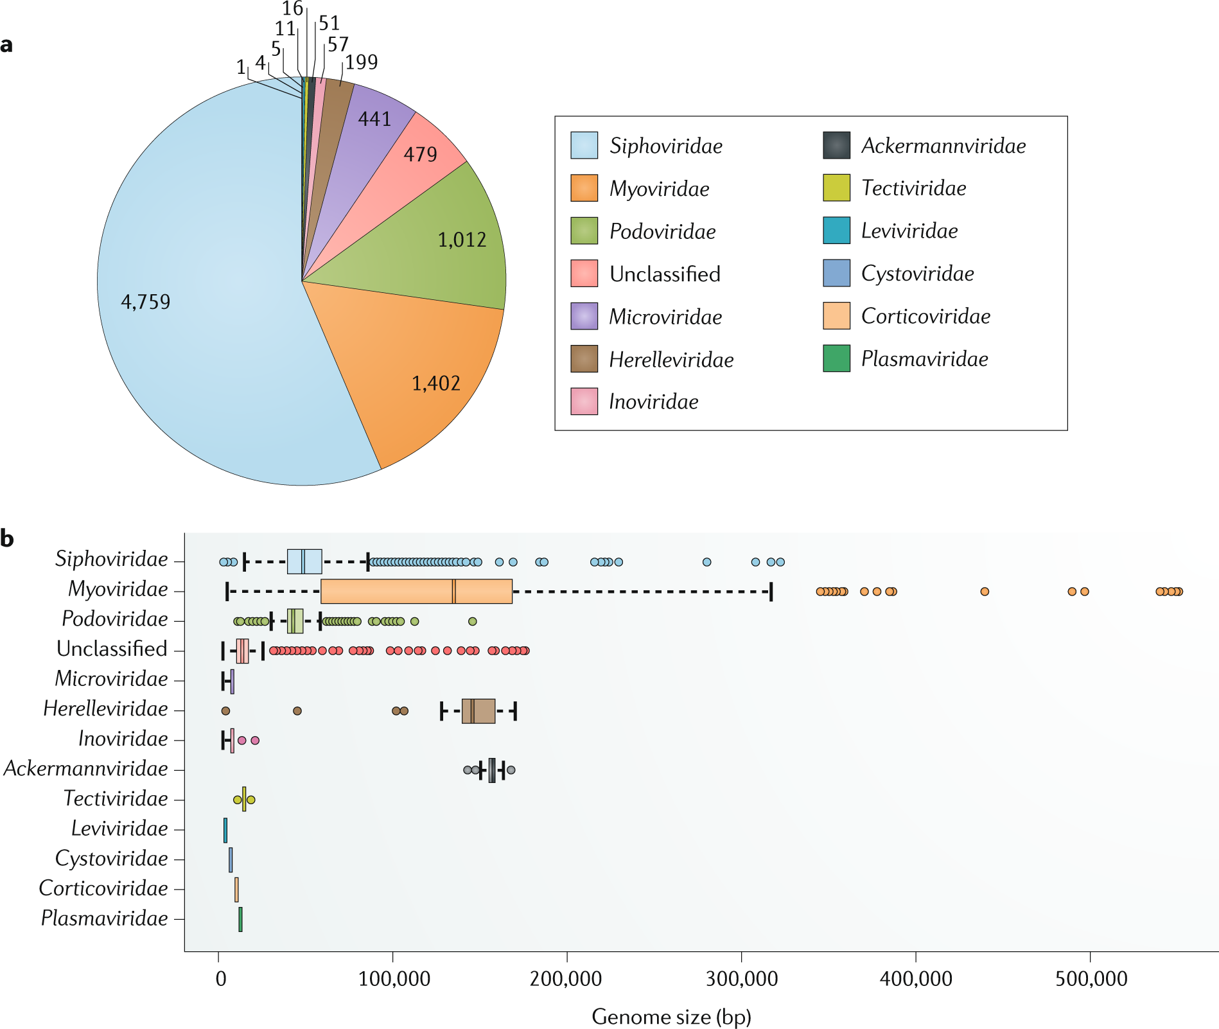
Notes:
Dion, M.B., Oechslin, F. & Moineau, S. Phage diversity, genomics and phylogeny. Nat Rev Microbiol 18, 125–138 (2020). https://doi.org/10.1038/s41579-019-0311-5

Slide 4
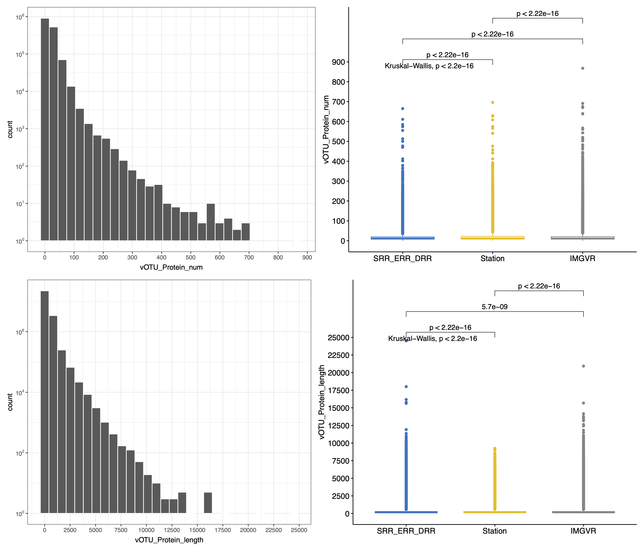
Basic Statistics – protein Faa
file | num_seqs | max_len | min_len | avg_len
vOTU_LabGovImgvrBGI.faa | 26,166,546 | 24,507 | 20 | 244.4
Big Protein? Prediction parameters?

Slide 5
Processing
checkv end_to_end -t 28 -d /data2/checkv-db-v1.5 input.fasta output/
prodigal-gv -m -p meta -i input.fasta -a protein.faa
vOTU_LabGovImgvrBGI.fasta.gz
CheckV v1.0.3, database v1.5
Prodigal V2.11.0-gv
Results
/Files/ResultData/Notebook/limin/Final_marine_checkv/final/
最终checkV筛选后的病毒序列
最终checkV筛选后的病毒基因组翻译后的蛋白序列
以上蛋白序列 Diamond + hmmsearch比对数据库后的结果文件
全部输入病毒的质量评估表格
20G final.viruses.fna
11G final_virus.proteins.faa
2.3G final_virus.gene_features.uniq.tsv
206M total.quality_summary.tsv
6.4M final.tr.fna
4.2M final.proviruses.fna
8.9G total.aai.tsv.gz
8.0M total.complete_genomes.tsv
268M total.completeness.tsv
134M total.contamination.tsv
4.2G total.proteins.faa.gz
26G total.diamond.tsv.gz
3.6G total.hmmsearch.txt.gz
421M total.gene_features.tsv.gz
最终文件
末端重复序列
原病毒序列
氨基酸相似性
基因组完整度
污染度
全部输入病毒的蛋白序列
Diamond比对
Hmmsearch比对结果
Diamond + hmmsearch比对数据库后的结果文件
中间文件

Slide 6
CheckV Overview
Contamination
vOTU_LabGovImgvrBGI.fasta.gz
final.viruses.fna
final.proviruses.fna
(425)
file | type | num_seqs | min_len | avg_len | max_len
final.viruses.fna | DNA | 1,524,471 | 1,558 | 13,345.4 | 630,638

Slide 7
Protein Prediction Overview
file | type | num_seqs | sum_len | min_len | avg_len | max_len
final_virus.proteins.faa | Protein | 26,131,560 | 6,402,065,253 | 20 | 245 | 24,476
Hmmsearch 注释率
7,611,245/ 26,131,560 *100= 29.12%
database | annotated_seq_num
ko | 606,436
pfam_a | 334,029
pfam_b | 36,292
rvdb | 212,754
tigr | 87,715
vog | 3,490,798
vpfs | 2,843,227

Slide 8
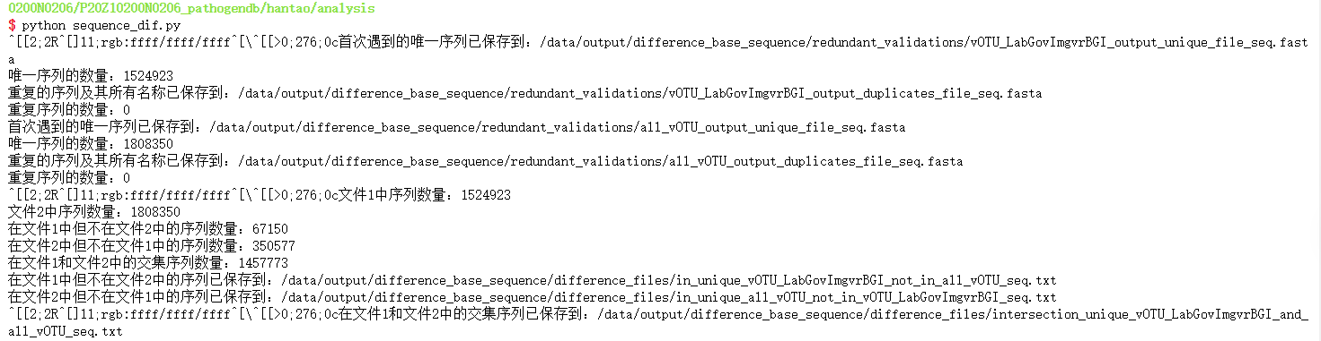
Redundancy inspection
----Input
File_1=“../govc/Input/fromCooperate/marine-bgi/vOTU_LabGovImgvrBGI.fasta”
File_2=“../ govc/Input/fromCooperate/marine-bgi/all_vOTU.fasta"
----Based Sequence
--Output
--Analysis
没有考虑到反向互补，需要重新写脚本统计（存在11对序列为反向互补实际），计划使用：
Seqkit/cdhit，学习和比较两者的效果

Slide 9
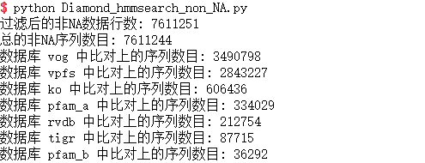
Extract and Classify Based On hmmer
----Input
File=“…/final_virus.proteins.faa ” #checkV筛选后的病毒基因组翻译后的蛋白序列
File=“…/ final_virus.gene_features.uniq.tsv” # 蛋白序列 Diamond + hmmsearch比对数据库的结果文件
----Extract non_NA Protein Sequence
database | annotated_seq_num
ko | 606,436
pfam_a | 334,029
pfam_b | 36,292
rvdb | 212,754
tigr | 87,715
vog | 3,490,798
vpfs | 2,843,227
--Output
--Analysis
存在蛋白序列hmmsearch比对上多次的情况（7条），但本处仅为过滤和得到non_NA sequence，可不找出

Slide 10
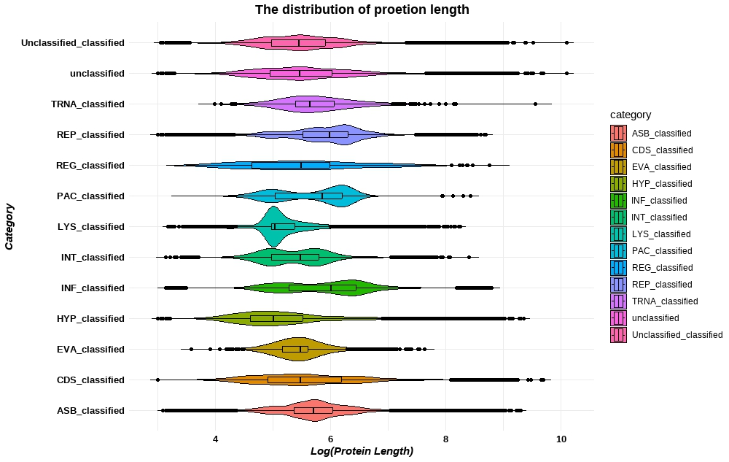
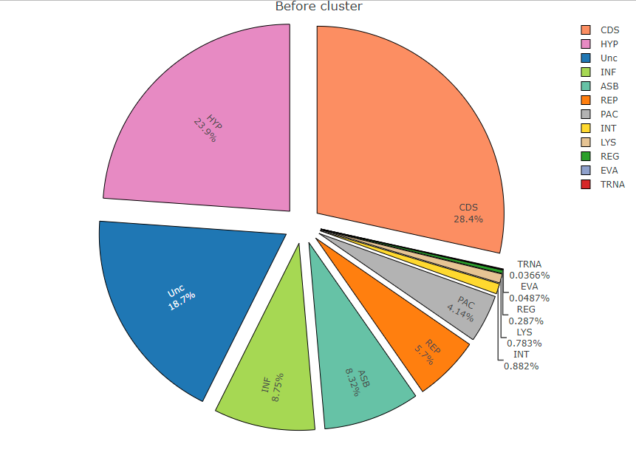
Extract and Classify Based On hmmsearch
----Input
File=“…/final_virus.proteins.faa ” #checkV筛选后的病毒基因组翻译后的蛋白序列
File=“…/ total.hmmsearch.txt.gz” # 蛋白序列hmmsearch结果文件
----Classify non_NA Protein Sequence
--Output
--Analysis
CDS和注释不在分类标准中的较多，占到52%

Slide 11
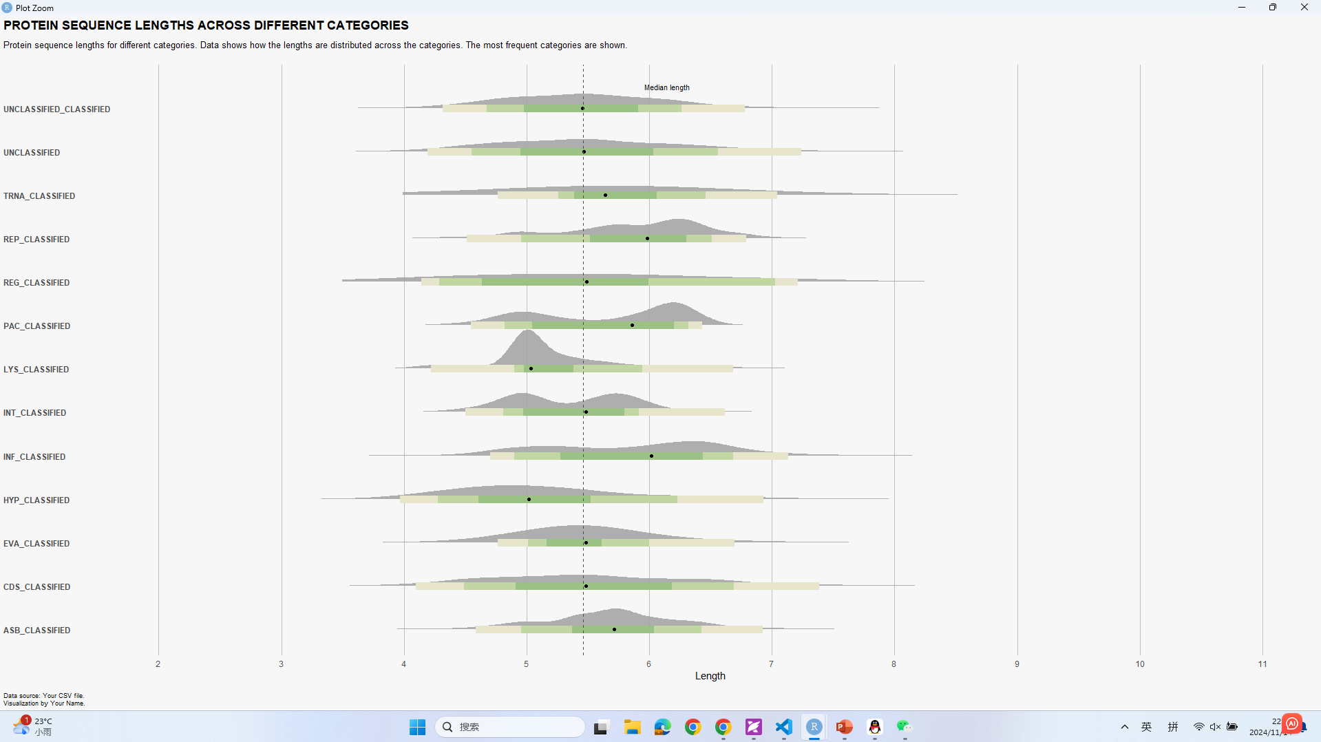
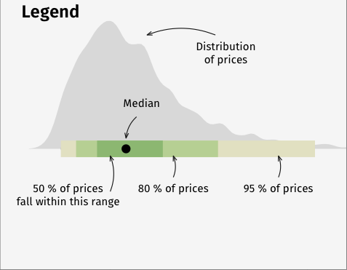
Distribution of length
50% of length fall within the range
80% of length
95% of length

Slide 12
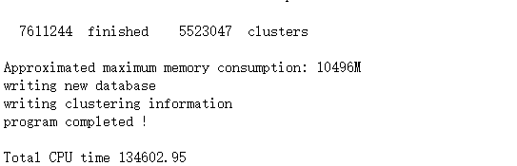
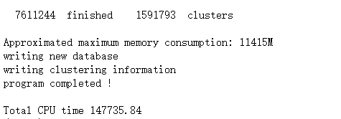
Cluster ——CDHIT
----Input
File=“…/non_na_all.fasta” #D+H比对后，score非NA的蛋白序列
File=“…/ classified_to_12_no_NA” # 依据hmmsearch分类后的蛋白序列
----Based on all the sequence in a fasta
--Output
--C 1.0
--C 0.7

Slide 13
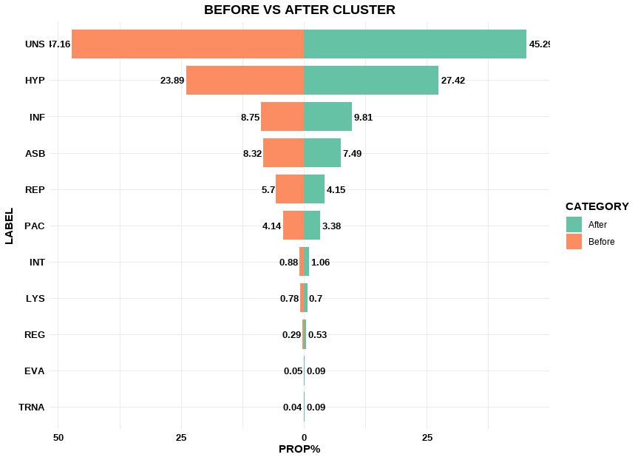
Cluster ——CDHIT
----Input
File=“…/non_na_all.fasta” #D+H比对后，score非NA的蛋白序列
File=“…/ classified_to_12_no_NA” # 依据hmmsearch分类后的蛋白序列
----Based on all the sequence in different fasta
--Output
GROUPS | BEFORE | AFTER
TRNA | 2786 | 1383
EVA | 3703 | 1405
REG | 21870 | 8623
LYS | 59620 | 11381
INT | 67101 | 17139
PAC | 315388 | 54750
REP | 433958 | 67264
ASB | 632914 | 121344
INF | 666084 | 158900
Unc | 1425700 | 366243
HYP | 1818000 | 444371
CDS | 2164127 | 367602
SUM | 7611251 | 1620405
--C 0.7

Slide 14
To do list
Alphafold2 安装测试
Rosettafold2安装测试
Cdhit/seqkit去冗余

