Slide 1
Multi-Lingual TextBoxes++
박재현 한상준 이용우
04 Jun 2019

Slide 2
Summary of Our Work
Multi-Lingual TextBoxes++ (MLTBPP)
Modification of TextBoxes++ (TBPP)
SSD-based end-to-end solution for multi-lingual text problem
Nice performance: Fast, Accurate and Flexible
13.16 FPS
F1 score 0.5258
Treats arbitrarily oriented multi-lingual texts with various aspect ratios
Notes:
tbpp 2018
Survey: SSD YOLOv2 Faster R-CNN
Faster – RCNN : 7
SSD: 46 / 19
YOLO 40 / 91

Slide 3
SSD: Single Shot Multibox Detector
Object Detection Detecting objects of certain classes in digital images
3 Most Popular Methods
 | (Faster) R-CNN | SSD | YOLO
Concept | Region proposal + Classifier Network | Detect from multi-scale feature layers | Regression problem to separated boxes
Accuracy | Super high | High | Good
Cost | Time and memory consuming | Fast | Super fast
Limitation | Expensive costs | - | Fails on tiny or dense objects
>
>
<
<
Notes:
https://mc.ai/object-detection-speed-and-accuracy-comparison-faster-r-cnn-r-fcn-ssd-and-yolo/

Slide 4
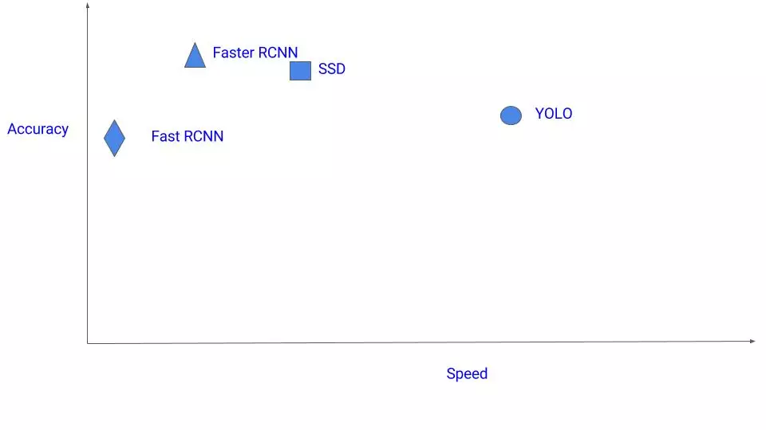
SSD: Single Shot Multibox Detector
Notes:
https://mc.ai/object-detection-speed-and-accuracy-comparison-faster-r-cnn-r-fcn-ssd-and-yolo/

Slide 5
SSD: Model Description
Input
300x300x3
Get multi-scale feature maps from VGG16
Predict predict-boxes from each layer
Merge the predict boxes by NMS
VGG up to Conv 4_3
38x38
x512
19x19
x1024
10x10x512
5x5x
256
3x3x
256
1x1x
256
VGG
up to fc7
Conv
Conv
Conv
Conv
Output
Layers
Conv
Conv
Conv
Conv
Conv
Conv
# Predict
Boxes
38x38x4
19x19x6
10x10x6
5x5x6
3x3x4
1x1x4
Non-Maximum Suppression
Output
Notes:
각 Default Boxes는 4+#classes의 element를 포함
https://user-images.githubusercontent.com/24144491/48844084-4621ac00-eddc-11e8-897b-8e7c1348eb92.png

Slide 6
SSD: Output Layer
5x5x6 Predict Boxes
Conv
5x5x256
Default boxes
Default Boxes
Determined by the model structure
Each default box predicts a nearby predict-box
(# aspect ratio) x (feature map size) many default boxes
4+c
Input image
Predict Boxes
4 offsets relative to the corresponding default box + class scores
…
Notes:
https://docs.google.com/presentation/d/1rtfeV_VmdGdZD5ObVVpPDPIODSDxKnFSU0bsN_rgZXc/pub?start=false&loop=false&delayms=3000&slide=id.g179f601b72_0_106
Area는 등차로 감소

Slide 7
SSD: Output Layer
5x5x256
3x3 Conv
#filter = 6x(4+c)
Predict Box
…
…
Default
Boxes
…
5x5x(6x(4+c))
Default Box
6
…
…
…
dx, dy, dw, dh
4+c
class scores
Notes:
https://docs.google.com/presentation/d/1rtfeV_VmdGdZD5ObVVpPDPIODSDxKnFSU0bsN_rgZXc/pub?start=false&loop=false&delayms=3000&slide=id.g179f601b72_0_106
TODO 6x(4+c) 2차원 숫자로 쓰기

Slide 8
Text Detection
Texts have unusual features
Extreme aspect ratios
Vertically dense
Multi-oriented
Traditional SSD is NOT optimal
Bad performance due to the unusual features of texts
Incapable to detect rotated rectangles
TextBoxes++(TBPP)
A Single-Shot Oriented Scene Text Detector
SSD-based end-to-end text detector

Slide 9
TBPP vs SSD
TBPP shares same base structure with SSD512.
Optimizations for text detection
Default boxes with a vertical offset
Better cover texts dense in the vertical orientation
Better choice of kernel size
TBPP 3x5 (SSD 3x3, TB 1x5)
Better detection for either long or oriented texts
General box representations
Quadrilateral / Rotated rectangle
Detects arbitrary oriented texts

Slide 10
TBPP: Model Description
Input
512x512x3
VGG up to Conv 4_3
Same base structure with SSD512
64x64x
512
32x32x
1024
16x16x512
8x8x
256
4x4x
256
2x2x
256
1x1x256
VGG
up to fc7
Conv
Conv
Conv
Conv
Conv
Output
Layers
Conv
Conv
Conv
Conv
Conv
Conv
Conv
# Predict Boxes
64x64x14
32x32x14
16x16x14
8x8x14
4x4x14
2x2x14
1x1x14
Non-Maximum Suppression
Output
Notes:
각 Default Boxes는 4+#classes의 element를 포함
https://user-images.githubusercontent.com/24144491/48844084-4621ac00-eddc-11e8-897b-8e7c1348eb92.png

Slide 11
TBPP: Prediction
4x4x256
Default boxes
Various aspect ratios and vertical offsets
(# aspect ratio)x(# vertical offset)x(layer size) many default boxes
Default Box
Oriented texts!
bbox
qbox
rbox
conf
Predict Boxes
bbox(4)+ qbox(8) + rbox(5) + confidence(2)
Quadrilateral / Rotated rectangle representation
…
…
…
Vertically dense search!
Notes:
https://docs.google.com/presentation/d/1rtfeV_VmdGdZD5ObVVpPDPIODSDxKnFSU0bsN_rgZXc/pub?start=false&loop=false&delayms=3000&slide=id.g179f601b72_0_106

Slide 12
TBPP: Prediction
4x4x256
Long texts!
3x5 Conv
#filter=(7x2)x19
※ SSD 3x3 Conv
#filter 7x(4+c)
Default Box
4x4x(7x2x19)
Notes:
https://docs.google.com/presentation/d/1rtfeV_VmdGdZD5ObVVpPDPIODSDxKnFSU0bsN_rgZXc/pub?start=false&loop=false&delayms=3000&slide=id.g179f601b72_0_106

Slide 13
TBPP: Prediction
4x4x256
Oriented texts!
3x5 Conv
#filter= (7x2)x19
…
…
…
Predict Box
Default
Boxes
…
…
…
Default Box
7x2
…
…
…
…
…
…
…
…
…
…
…
bbox
qbox
rbox
conf
19
Notes:
https://docs.google.com/presentation/d/1rtfeV_VmdGdZD5ObVVpPDPIODSDxKnFSU0bsN_rgZXc/pub?start=false&loop=false&delayms=3000&slide=id.g179f601b72_0_106
BBOX => IOU for NMS
QBOX => IOU for Fscore

Slide 14
Multi-Lingual Text Problem
We aim to detect and classify multi-lingual texts
TBPP does not work for multi-lingual text problems
TBPP does not consider languages
Some parameters for TBPP are NOT optimal
We implement Multi-Lingual TextBoxes++ (MLTBPP)
TBPP with language concept
Better loss function
Optimize parameters

Slide 15
MLTBPP: Model Description
Input
512x512x3
Same base structure with TBPP
VGG up to Conv 4_3
64x64x
512
32x32x
1024
16x16x512
8x8x
256
4x4x
256
2x2x
256
1x1x256
VGG
up to fc7
Conv
Conv
Conv
Conv
Conv
Output
Layers
Conv
Conv
Conv
Conv
Conv
Conv
Conv
# Predict Boxes
64x64x14
32x32x14
16x16x14
8x8x14
4x4x14
2x2x14
1x1x14
Non-Maximum Suppression
Output
Notes:
각 Default Boxes는 4+#classes의 element를 포함
https://user-images.githubusercontent.com/24144491/48844084-4621ac00-eddc-11e8-897b-8e7c1348eb92.png

Slide 16
MLTBPP: Output Layer
4x4x256
Default boxes
Same with TBPP
Predict Boxes
offsets(4+8+5) + language score(l)
…
…
…
…
bbox
qbox
rbox
language
Notes:
https://docs.google.com/presentation/d/1rtfeV_VmdGdZD5ObVVpPDPIODSDxKnFSU0bsN_rgZXc/pub?start=false&loop=false&delayms=3000&slide=id.g179f601b72_0_106

Slide 17
MLTBPP: Output Layer
4x4x256
※ TBPP 3x5 Conv
#filter=(7x2)x19
3x5 Conv
#filter=(7x2)x(17+l)
4x4x(7x2x(17+l))
Notes:
https://docs.google.com/presentation/d/1rtfeV_VmdGdZD5ObVVpPDPIODSDxKnFSU0bsN_rgZXc/pub?start=false&loop=false&delayms=3000&slide=id.g179f601b72_0_106

Slide 18
MLTBPP: Output Layer
4x4x256
3x5 Conv
#filter=(7x2)x(17+l)
Korean
…
…
…
…
Predict Box
Default
Boxes
…
…
…
…
Default Box
7x2
…
…
…
…
…
…
…
…
…
…
…
…
…
bbox
qbox
rbox
lang
17+l
Notes:
https://docs.google.com/presentation/d/1rtfeV_VmdGdZD5ObVVpPDPIODSDxKnFSU0bsN_rgZXc/pub?start=false&loop=false&delayms=3000&slide=id.g179f601b72_0_106

Slide 19
MLTBPP: Summary
Input
512x512x3
End-to-end solution with a simple pipe line
Multi-scale feature maps
Detects long and oriented texts
Multi-lingual text classifier
VGG up to Conv 4_3
64x64x
512
…
…
…
…
32x32x
1024
16x16x512
8x8x
256
4x4x
256
2x2x
256
1x1x256
VGG
up to fc7
Conv
Conv
Conv
Conv
Conv
Output
Layers
Conv
Conv
Conv
Conv
Conv
Conv
Conv
# Predict Boxes
64x64x14
32x32x14
16x16x14
8x8x14
4x4x14
2x2x14
1x1x14
Non-Maximum Suppression
Output
Notes:
각 Default Boxes는 4+#classes의 element를 포함
https://user-images.githubusercontent.com/24144491/48844084-4621ac00-eddc-11e8-897b-8e7c1348eb92.png

Slide 20
MLTBPP: Matching Strategy
Our output shape of a image
(# default boxes, 17+6)
Match the ground truths to fit MLTBPP
Match each ground truth with default boxes of followings:
IoU higher than 0.5
If there is no such default box, choose the default box with the best IoU
Notes:
76454

Slide 21
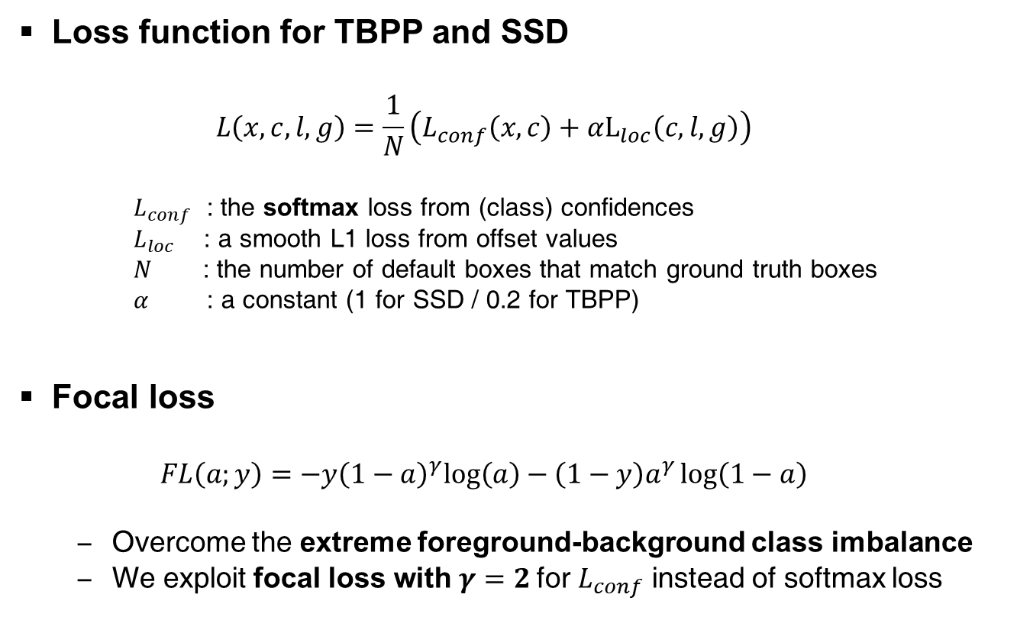
MLTBPP: Loss Function
Loss function for TBPP and SSD
$$L\left(x,c,l,g\right)=\frac{1}{N}\left(L_{conf}\left(x,c\right)+αL_{loc}\left(c,l,g\right)\right)$$
$L_{conf}$ : the softmax loss from (class) confidences
$L_{loc}$ : a smooth L1 loss from offset values
$N$ : the number of default boxes that match ground truth boxes
$α$ : a constant (1 for SSD / 0.2 for TBPP)
Focal loss
$$FL\left(a;y\right)=−{y\left(1−a\right)}^{γ}log\left(a\right)−{\left(1−y\right)a}^{γ}\log\left(1−a\right)$$
Overcome the extreme foreground-background class imbalance
We exploit focal loss with $γ=2$for $L_{conf}$ instead of softmax loss
Notes:
Focal loss alpha-balance 내용은 뺐음
“””
Class Imbalance: Both classic one-stage object detection methods, like boosted detectors [37, 5] and DPMs [8], and more recent methods, like SSD [22], face a large class imbalance during training. These detectors evaluate 104 - 105 candidate locations per image but only a few locations contain objects. This imbalance causes two problems: (1) training is inefficient as most locations are easy negatives that contribute no useful learning signal; (2) en masse, the easy negatives can overwhelm training and lead to degenerate models. A common solution is to perform some form of hard negative mining [33, 37, 8, 31, 22] that samples hard examples during training or more complex sampling/reweighing schemes [2]. In contrast, we show that our proposed focal loss naturally handles the class imbalance faced by a one-stage detector and allows us to efficiently train on all examples without sampling and without easy negatives overwhelming the loss and computed gradients.
In this work, we identify class imbalance as the primary obstacle preventing one-stage object detectors from surpassing top-performing, two-stage methods. To address this, we propose the focal loss which applies a modulating term to the cross entropy loss in order to focus learning on hard negative examples. Our approach is simple and highly effective.
“””#[Focal loss for dense object detection 17]
“””
Class Imbalance: boosted detector,DPMs,최신의 SSD 같은 일반적인 one-stage object detection 에서는 학습 과정에서 클래스 불균형 문제가 심각했다.
이들 detectors 는 한장의 이미지에서 10^4~10^5 개의 후보 위치를 제안하지만 실제로는 몇개의 오브젝트만 있을 뿐이다.
이러한 불균형 현상은 2가지 문제를 일으킨다
(1) 분류하기 쉬운easy negative 들이 대부분인데 이들이 학습에 기여하는 것이 거의 없기 때문에 학습이 비효율적이다.
(2) 수많은 easy negative 들이 학습 과정을 압도하므로 비일반적인 모델이 학습되어 버린다.
일반적인 해결방법은 학습과정에서 hard examples을 샘플링하는 hard negative minining(학습이 잘 안되는 샘플들을 모으는것) 을 하거나 더 복잡한 샘플링 기법 혹은 가중치 조절 방법을 쓰는 것이다.
반면, 우리가 제안하는 focal loss 는 one-stage detector 에서는 피할 수 없는 클래스 블균형문제를 자연스럽게 해결한다.
샘플링 기법을 사용하지 않고도 모든 샘플에 대해서 효율적인 학습이 이루어지도록 해준다.
focal loss는 easy negative 에게 압도당하지 않는 로스와 그라디언트를 계산해준다.
“”” #https://m.blog.naver.com/PostView.nhn?blogId=sogangori&logNo=221087066947&proxyReferer=https%3A%2F%2Fwww.google.com%2F

Slide 22
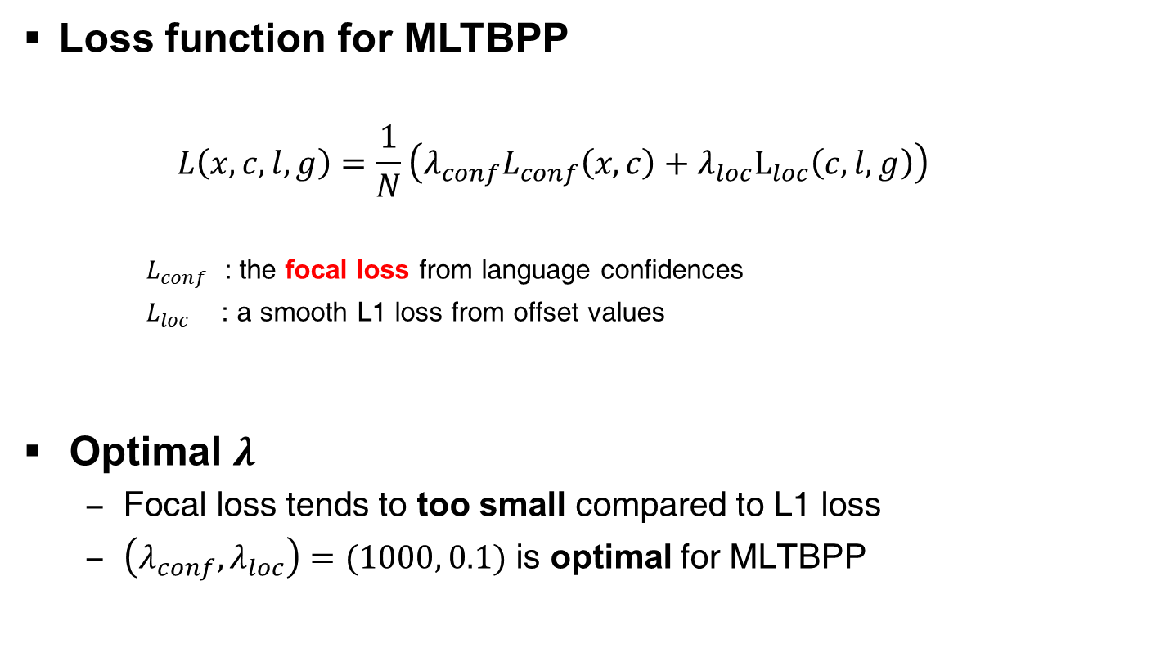
MLTBPP: Loss Function
Loss function for MLTBPP
$$L\left(x,c,l,g\right)=\frac{1}{N}\left(λ_{conf}L_{conf}\left(x,c\right)+λ_{loc}L_{loc}\left(c,l,g\right)\right)$$
$L_{conf}$ : the focal loss from language confidences
$L_{loc}$ : a smooth L1 loss from offset values
Optimal $λ$
Focal loss tends to too small compared to L1 loss
$\left(λ_{conf}, λ_{loc}\right)=(1000, 0.1)$ is optimal for MLTBPP
Notes:
기존의 TBPP+focal보다 class가 높아졌으니 lamb_conf가 커져야 하는게 맞는건가..? -> 사실은 작아져야할듯..?
Class로 나눠졌다고 이해해야하는건가?

Slide 23
Exp. Environ. and Dataset
Experimental environment
Implementation based on Keras, Python
Google Colab: 14.7 GiB GPU
Dataset description
Training: ICDAR 2019 RRC-MLT Dataset
10,000 images and ground truths with 10 languages
Testing: ICDAR 2017 RRC-MLT Validation Dataset
1,800 images and ground truths with 9 languages
Notes:
Github: https://github.com/mvoelk/ssd_detectors
Copyright© 2016 Andrey Rykov Copyright© 2017-2018 Markus Völk
Datatset: https://rrc.cvc.uab.es/?ch=15
Augmentation: aspect ratio + 512x512 resize

Slide 24
Implementation Details
Optimizer: Adam
Learning rate:
0.0005 for the first 20 epochs
0.0002 for the rest 20 epochs
IOU threshold: 0.4
Grid search
Augmentation
Crop with various aspect ratios
Notes:
10000개 중 bad data 54개 버리고
9005개 train
941로 validate 및 IoU grid search함

Slide 25
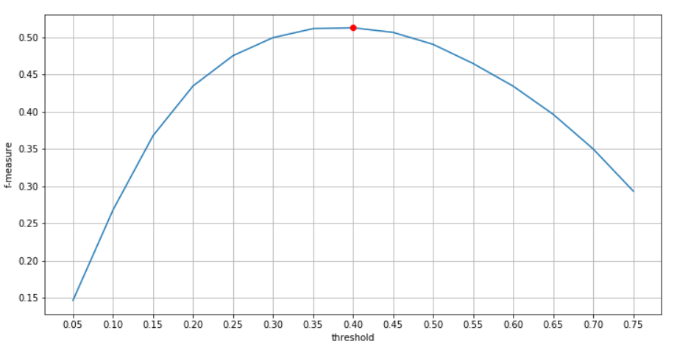
Implementation Details
Notes:
10000개 중 bad data 54개 버리고
9005개 train
941로 validate 및 IoU grid search함

Slide 26
Experimental Result
Text Detection |  |  | Text Detection & Script Identification |  |  | FPS
Precision | Recall | F1 | Precision | Recall | F1
0.7708 | 0.4371 | 0.5578 | 0.7265 | 0.4120 | 0.5258 | 13.16
Notes:
500 images per 38.063seconds

Slide 27
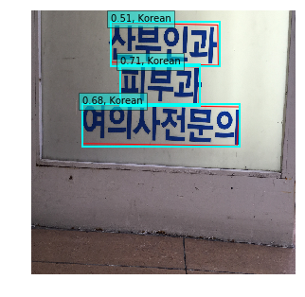
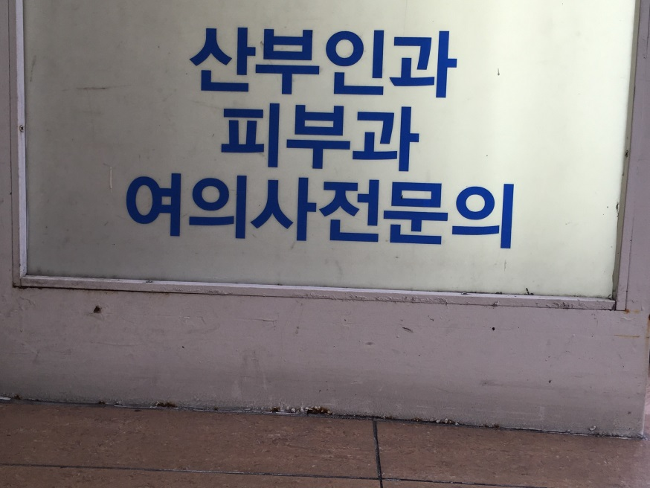
Experimental Result: Horizontal(1)

Slide 28
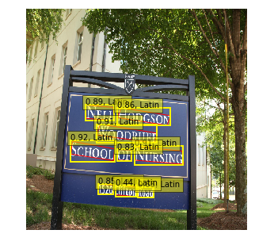
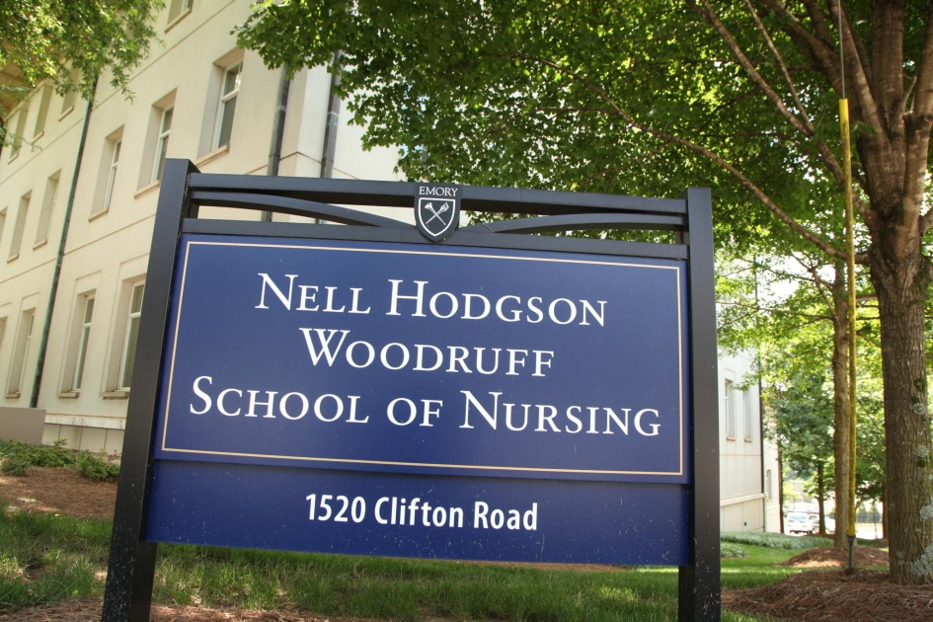
Experimental Result: Horizontal(2)

Slide 29
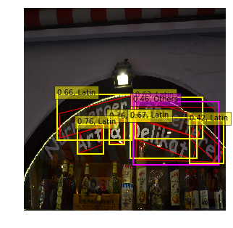
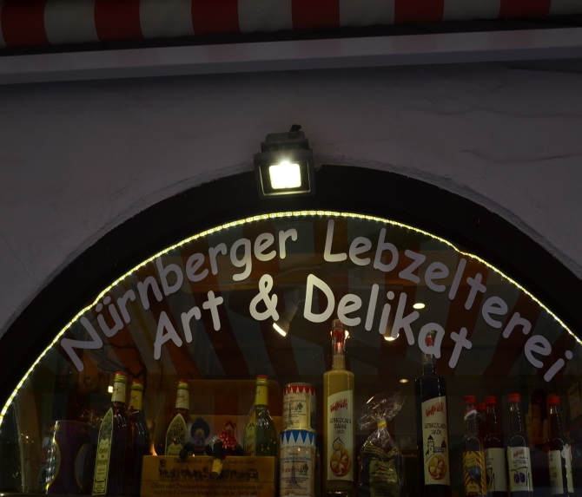
Experimental Result: Rotated

Slide 30
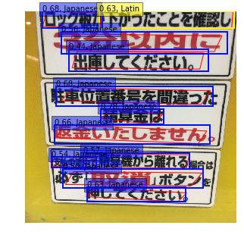
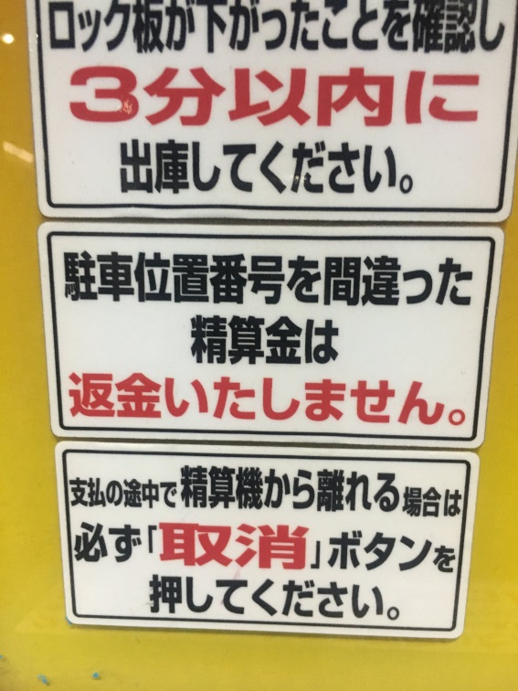
Experimental Result: Long & Dense

Slide 31
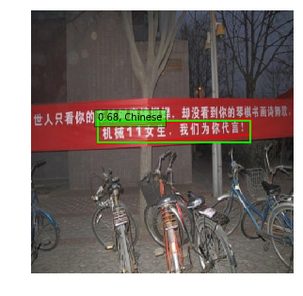
Experimental Result: Too Long

Slide 32
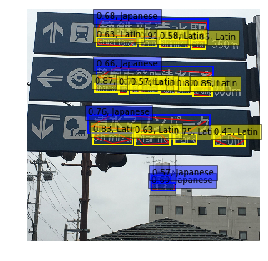
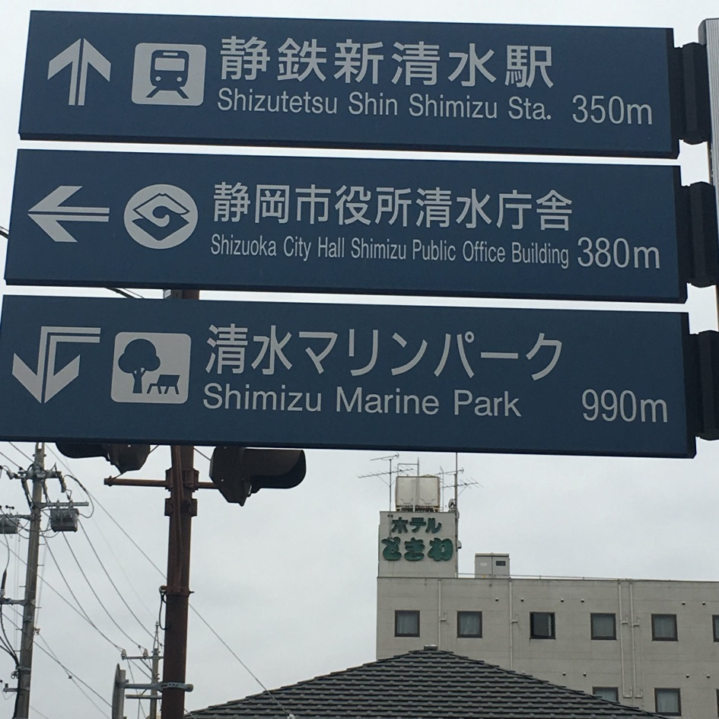
Experimental Result: Multi lingual(1)

Slide 33
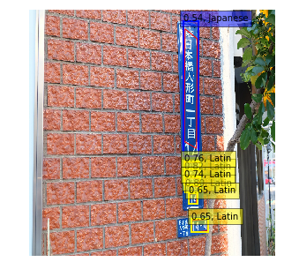
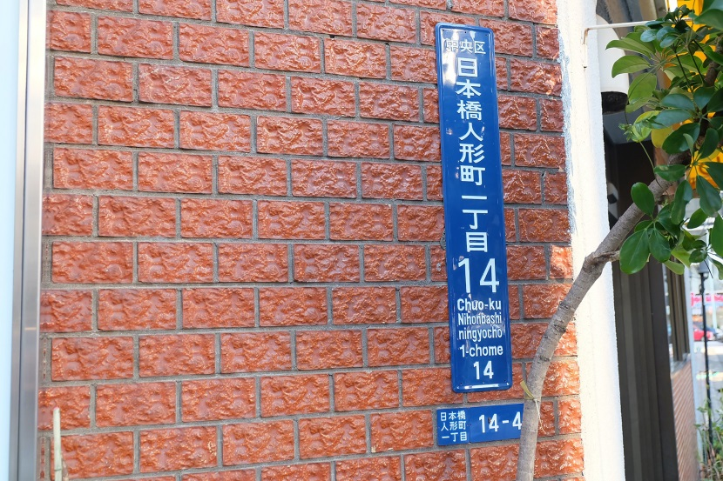
Experimental Result: Multi lingual(2)

Slide 34
Reference
SSD: Single Shot MultiBox Detector - https://arxiv.org/abs/1512.02325
TextBoxes++: A Single-Shot Oriented Scene Text Detector - https://arxiv.org/pdf/1801.02765
Focal Loss for Dense Object Detection - https://arxiv.org/abs/1708.02002
TextBoxes++ code - https://github.com/mvoelk/ssd_detectors

Slide 35
THANK YOU

