Slide 1
图像语义分割
马留龙

Slide 2
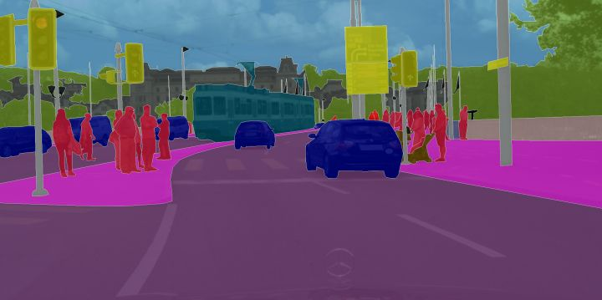
概念
像素(RGB) -> 像素(类别)

Slide 3
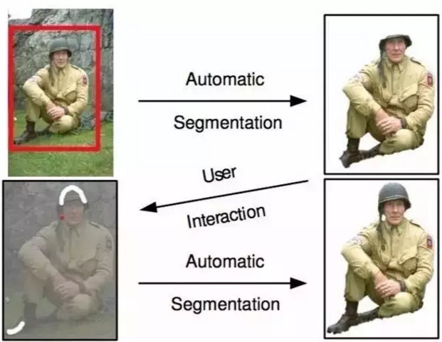
传统方法
阈值法、基于像素聚类的分割方法、Grab Cut等
https://www.cnblogs.com/ariel-dreamland/p/8028492.html

Slide 4
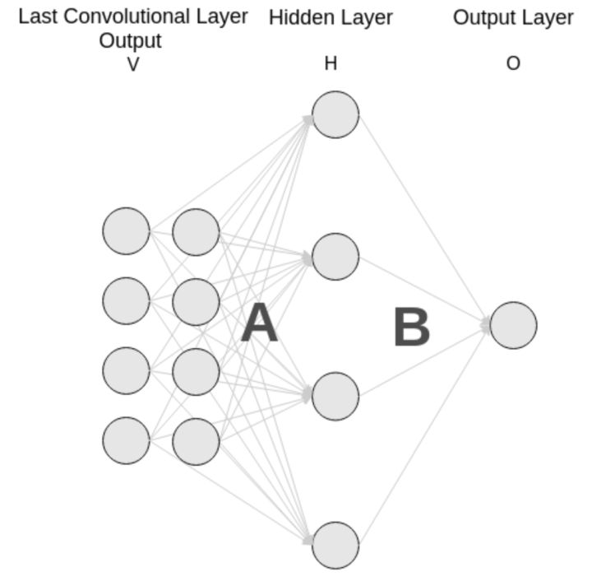
神经网络
一般分类网络，如VGG, ResNet等，全连接层 -> 一维概率信息

Slide 5
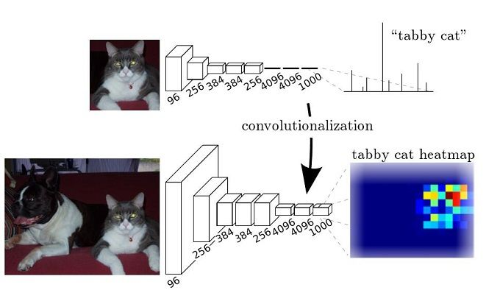
FCN(Fully Convolutional Network)
Convolutional
Long J, Shelhamer E, Darrell T. Fully convolutional networks for semantic segmentation[C]//Proceedings of the IEEE conference on computer vision and pattern recognition. 2015: 3431-3440.

Slide 6
FCN
Upsample
Convolution forward
Deconvolution forward
Long J, Shelhamer E, Darrell T. Fully convolutional networks for semantic segmentation[C]//Proceedings of the IEEE conference on computer vision and pattern recognition. 2015: 3431-3440.

Slide 7
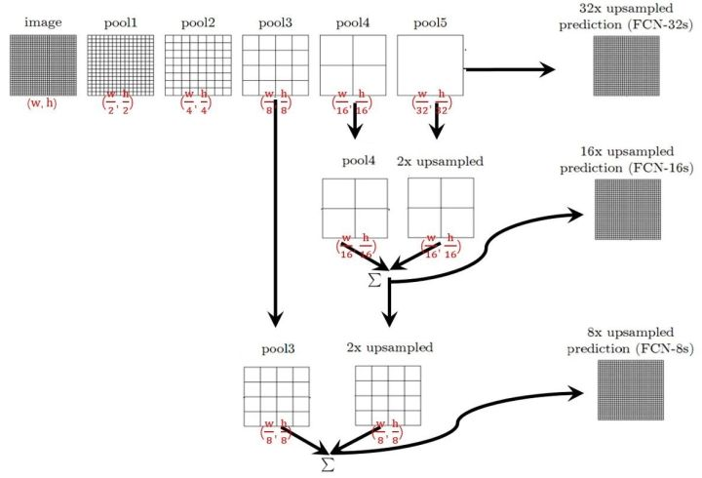
FCN
Skip Layer
Long J, Shelhamer E, Darrell T. Fully convolutional networks for semantic segmentation[C]//Proceedings of the IEEE conference on computer vision and pattern recognition. 2015: 3431-3440.

Slide 8
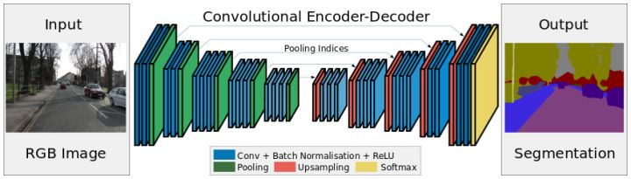
SegNet
Badrinarayanan V, Kendall A, Cipolla R. Segnet: A deep convolutional encoder-decoder architecture for image segmentation[J]. IEEE transactions on pattern analysis and machine intelligence, 2017, 39(12): 2481-2495.

Slide 9
FCN的不足
对细节不敏感
空间不敏感

Slide 10
Dilated Convolutions
采用疏松卷积核来取代池化
Yu F, Koltun V. Multi-scale context aggregation by dilated convolutions[J]. arXiv preprint arXiv:1511.07122, 2015.

Slide 11
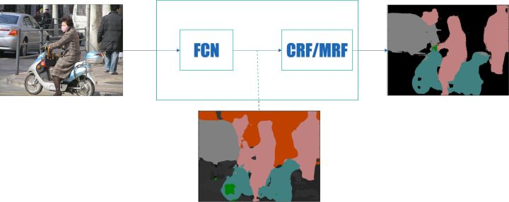
Graph Model
采用图模型作为后端进行优化
Zheng S, Jayasumana S, Romera-Paredes B, et al. Conditional random fields as recurrent neural networks[C]//Proceedings of the IEEE International Conference on Computer Vision. 2015: 1529-1537.

Slide 12
DeepLab
逐像素分类
结合了深度卷积神经网络（DCNNs）和概率图模型（DenseCRFs）
折中了DCNNs的识别能力和全连接的CRF的细粒度定位精度
Atrous Convolution（即Dilated Convolutions）
多尺度预测（提高边界定位效果）
Chen L C, Papandreou G, Kokkinos I, et al. Deeplab: Semantic image segmentation with deep convolutional nets, atrous convolution, and fully connected crfs[J]. IEEE transactions on pattern analysis and machine intelligence, 2018, 40(4): 834-848.

Slide 13
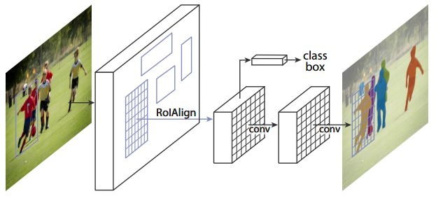
Mask RCNN
Faster-RCNN:对候选窗口进行分类和窗口坐标回归
He K, Gkioxari G, Dollár P, et al. Mask r-cnn[C]//Computer Vision (ICCV), 2017 IEEE International Conference on. IEEE, 2017: 2980-2988.

Slide 14
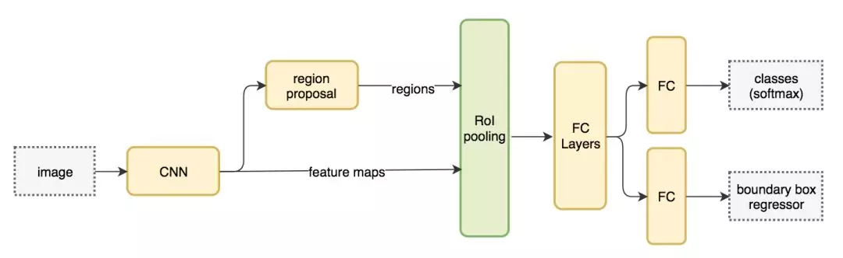
Faster RCNN
Ren S, He K, Girshick R, et al. Faster r-cnn: Towards real-time object detection with region proposal networks[C]//Advances in neural information processing systems. 2015: 91-99.

