Slide 1
GPS 室内外判别 GPS indoor / outdoor classification
特征分析 feature analysis
模型 调试 model trials
Notice: for this project, training data & testing data collected by different people. So there is a need to compare the features between them before deciding which model will be suitable.

Slide 2
特征分析 – 采集的数据对比 feature analysis, comparisons between training data & testing data
12 个 特征的值域， 分布对比 compare the features between training data & testing data
地铁室外跑 组 the testing data when subway-train running outdoors
地铁站内 组 the testing data when in the subway stations (indoors)
其他 组 other main scenes such as streets, communities, stores, buildings, etc.

Slide 3
地铁室外跑 the testing data when subway-train running outdoors

Slide 4
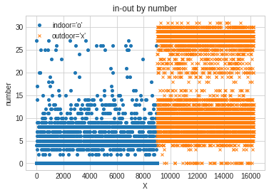
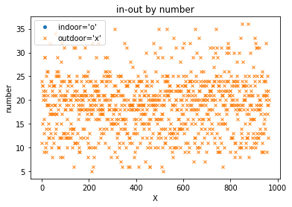
Training data
Testing data
特征 1 / feature 1
number: 手机将卫星用于定位的数量

Slide 5
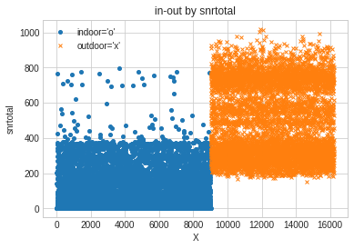
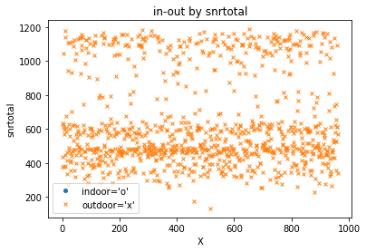
Training data
Testing data
特征 2 / feature 2
snrtotal :所有能检测到卫星的信噪比总和

Slide 6
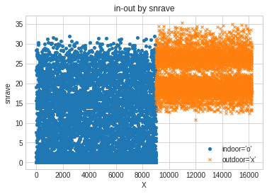
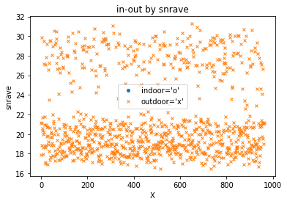
Training data
Testing data
特征 3 / feature 3
snrave :所有能检测到卫星的信噪比的平均值

Slide 7
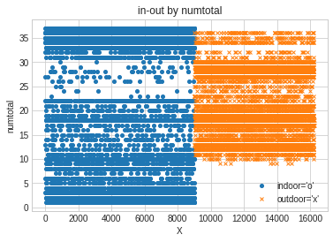
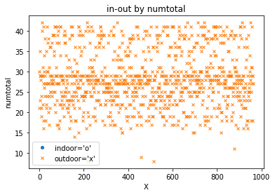
Training data
Testing data
特征 4 / feature 4
numtotal :当前手机所能检测的所有卫星数量 (包括信号强度低的卫星)

Slide 8
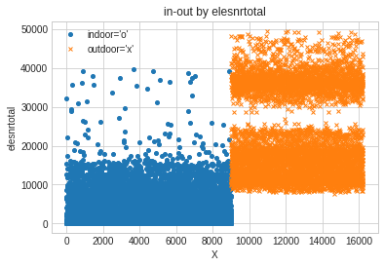
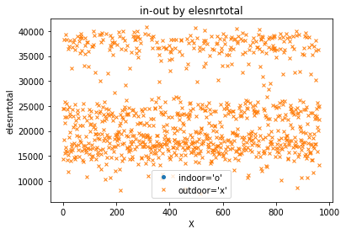
Training data
Testing data
特征 5 / feature 5
elesnrtotal :所有能检测到卫星的俯仰角和信噪比 乘积的总和

Slide 9
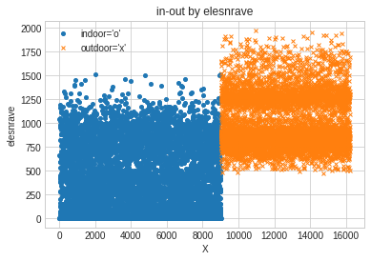
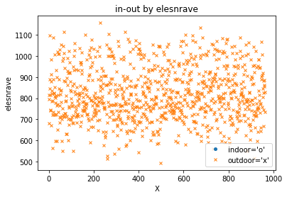
Training data
Testing data
特征 6 / feature 6
elesnrave :所有能检测到卫星的俯仰角和信噪比 乘积的平均值

Slide 10
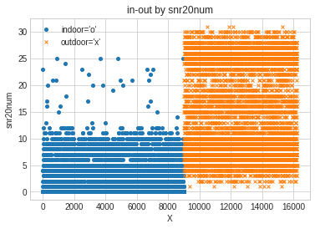
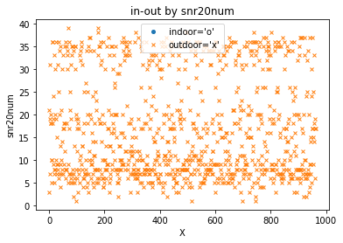
Training data
Testing data
特征 7 / feature 7
snr20num :手机检测到信噪比大于等于 20 的卫星 数量

Slide 11
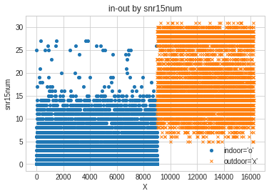
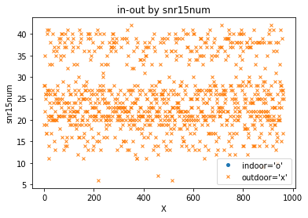
Training data
Testing data
特征 8 / feature 8
snr15num :手机检测到信噪比大于等于 15 的卫星 数量

Slide 12
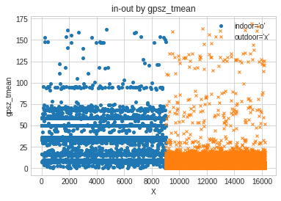
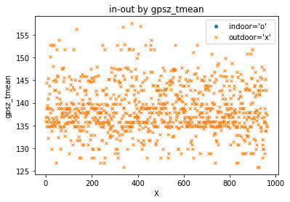
Training data
Testing data
特征 9 / feature 9
gpsz_tmean :当前位置的 GPS 海拔高度与手机测试 海拔高度差的绝对值

Slide 13
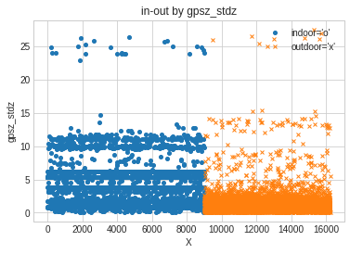
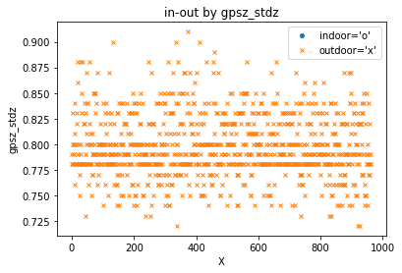
Training data
Testing data
gpsz_stdz 特征处理明显不一致， 所以后面去掉这个特征
特征 10 / feature 10
gpsz_stdz :当前位置的 GPS 海拔高度与手机测试 海拔高度差的绝对值是否小于标准差 (0 or 1)

Slide 14
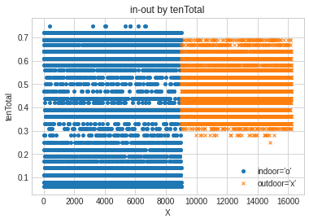
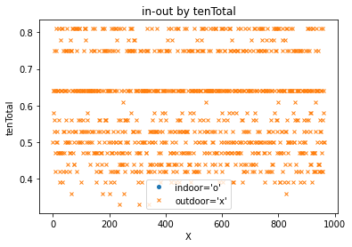
Training data
Testing data
特征 11 / feature 11
tenTotal :将 360°分为 36 份(10°)，包含卫星的份数总和与 36 之比

Slide 15
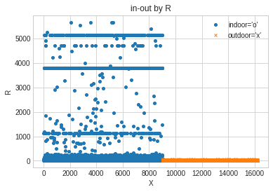
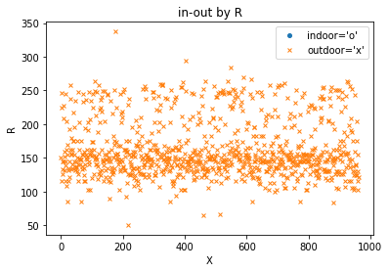
Training data
Testing data
特征 12 / feature 12
R :GPS 预测误差半径

Slide 16
地铁站内 the testing data when in the subway stations (indoors)

Slide 17
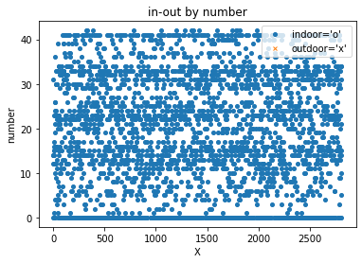
Training data
Testing data
特征 1 / feature 1
number: 手机将卫星用于定位的数量

Slide 18
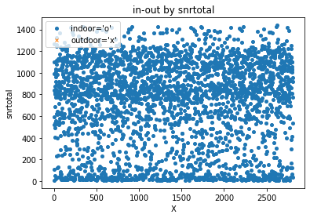
Training data
Testing data
特征 2 / feature 2
snrtotal :所有能检测到卫星的信噪比总和

Slide 19
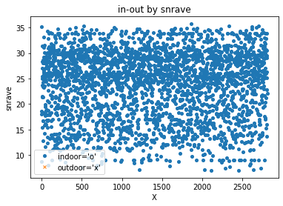
Training data
Testing data
特征 3 / feature 3
snrave :所有能检测到卫星的信噪比的平均值

Slide 20
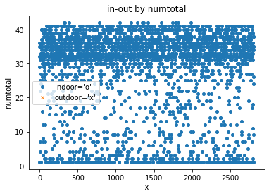
Training data
Testing data
特征 4 / feature 4
numtotal :当前手机所能检测的所有卫星数量 (包括信号强度低的卫星)

Slide 21
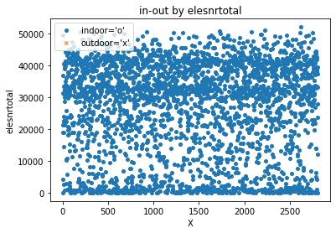
Training data
Testing data
特征 5 / feature 5
elesnrtotal :所有能检测到卫星的俯仰角和信噪比 乘积的总和

Slide 22
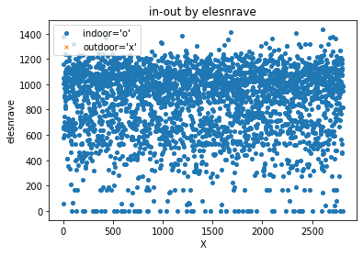
Training data
Testing data
特征 6 / feature 6
elesnrave :所有能检测到卫星的俯仰角和信噪比 乘积的平均值

Slide 23
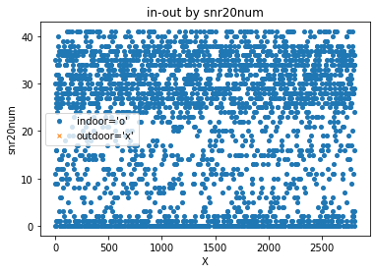
Training data
Testing data
特征 7 / feature 7
snr20num :手机检测到信噪比大于等于 20 的卫星 数量

Slide 24
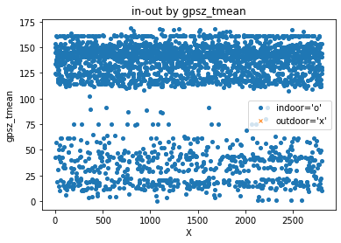
Training data
Testing data
特征 8 / feature 8
snr15num :手机检测到信噪比大于等于 15 的卫星 数量

Slide 25
Training data
Testing data
特征 9 / feature 9
gpsz_tmean :当前位置的 GPS 海拔高度与手机测试 海拔高度差的绝对值

Slide 26
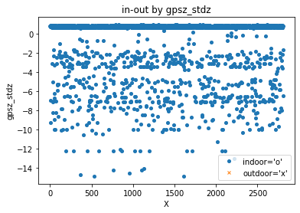
Training data
Testing data
gpsz_stdz 特征处理明显不一致， 所以后面去掉这个特征
特征 10 / feature 10
gpsz_stdz :当前位置的 GPS 海拔高度与手机测试 海拔高度差的绝对值是否小于标准差 (0 or 1)

Slide 27
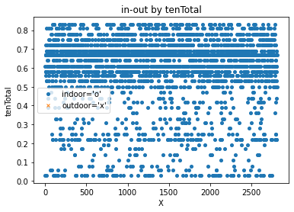
Training data
Testing data
特征 11 / feature 11
tenTotal :将 360°分为 36 份(10°)，包含卫星的份数总和与 36 之比

Slide 28
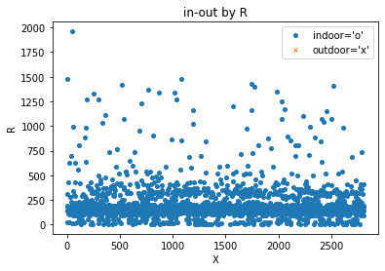
Training data
Testing data
特征 12 / feature 12
R :GPS 预测误差半径

Slide 29
其他 – 删掉了 地铁室外跑 & 地铁站内 other main scenes such as streets, communities, stores, buildings, etc. excluding scenes related to Subway

Slide 30
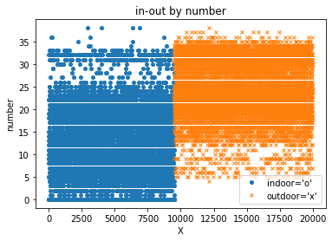
Training data
Testing data
特征 1 / feature 1
number: 手机将卫星用于定位的数量

Slide 31
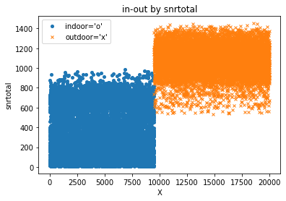
Training data
Testing data
特征 2 / feature 2
snrtotal :所有能检测到卫星的信噪比总和

Slide 32
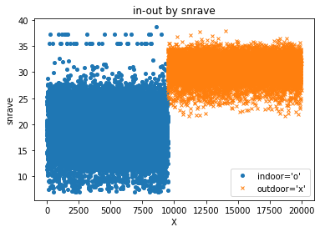
Training data
Testing data
特征 3 / feature 3
snrave :所有能检测到卫星的信噪比的平均值

Slide 33
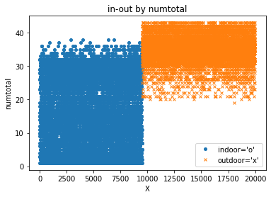
Training data
Testing data
特征 4 / feature 4
numtotal :当前手机所能检测的所有卫星数量 (包括信号强度低的卫星)

Slide 34

Training data
Testing data
特征 5 / feature 5
elesnrtotal :所有能检测到卫星的俯仰角和信噪比 乘积的总和

Slide 35
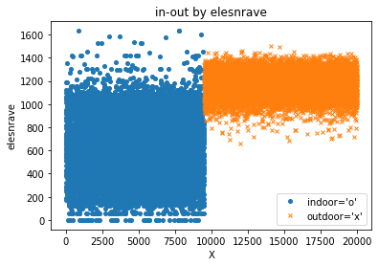
Training data
Testing data
特征 6 / feature 6
elesnrave :所有能检测到卫星的俯仰角和信噪比 乘积的平均值

Slide 36
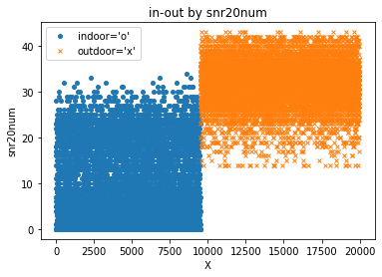
Training data
Testing data
特征 7 / feature 7
snr20num :手机检测到信噪比大于等于 20 的卫星 数量

Slide 37
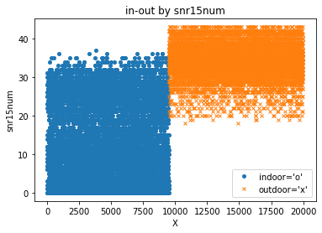
Training data
Testing data
特征 8 / feature 8
snr15num :手机检测到信噪比大于等于 15 的卫星 数量

Slide 38
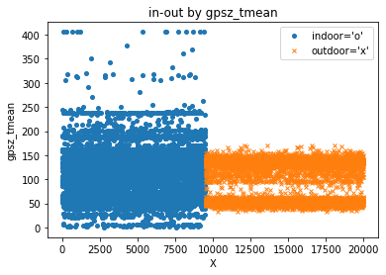
Training data
Testing data
特征 9 / feature 9
gpsz_tmean :当前位置的 GPS 海拔高度与手机测试 海拔高度差的绝对值

Slide 39
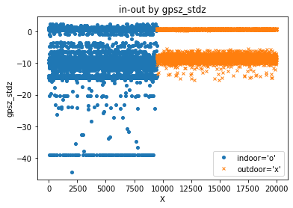
Training data
Testing data
gpsz_stdz 特征处理明显不一致， 所以后面去掉这个特征
特征 10 / feature 10
gpsz_stdz :当前位置的 GPS 海拔高度与手机测试 海拔高度差的绝对值是否小于标准差 (0 or 1)

Slide 40
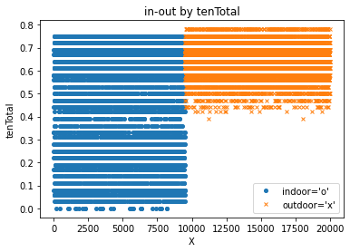
Training data
Testing data
特征 11 / feature 11
tenTotal :将 360°分为 36 份(10°)，包含卫星的份数总和与 36 之比

Slide 41
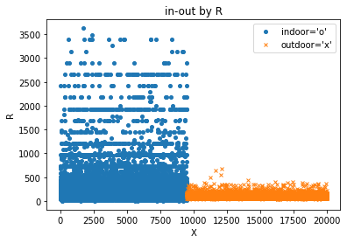
Training data
Testing data
特征 12 / feature 12
R :GPS 预测误差半径

Slide 42
模型 调试 try different models
特征个数减少 reduce training features from 12 to 11, 8.
参数调整 parameters adjustments.

Slide 43
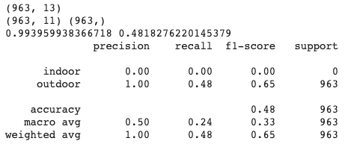
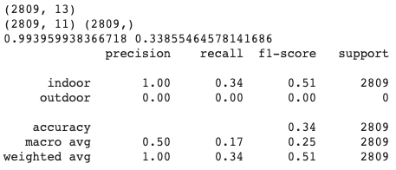
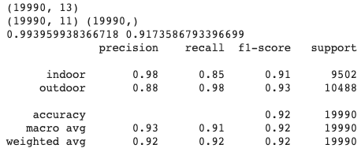
采集的训练数据集 zhuyining
采集的测试数据集 guihan
去掉 gpsz_stdz, 用 11 个特征， 4个子模型， 深度6
地铁室外跑
地铁站内
其他
(删掉 地铁室外跑& 地铁站内)

Slide 44
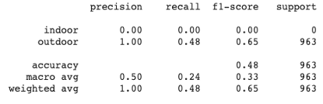





采集的训练数据集 zhuyining
采集的测试数据集 guihan
去掉 gpsz_stdz, 用 11 个特征， 4个子模型， 深度6
用 12 个特征， 4个子模型， 深度10
地铁室外跑
地铁站内
其他

Slide 45
Reference
Zhu, Y., Luo, H., Wang, Q., Zhao, F., Ning, B., Ke, Q. and Zhang, C., 2019. A Fast Indoor/Outdoor Transition Detection Algorithm Based on Machine
Learning. Sensors, 19(4), p.786.
Huang, H., Zeng, Q., Chen, R., Meng, Q., Wang, J. and Zeng, S., 2018, March. Seamless Navigation Methodology optimized for Indoor/Outdoor Detection Based on WIFI. In 2018 Ubiquitous Positioning, Indoor Navigation and Location-Based Services (UPINLBS) (pp. 1-7). IEEE.
Cho, H., Song, J., Park, H. and Hwang, C., 2014, November. Deterministic indoor detection from dispersions of GPS satellites on the celestial sphere. In The 11th international symposium on location based services.
Chen, K. and Tan, G., 2017, May. SatProbe: Low-energy and fast indoor/outdoor detection based on raw GPS processing. In IEEE INFOCOM 2017-IEEE Conference on Computer Communications (pp. 1-9). IEEE.
Okamoto, Masayuki, and Cheng Chen. "Improving GPS-based indoor-outdoor detection with moving direction information from smartphone." In Adjunct Proceedings of the 2015 ACM International Joint Conference on Pervasive and Ubiquitous Computing and Proceedings of the 2015 ACM International Symposium on Wearable Computers, pp. 257-260. ACM, 2015.

Slide 46
Thank you!

