Slide 1

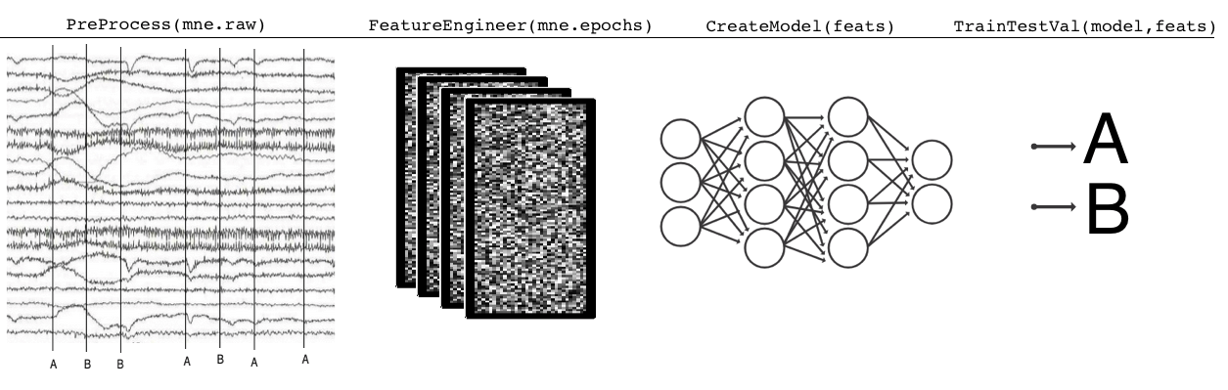
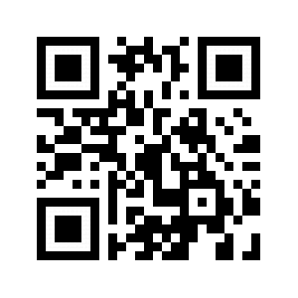
Create various deep learning models to apply to EEG/MEG/LFP data. Simulate EEG/ERP data and test various models
DeepEEG: A Keras/TensorFlow library and notebooks for
machine learning with neuropsychogical data
Kyle E. Mathewson¹, Kory W. Mathewson²
Department of Psychology¹, Department of Computing Science², Faculty of Science, University of Alberta
INTRODUCTION
Mike Morrison created a template for a “Better Scientific Poster” (BSP) (https://osf.io/ef53g/)
The BSP format has been praised by many, yet disparaged by others.
The current project had 2 goals:
Create a template that I think could be useful.
Point out that we don’t need to either love or hate the new format—the middle is just fine.
METHOD
To create a new template, I identified strengths of the BSP template and the traditional format.
BSP strengths: clear take-away message, minimal text, QR code
Traditional format strengths: room for figures, reasonable text size on sides, large title to make finding posters in poster session easy, web link and email for people who don’t like QR codes
RESULTS
Preregistered analysis: 78% increase in liking compared to traditional format and 24% increase compared to the BSP format.
Exploratory analysis: room for improvement in this template (Arial font, seriously?!?!).
DISCUSSION
Sometimes it makes sense to pick a side; this is not one of those times.
Praise what you like, make suggestions for improvement, and then make something better.Take Mike’s ideas, incorporate some of mine, be creative, and let’s make posters more useful.
Poster template: https://osf.io/ayjzg/
kyle.mathewson@ualberta.ca
Take a picture to download the full paper
Notes:
Notes:
In Powerpoint, click View > Guides
Keep text within gutter guides.
Author list: Don’t split names onto two lines (e.g., “Jimmy [break] Smith”). If that happens, use a new line, unless you need the space. Bold the first names of anybody who’s presenting in person.
Intro/methods/result: Do not drop below font size 28, but if you have extra space, jack up the font size until the space is full.
Do not use color in the sidebars except in graphs/figures. It’ll pull attention from the center and slow interpretation for passersby.
2. Generate QR codes here: https://www.qrcode-monkey.com/

