Slide 1
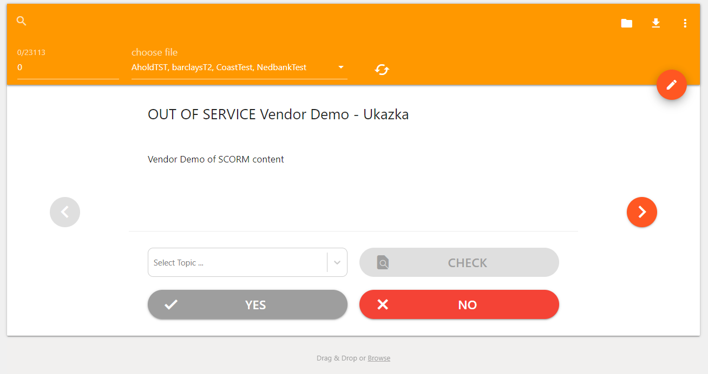
Search
Download
Item Index
Manage files
JSON Editor
Active files
Annotation
File Upload

