Slide 1

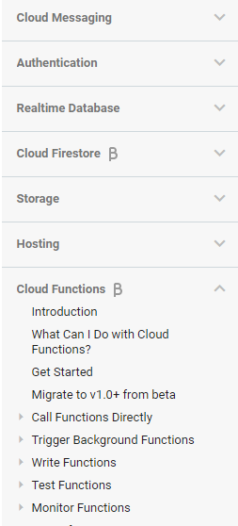
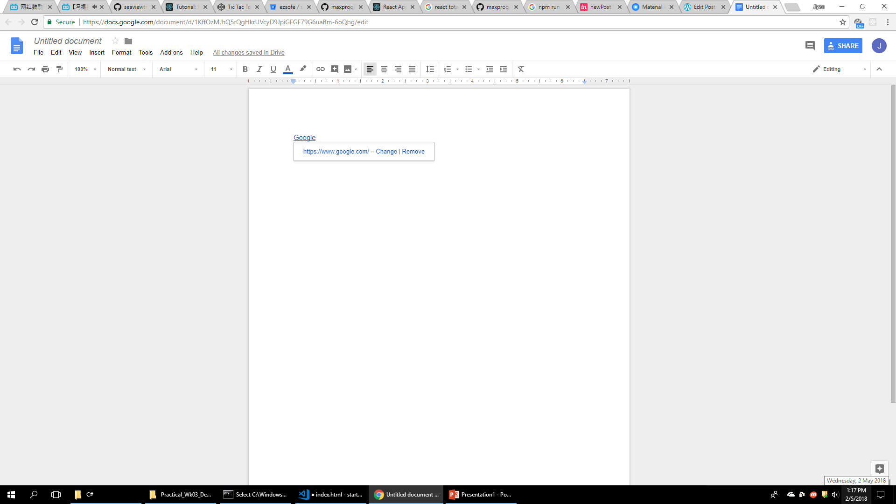
Short Code Library
Post Title
Preview
Update
View
HTML
History
2 Revisions
[contact-form][contact-field label="Name" type="name" required="1" /][contact-field label="Email" type="email" required="1" /][contact-field label="Website" type="url" /][contact-field label="Comment" type="textarea" required="1" /][/contact-form]
<strong><strong>
</strong></strong>
[contact-form][contact-field label="Name" type="name" required="1" /][contact-field label="Email" type="email" required="1" /][contact-field label="Website" type="url" /][contact-field label="Comment" type="textarea" required="1" /][/contact-form]
<h2><strong><code>123456</code></strong>
<!--more--><!--more--></h2>
<img class="alignnone size-full wp-image-8" src="https://hanjiyao.files.wordpress.com/2018/04/person-smartphone-office-table.jpeg" alt="Placeholder Image" width="1600" height="1067" />
<h1></h1>
&nbsp;
Just Now
+ 50 - 30
1 Day ago
+ 30 - 30

