Slide 1
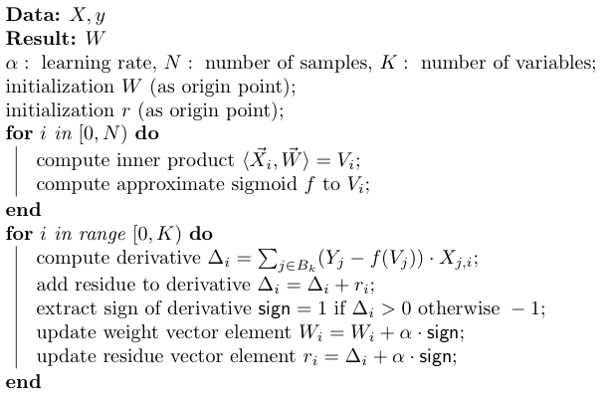
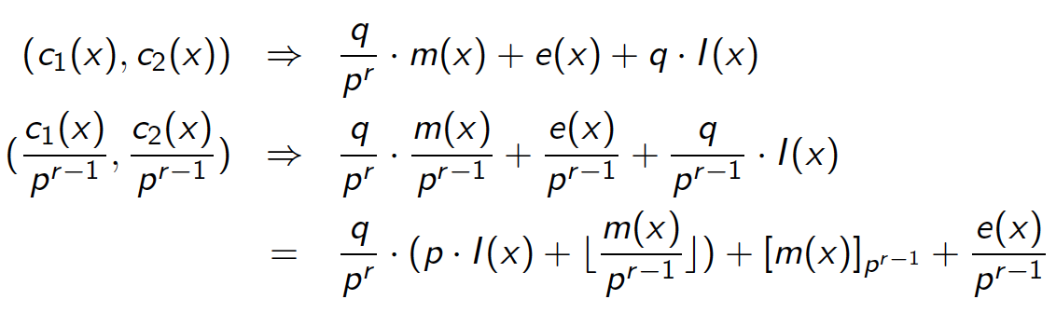
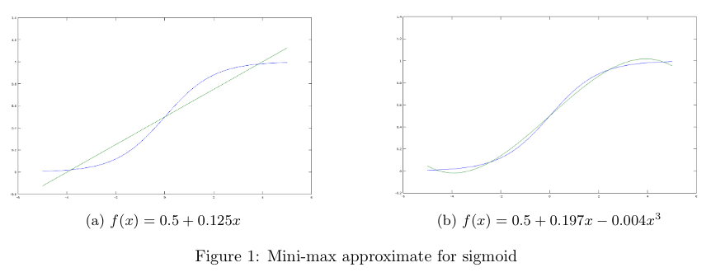
Homomorphic Machine Learning with SEAL
Hao Chen¹, Kyoohyung Han², Zhicong Huang³, Amir Jalali⁴, Kim Laine¹, Ran Gilad-Bachrach¹, Kristin Lauter¹
¹Microsoft Research, ²Seoul National University, ³École Polytechnique Fédérale de Lausanne, ⁴Florida Atlantic University
Homomorphic Machine Learning
Homomorphic Flooring using SEAL
To run learning phase of machine learning in encrypted state, what is the big problem? message size problem
FV style encryption of message m:
Input :
I(x)
Msg
Err
Division:
I(x)
Msg
Err
I’(x)
Msg’
Err
Approx-Recrypt:
I’’(x)
Msg”
Err
Extract:
I’’(x)
f
Err
Instead of using gradient decent, “1-Bit Stochastic Gradient Descent” used only sign information in learning and this solves the message size problem [1].
Only need to keep lowest digit part, this makes our recrypt faster with approx-recrypt.
Full process is little-bit expensive than bootstrapping, but we can perfume bootstrapping and flooring at once.
Sign Extraction can be expressed by floor function, and we can adapt SIMD technique.
Polynomial Approximate of Sigmoid Function
Mini-max polynomial approximate
Range [-5, 5]
Degree 1 and 3 for each
Encryption Parameter
Setting and Result
We used SEAL with RNS-FV version and bootstrapping implementation [2].
Each coefficient modulus chain is 60-bit prime integer
Timing for each iteration is same and bootstrapping is included in homomorphic floor, so we can perform any number of iteration (total running time will increase linear to iteration number).
Number of samples: 1000 ~ 2000
Number of features: 18 (include 1 dummy)
Timing result: 300 seconds per iteration,
[1] Seide, Frank, et al. "1-bit stochastic gradient descent and its application to data-parallel distributed training of speech dnns." Fifteenth Annual Conference of the International Speech Communication Association. 2014.
[2] Bajard, Jean-Claude, et al. "A full RNS variant of FV like somewhat homomorphic encryption schemes." Selected Areas in Cryptography-SAC. 2016.

