Slide 1


Slide 2

Figure 2 (audio schematic)

Slide 3
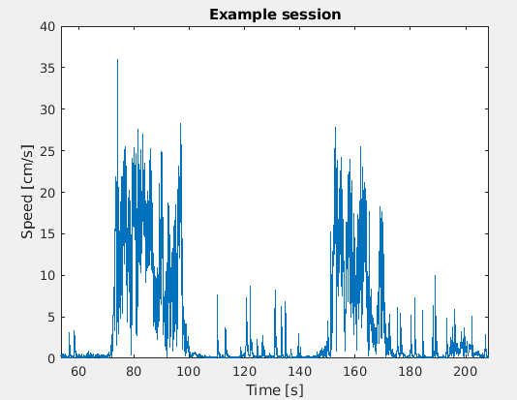
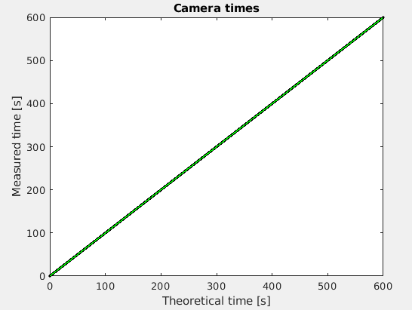
Figure 3

Slide 4


Figure 4

