Slide 1
What I’ve been up to...
Not much time to go into depth
But, I’ll start at the beginning
Arduino: founded in 2008
Microcontrollers exploded from there
  Unique features of the Arduino:
    Cheap!!
    Open source!!
    Simple programming language and environment (written in language similar to C++, and in fact can utilize C++ and C libraries

Slide 2
Other advantages
Only a single process is run at a time: no overhead of an operating system, etc.
Easy to build and add shields, attach to other boards, etc.
Lend themselves VERY easy to experimental control, and are very accurate as noted and tested previously noted in “Arduino: A low-cost multipurpose lab equipment” (Alessandro D’Ausilio, 2012).

Slide 3
Teensy microcontrollers
Basically, the same thing, with a few unique features
Has a library built on top of the Arduino library (i.e. can use Arduino functions, plus many extras!)
We utilize the 3.2 in particular
Similar number of channels, but capable of true analog output (instead of PWM)
Faster processor (potentially more accuracy): 72 vs 16 MHz
All pins have interrupt capability (we don’t utilize this here)
Special, added libraries on top of the standard Arduino libraries

Slide 4
Teensy libraries
Key functions: IntervalTimer → generates interrupts at microsecond time scale; can utilize 4 at a time
Audio library: 44.1 kHz library for playing and synthesizing tones – super easy to use, and can be used concomitantly with other interval timers
Plug-and-play add-ons: e.g. prop-shield serves as an easy amplifier: just solder on, and you are good to go
Like Arduino, capable of interacting with serial peripheral interfaces, like the ADNS-9800

Slide 5
ADNS-9800
Originally a gaming sensor
Board created recently by Jack Enterprises (https://www.tindie.com/products/jkicklighter/adns-9800-laser-motion-sensor/)
12000 FPS frame rate, up to 8200 counts per inch (compare to ~ 125 fps max, maybe 1000, and far fewer counts per inch)
16 bit storage: don’t have to poll as often, so the sensors won’t saturate

Slide 6
ADNS-9800
Simple SPI interface
Our Mark expanded the included code into a library, so it is easy to start sensors, clear, and read from motion burst registers and others using his code instead of diving into the nitty gritty (back in 2014...)
Downsides: wiring the sensors kind of sucks

Slide 7


Slide 8

Figure 2 (audio and motor schematic)

Slide 9
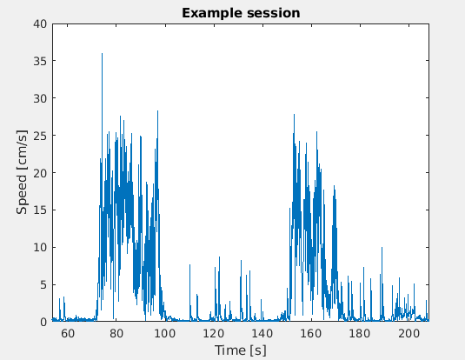
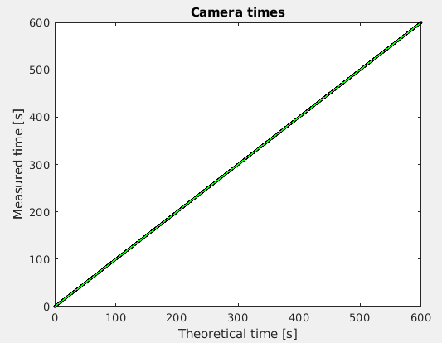
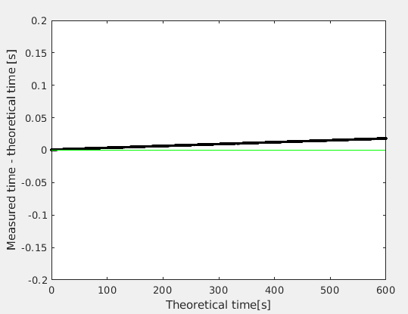
Figure 3
Data collected from the device is temporally VERY accurate, only slightly biased

Slide 10


Figure 4
Tone puff: also very accurate

Slide 11
Conclusion
Use these!
Excellent temporal resolution; not as high-level as MATLAB: less jitter/competing processes
Easy to set up
Should be easy to integrate into ViRMeN (sp?), if anyone wants a project?

Slide 12
Revisions to the original manuscript

Slide 13


Slide 14
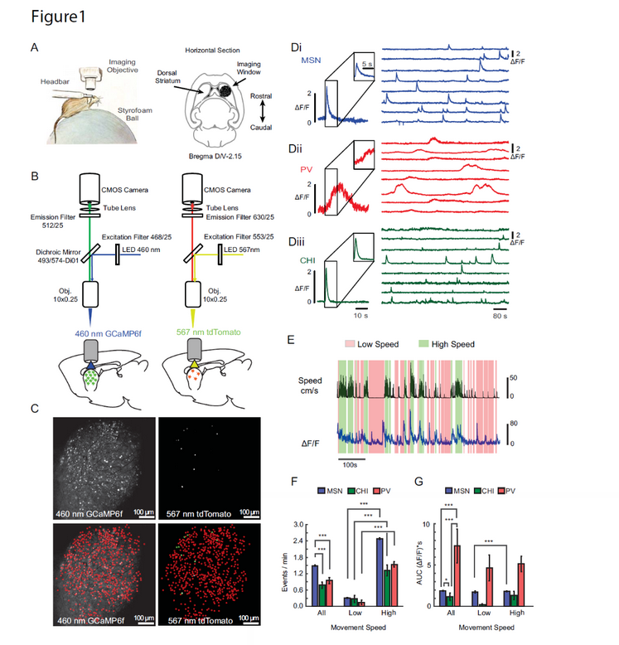

Slide 15
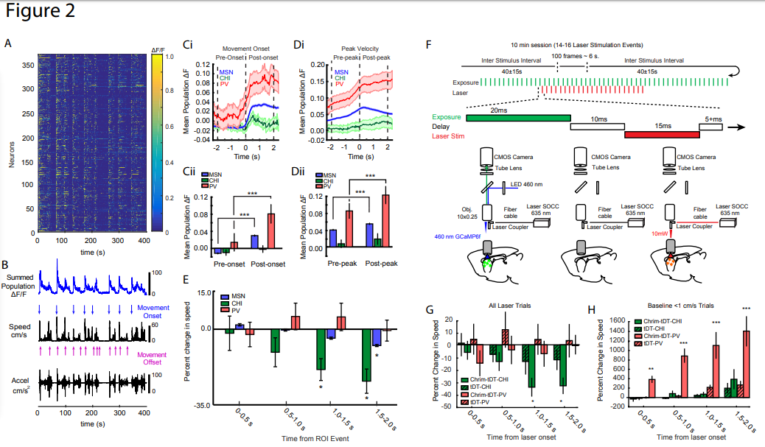
Issues: do PV cells increase their firing before MSNs?
Do CHI interneurons peak later than MSNs?
Also, how do we know that percent change in speed is different for three cell types?

Slide 16
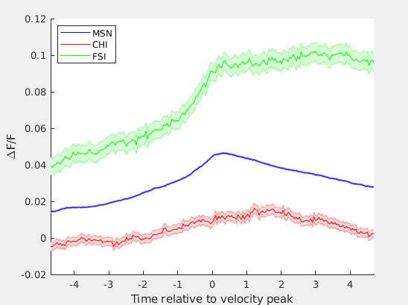
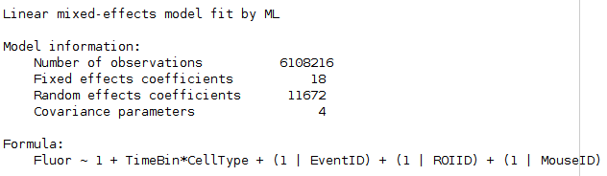
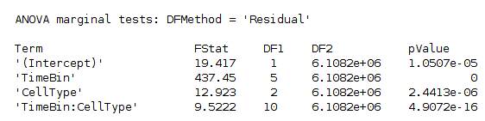

Slide 17
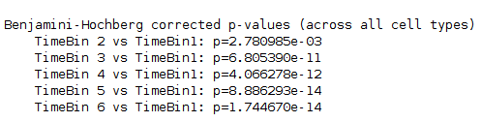
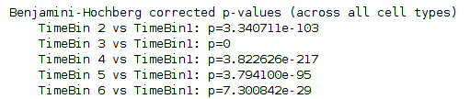
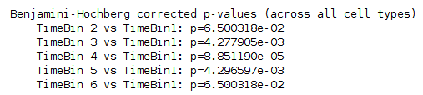
FSI
MSN
CHI

Slide 18
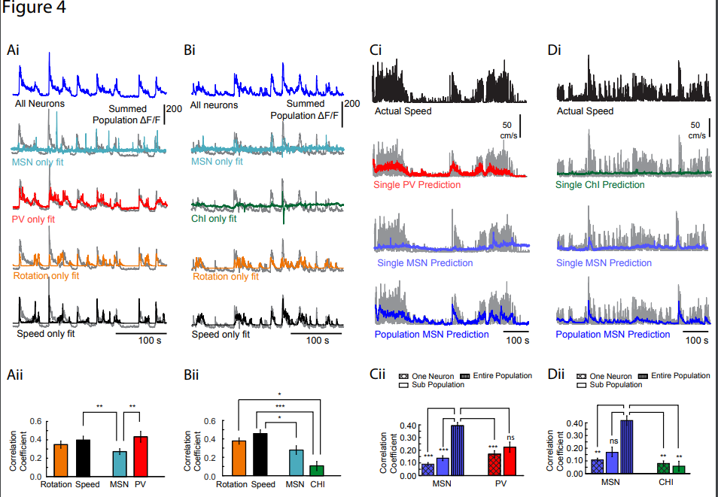
Criticism: why not combine everything into a single model and thereby
make inferences?

Slide 19
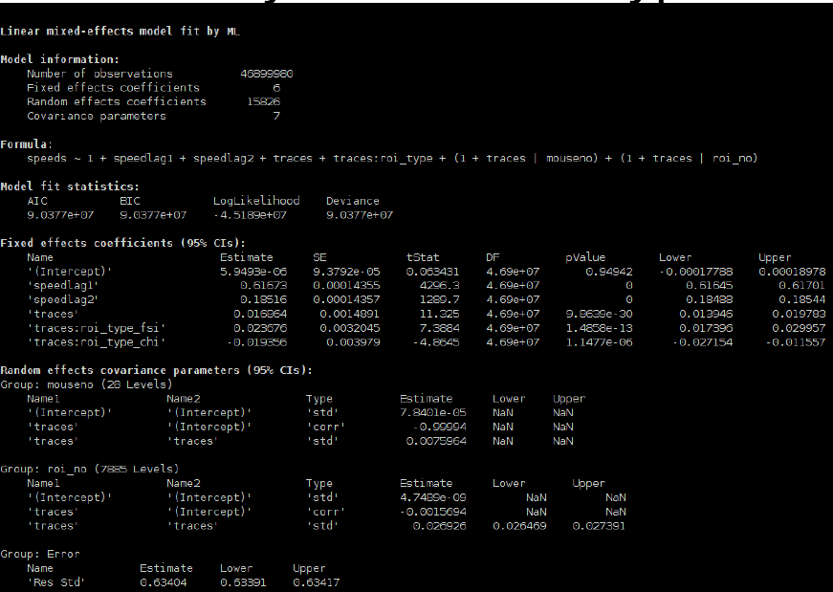

Slide 20
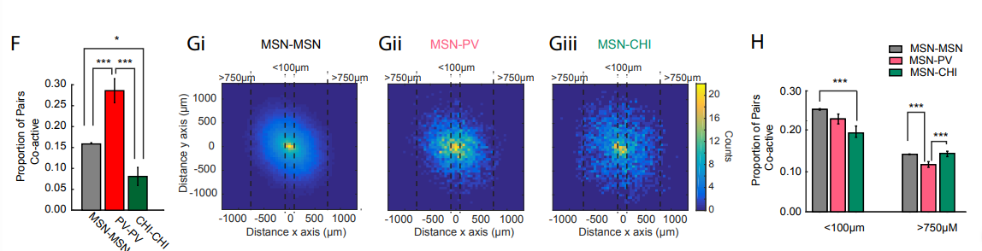
Reviewer comment: argue that the change in proportion of pairs coactive vs distance is different for all three cell types, but demonstrate no statistics

Slide 21
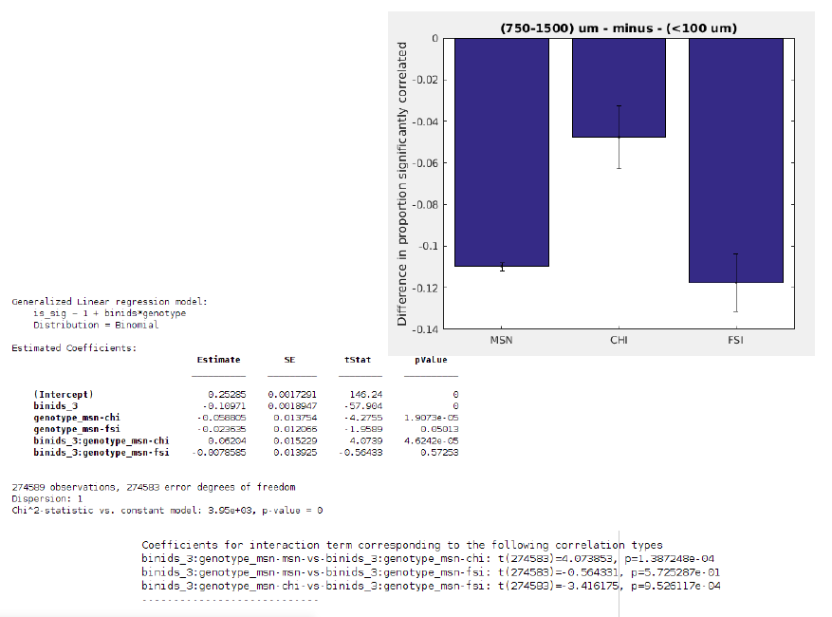

Slide 22
Now, beginning a “network” analysis
Mentioned over the summer, several papers have reported that neurons form clusters that are spatially biased
What do we see when we use the same methodology? (meta k-means)
  1st, randomly select chunk of data
  Run k-means 100 times with “correlation” as distance metric
  Randomly select different chunk of data
  Make histogram: # of times that each pair together
  Choose cutoff value that maximizes # of clusters

Slide 23
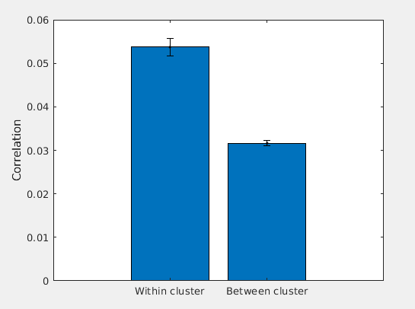
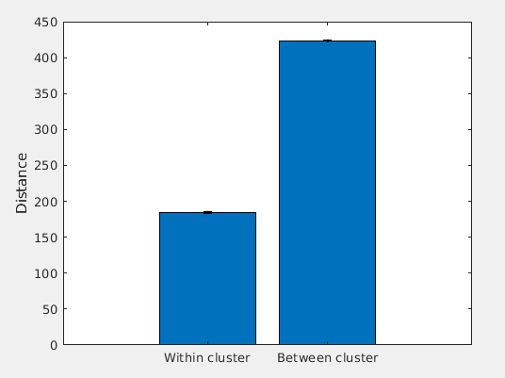
Summary statistics

Slide 24
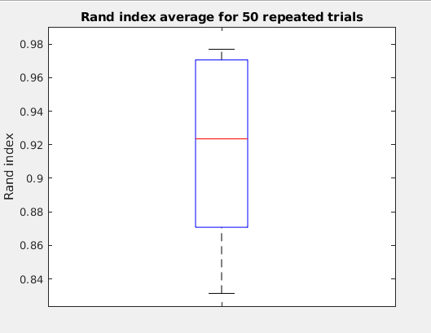
Make sure we are converging on same clusters

Slide 25
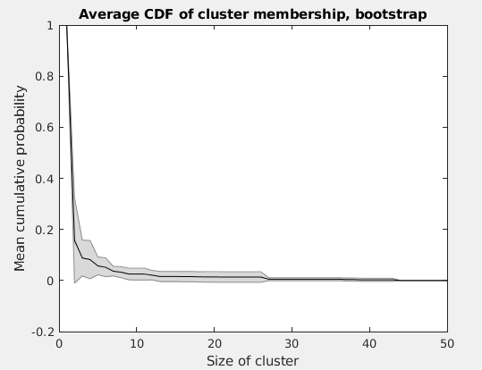
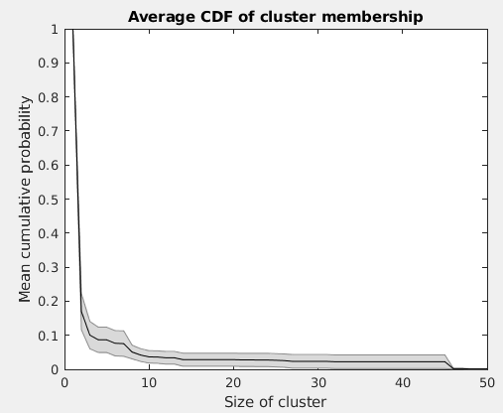
Summary statistics

Slide 26
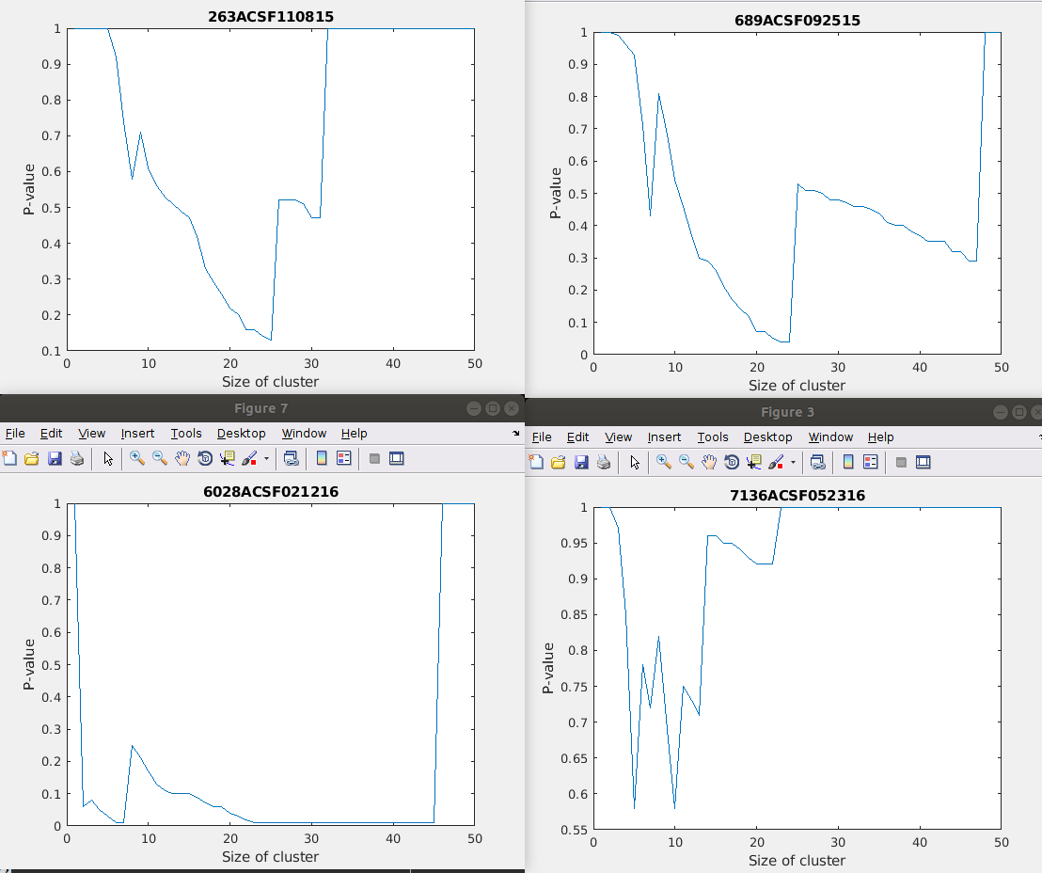

Slide 27
Next steps
Keep going down this path? Then, see whether or not clustering

