Slide 1
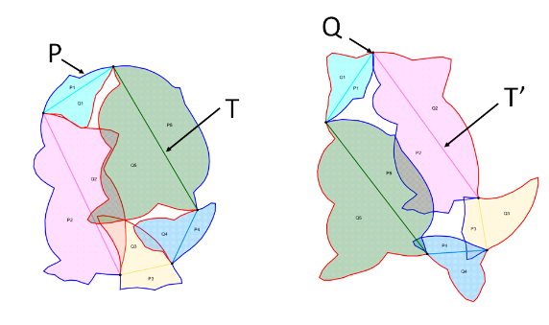
Problem Recap
Input: a shape P and its trunk T, shape Q as the riot of P, and its trunk T’.
Target: to fabricate common pieces of P and Q, which can be assembled along a chain, so that rotating the chain clockwise forms one figure and counter-clockwise forms the other figure.
Problem: The red exterior contour Q (Right figure) is split by T’ into curves, forming the red interior curves of P (Left figure). Each piece, denoted as {Qi} in the following figure, is represented by a red boundary curve and a polygon edge. In the left figure, they may have overlaps which would cause piece conflictions after fabrication. The target is to deform the boundary curves in {Qi} to eliminate overlaps in P, and minimize gaps, while preserving the curve details as much as possible, so that when we reverse P to Q (Right figure), the shape Q is still recognizable.

Slide 2
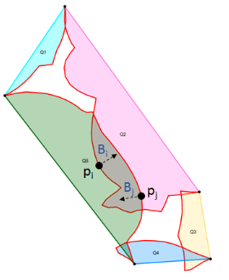
Boundary deformation
Deformation method - Laplacian editing is used for deforming boundary curves while preserving curve details.
Refer : [Laplacian Surface Editing. O. Sorkine, D. Cohen-Or, Y. Lipman, M. Alexa, C. Roessl, and H.-P. Seidel. Proc. SGP 2004]
Moving directions – Attraction-Repulsion force is applied to both overlap and gaps. Each curve has a set of sample points, and the force is defined between points from two nearby curves.
Take the following figure for example, to eliminate the overlaps, we should pull
the green part along p_{j} direction, and red part along p_{i} direction.
Refer: Organic Labyrinths and Mazes, H. Pedersen, K. Singh, NPAR 06
And a brief description can be found from my previous document:
https://docs.google.com/document/d/1Ew4pw0Arjmo31uNVXHfO5A1IDfwZYxYSnbLcbG8p_HU/edit?usp=sharing
Iteratively compute the moving vectors (step) of each point on a curve, select the
largest step, and apply Laplacian deformation to the curve.

Slide 3
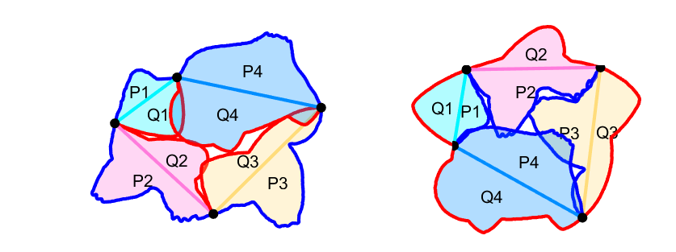
Some Results
RIOT 1

Slide 4
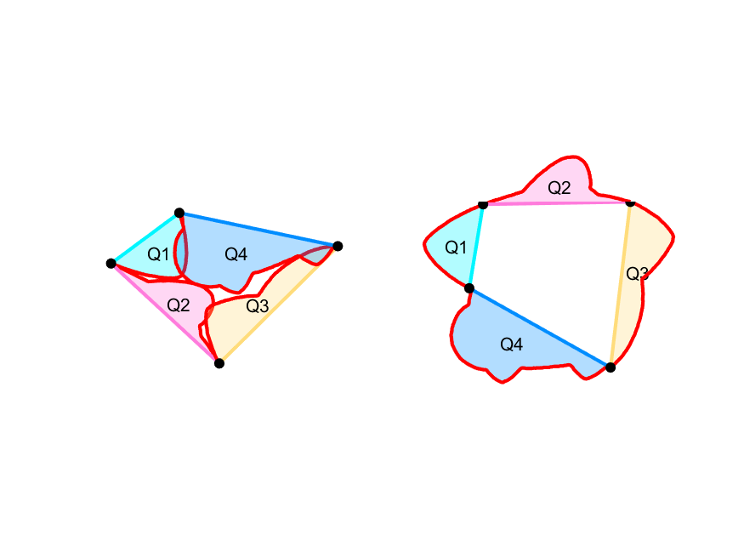
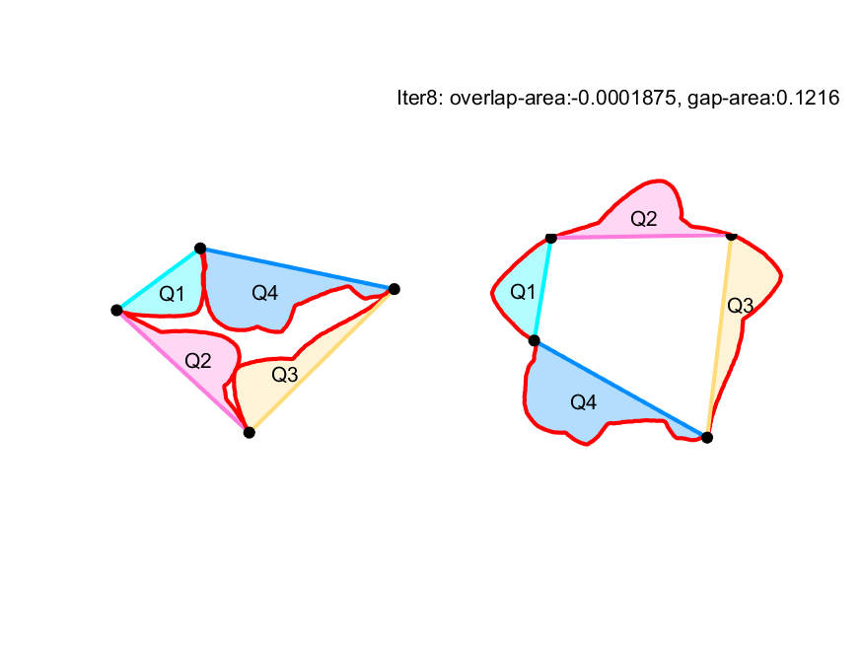
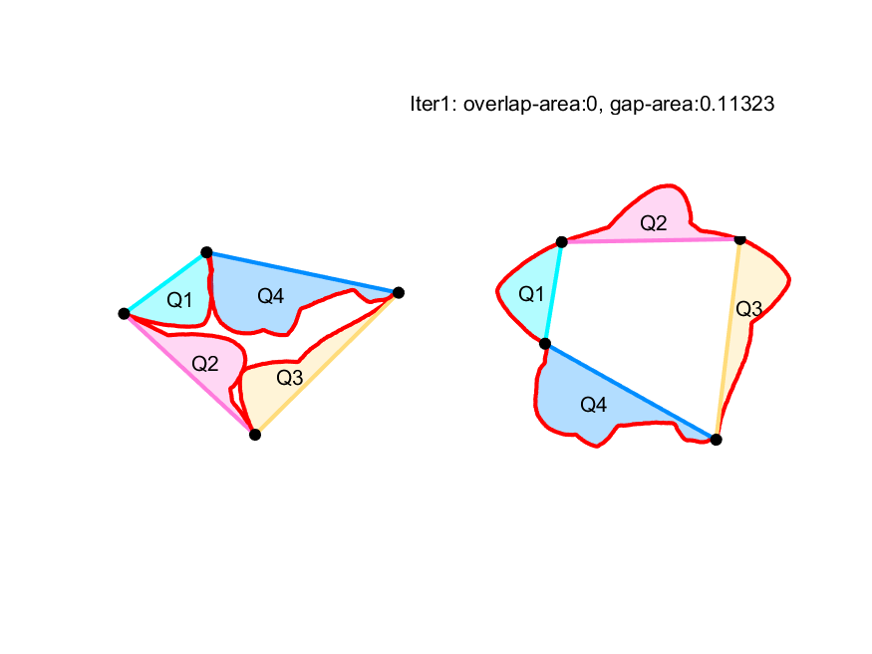
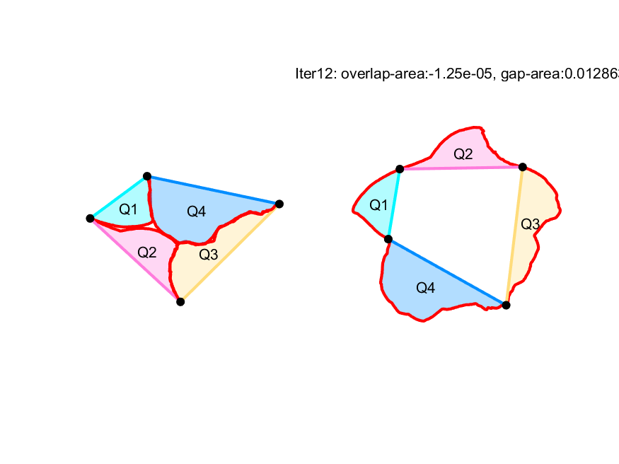
Original P
After eliminating overlaps
Minimizing gaps – Iter 1
Minimizing gaps – Iter 12

Slide 5
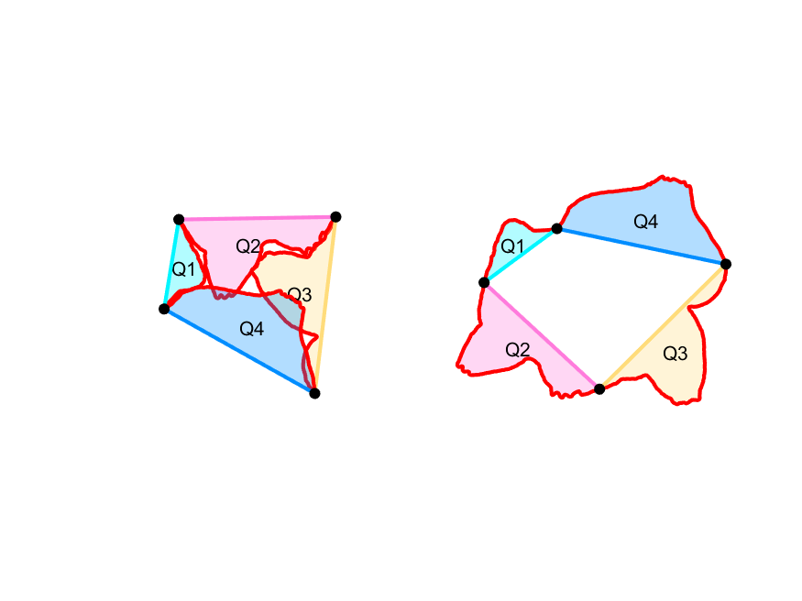
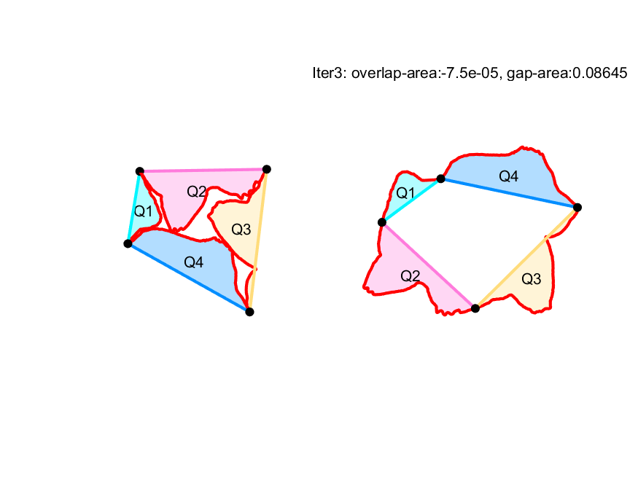

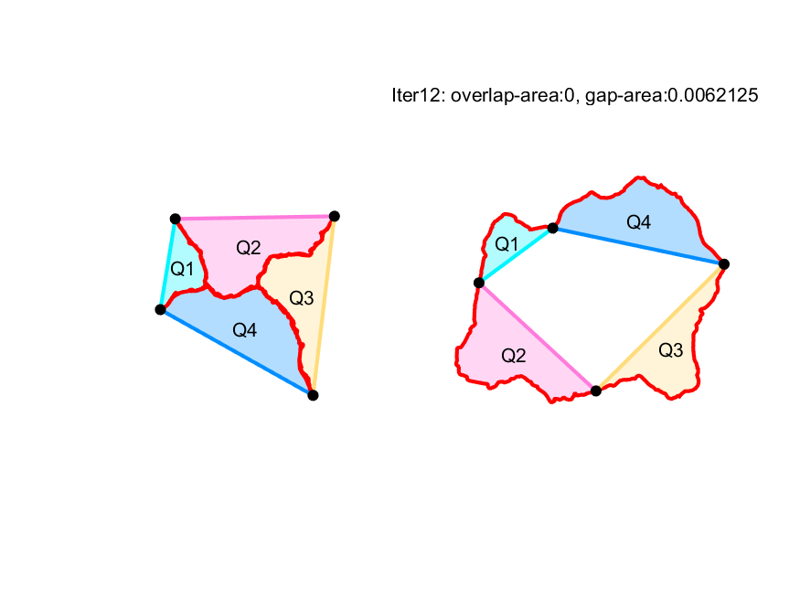
Original Q
After eliminating overlaps
Minimizing gaps – Iter 1
Minimizing gaps – Iter 12

Slide 6
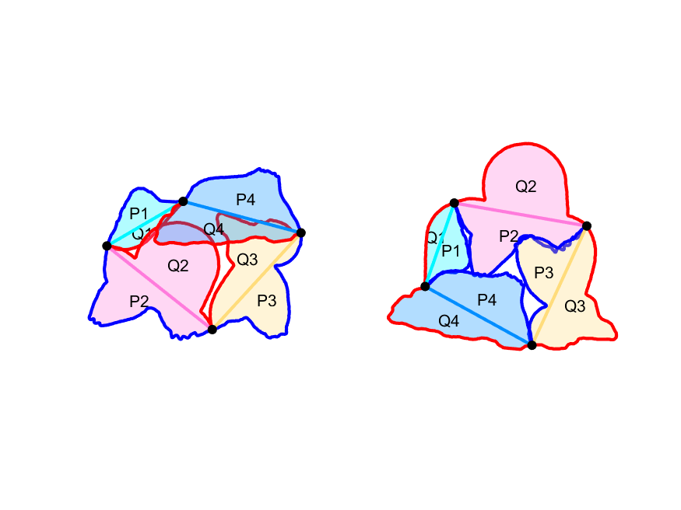
RIOT 2

Slide 7
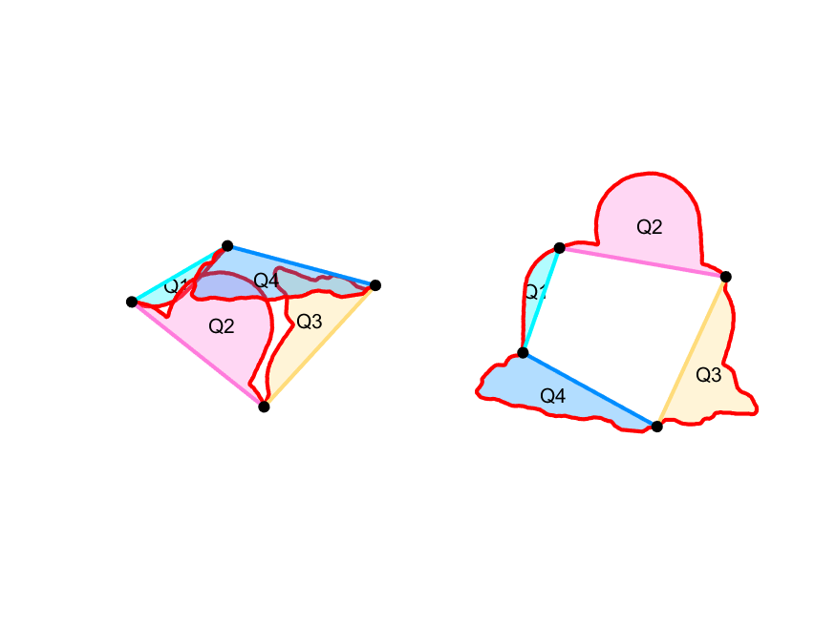
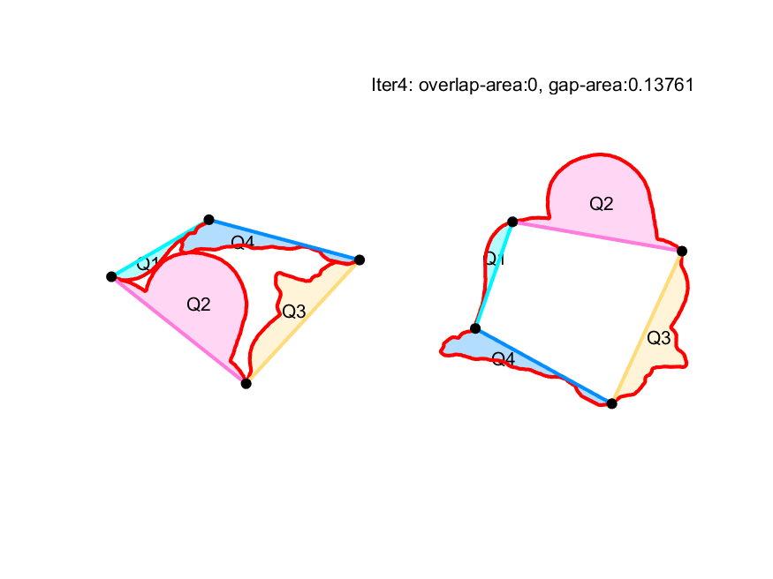
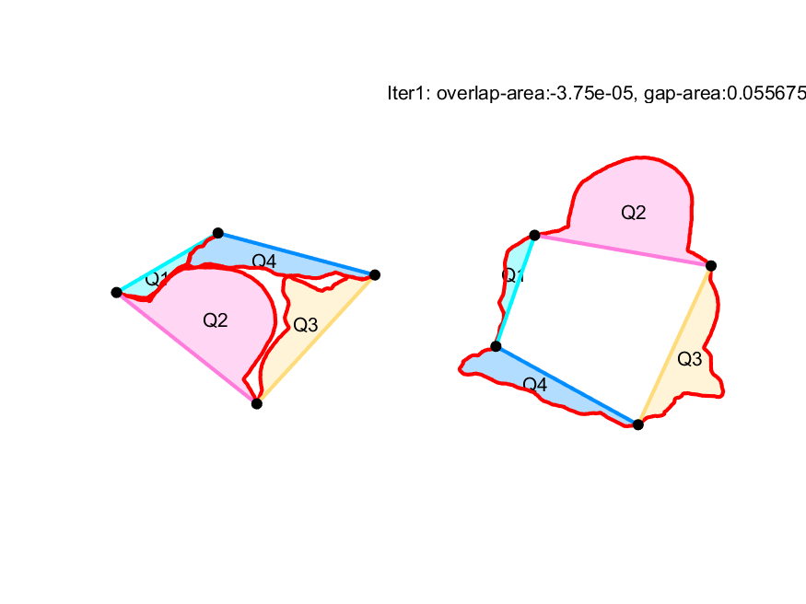
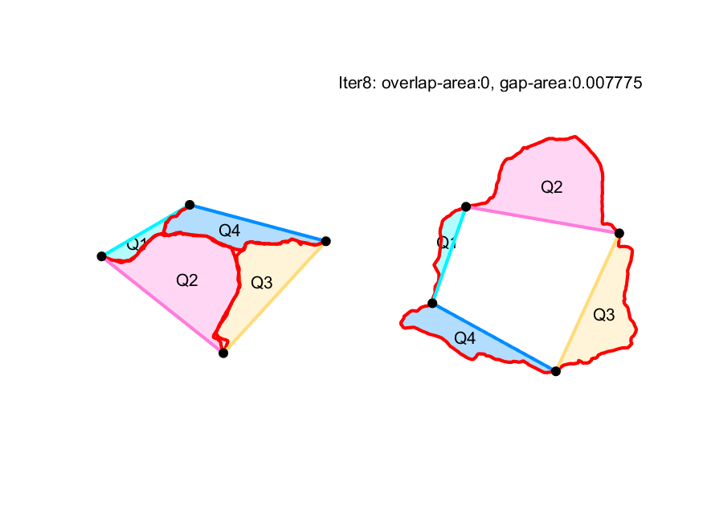
Original P
After eliminating overlaps
Minimizing gaps – Iter 1
Minimizing gaps – Iter 8

Slide 8
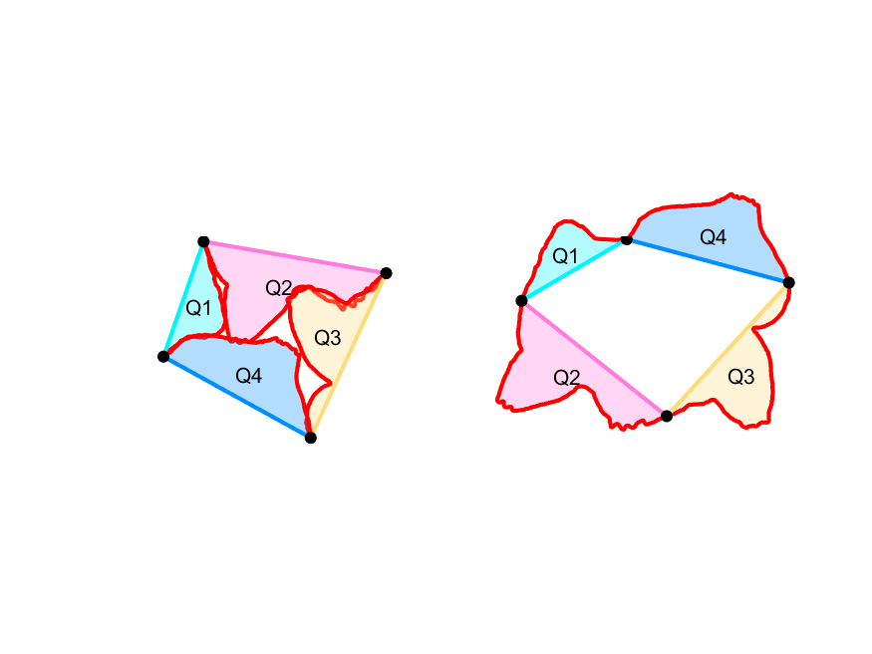
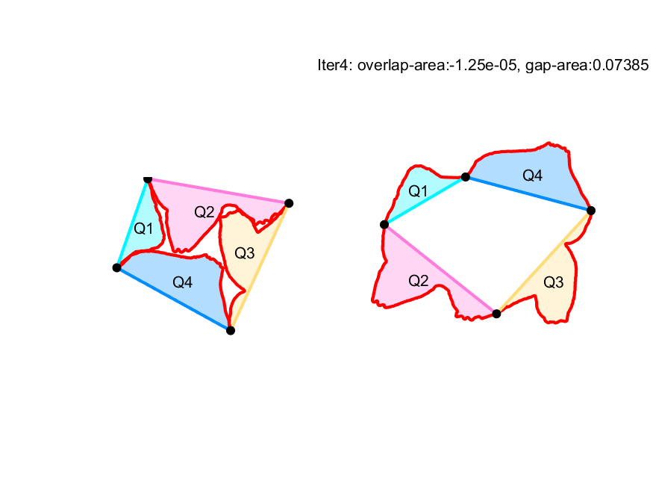
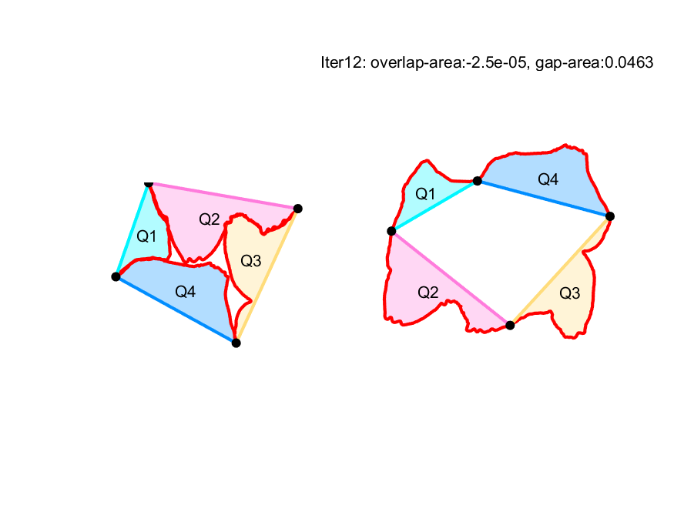
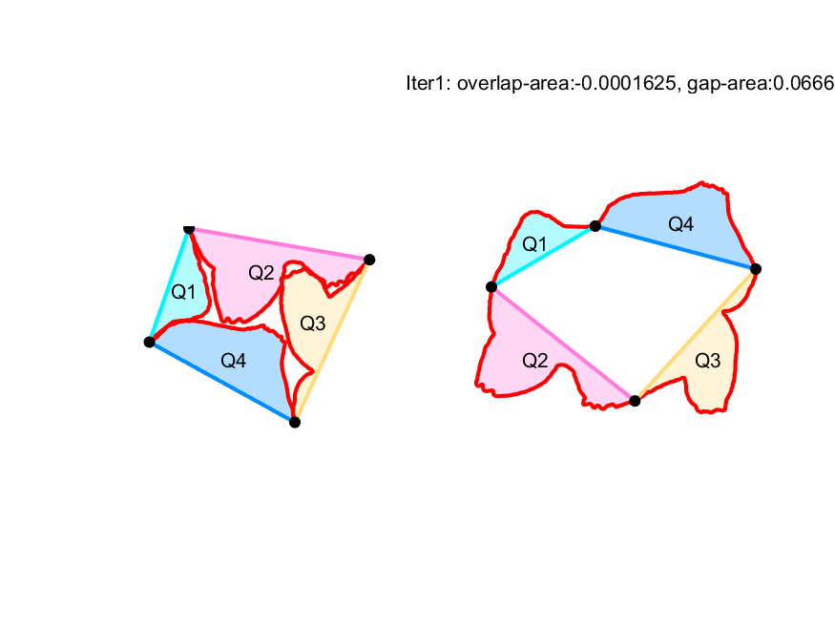
Original Q
After eliminating overlaps
Minimizing gaps – Iter 1
Minimizing gaps – Iter 12

Slide 9
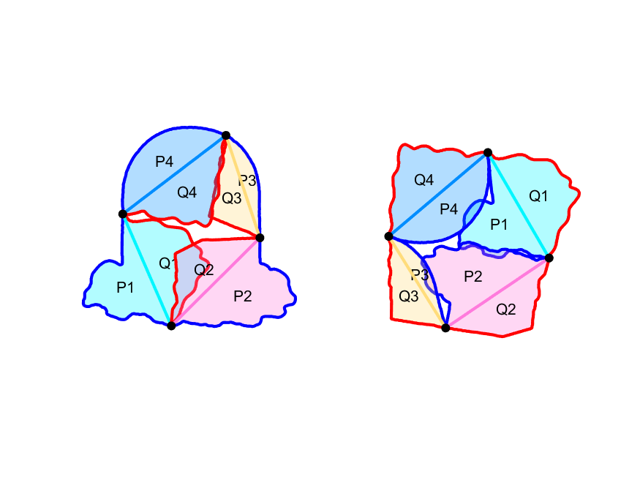
RIOT 3

Slide 10
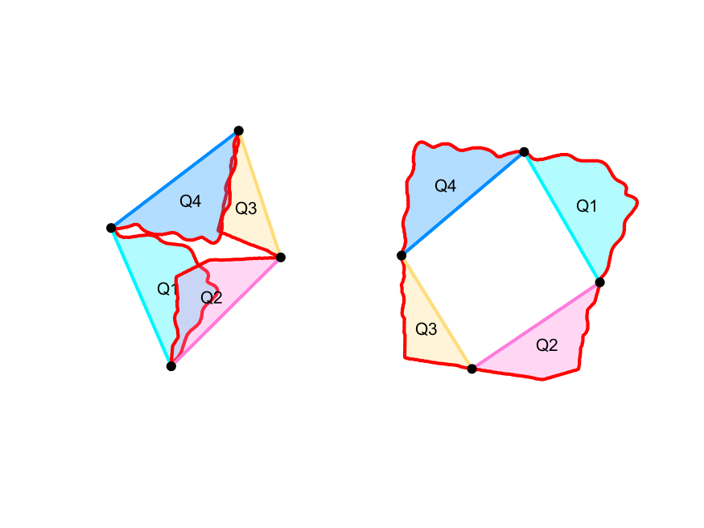
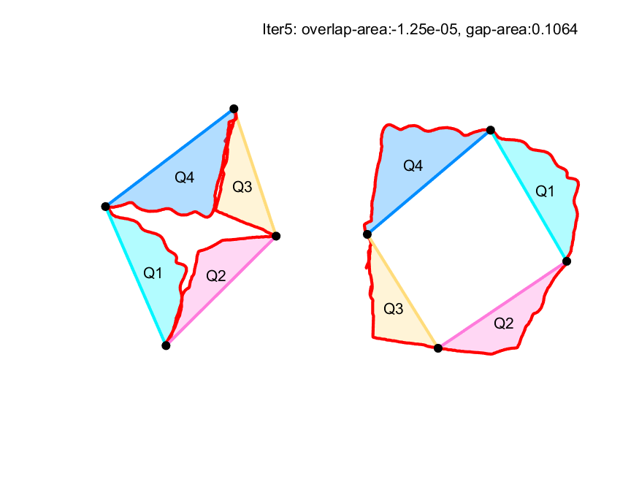

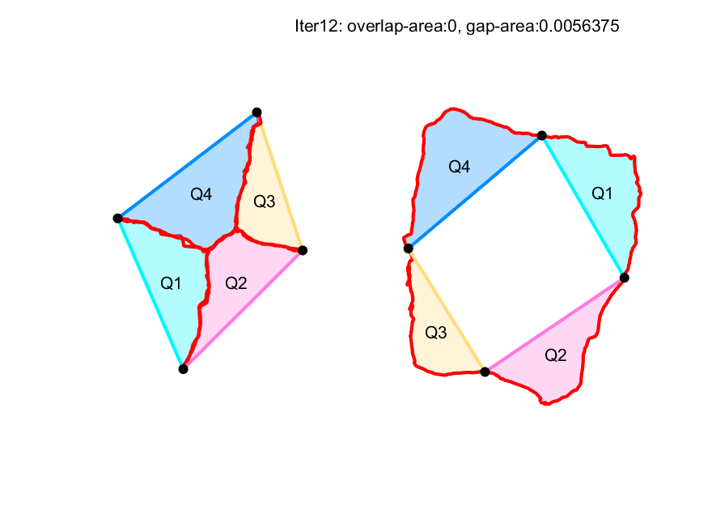
Original P
After eliminating overlaps
Minimizing gaps – Iter 1
Minimizing gaps – Iter 12

Slide 11
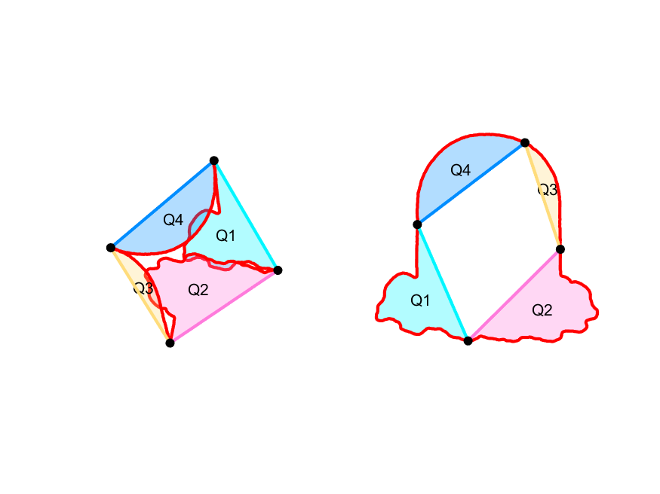
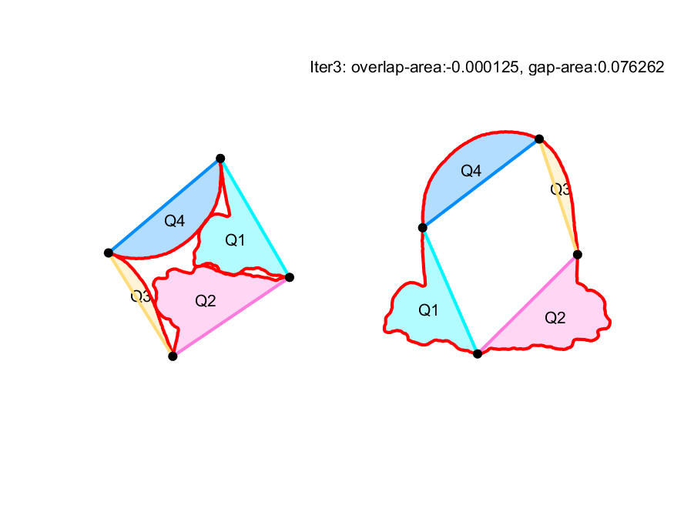
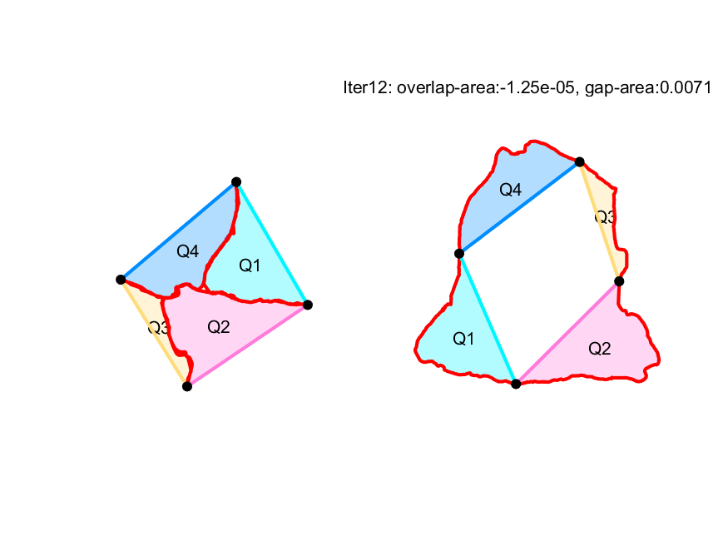
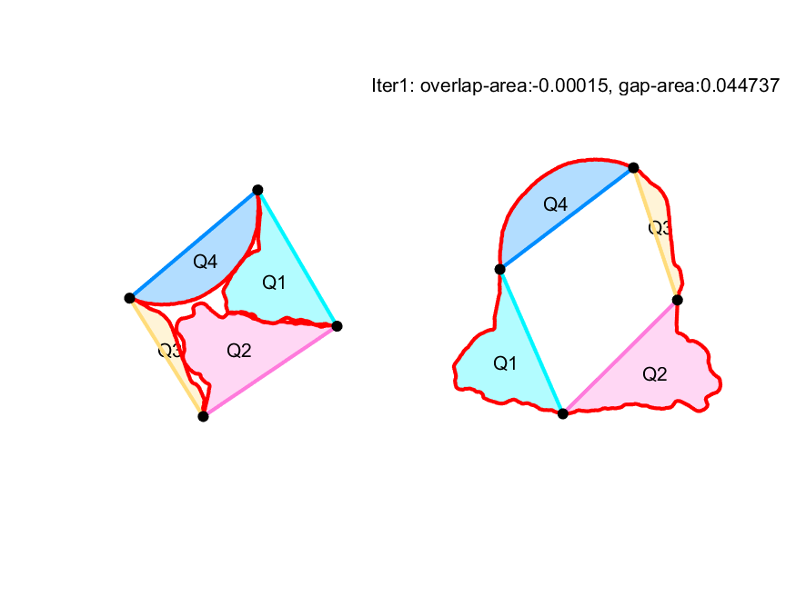
Original Q
After eliminating overlaps
Minimizing gaps – Iter 1
Minimizing gaps – Iter 12

Slide 12
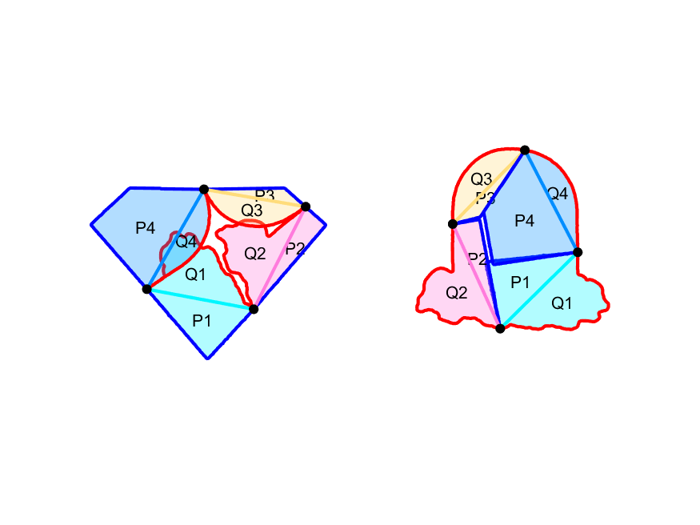
RIOT 4
To Do: In the case that boundary curves are straight lines, the curve deformation cannot handle it well, maybe we should take it as a special case to solve, such as vertices merge.

Slide 13
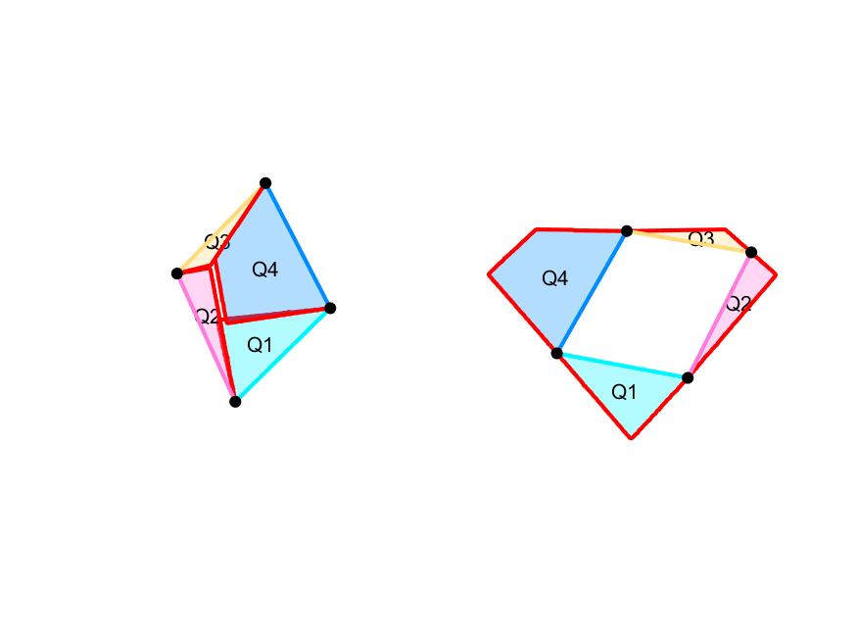
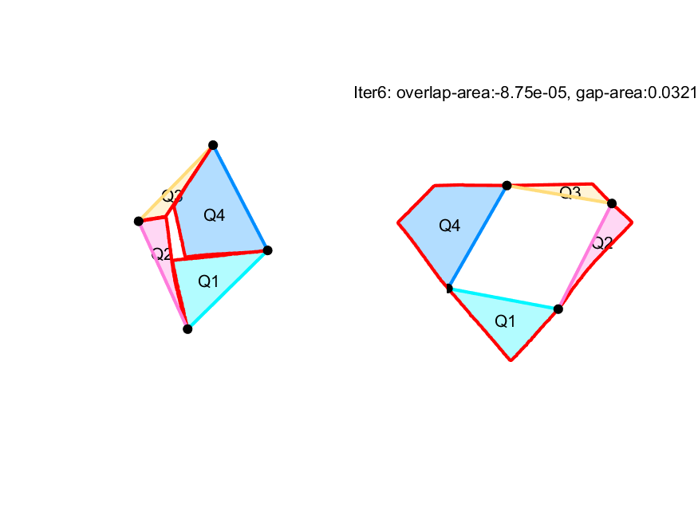
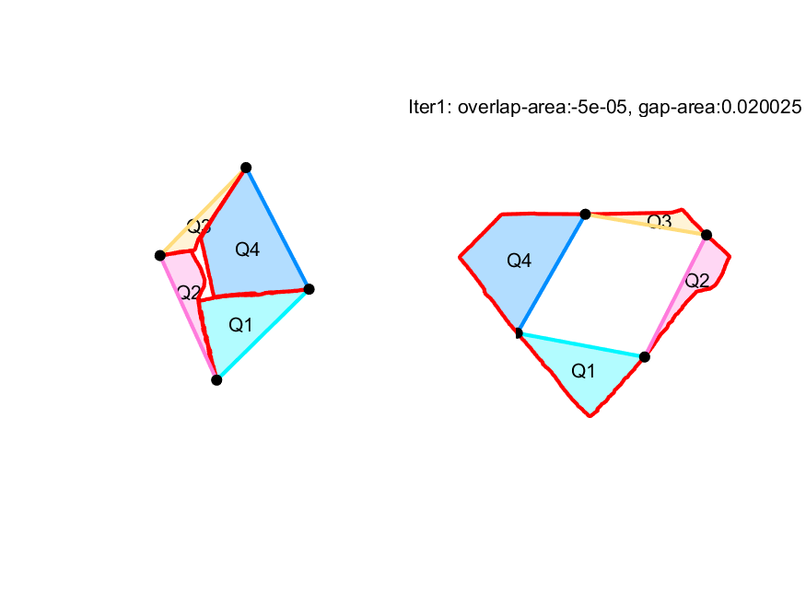

Original Q
After eliminating overlaps
Minimizing gaps – Iter 1
Minimizing gaps – Iter 2

Slide 14
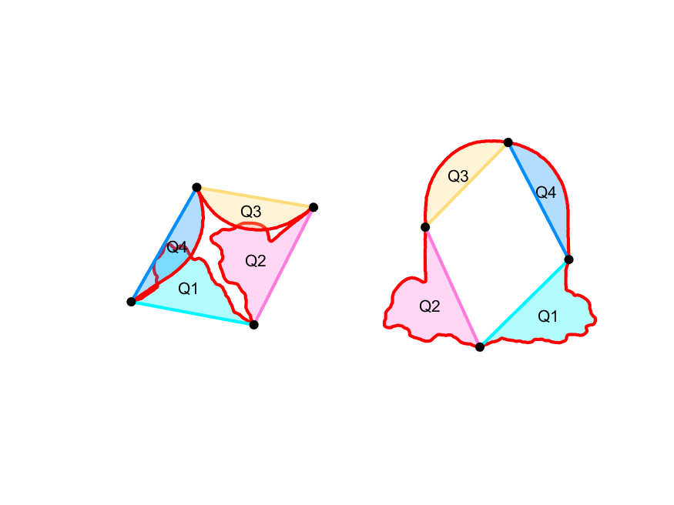
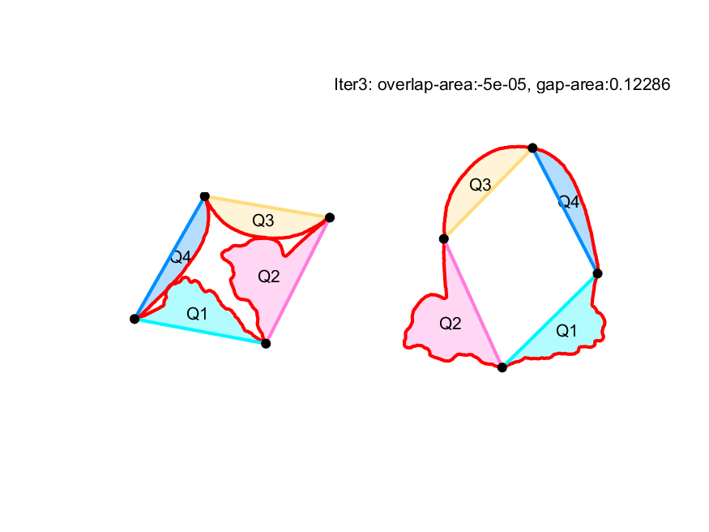
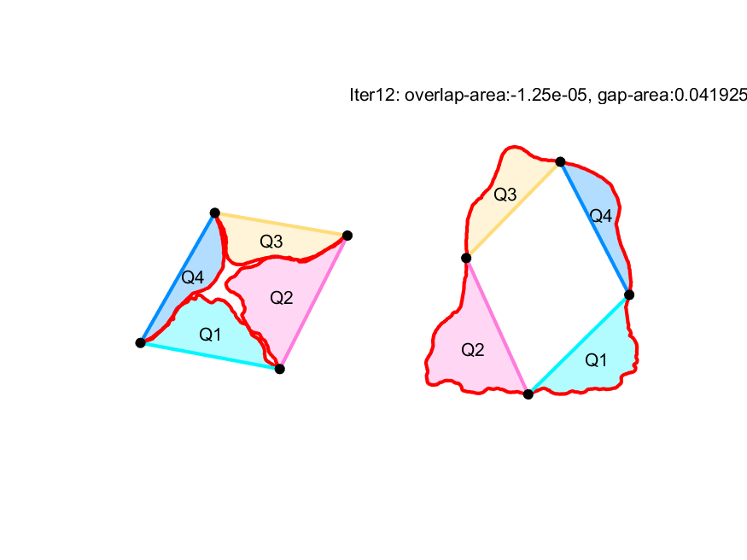
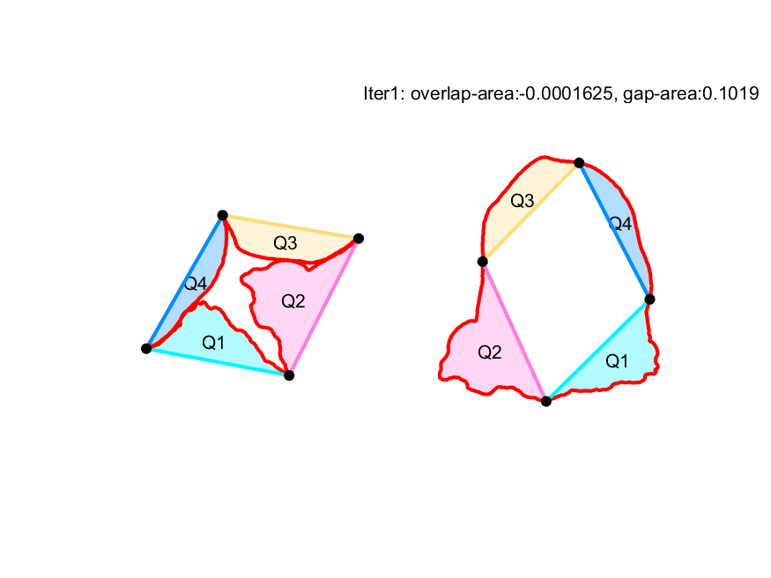
Original P
After eliminating overlaps
Minimizing gaps – Iter 1
Minimizing gaps – Iter 12

Slide 15
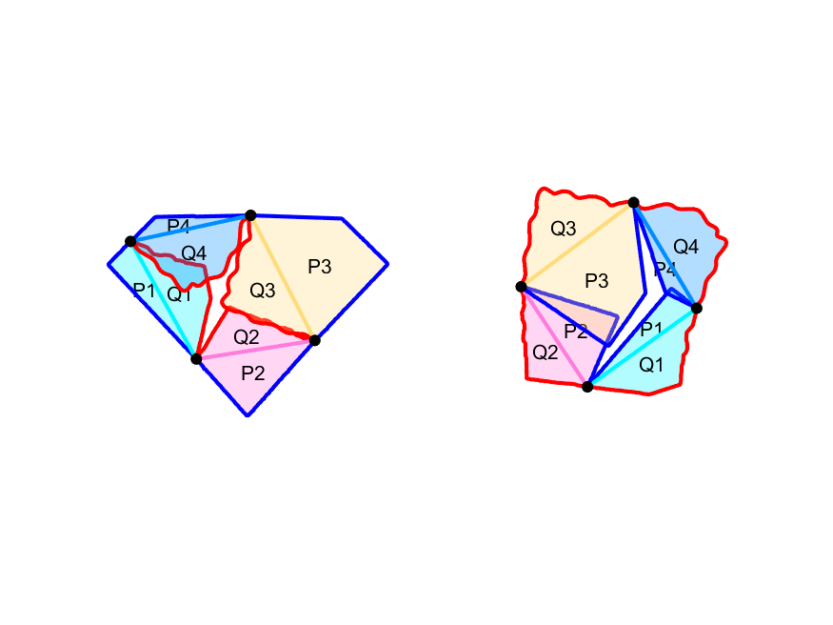
RIOT 5

Slide 16
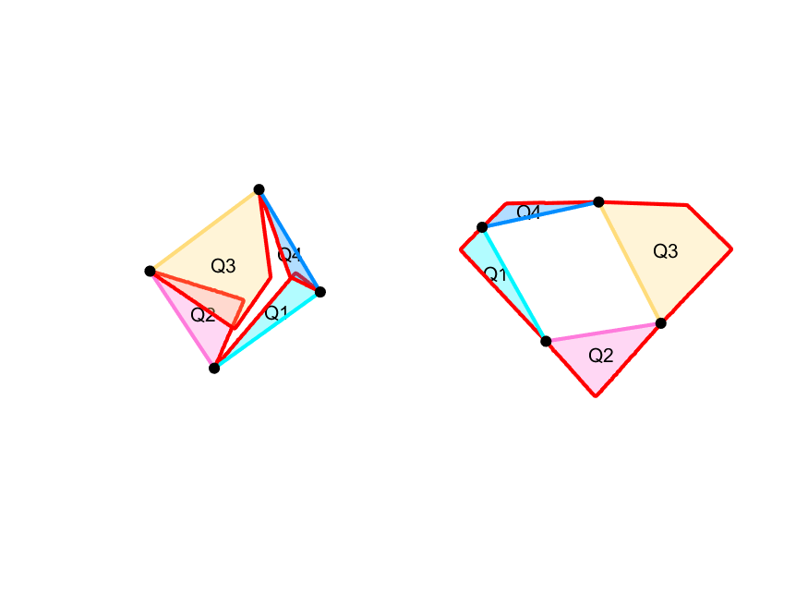
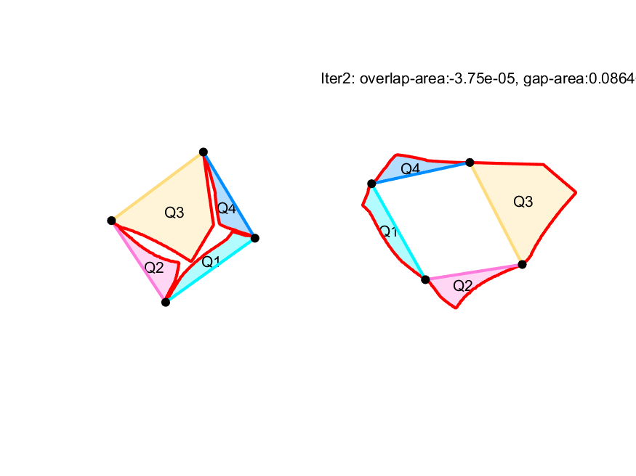

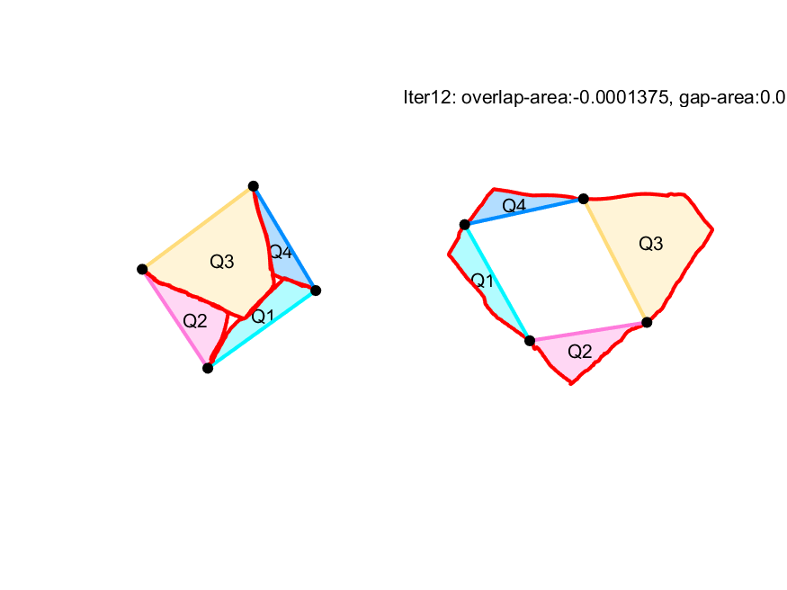
Original Q
After eliminating overlaps
Minimizing gaps – Iter 1
Minimizing gaps – Iter 5

Slide 17
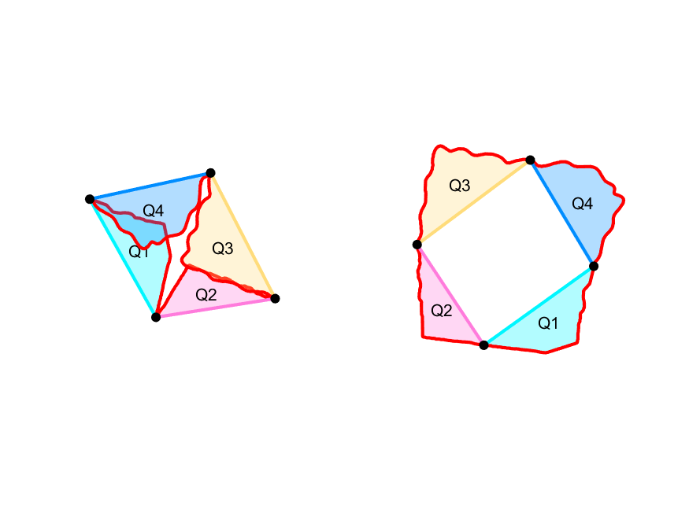
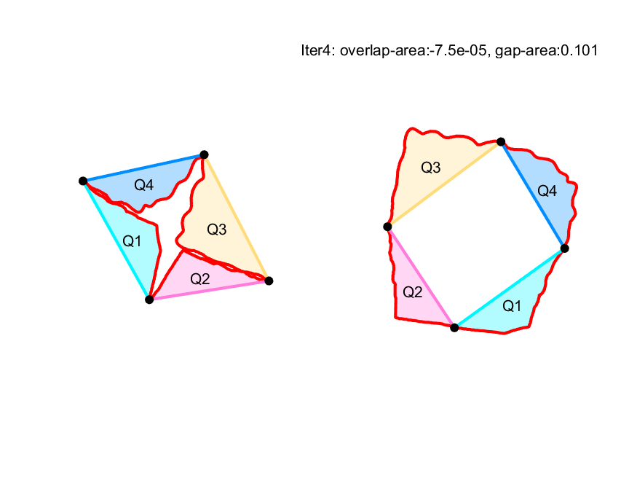
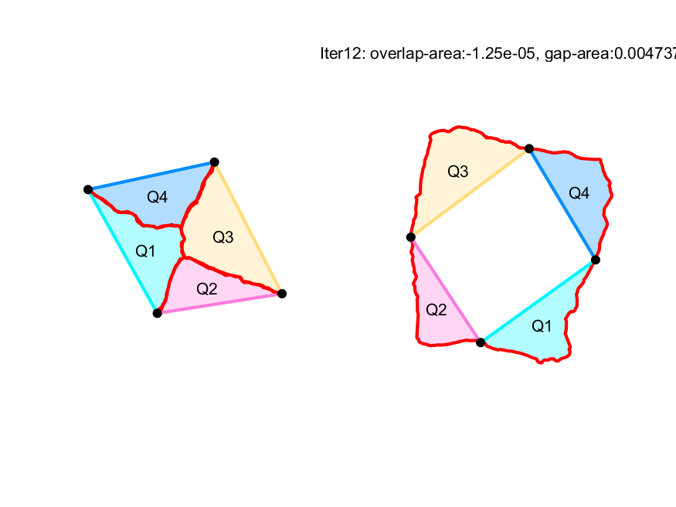
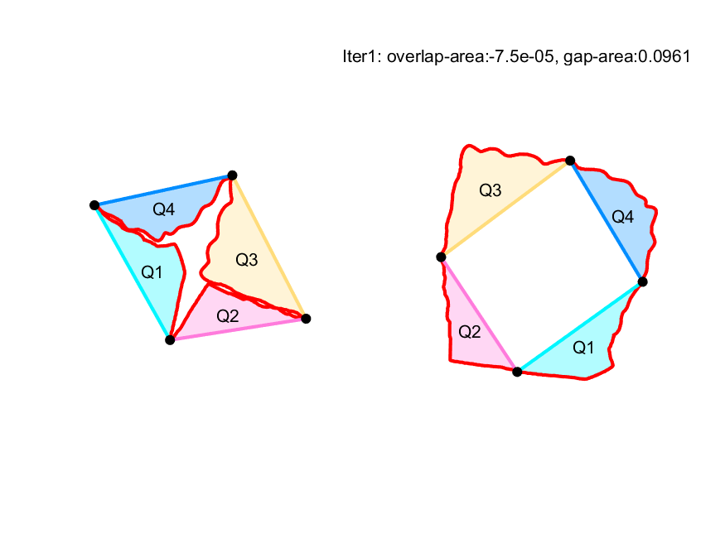
Original P
After eliminating overlaps
Minimizing gaps – Iter 1
Minimizing gaps – Iter 12

