Slide 1
SELF INTRODUCTION
TEA HAN QIN
20 years old
Malaysian
Computer Science and Technology
CST1909544

Slide 2
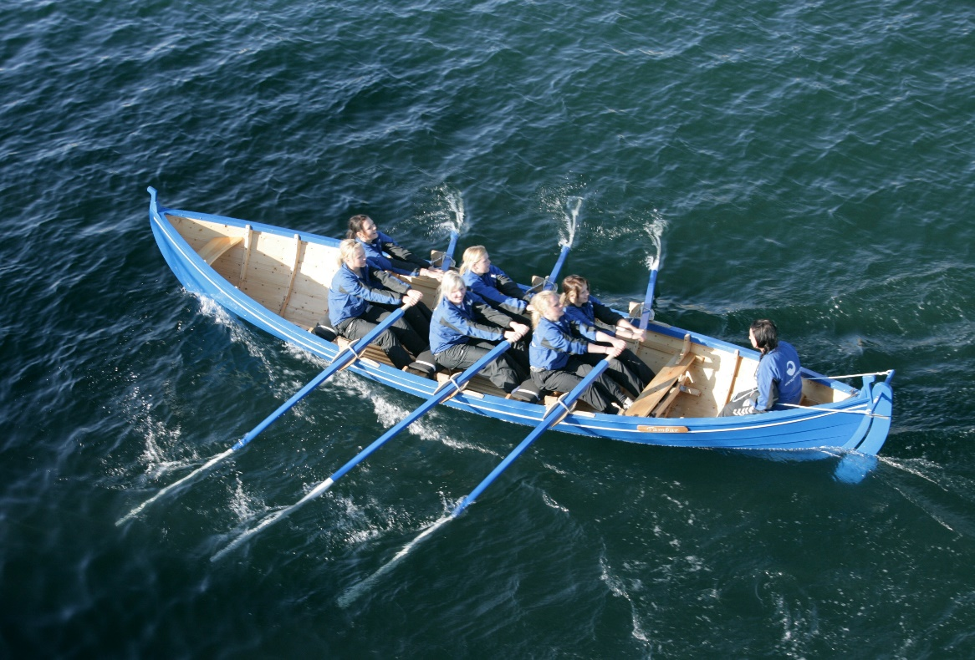
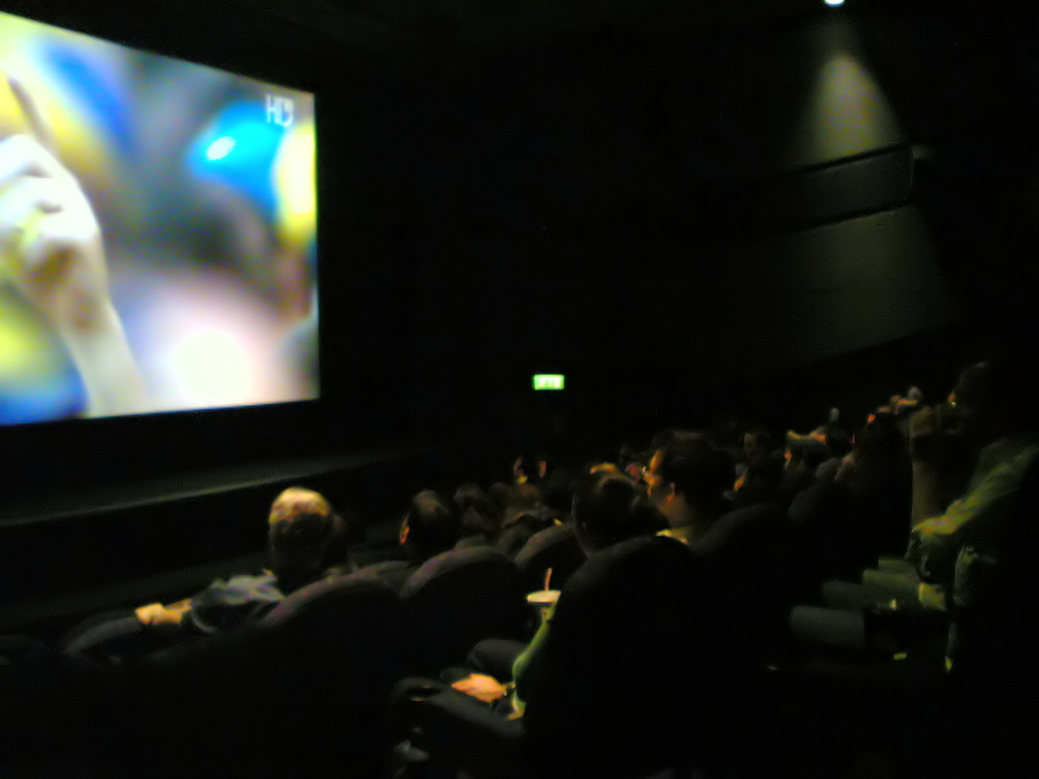
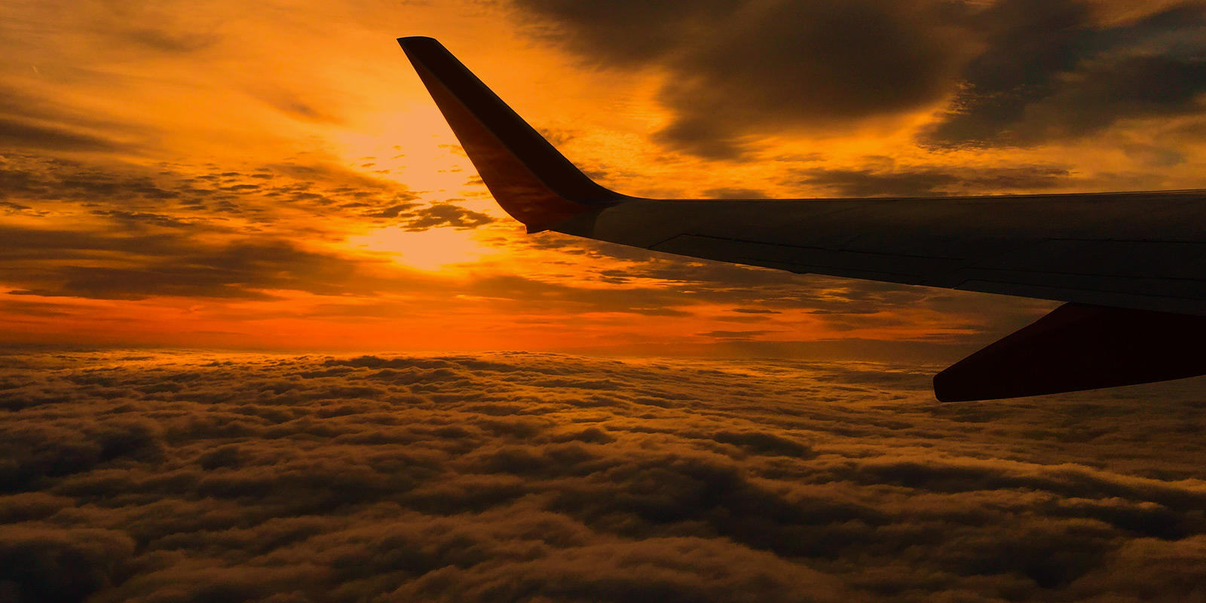
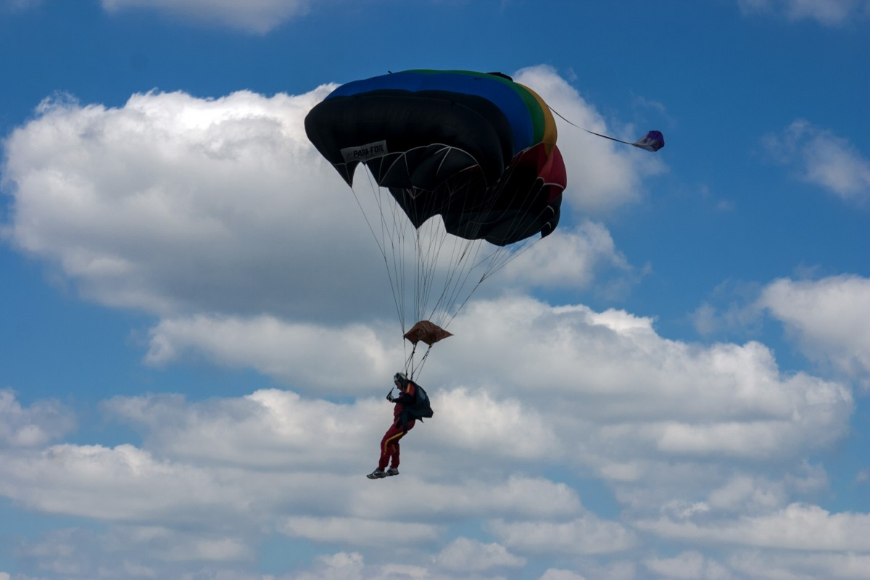
HOBBY
Rowing
Watching Movie
Travel
Extreme Sport

Slide 3
MY WISH
I hope I can earn more money to carry out my hobby.
I wish I can graduate successfully.
I hope I can make more friend in this university.
I wish I can travel to all beautiful place all over the world.
I hope I can always healthy.

Slide 4
THE END

