Slide 1
Dengue Outbreak Prediction
BS6200
Course Project
Han Runbing
Feb 2021

Slide 2
Content
1. Introduction
2. Data Analysis & Pre-Processing
3. Parameter Tuning & Model Training
4. Performance Evaluation
5. Achievement & Future works

Slide 3
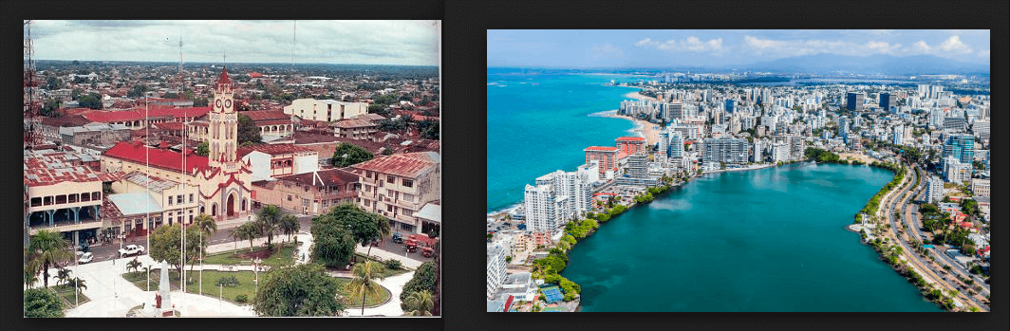
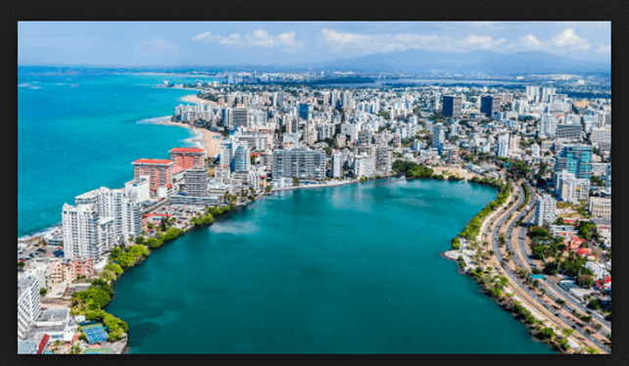
Introduction
Disease Description
Dengue
Carried by mosquitoes
Occurs in tropical and sub-tropical
Climate Features
NDVI
Temperature
Precipitation
Humidity
San Juan
Iquitos
Notes:
Dengue is a mosquito-borne disease that occurs in tropical and sub-tropical parts of the world. Because it is carried by mosquitoes, the transmission dynamics of dengue are related to climate variables such as temperature and precipitation. A growing number of scientists argue that climate change is likely to have some impact on the spread of dengue.
This data set contains weekly dengue cases recorded in San Juan and Iquitos. With the corresponding climate –related data. The 20 feature Devided into 4 types.

Slide 4
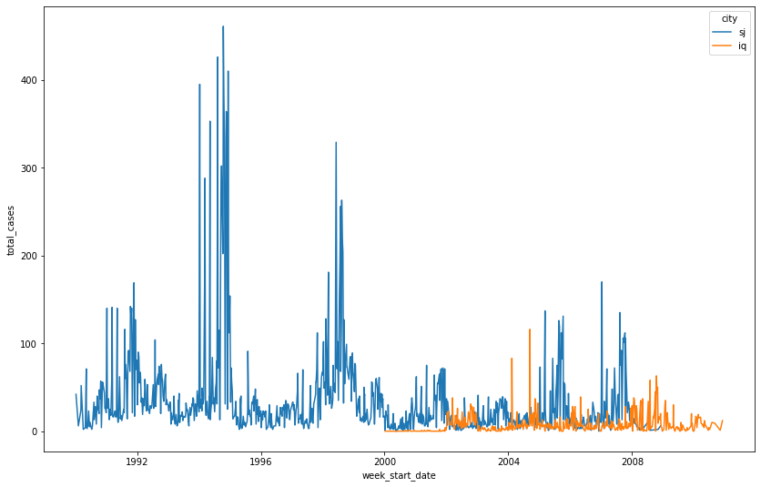
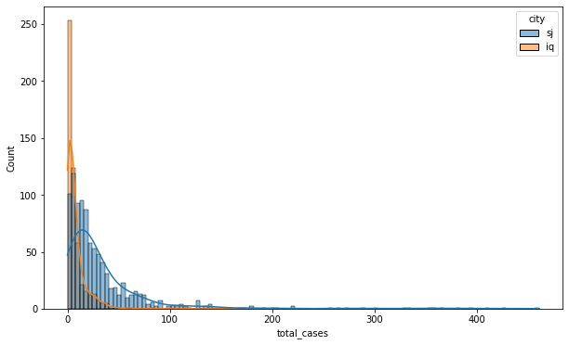
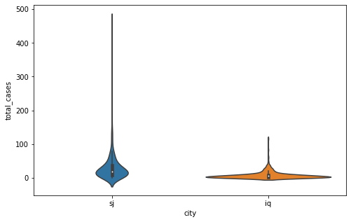
Data Analysis
Difference between two cities
Sample size
General cases
Extreme cases
Extent of variation
Notes:
). Since we hypothesize that the spread of dengue may follow different patterns between the two, we will divide the dataset, train seperate models for each city, and then join our predictions before making our final submission.

Slide 5
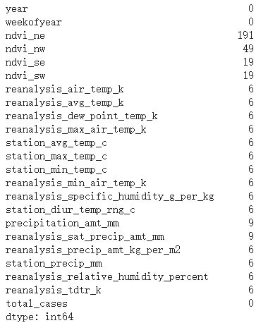
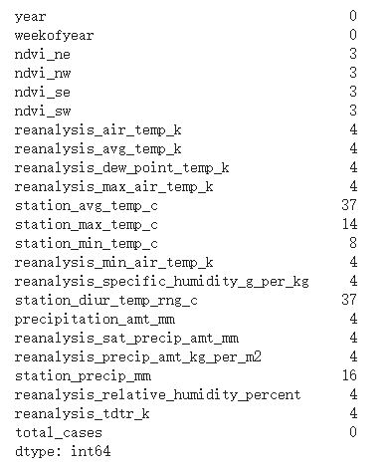
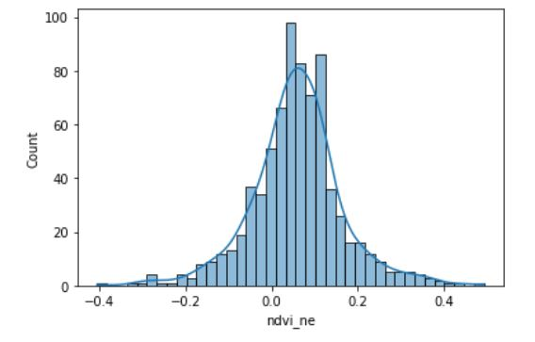
Missing data imputation
ndvi_ne in San Juan(20%) – Global mean
Others (less than 10%) – Global median
Missing values in San Juan
Missing values in Iquitos

Slide 6
Principles of regression
Regression analysis typically estimates the conditional expectation of the dependent variable given the independent variables
It is also used to understand which among the independent variables are related to the dependent variable, and to explore the forms of these relationships

Slide 7
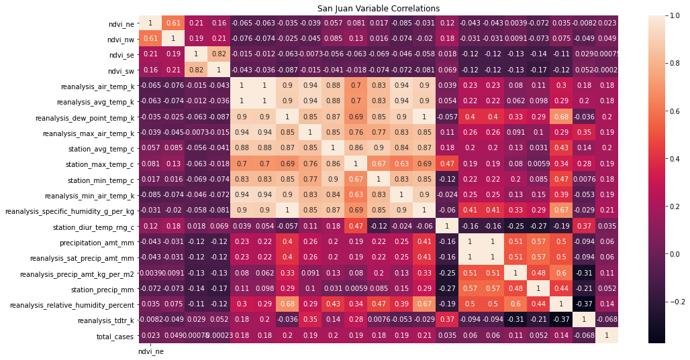
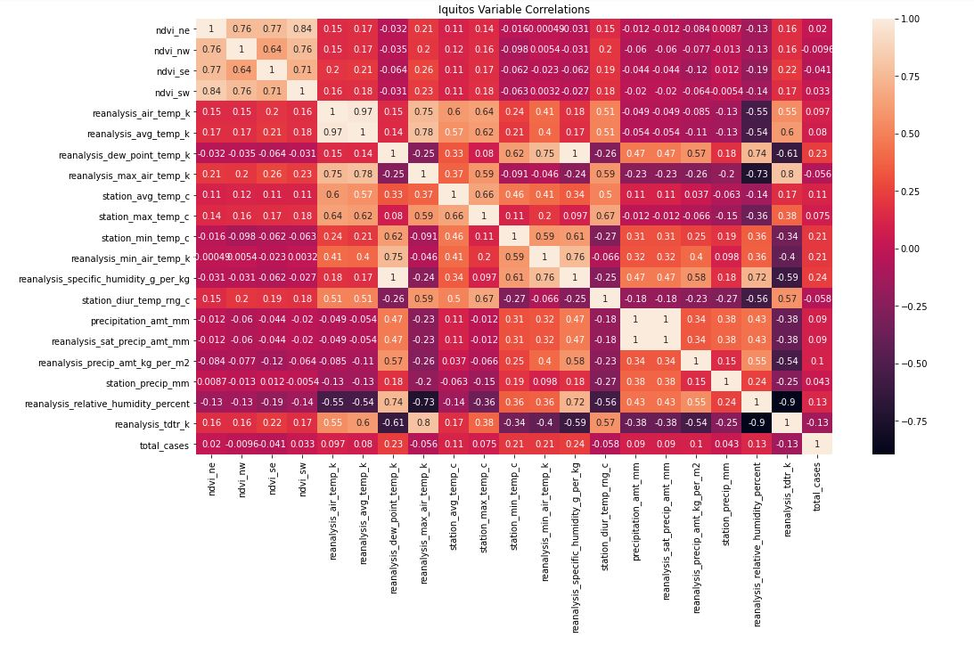
independence variables analysis

Slide 8
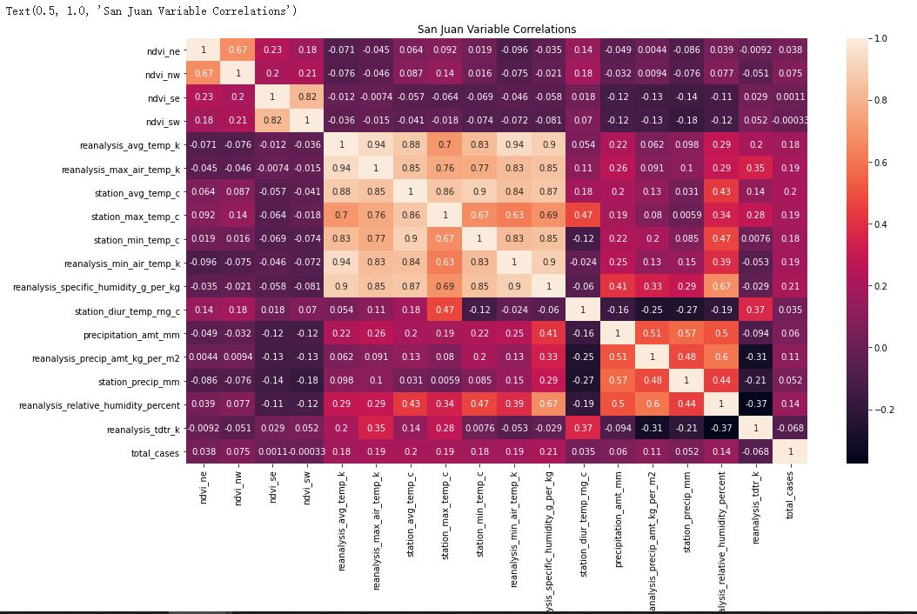
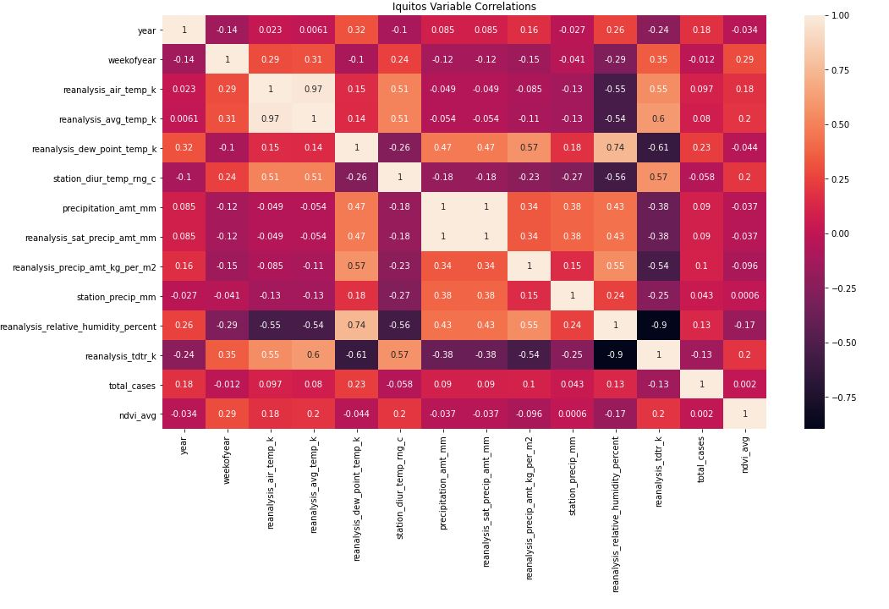
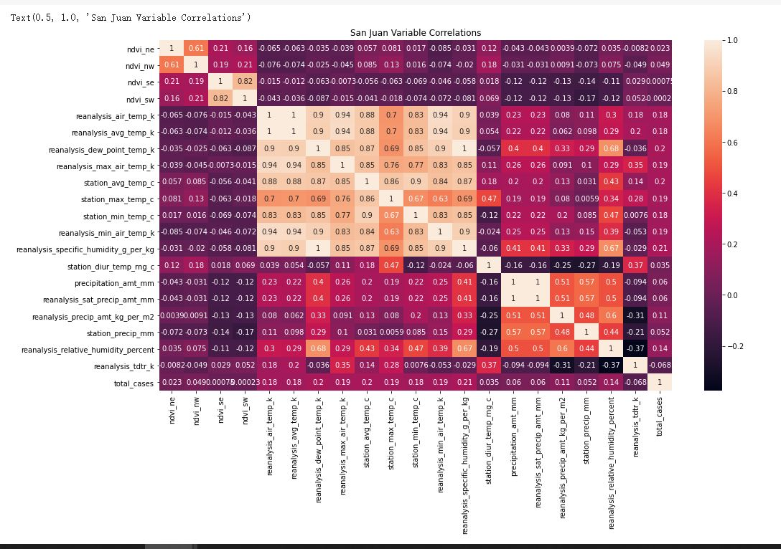
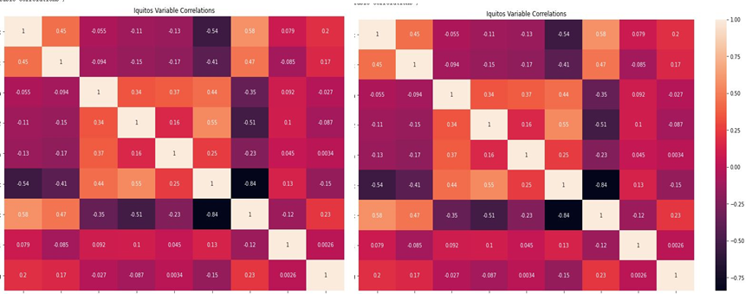
Feature selection and aggression
Feature
Selection
Feature
Aggression

Slide 9
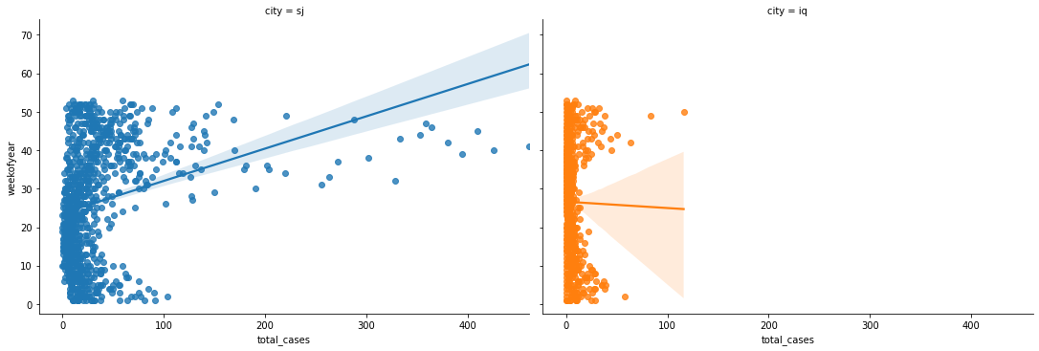
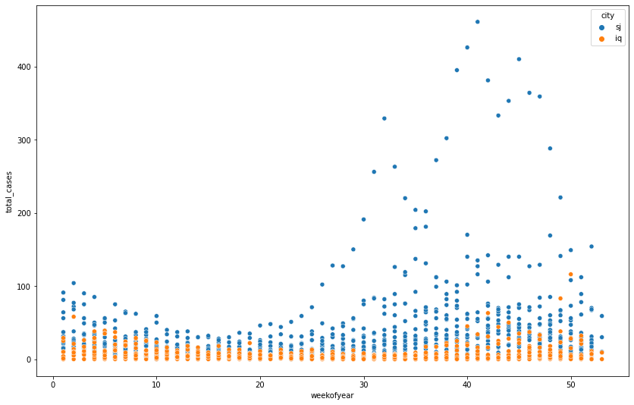
dependence variables analysis
Total cases vs. Week of year

Slide 10
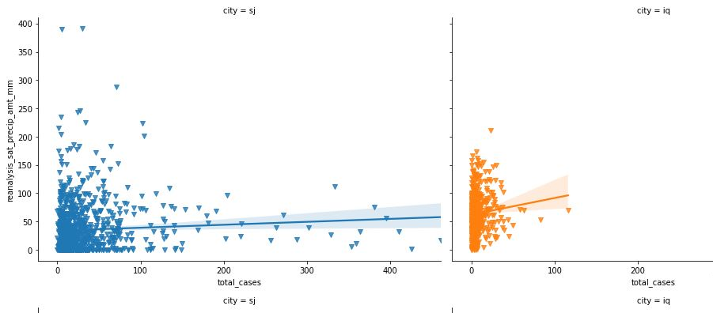
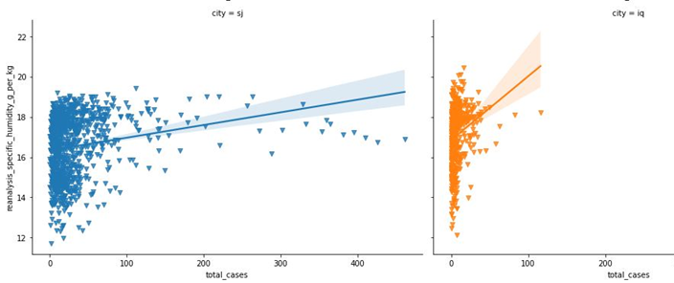
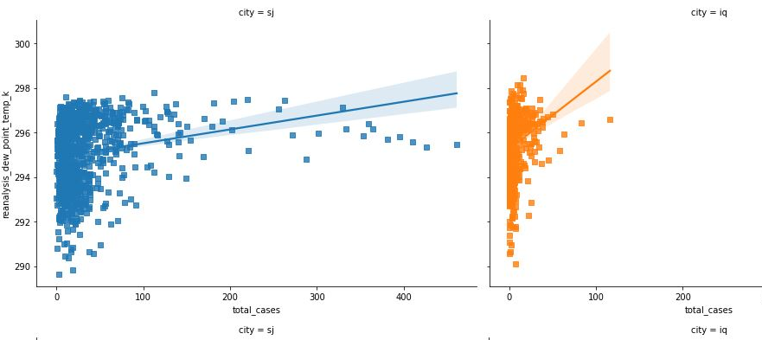
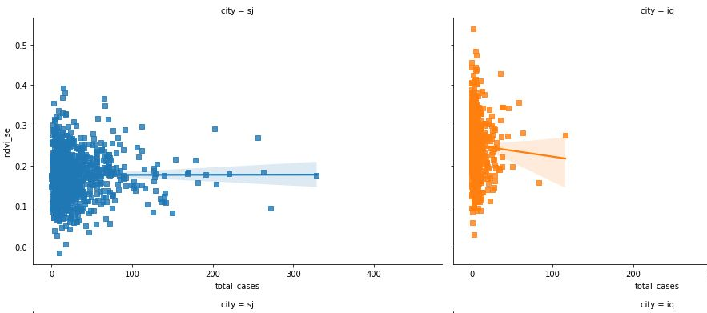
dependence variables analysis
Total cases vs. Precipitation
Total cases vs. Humidity
Total cases vs. Temperature
Total cases vs. NDVI

Slide 11
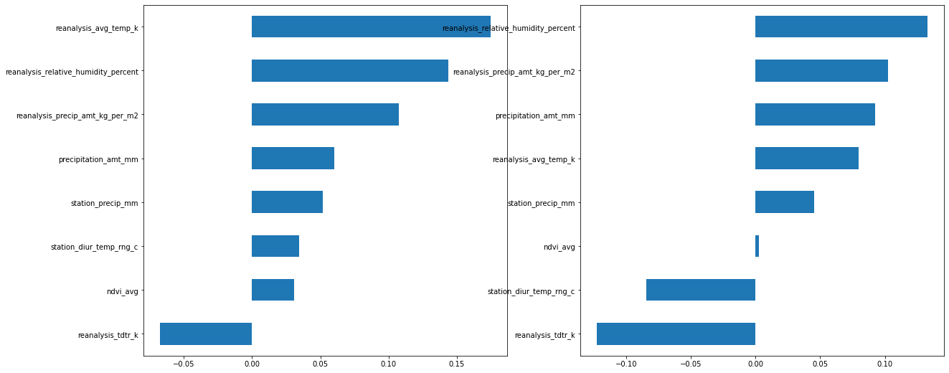
Feature selection

Slide 12
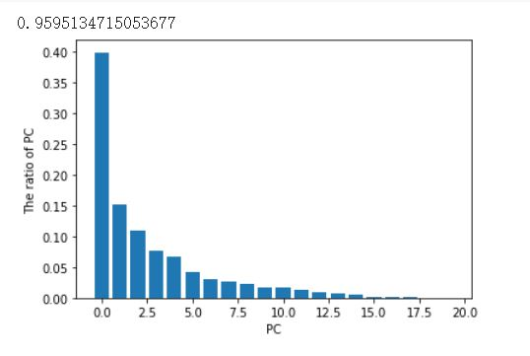
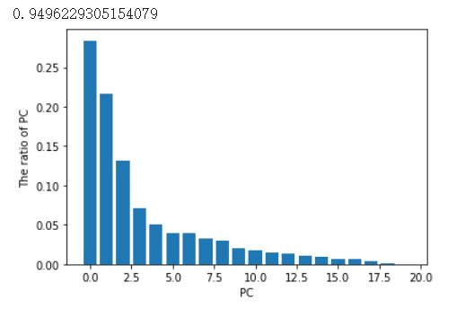
Feature selection
PAC
95% ratio are selected
11 PC for San Juan
10 PC for Iquitos

Slide 13
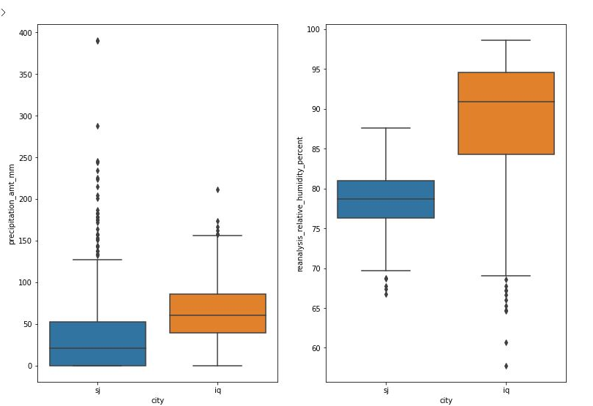
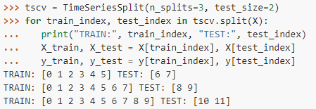
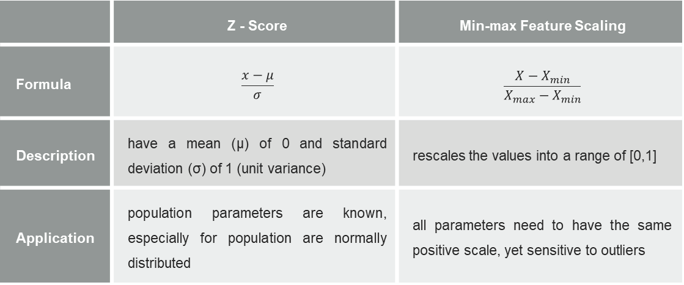
Normalisation and data splitting
Normalization Selection
 | Z - Score | Min-max Feature Scaling
Formula | $$\frac{x−μ}{σ}$$ | $$\frac{X−X_{min}}{X_{max}−X_{min}}$$
Description | have a mean (μ) of 0 and standard deviation (σ) of 1 (unit variance) | rescales the values into a range of [0,1]
Application | population parameters are known, especially for population are normally distributed | all parameters need to have the same positive scale, yet sensitive to outliers
Data Splitting – Time Series Split
Train data: Top 75%th Test data : Last 15%th
Time series

Slide 14
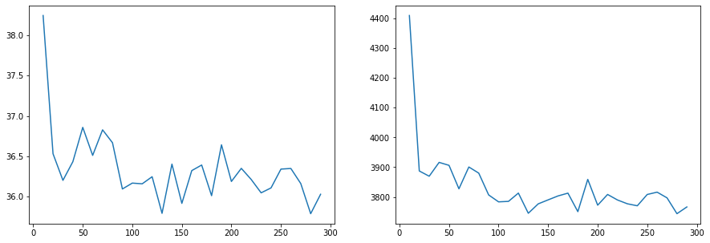
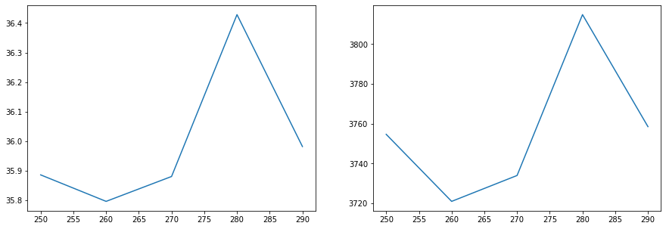
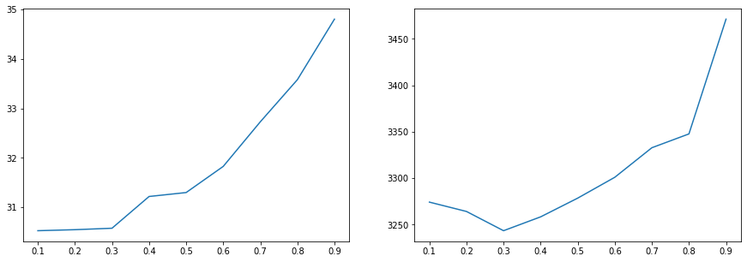
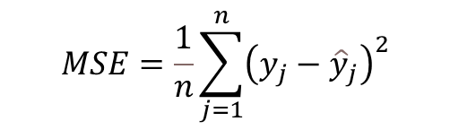

Parameter TUNING
$$MAE=\frac{1}{n}\sum_{j=1}^{n}{\left|y_{j}−{\hat{y}}_{j}\right|}$$
$$MSE=\frac{1}{n}\sum_{j=1}^{n}{{\left(y_{j}−{\hat{y}}_{j}\right)}^{2}}$$
Random Forest Regression
n_estimatorsint
max_depthint
Gradient Boosting Regressor
n_estimatorsint
learning_rate
MAE
MSE

Slide 15
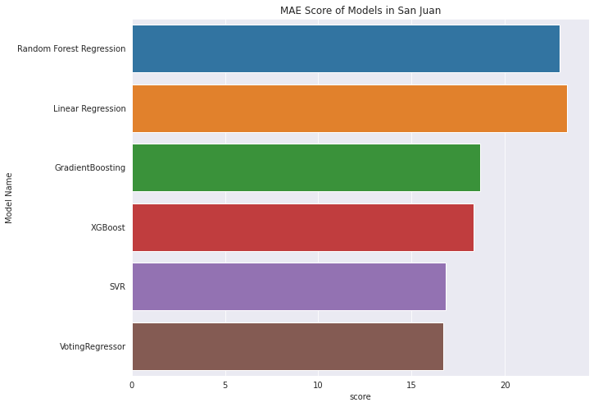
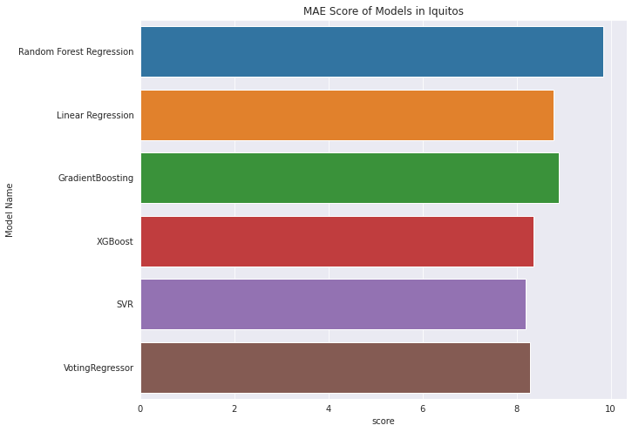
model performance evaluation
Model Name | Feature Selection | San Juan |  | Iquitos
 |  | MAE | MSE | MAE | MSE
Linear Regression | Aggression | 27.365 | 1139.062 | 8.352 | 185.81
 | PCA | 19.31042 | 793.8808 | 9.23 | 171.7
Random Forest Regression | Aggression | 29.443 | 1476.09 | 10.75 | 282.54
 | PCA | 16.40166 | 676.807 | 8.9357 | 170.465
SVR | Aggression | 17.44 | 741.277 | 8.35 | 214.67
 | PCA | 16.22779 | 756.615 | 8.0472 | 180.5797
XGBoost | PCA | 24.04273 | 1347.54 | 9.4923 | 243.0153
Gradient Boosting | PCA | 18.3461 | 1034.714 | 8.36153 | 197.7769
Voting Regressor | PCA | 18.67687 | 751.565 | 8.896161 | 171.4358

Slide 16
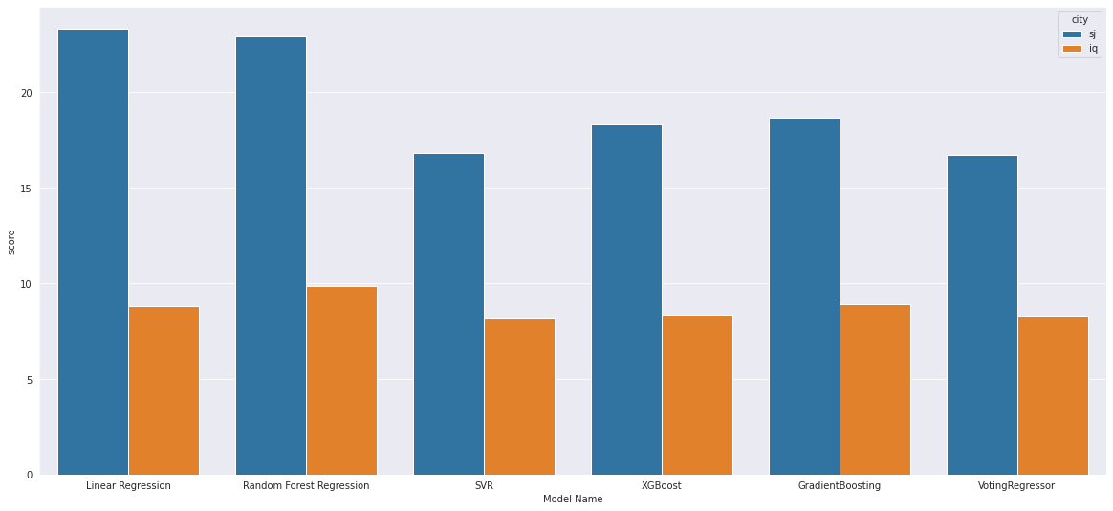
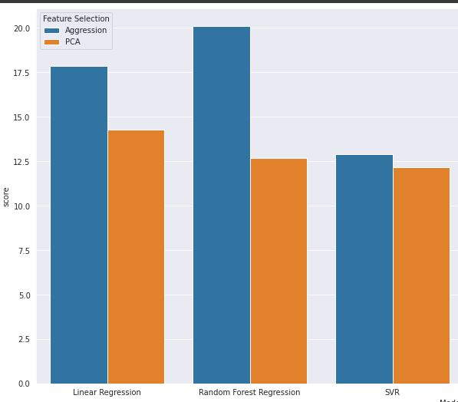
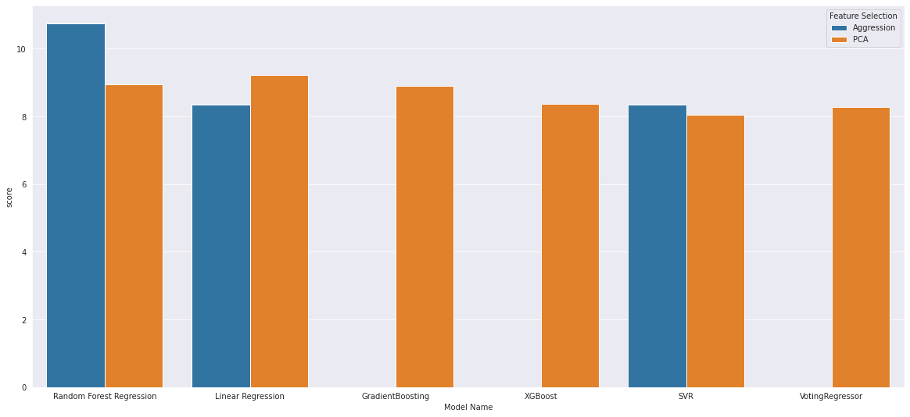
Different performances analysis
Performances vary in two cities
Dependence of target variable
Extent of variation
Performances vary in two feature selection method
Most sensitive : Random Forest Regression
Most robust : SVR
Exception : Linear Regression in Iquitos

Slide 17
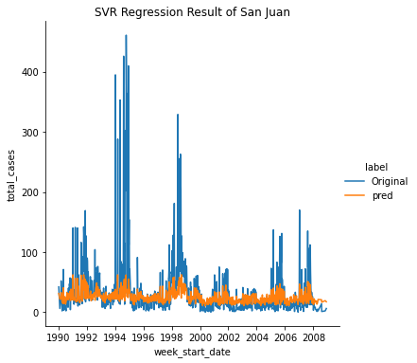
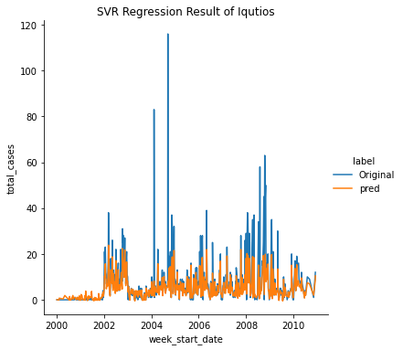
Prediction visualization

Slide 18
Achievement and Future works
Achievement
Data analysis and feature selection following the principles of regression
Normalisation and Time series splitting
Parameters tuning and Model training
Model performances evaluation and comparation
Different performances analysis and discuss
Future works
Convert into classification problem and do comparation
Further fine-tuning of parameters

Slide 19
Thank you

