Slide 1
Service Platform Aradon

Slide 2
Preface
Imaging
What is Platform
Why do we need New Platform
What is Aradon
Demo(Distribute Chat)
Notes:
은하제국 같은 앱을 하나 만들려고 한다.
음. 서버가 필요하다. 서버를 어떻게 만들지 ?

Slide 3
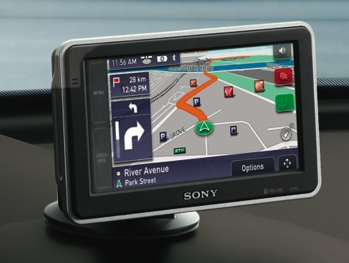
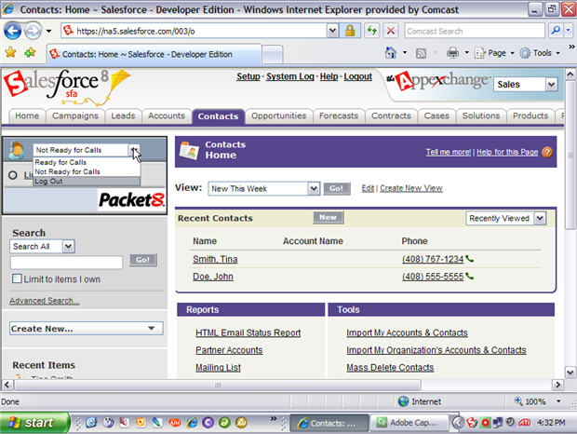
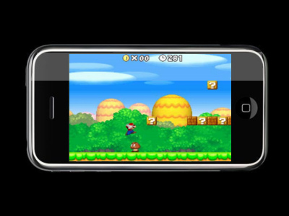
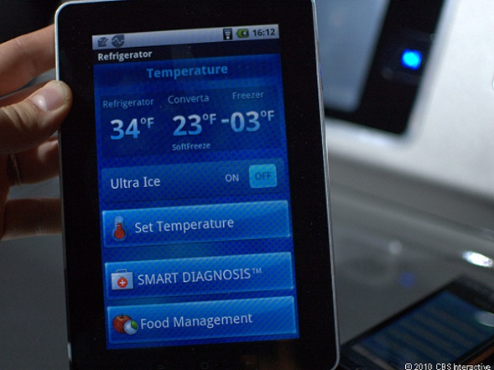
Imaging
Notes:
은하제국 같은 앱을 하나 만들려고 한다.
음. 서버가 필요하다. 서버를 어떻게 만들지 ?
http://timothyfitz.wordpress.com/2009/02/12/why-http/

Slide 4
What is Platform ?
DRY
Callback – Class Level
Framework – Component Level
Platform – Service Level
What is Common in Service
required high scalability
quick/easy deploy & Test
nonfunctional requirement
support various protocol(ex realtime)
Notes:
은하제국 같은 앱을 하나 만들려고 한다.
음. 서버가 필요하다. 서버를 어떻게 만들지 ?
http://timothyfitz.wordpress.com/2009/02/12/why-http/

Slide 5
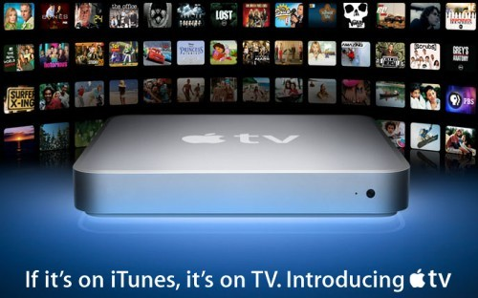
Why do we need New Platform
변화된 시장환경
More Networked Devices
HTML5
From software To Service
Cloud
Why not Servlet based Platform
Servlet의 한계: Connected Web, Streaming, Split Service, Data Serialization
Required High Scalability
Not Fun and Not Productive
Notes:
동적인 웹 페이지를 만들기 위해 나온 Servlet, JSP의 한계 - Servlet Arch Model : State Model, Disconnected Web - 서블릿이 하기 어려운 문제들 : Connected Web, Streaming Distribute & Split Service(Not Cluster) 데이터 직렬화(AVRO, Apache Thrift)
Mobile Device의 확장에 따른 시장 환경 - Required high scalability
배포와 테스트 곤란 - Servlet Model은 Test 친화적이지 않다. - View와 너무 밀접하게 연관되어 있다. - Not Fun and Not Productive - WANT to reload service

Slide 6
What Aradon ?
Aradon – New Service Platform
Filter
Context
HTTP Extend
WrapperClient
Connection Engine
AradonClient
Request
HttpHandler
[Async] HttpClient
WebDavHandler
WebSocketHandler
Response
EventSourceHandler
Simple, Jetty, Netty, Restlet
MyService.ZIP
Deploy

Slide 7
What Aradon ?
Distributed Aradon With DataGrid(Craken)
AradonClient
AradonClient
AradonClient
AradonClient
Request Response
Horizontal Scalability
AradonNode
AradonNode
AradonNode
State Sharing With DataGrid(Craken)

Slide 8
What Aradon ?
Why use HTTP Protocol in Aradon
Servers and Clients in any language
Everyone already knows HTTP
HTTP 2.0 : SPDY
Prior knowledge and tools
HTTP Extend : WebSocket, EventSource etc
Aradon Feature
Testability
Scalability
Multi tenancy
From Software To Service
Notes:
http://timothyfitz.wordpress.com/2009/02/12/why-http/

Slide 9
What Aradon ?
Aradon can do
Distribute Search/Index Service
Distribute Message Service
App Game Server
Content Repository Service etc
Notes:
Multitenancy refers to a principle in software architecture where a single instance of the software runs on a server, serving multiple client organizations (tenants). Multitenancy is contrasted with a multi-instance architecture where separate software instances (or hardware systems) are set up for different client organizations. With a multitenant architecture, a software application is designed to virtually partition its data and configuration, and each client organization works with a customized virtual application instance.

Slide 10
Project
Aradon
Server : https://github.com/bleujin/aradon
Client : https://github.com/bleujin/aradonClient
Extend : https://github.com/bleujin/aradonExtend
Agent : ...
doc : http://bleujin.springnote.com/pages/8011148
etc..
Craken : https://github.com/bleujin/craken
ionfw : https://github.com/bleujin/ionframework
Notes:
Multitenancy refers to a principle in software architecture where a single instance of the software runs on a server, serving multiple client organizations (tenants). Multitenancy is contrasted with a multi-instance architecture where separate software instances (or hardware systems) are set up for different client organizations. With a multitenant architecture, a software application is designed to virtually partition its data and configuration, and each client organization works with a customized virtual application instance.

Slide 11
Demo
Notes:
Multitenancy refers to a principle in software architecture where a single instance of the software runs on a server, serving multiple client organizations (tenants). Multitenancy is contrasted with a multi-instance architecture where separate software instances (or hardware systems) are set up for different client organizations. With a multitenant architecture, a software application is designed to virtually partition its data and configuration, and each client organization works with a customized virtual application instance.

