Slide 1
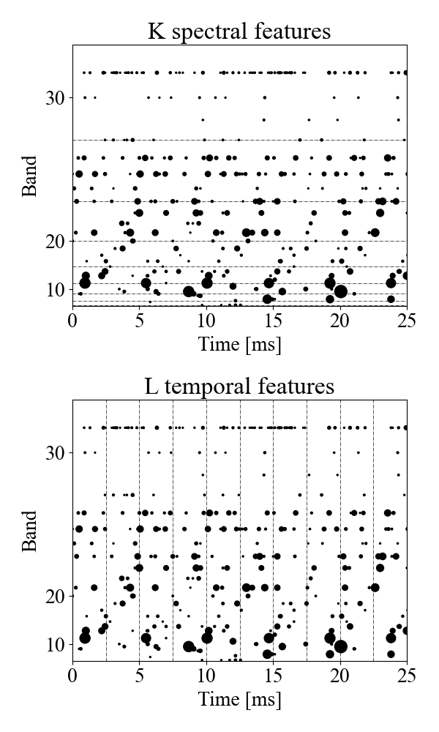
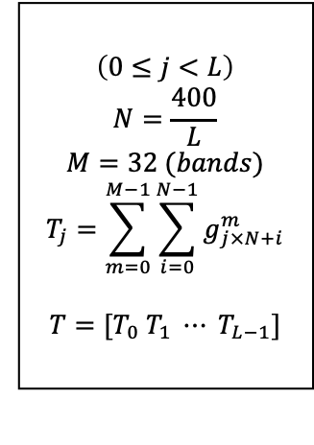
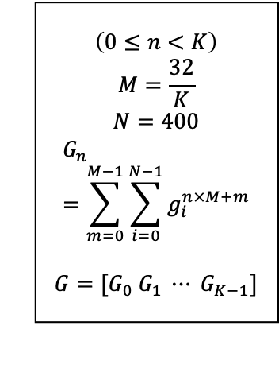
$$\left(0≤n<K\right)$$
$$M=\frac{32}{K}$$
$$N=400$$
$$G_{n}=\sum_{m=0}^{M−1}{\sum_{i=0}^{N−1}{g_{i}^{n×M+m}}}$$
$$G=[G_{0} G_{1} ⋯ G_{K−1}]$$
$$\left(0≤j<L\right)$$
$$N=\frac{400}{L}$$
$$M=32 (bands)$$
$$T_{j}=\sum_{m=0}^{M−1}{\sum_{i=0}^{N−1}{g_{j×N+i}^{m}}}$$
$$T=[T_{0} T_{1} ⋯ T_{L−1}]$$

