Slide 1
B.E. Project (402047)
Group No.: _____ Sponsored / Non- Sponsored :
Project Title :__________________________________________________
_____________________________________________________________
Name of Guide : Prof. Dr. ………………………… (do not add Sir after the name.
Name of Students:
1. ABC
2.
3.
Name of Students from other department: for inter/Multi disciplinary project
1 ………………………………. ( Dept. name)
2. ………………………………. ( Dept. name)
3. ………………………………. ( Dept. name)

Slide 2
Sponsored Certificate in the given format

Slide 3

BE Project Work
Objectives:
To monitor the initial progress of project groups in a structured manner.
To ensure students begin their project work on time and stay focused.
To assess the effectiveness of problem identification and understanding of the domain.
To encourage teamwork, research skills, and brainstorming in the early stages.
To provide an opportunity for early feedback and guidance from guide associated.
To help students refine and finalize a technically and practically feasible problem statement.
To align project objectives with academic standards and industry relevance.
To promote accountability and systematic project documentation from the start.
To build a strong foundation for design, development, and implementation phases ahead.

Slide 4
Identification of Problem:
Area / Domain of Interest:
Autonomous UAV systems for aerial survey missions — covering disaster response, agricultural monitoring, and infrastructure inspection.
How the Problem Was Identified:
Current UAV path planners assume a fixed, generic drone model. Literature survey (Hehn & D'Andrea, 2015; Cabreira et al., 2019) confirmed that no existing framework links mechanical design parameters directly to mission-level path optimization.
Background Context:
Our UIN2549 quadcopter (EMAX MT3110 480KV, APC1238 props, 2.0 kg MTOW, 14.8V 6800mAh) has specific aeromechanical characteristics — disk loading, induced power, optimal cruise speed — that differ from generic models. Using a one-size-fits-all planner leads to suboptimal missions, wasted battery, and unrealistic trajectories.

Slide 5
Purpose and Need (Motivation) of the Problem:
Core Problem Statement:
There is no existing framework that takes a drone’s mechanical design (mass, rotor count, propeller size, battery capacity) as input and produces a physics-grounded, energy-optimized flight plan as output.
Why It Matters:
• Generic planners ignore propulsion physics — they treat all drones identically
• Sub-optimal cruise speeds waste 20–40% of battery per mission
• Wrong altitude selection causes redundant sweep passes or missed coverage
• Wind conditions and payload mass can increase mission energy by 50–78%
Significance:
A design-aware planner directly outputs: optimal cruise speed V* (m/s), flight altitude (m AGL), sweep spacing (m), number of passes, total mission energy (Wh), and feasibility check against battery capacity. This is the first step toward truly adaptive autonomous UAV missions.

Slide 6
Gap Identification:
Current Challenges in Existing Solutions:
• QGroundControl / Mission Planner: Manual parameter entry, no aeromechanical model
• DJI mission planning apps: Proprietary, closed, device-locked
• Academic planners (Cabreira 2019, Araujo 2013): Coverage only — no energy physics
Our Innovation — What Didn’t Exist Before:
• Physics-grounded model: P(V) = P_induced(V) + P_profile + P_parasitic(V)
• Optimal speed solved as: V* = argmin(P(V)/V) — minimum energy per metre, not minimum power
• Full mission output: speed, altitude, sweep count, energy, feasibility check, wind sensitivity
Benefits over Existing Solutions:
• Our quadcopter (UIN2549): V* = 11.1 m/s, mission energy = 20.46 Wh on 200×200 m field at 40 m AGL
• 55.5 Wh usable battery — 2.7× more than needed — validated feasibility before flight

Slide 7
Assumptions, Constraints & Project Requirements:
Assumptions:
• ISA sea-level air density (1.225 kg/m³), level flight, no GPS error
• Momentum theory valid for forward flight using Glauert inflow model
• Battery energy fully available at start; 25% reserve held back
Constraints:
• MTOW ≤ 2.0 kg (frame 460g + electronics + 200g payload = 1995g)
• Battery: 14.8V 6800mAh 40C — max continuous discharge 272A, usable 74Wh (80% DoD)
• Prop: APC1238 (R = 152.4mm), motor: EMAX MT3110 480KV, cruise speed 2–18 m/s range
Project Requirements:
• Software: Python 3.x, NumPy, SciPy (minimize_scalar), Matplotlib
• Hardware: Pixhawk PX4, Raspberry Pi 4B, Radiolink M10N GPS, Benewake TF-LC02 LiDAR
• Camera: RPi Cam Module 3 AI (FOV 75°, 12MP), MLX90640 thermal
Applications:
• Disaster reconnaissance • Agricultural field survey • Infrastructure inspection • Competition missions (SAE Aerothon)

Slide 8
Proposed Project Title:
Aeromechanical Performance-Based Mission Optimization for Multirotor UAVs
(Design-Aware Path Planning: linking drone mechanical design to energy-optimal autonomous survey missions)
Objectives:
1. Develop a parametric aeromechanical power model for multirotor UAVs using momentum theory + blade element analysis
2. Derive optimal cruise speed V* = argmin(P(V)/V) for any given drone configuration
3. Generate a complete mission flight plan: altitude, sweep spacing, turn radius, time, energy per mission
4. Conduct parametric analysis: rotor count, payload mass, propeller radius, altitude, wind — with numerical results
5. Validate model against measured specs of UIN2549 quadcopter (EMAX MT3110, APC1238, 14.8V 6.8Ah battery)
6. Demonstrate feasibility check: mission energy vs usable battery for any field/drone combination

Slide 9
Literature survey and review of Minimum 10 research papers
(Scopus/SCI Indexed Journals), patents published, or any other technical paper published in an international journal.
Title of the Paper
Author(s) & Year of Publication
Journal / Conference / Publisher
Objective / Purpose of the Study
Methodology / Approach Used
Key Findings / Results
Limitations Identified
Relevance to Proposed Project
Use one slide per paper (concise, point form).
Minimum 10 Quality Research papers to be included with understanding and justification.

Slide 10
Literature survey and review of Minimum 10 research papers
Summery and Analysis of alternatives (Methodologies)
Sr. No. | Method / Approach | Reference (Author, Year) | Key Concept / Working Principle | Advantages | Limitations | Suitability to Our Project
1
2
3
4
5

Slide 11
Methodology: Physics-Based Power Model
Total Power at Forward Speed V:
P(V) = P_induced(V) + P_profile + P_parasitic(V)
P_induced(V) — Lift Power [Glauert forward-flight model]:
v_i⁴ + V²·v_i² − v_h⁴ = 0 solved for v_i → P_ind = K · T · v_i
where v_h = √(T / 2ρA) is hover induced velocity, K = 1.15 (tip loss correction)
P_profile — Blade Profile Drag [constant w.r.t. speed]:
P_pro = N · (σ·Cd0/8) · ρ · A_rotor · V_tip³
σ = 0.05 (solidity), Cd0 = 0.015, V_tip = 150 m/s
P_parasitic — Airframe Drag [cube law]:
P_par = 0.5 · ρ · Cd · A_front · V³ Cd = 0.80, A_front = 0.12 m²
Optimal Cruise Speed:
V* = argmin( P(V) / V ) → minimises energy per metre, NOT minimum power
For UIN2549 Quadcopter: V* = 11.1 m/s, P* = 204 W, E/m = 18.3 J/m

Slide 12
Scanned copy of Review 1
Along with comment of the panel members
Compliance by the Group

Slide 13
Scanned copy of Review 2
Along with comment of the panel members
Compliance by the Group

Slide 14
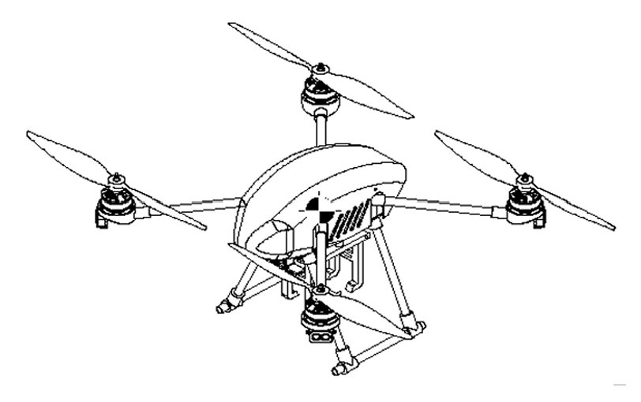
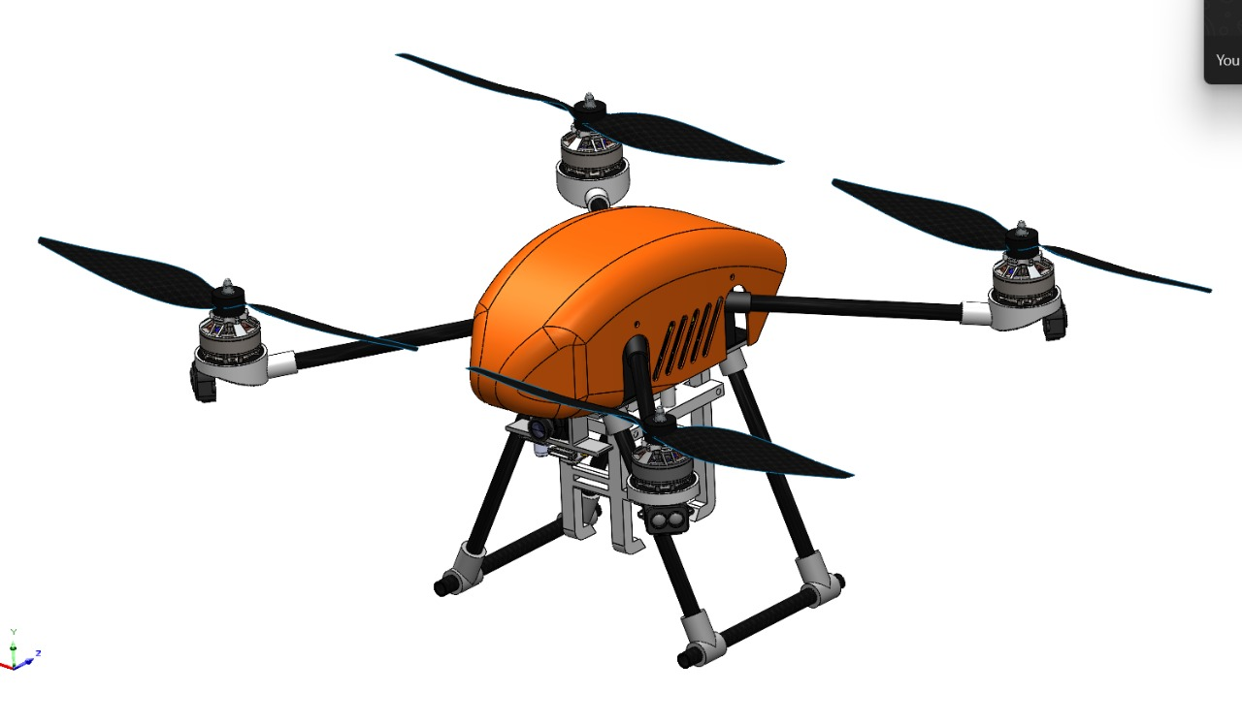
Experimental Set-up / Virtual Model (CAD/CAM/CAE)
Preliminary Design (Engineering Drawing)
Optimised Design (SolidWorks 2025 Render)
Key Dimensions: Wheelbase = 349.60 x 349.60 mm | Arm length = 180 mm | Hub = 150x80 mm | Prop dia = 305.96 mm | MTOW = 1995 g | TWR = 1.8

Slide 15
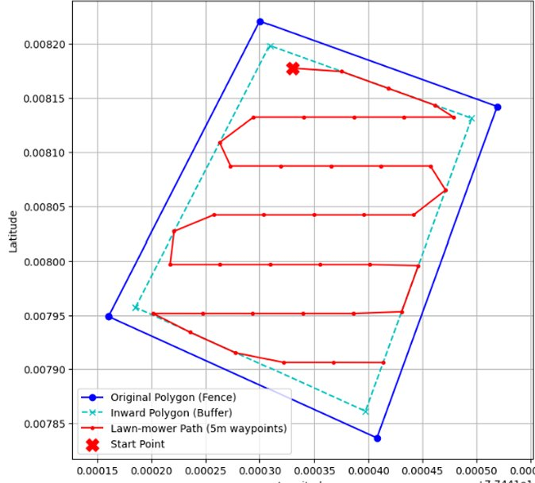
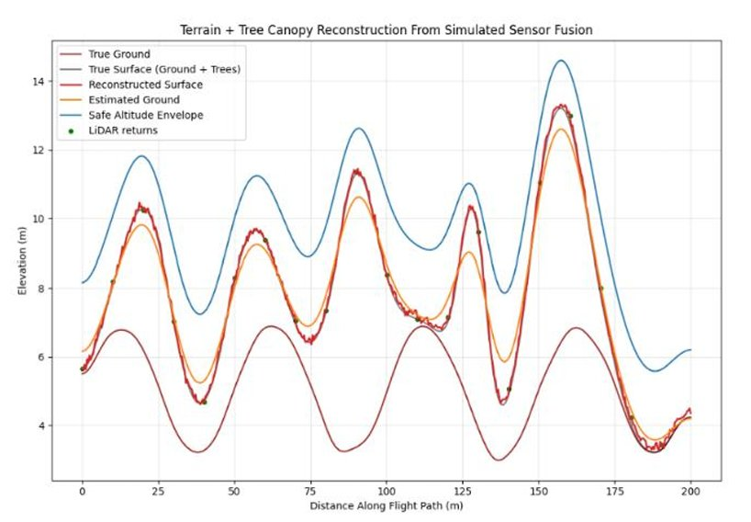
Mission Simulation Output
Autonomous Lawnmower Coverage Path
Terrain + Tree Canopy Reconstruction (LiDAR)
Left: Polygon geofence + buffer + 5m-waypoint lawnmower path (Python simulation output) | Right: Terrain + tree canopy from LiDAR sensor fusion. Blue = safe altitude envelope.

Slide 16
Progress After Stage-I: Simulation & Analysis Results
Tabular Summary — UIN2549 Quadcopter Baseline (200×200 m field, 40 m AGL):
Parameter Value Unit
─────────────────────────────────────────────────────────────────
Optimal Cruise Speed V* 11.1 m/s
Power at V* (P*) 204 W
Hover Power 92 W
Number of Sweeps 12 passes
Sweep Spacing 18.0 m
Turn Radius (15° bank) 24.3 m
Mission Time 6.0 min
Mission Energy 20.5 Wh
Battery Margin 35.0 Wh (feasible ✓)
Cruise Endurance 28.4 min on 74 Wh
Tools Used: Python 3 · NumPy · SciPy · Matplotlib · ANSYS 2024 R1 · SolidWorks 2025

Slide 17
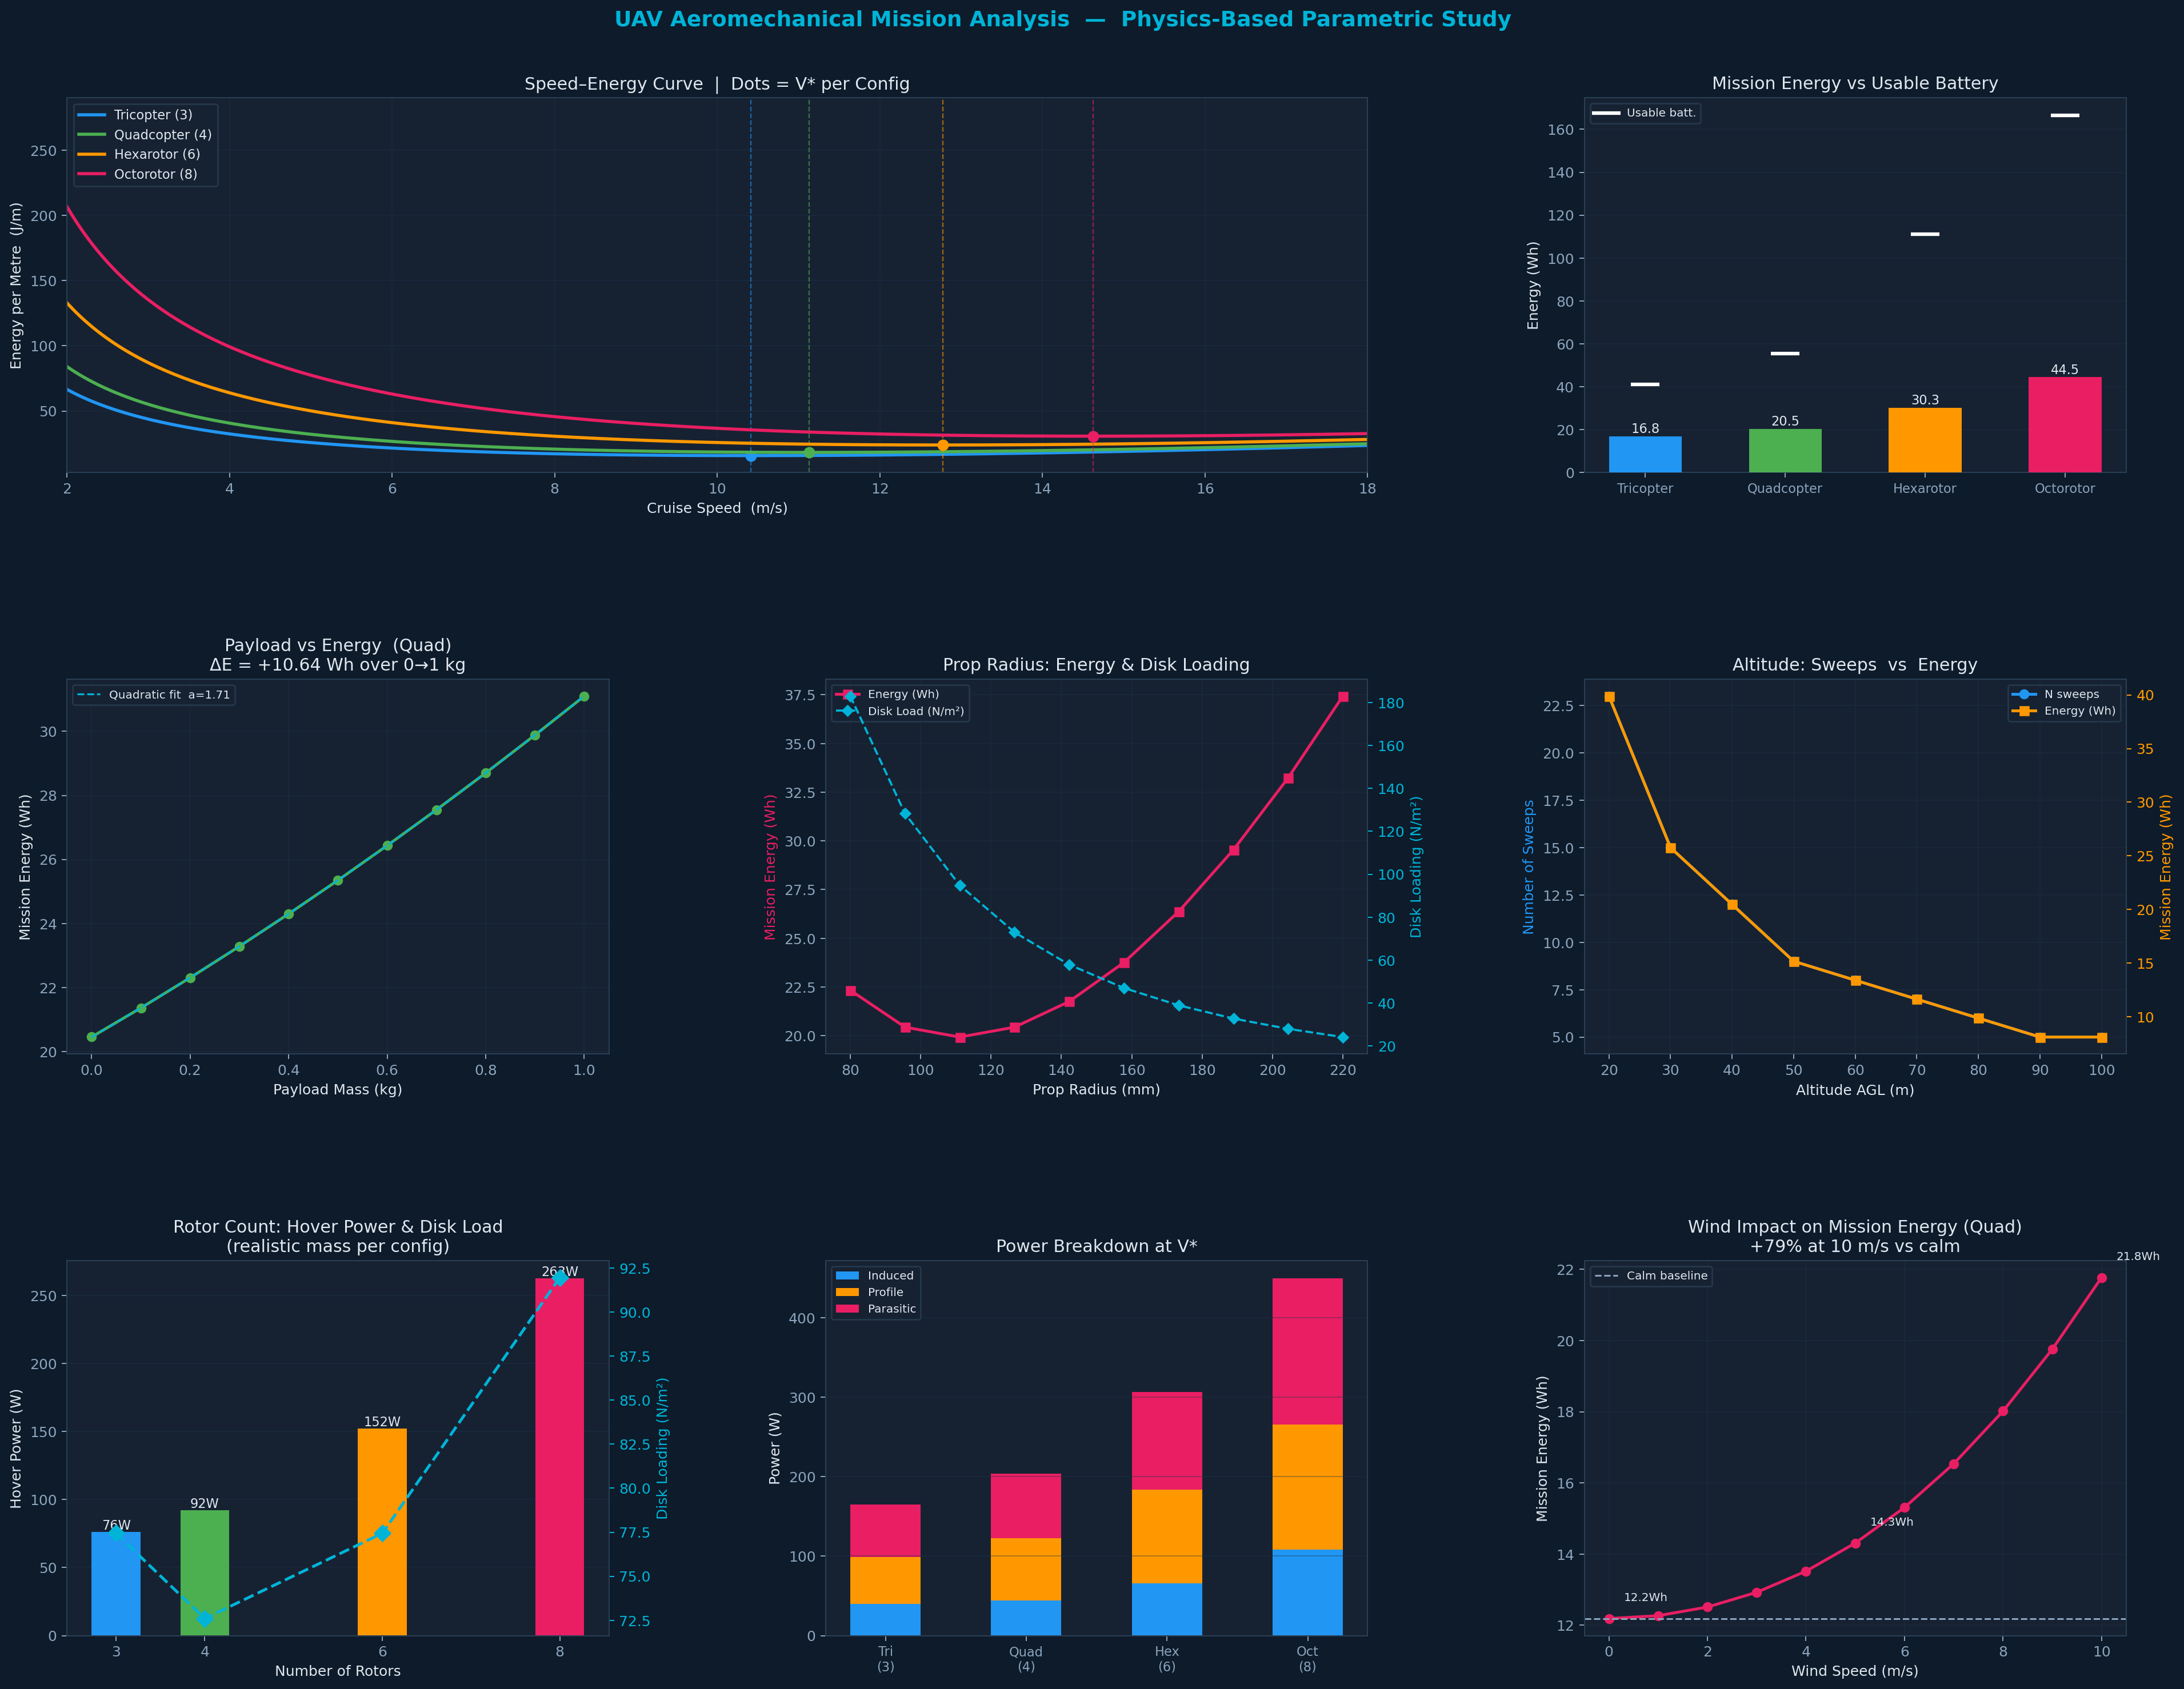
Parametric Analysis Charts — Physics-Based Results (7 Studies)

Slide 18
Results Analysis:
1. Configuration Comparison (Tri / Quad / Hex / Octo):
Tricopter V* = 10.4 m/s, E = 16.8 Wh | Quadcopter V* = 11.1 m/s, E = 20.5 Wh | Hexarotor V* = 12.8 m/s, E = 30.3 Wh | Octorotor V* = 14.6 m/s, E = 44.5 Wh
Finding: Heavier configs need faster V* to compensate induced power drop; all feasible on respective batteries.
2. Payload Mass (Quadcopter, 0 → 1 kg additional):
Energy: 20.5 → 31.1 Wh (+52.0%) | V* shifts: 11.1 → 13.2 m/s | Quadratic scaling (a = 1.71 Wh/kg²)
Finding: Payload is the dominant energy driver — non-linear increase; design payload minimisation is critical.
3. Propeller Radius (Quadcopter, 80 → 220 mm):
Minimum energy at R = 111 mm (19.9 Wh). Smaller: profile drag dominates. Larger: mass penalty offsets efficiency.
Finding: Optimal propeller exists at intermediate size — APC1238 (R = 127 mm) is near-optimal for our mass.
4. Altitude (20 → 100 m AGL):
Sweeps: 23 → 5 passes | Energy: 39.9 → 8.1 Wh (−79.7%) | Optimal: 80–100 m for energy, trade-off vs ground resolution.
5. Wind Effect (0 → 10 m/s headwind):
Energy: 12.2 → 21.8 Wh (+78.6%) | Headwind leg V* drops from 11.1 → 8.1 m/s (planner re-optimises per leg)
Finding: Wind is the most dangerous mission variable — 25% reserve is insufficient above 8 m/s for our battery.

Slide 19
Proposed Work Plan and Expected Outcome:
Month Planned Activities Expected Output
────────────────────────────────────────────────────────────────────────────────
Jan 2026 Physics model development + parametric simulation Validated P(V) model for all configs
Feb 2026 Mission planner algorithm + lawnmower path generation Working Python optimizer with test outputs
Mar 2026 Hardware integration: Pixhawk + RPi + GPS + LiDAR Autonomous takeoff + geofenced survey flight
Apr 2026 Wind model + payload drop integration + YOLO detection Full autonomous mission demo (SAE Aerothon)
May 2026 Report writing + paper draft + project diary completion Final report + research paper draft submitted
Expected Outcomes:
• Python simulation framework with 7 parametric analyses + publication-quality charts
• Validated optimal flight plan for UIN2549: V* = 11.1 m/s, alt = 40–80 m, energy = 20.5–10 Wh
• Autonomous mission demonstrated on physical quadcopter with live telemetry
• Research paper submitted to an indexed journal or conference

Slide 20
Roles and Responsibilities (within group)
How the team has divided initial responsibilities among members.
Sr. No. | Name of Student | Expected Contribution towards Project work | Work done by the Member
1 | Leader
2 | Member 1
3 | Member 2
4

Slide 21
Photographs (Geo-tagged) of the Project work carried till 12th Jan 2026

Slide 22
References

Slide 23
Scanned Project Diary

