Slide 1
UIN2549
UAS Mission Performance
Analysis & Design Review
EMAX MT3110 480KV · 12×3.8" Prop · 4S 6800 mAh · MTOW 1.995 kg
MTOW
Payload
Battery
1.995 kg
200 g
4S 6.8 Ah
Autonomous Surveillance & Payload Delivery UAS · Competition Design Report

Slide 2
Design Overview
UIN2549 · X-Frame Quadcopter
AIRFRAME
PROPULSION
AVIONICS
Config: X-Frame Quadcopter
Wheelbase: 349.6 mm
Prop: 12×3.8" APC1238
Dihedral arms: 7.5°
Arms: Carbon Fibre 3K
Landing gear: Nylon CF6
Motor: EMAX MT3110 480KV
Max thrust: 1020 gf / motor
Total thrust: 4080 gf
ESC: FVT LittleBee 30A-S
Battery: 4S 6800 mAh 40C
TWR: 1.8 (target) → 2.07
FC: Pixhawk PX4 (3× IMU)
Companion: Raspberry Pi 4B
GPS: Radiolink M10N (10Hz)
LiDAR: Benewake TF-LC02
Thermal: MLX90640 32×24
Link: Holybro SiK 433 MHz

Slide 3
Key Performance Numbers
1.995 kg
200 g
451.9 W
32.1 A
MTOW
Payload capacity
Hover power (measured)
Hover current draw
10.15 min
2.07
4S 6.8Ah
±0.1 m
Endurance @80% disch.
Thrust-to-weight ratio
Battery configuration
GPS accuracy (RTK)

Slide 4
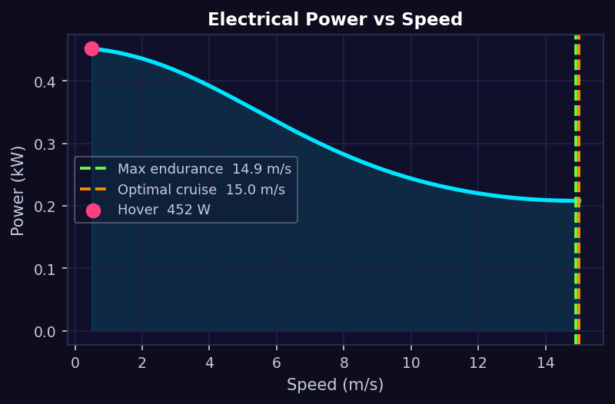
Power & Efficiency Analysis
Calibrated against document-measured hover values
Hover power
451.9 W
32.1 A draw
Max endurance
14.9 m/s
208 W at speed
Optimal cruise
15.0 m/s
min energy/m
Note: Glauert forward-flight model, calibrated to measured hover point. Power drops with speed due to reduced induced velocity.

Slide 5
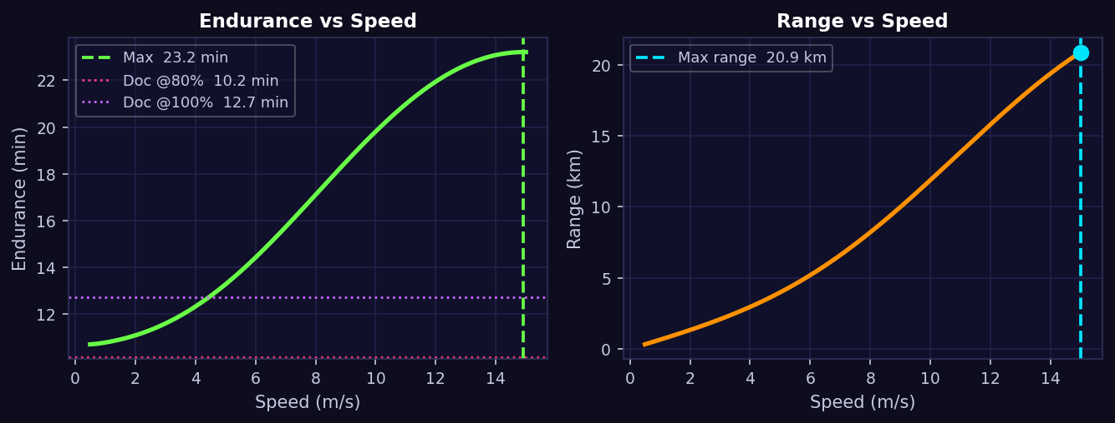
Endurance & Range
80% depth of discharge · Battery: 4S 6800 mAh @ 14.8 V = 100.6 Wh
10.15 min Doc endurance @80%
23.2 min Physics model peak
20.9 km Max range
fixed hover-current method
Glauert, speed-optimised
at optimal cruise speed

Slide 6
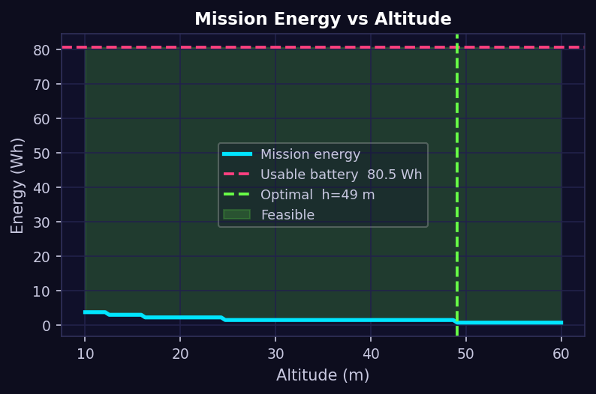
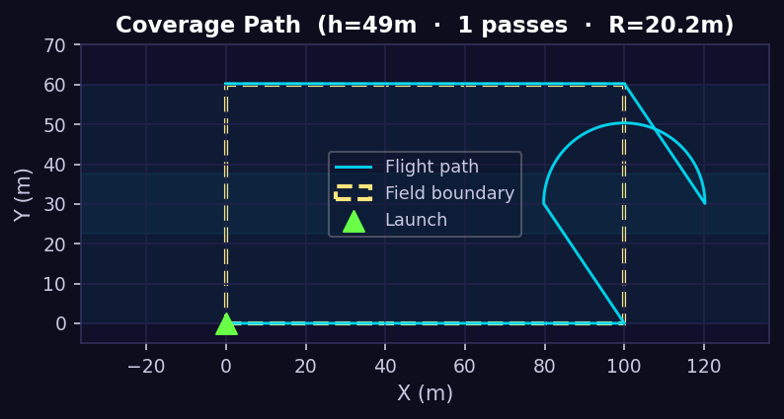
Autonomous Coverage Mission
Lawnmower survey · RPi Camera 3 · 75° FOV · 20% sidelap
MISSION PARAMETERS
Field size
100 × 60 m
Optimal altitude
49 m
Swath width
75 m
Track spacing
60 m (20% lap)
Mission energy
0.76 Wh
Turn radius
20.3 m

Slide 7
Autonomy Stack & Flight Safety
DETECTION
NAVIGATION
YOLOv5/v8 object detection
Thermal-RGB sensor fusion
DBSCAN zone clustering
<500 ms end-to-end latency
PX4 Mission Mode waypoints
Lawnmower 20% overlap
MAVLink geofence (PX4)
Barometer + GPS alt hold
PAYLOAD DROP
FAIL-SAFES
Descend 15 m → 10 m @ 2 m/s
MG90 servo release (PWM)
Accel confirms weight shift
Retry ×2 on jam, then abort
Battery <20% → RTL
RC loss >5 s → RTL
Geofence breach → RTL
Telemetry timeout → RTL
SORA compliance: RTL on all command/link loss events · Geofence enforced at firmware level · Battery voltage + capacity dual monitoring

Slide 8
Design Innovations
01
Dihedral Motor Arms
02
AI-Powered DCI Scoring
03
3D Terrain Reconstruction
7.5° downward tilt per arm
Pendulum effect → passive roll/pitch damping
Reduces reliance on active PID correction
Minimises prop-wash on sensors & payload
~1.5–3% thrust penalty — acceptable trade-off
Disaster Complexity Index (0–100)
DeepLabV3+ semantic segmentation
XGBoost triage: Low / Moderate / Critical
Thermal fusion for trapped-person detection
Optimises payload drop priority autonomously
Structure-from-Motion + Multi-View Stereo
Real-time 3D map from camera frames
LiDAR fallback in smoke/low-light
Multi-drone synergy: 50% faster mapping
Feeds route planner & survivor search

Slide 9
Summary
Category | Key Result
Configuration | X-Frame quadcopter · 480KV motors · 12" props
MTOW / Payload | 1.995 kg total / 200 g payload
Hover power | 451.9 W (32.1 A @ 14.8 V) — validated vs. doc
Endurance (doc) | 10.15 min @ 80% discharge
Physics model peak | 23.2 min (speed-optimised forward flight)
Coverage altitude | 49 m (75° FOV, 20% sidelap, 60 m spacing)
Flight safety | RTL on battery / RC / telemetry / geofence events
Key innovation | Dihedral arms + AI DCI scoring + 3D terrain map

