Slide 1

Datathon 2025 - Sentient Challenge

Slide 2
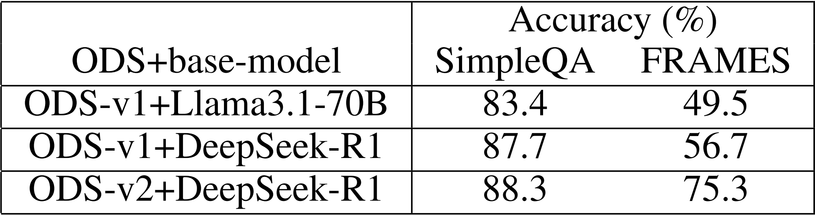
Datathon 2025 - Sentient Challenge
Table 1: Accuracy for different ODS+base-model configurations on SimpleQA and FRAMES tasks. (Alzubi et al., 2025)
Notes:
Table 1 was adapted by Alzubi and here we can see the accuracy for different OpenDeepSearch+base-model configurations on SimpleQA and FRAMES tasks. From Alzubi et al. (2023), who benchmarked multiple models on reasoning tasks.”
This number on the bottom right was the benchmark achieved by ODS + DeepSeekR1

Slide 3
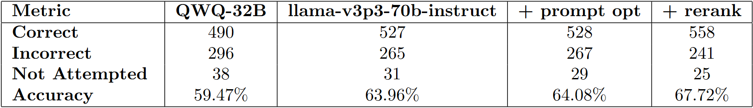
Datathon 2025 - Sentient Challenge
Table 2: Performance comparison across four models including prompt optimization and reranking.

Slide 4
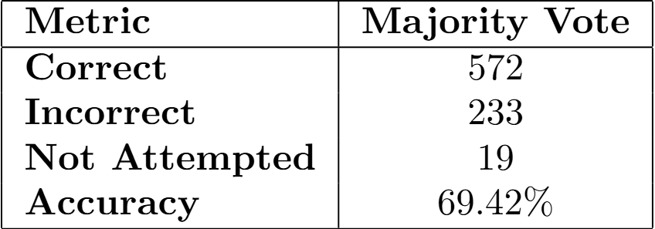
Datathon 2025 - Sentient Challenge
Table 3: Performance comparison across four models including prompt optimization and reranking.
Notes:
Breakthrough with Majority Vote:
Time: 1 hour before deadline

Slide 5
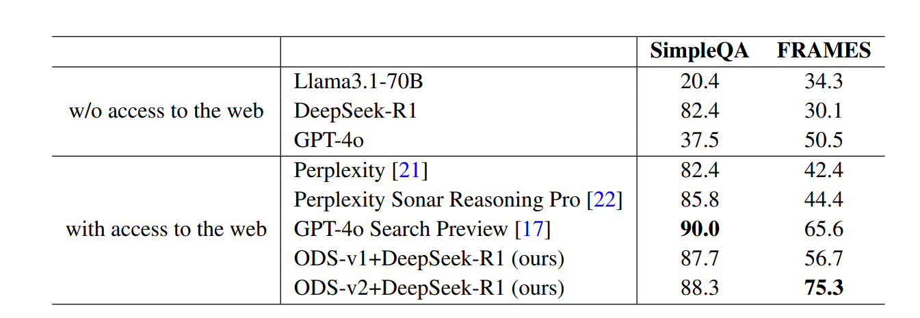
Datathon 2025 - Sentient Challenge
Table 4: Accuracy for different configurations on SimpleQA and FRAMES tasks. (Alzubi et al., 2025)

Slide 6
Datathon 2025 - Sentient Challenge
References: [1]Alzubi, S., Brooks, C., Chiniya, P., Contente, E., von Gerlach, C., Irwin, L., Jiang, Y., Kaz, A., Nguyen, W., Oh, S., Tyagi, H., & Viswanath, P. (2025). Open Deep Search: Democratizing search with open-source reasoning agents. arXiv preprint arXiv:2503.20201. https://arxiv.org/abs/2503.20201

